Slide 1
Theory of Computation
Turing Machines
Space bounds
Reductions
Complexity classes

Slide 2
Formal definitions in complexity
Informal | Formal
Problems | Languages(string functions)
Algorithms | Turing Machines
Efficiency | Complexity classes

Slide 3
Turing Machine

Slide 4
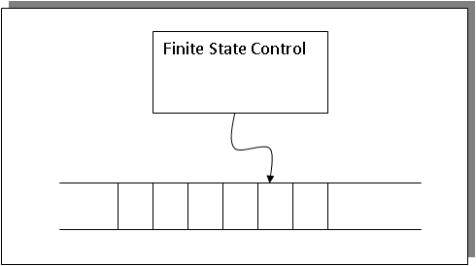
Picture of a Turing Machine

Slide 5
Multi Tape Turing Machine

Slide 6
Space Bounds
Consider a TM with an input tape, k temp tapes and 1 output tape.
A TM to check for palindromes would need 2 temp tapes just to hold the index of the symbols, one set to i and the other set to n-i. Each tape need to be only log(n) in length (the numbers of bits needed to represent the input).
PAL ∈ SPACE(log n)

Slide 7
Non Determinism

Slide 8
The Halting Problem

Slide 9
Halting Problem Solution

Slide 10
Halting Problem

Slide 11
Turing Reducibility

Slide 12
Complexity Classes

Slide 13
Space/Time Hierarchy

