Slide 1
IF-THEN-ELSE
Conditional Statements

Slide 2
All lines of code run
int Mets = 6;
int Phillies = 3;
Print(‘Mets are winning’);
Print(‘Phillies are winning’)
Output:
Mets are winning
Phillies are winning

Slide 3
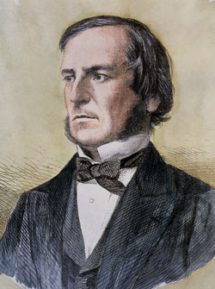
IF-THEN Statement
IF (it is raining)
THEN
- bring an umbrella
IF <Boolean expression> THEN <then statement(s) >
George Boole

Slide 4
IF-THEN-ELSE Statement(s)
IF (it is raining)
THEN
- bring an umbrella
- wear a hat
ELSE
- bring sunglasses
IF <Boolean expression> THEN <then statements(s)> ELSE <else statement(s)>

Slide 5
Dangling ELSE problem
if b1 then if b2 then s1 else s2
Under which case would statement s1 run? Ans: when b1 and b2 are both true
Under which case would statement s2 run? Ans: b1 is true and b2 is false OR b1 is false?
if b1
then
if b2
then
s1
else
s2
if b1
then
if b2
then
s1
else
s2

Slide 6
Solving Dangling ELSE problem with { }
if b1 then { if b2 then s1 else s2}
if b1 then { if b2 then s1 } else s2
if b1
then
if b2
then
s1
else
s2
if b1
then
if b2
then
s1
else
s2

Slide 7
IF – THEN – ELSE (i.e. IF b { } ELSE { })
int Mets = 3;
int Phillies = 3;
IF (Mets > Phillies)
{ Print(‘Mets are winning’); }
ELSE // negation of Mets > Phillies is not Phillies > Mets
{ Print(‘Phillies are winning’); }
Output:
Phillies are winning

Slide 8
Series of IF-THEN statements
int Mets = 6;
int Phillies = 3;
IF (Mets > Phillies) { Print(‘Mets are winning’); }
IF (Phillies > Mets) { Print(‘Phillies are winning’); }
IF (Phillies == Mets) { Print(‘Game is Tied’); }
Output:
Mets are winning

Slide 9
Switch (Series of IF-THEN statements)
Switch(dayOfWeek) // dayOfWeek set as 0=Sunday, 1=Monday…6=Saturday
case 1,2,3,4,5:
print(“Today is a Weekday”);
break;
case 0,6:
print(“It’s the weekend”);
break;
default:
print(“Error: Something is wrong!”);
break;

Slide 10
Assignment (=) vs. Equals (==)
A = 3; will assign the value 3 to the memory location A
IF (A == 3) {…} will not assign A to 3. It evaluates the boolean expression “Is A equal to 3” is true.
In many programming languages (C, C++, Java, php, JavaScript), the statement
int A = 9;
if (A = 3) { Print(“ A does equal 3 ”);
Will actually first assigns A to 3 then evaluate if A equals 3, which of course is now true

Slide 11
True or False (Zero or Not)
int A = -3;
IF (A)
{
Print(‘Boolean expression was True’);
}
ELSE
{
Print(‘Boolean expression was False’);
}
// What is the output? 1) True 2) False 3) compiler error because A is not a Boolean expression

Slide 12
Boolean Logic
Boolean algebra
the conjunction (and) denoted as ∧
the disjunction (or) denoted as ∨
the negation (not) denoted as ¬
Ex) A ∧ (B ∨ ¬ C) read “1) A is true 2) either B is true OR C is not true
commonly written in computer code as: IF (A && (B || !C))

Slide 13
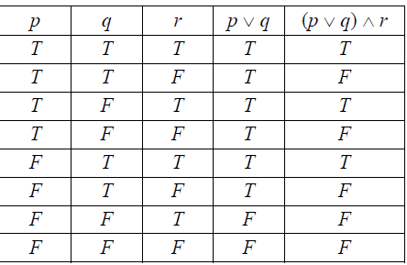
Truth table
(p is true OR q is True) AND r it true

