Slide 1
Virtual Memory
Virtual Address Space
Page translation
Segmented systems

Slide 2
Virtual Address Space
In computing, virtual address space (abbreviated VAS) is a memory mapping mechanism available in modern operating systems such as OpenVMS, UNIX, Linux, and Windows.
This is beneficial for different purposes, one is security through process isolation. An address generated by the process is called logical address (virtual address) and it is mapped to the virtual address space.
Source: Wikipedia

Slide 3
Page translation in books
You write a manuscript that is 325 lines long.
You give it to a publisher and they publish it in a book that has pages with 32 lines each.
Question) If you wanted to find line 135 in your manuscript and you have a copy of your book, where would the line be (assuming the first page is page 0 and the first line on each page is line 0)?
Answer) Use page translation
Page = RoundDown((135)/32) = page #4 (the 5th page)
Offset into the page = 135 mod 32 = #7 (the 8th line)
So it is on page 4, then go to line 7.

Slide 4
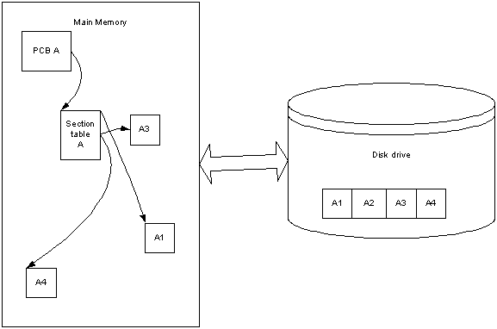
Section Table for a Process

Slide 5
Page tables <virtual,real> pairs

Slide 6
What’s a good page size
Pages should be powers of 2 fast data transfer and fast address translation
1K , 2K , 4K , 8K, 16K, 32K, 64K, 128K, 256K, 512K
1M, 2M , 4M , 8M, 16M, 32M, 64M, 128M, 256M, 512M
Etc.

Slide 7
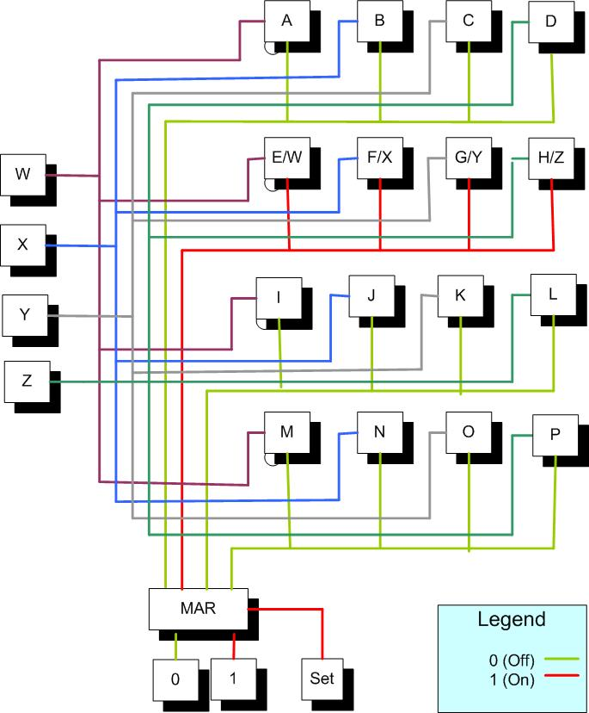
Recall transferring data in large sets.

Slide 8
Translate virtual 135 into real address

Slide 9
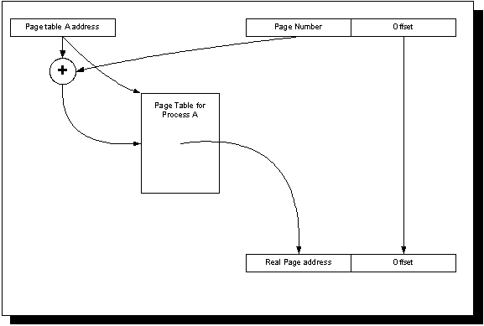
Page table for a process

Slide 10
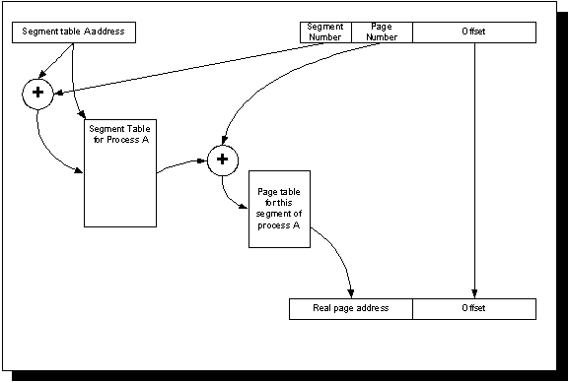
Paging/Segmented System

Slide 11
Page Translation speed
Page translation needs to be done only when two consecutive instructions are executed with virtual addresses that they are from 2 different pages. Checking this on each instruction could be time consuming.
Calculate the real page address needs to be done as quickly. Software searches are too time consuming.
Hardware could be used to speed this up.

Slide 12
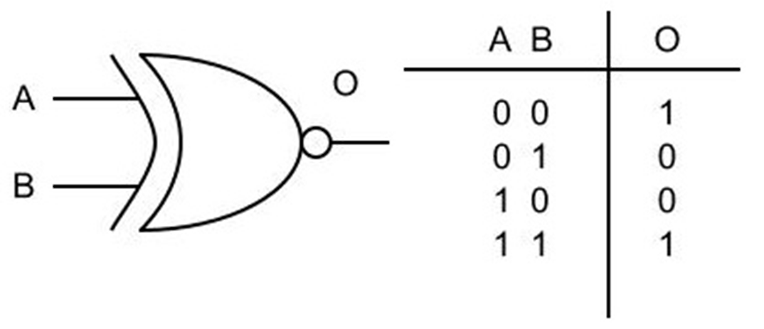
XNOR gates
Checks to see if both inputs match

Slide 13
Hardware for page translation(TLB)

Slide 14
Example: Contiguous Storage

Slide 15
Storage selection for segments/pages
Best Fit
Find the open block of consecutive page frames in MM that best fits the storage incoming storage location. Advantages:
Finds tightly fitted locations which will allow large open consecutive blocks for larger processes that may come in later
Disadvantages:
- Must check all open blocks of page frames which will take processing time
First Fit
Find the open block of consecutive page frames in MM that first fits (starting from the beginning of memory to the end)
Advantages:
Does not need to check all available spaces, since as soon as the first on is found.
Worst fit
Find the open block of consecutive page frames in MM that worst fits (biggest block of available free page frames) storage the incoming storage location. Advantages:
Finds tightly fitted locations which will allow large open consecutive blocks for larger processes that may come in later
Disadvantages:
- Must check all open blocks of page frames, which will take processing time.

Slide 16
Fragmentation
In computer storage, fragmentation is a phenomenon in which storage space is used inefficiently, reducing capacity and often performance. Fragmentation leads to storage space being "wasted", and the term also refers to the wasted space itself.
Source: wikipedia

Slide 17
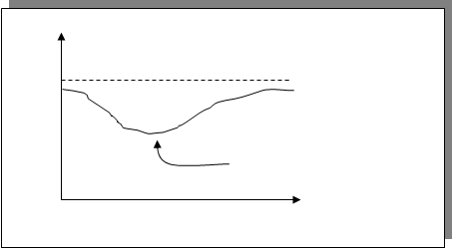
Minimizing Fragmentation

Slide 18
Minimizing Fragmentation

