Slide 1
LANs - Local Area Networks
Connections
Routing

Slide 2
LANs
A local area network (LAN) is a computer network that interconnects computers within a limited area such as a residence, school, laboratory, university campus or office building. By contrast, a wide area network (WAN) not only covers a larger geographic distance, but also generally involves leased telecommunication circuits.
Ethernet and Wi-Fi are the two most common technologies in use for local area networks.

Slide 3
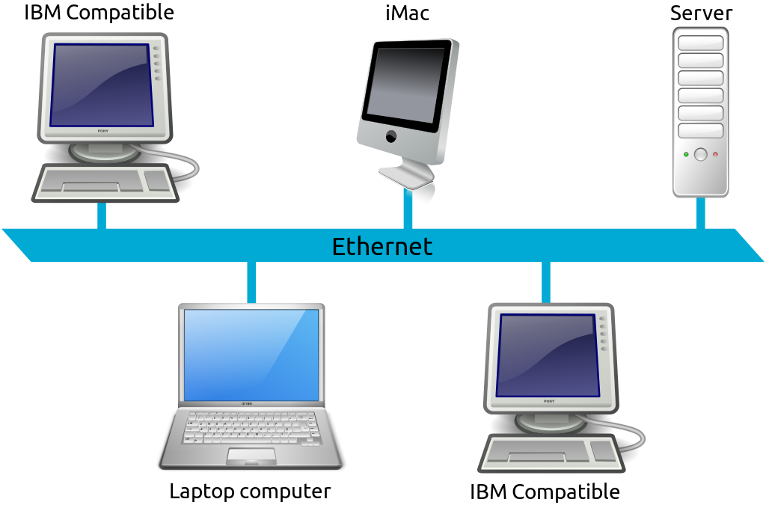
LAN

Slide 4
WIFI
Wi-Fi or WiFi (/ˈwaɪfaɪ/) is a technology for wireless local area networking with devices based on the IEEE 802.11 standards. Wi-Fi is a trademark of the Wi-Fi Alliance, which restricts the use of the term Wi-Fi Certified to products that successfully complete interoperability certification testing.

Slide 5
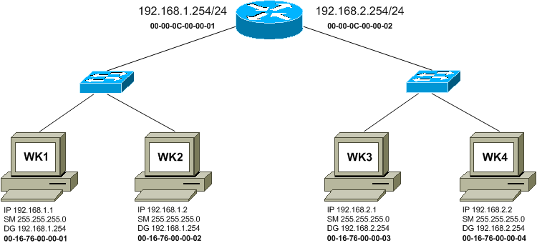
Routing packets in a LAN

Slide 6
MAC address
A media access control address (MAC address) of a device is a unique identifier assigned to network interface controllers for communications at the data link layer of a network segment.
Used by Ethernet and Wifi

Slide 7
Message going from WS1 to WS2
192.168.1.1 11000000.10101000.00000001.00000001 IP address
192.168.1.0 11111111. 11111111 .11111111 . 00000000 Subnet mask
---------------------------------------------------------
192.168.1.0 11000000.10101000.00000001.00000000 Subnet #
192.168.1.2 11000000.10101000.00000001.00000010 IP address
192.168.1.0 11111111. 11111111 . 11111111. 00000000 Subnet mask
---------------------------------------------------------
192.168.1.0 11000000.10101000.00000001.00000000 Subnet #
They match so communicate via the MAC address on the same subnet.

Slide 8
Message going from WS1 to WS3
192.168.1.1 11000000.10101000.00000001.00000001 IP address
192.168.1.0 11111111. 11111111 .11111111 . 00000000 Subnet mask
---------------------------------------------------------
192.168.1.0 11000000.10101000.00000001.00000000 Subnet #
192.168.1.2 11000000.10101000.00000001.00000010 IP address
192.168.2.0 11111111. 11111111 . 11111111 . 00000000 Subnet mask
---------------------------------------------------------
192.168.2.0 11000000.10101000.00000010.00000000 Subnet #
They do not match so communicate via default gateway

Slide 9
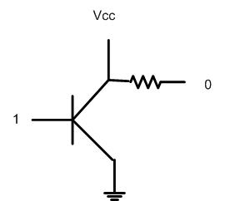
Not Gate

Slide 10
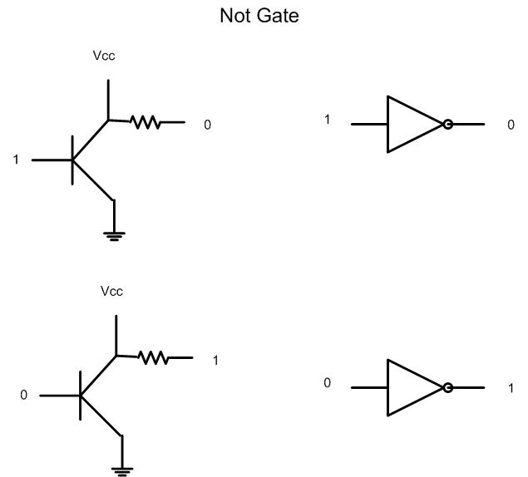
Not Gate 1→0 and 0→1

Slide 11
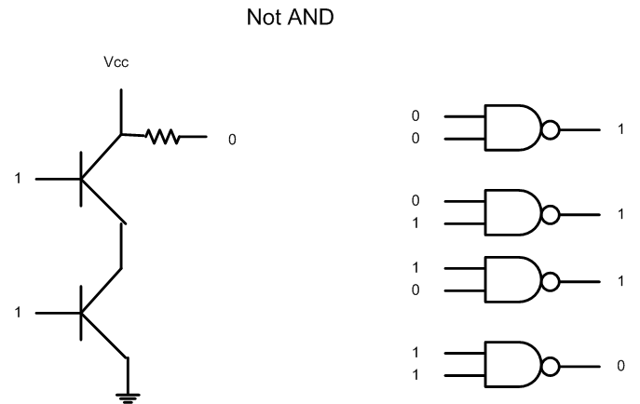
NAND

Slide 12
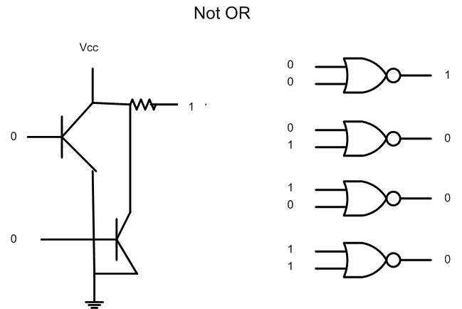
Not OR

Slide 13
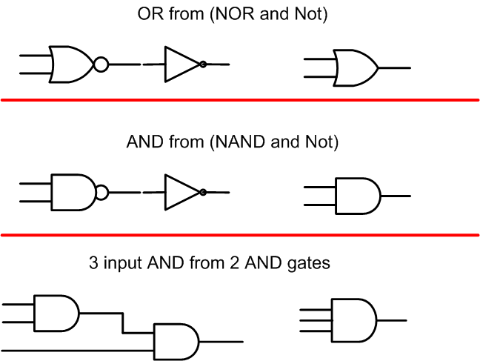
Create new gates from existing ones

Slide 14
4 bit Ander

Slide 15
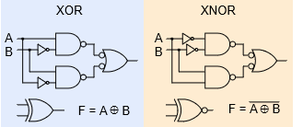
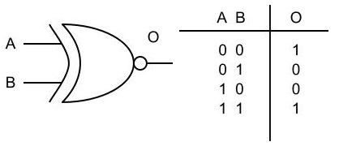
XNOR gate truth table

Slide 16
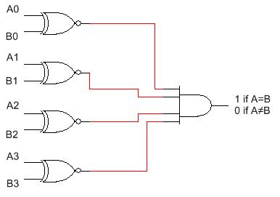
4 bit comparator

Slide 17
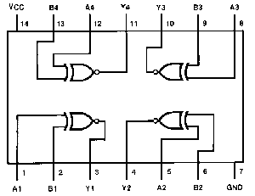
4 bit comparator chip

Slide 18
Compare 2 numbers for match

