Slide 1
Computer Hardware
Resistors, transistors,
Not gates, NAND gates, NOR gates
Decoders
Reading and Writing to memory

Slide 2
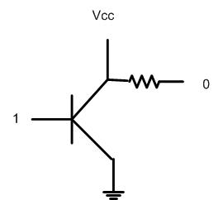
Not Gate

Slide 3
Bell Labs – Transistor Water Tower Holmdel, NJ (Exit 114 on the Garden State Parkway)

Slide 4
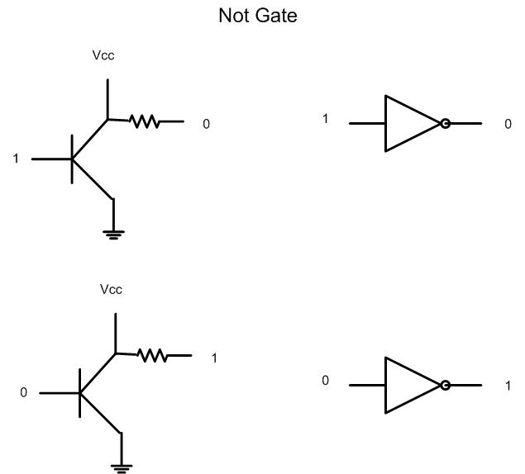
Not Gate 1→0 and 0→1

Slide 5
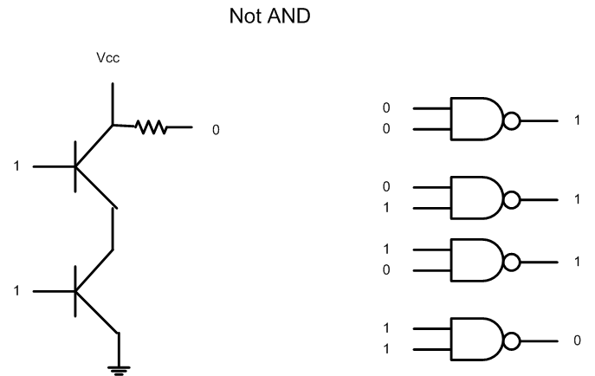
NAND

Slide 6
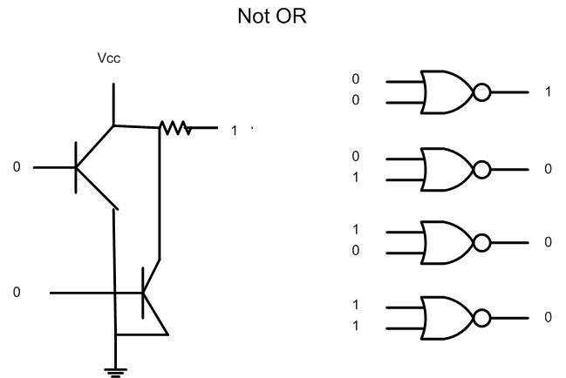
Not OR

Slide 7
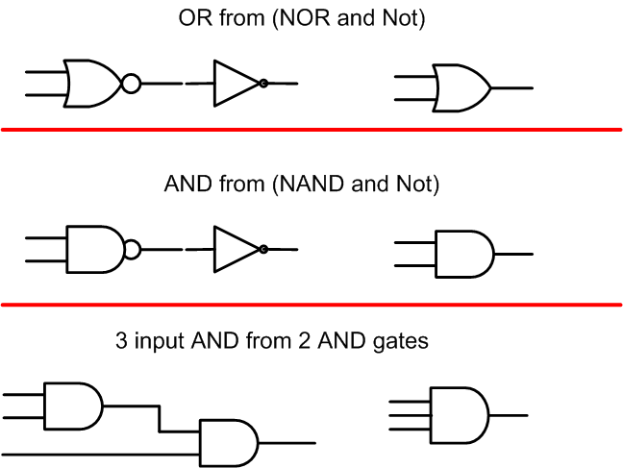
Create new gates from existing ones

Slide 8
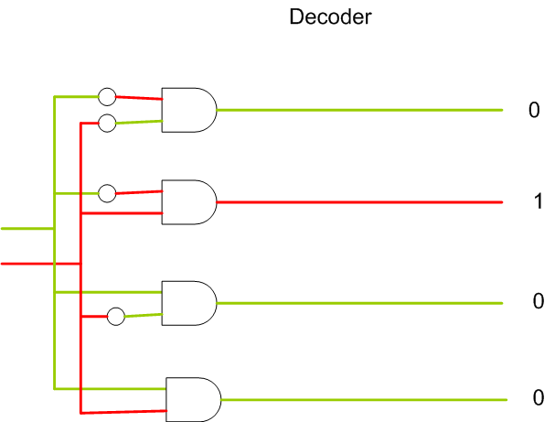
Decoder

Slide 9
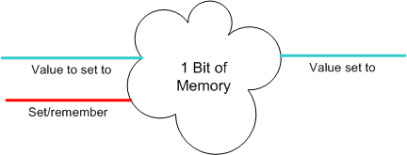
Consider this Java or C++ code
A = 5;
B= 6;
C=A+B;
We need to record A=5(decimal) in memory for later use.
We can convert decimal 5 to binary 0101 and record that.
How can we record 0’s and 1’s electrically for later use?

Slide 10
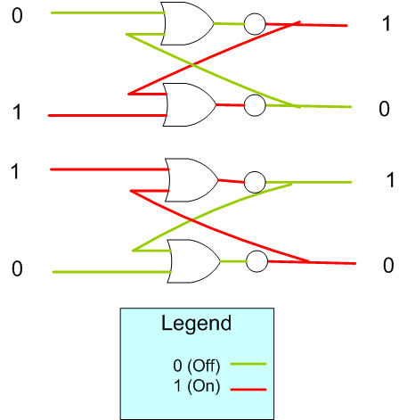
0
Setting a 1 bit value
1

Slide 11
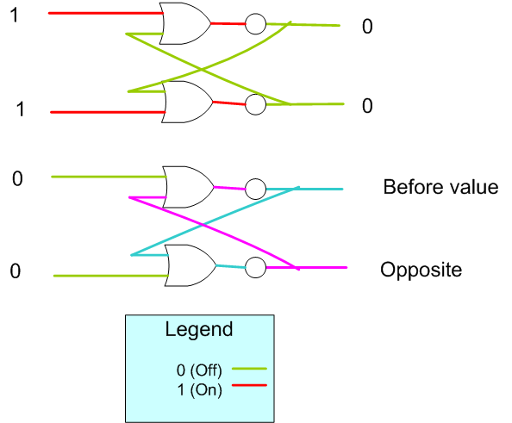
Saving on bit of memory

Slide 12
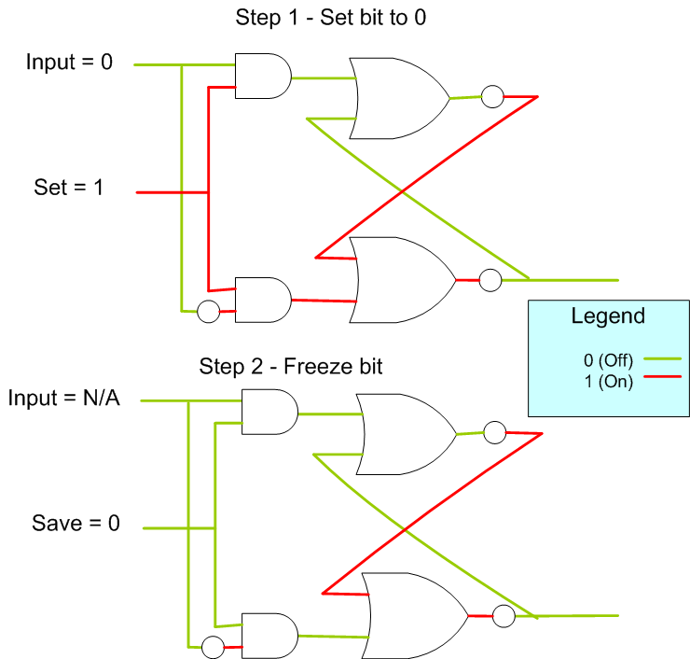
Set One bit of memory to 0

Slide 13
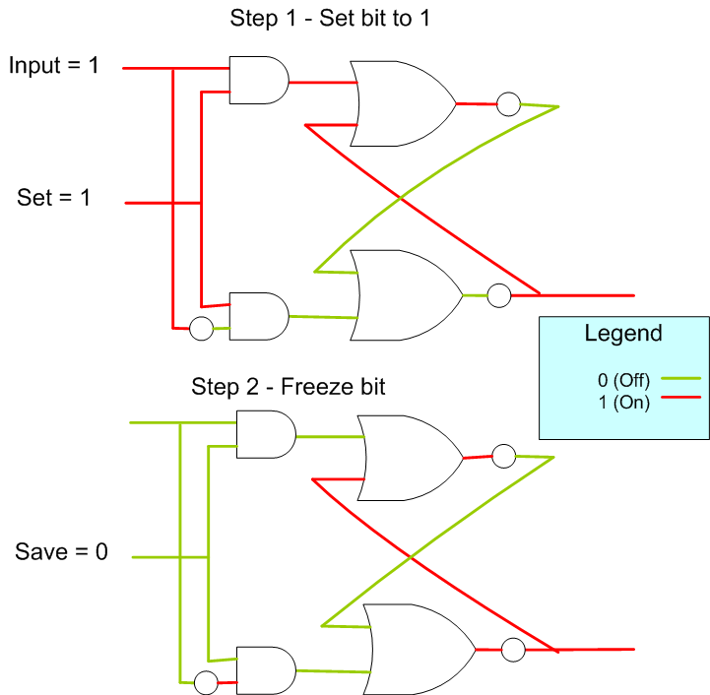
Set One bit of memory to 1

Slide 14
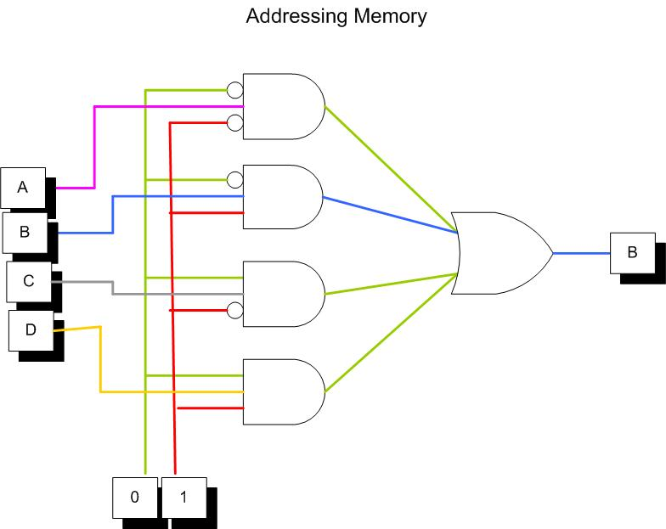
Addressing Memory location 0b01

Slide 15
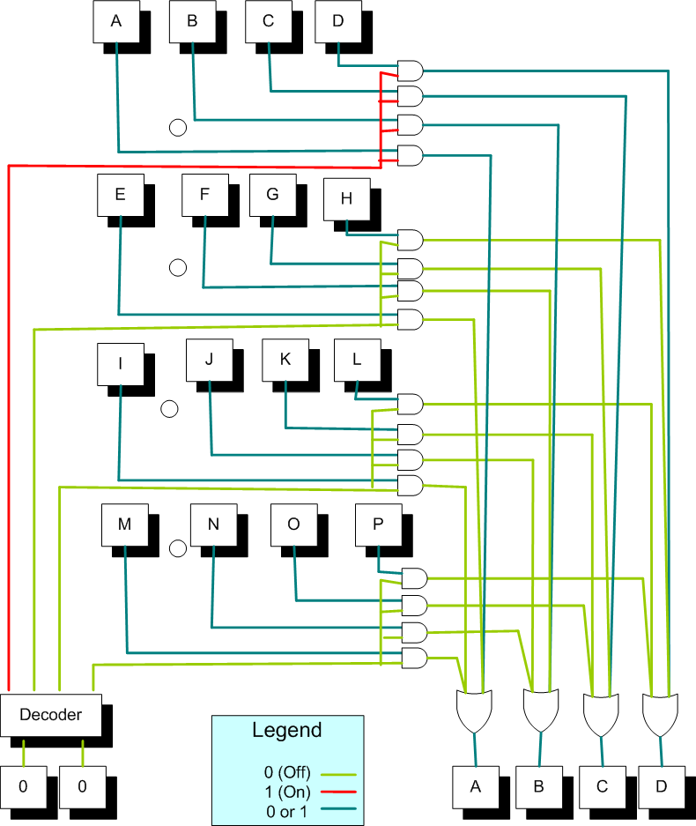
Reading From Memory – Nibble 0b00

Slide 16
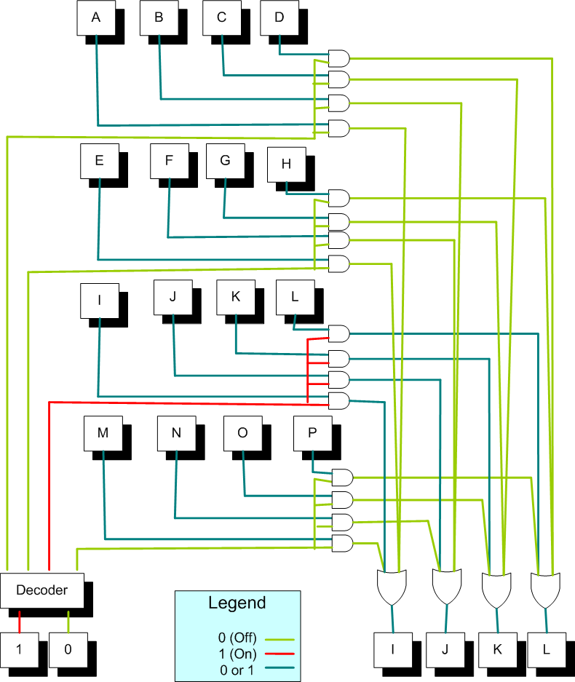
Reading from Memory – Nibble 0b10

Slide 17
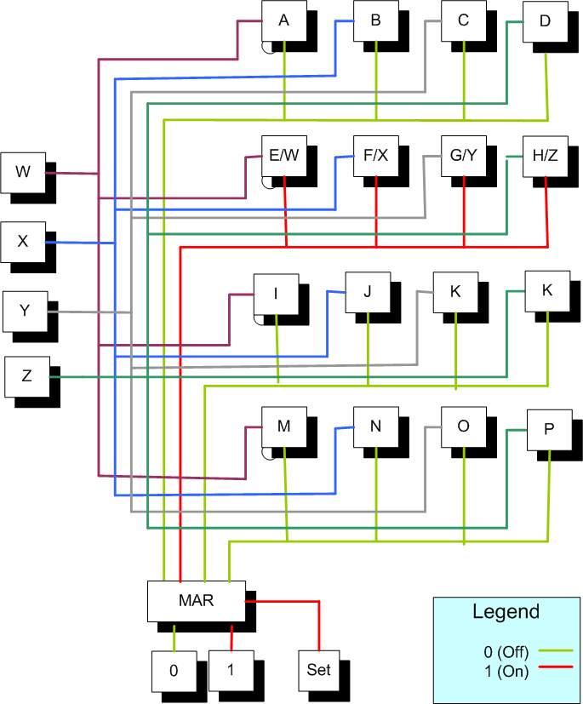
Writing to Memory - Nibble 0b01

Slide 18
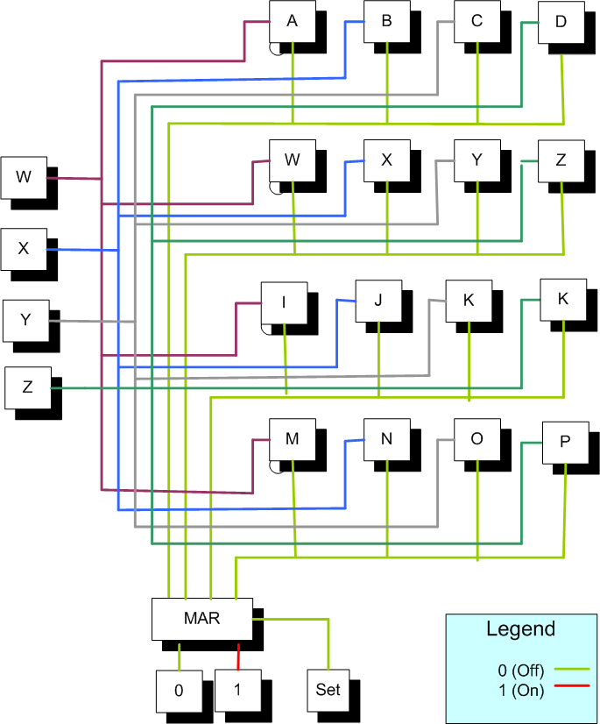
Freezing Memory – turn off Set bit

