Slide 1
Data Structures
Stacks
Linked Lists
Queues
Heaps
Hashes

Slide 2
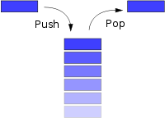
10 Stack - Overview

Slide 3
Stack - Prosperities
Last in First Out
Memory with access only to the top element
2 stacks can act as one Random Access Memory
Inserts (pushes) take O(1)
Deletes (pops) take O(1)

Slide 4
Stack Implementation in Java 10
public class Stack { public Stack( ) { theArray = new Object[ DEFAULT_CAPACITY ]; topOfStack = -1; } public boolean isEmpty( ) {return topOfStack == -1; } public void makeEmpty( ) { topOfStack = -1; | public Object top( ) { if( isEmpty( ) ) throw new UnderflowException( "ArrayStack top" ); return theArray[ topOfStack ]; } public void pop( ) { if( isEmpty( ) ) throw new UnderflowException( "ArrayStack pop" ); topOfStack--; }

Slide 5
Linked List

Slide 6
Implementation of a Linked List in Java
public class Listnode
{
private Object data;
private Listnode next;
public Listnode(Object d) { this(d, null); }
public Listnode(Object d, Listnode n){ data = d; next = n; }
public Object getData() { return data; }
public Listnode getNext() { return next; }
public void setData(Object ob) { data = ob; }
public void setNext(Listnode n) { next = n; }
}

Slide 7
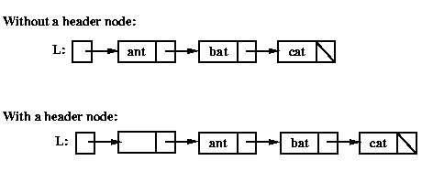
Operations on Linked Lists – Adding to Beginning

Slide 8
Operations on Linked Lists – Adding to End

Slide 9
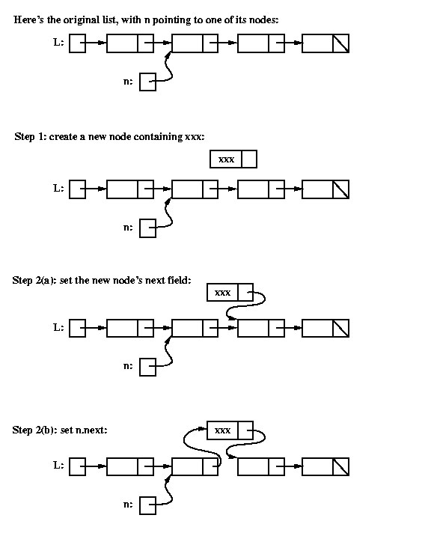
Operations on Linked Lists – Adding to a Middle node

Slide 10
Linked List – Prosperities 20
Unordered list
Inserts are O(1)
Deletes are O(n)
Ordered Lists
Inserts are O(n)
Deletes are O(n)

Slide 11
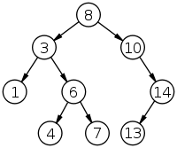
Binary Search Tree

Slide 12
Operations on Binary Search Trees
Inserts take O(log n)
Deletes take O(log n)
Searches take O(log n)

Slide 13
Implementation of a BST 30
An array that is sorted if by nature a binary search tree
the middle node at the root
all nodes i have as children
(i – (1/level)^2) *(1/2)*n
(i + (1/level)^2) *(1/2)*n
Creating node objects with the following data items
Value (data)
References to it’s children

Slide 14
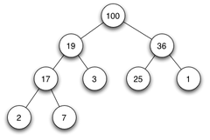
Heaps – Maxheaps and Min Heaps

Slide 15
Prosperities of Heaps(Priority Queue)
The root element is the Maximum (or Minimum)
Each element has a fixed number of children (usually 2)
Each element is larger (or smaller) then all it’s children

Slide 16
Operations on Heaps 35
Inserts take O(log n)
Deletes take O(n)
Searches take O(n)
Find_Max (or Find_Min) takes O(1)

Slide 17
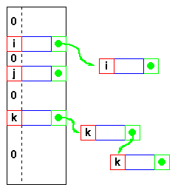
Hash tables

Slide 18
Analysis of hash operations 40
Inserts, delete and searches vary
Depends on the running time of you hash function
Depends on the type of linked list you use

