Slide 1
QuickSort
QuickSort
Best, Worst Average Cases
K-th Ordered Statistic
Log bases under Big Oh

Slide 2
QuickSort - Partition
partition( A , p , r)
x ← A[p]
i ← p - 1;
j ← r + 1;
while (true)
repeat j ← j - 1 until A[j] ≤ x
repeat i ← i + 1 until A[i] ≥ x
if (i < j)
swap ( A[i] , A[j] )
else
return j

Slide 3
QuickSort – Main Routine
quicksort ( A, p, r)
if (p < r)
q ← partition ( A, p, r)
quicksort( A, p, q))
quicksort( A, q+1, r )
quicksort( A, 1, length(A));

Slide 4
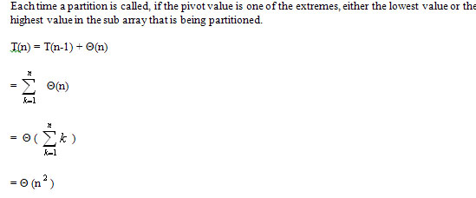
QuickSort – Worst Case

Slide 5
QuickSort - Best Case

Slide 6
QuickSort – Average Case
Probability question: If you cut a piece of rope at a random point, how big will be smaller piece be?

Slide 7
Logs bases and Big Oh

Slide 8
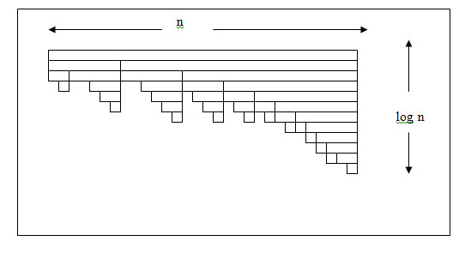
QuickSort – Average Case Graph

Slide 9
Correctness of QuickSort
To prove an algorithm correct, you must show that it works correctly on all possible inputs. Here we need to show inductively that Quicksort will sort:
lists of size 1 correctly
If Quicksort sorts a list of size k correctly, then it can sort a list of size k+1 for all k ≥ 1.
The initial assumption is correct because if Quicksort is given a list if size 1, then it will check if p < r which will not be true and therefore Quicksort will not do anything which leaves the element alone, which trivially sorts it.
The induction hypothesis (2) can be shown at follows:
The algorithm begins by dividing a list of length (k + 1) into two lists of length q and (k + 1 - q) where
1 < q < k+1.
Since q < k + 1, Quicksort (q) must sort correctly.
k + 1 - q < k + 1 so Quicksort (n + 1 - q) must sort correctly.
The final step of the algorithm is to combine the two correctly sorted lists. Remember, one contains all numbers ≤ pivot, the other contains all numbers ≥ pivot in sorted order, returning a correctly sorted list.

Slide 10
K-th Ordered Statistic
random-select ( A, p, r, i)
if p=r
return A[p]
A ← random-partition( A, p, r, i )
k ← q – p + 1
if i ≤ k
random-select( A, p, q, i )
else
random-select(A, q+1, r, i-k )

Slide 11
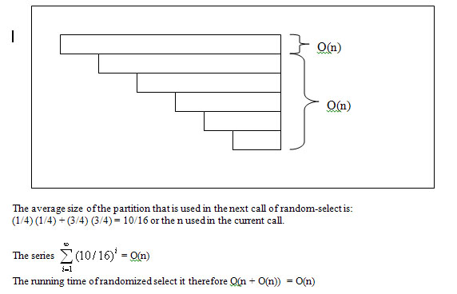
K-th Stat : Time analysis

