Slide 1
Cloud Computing
Cloud? Computing?
noSQL vs SQL
RAID 0,1,5,6,10

Slide 2
What is Computing?
the use or operation of computers
use of a computer to process data or perform calculations.
the act of calculating or reckoning
Reading from memory
Preforming mathematical computations.
Writing results (final or temporary)
5 + 3 * 4 ➔ 5 + 12 = 17

Slide 3
What if the Cloud?
What if you spilled coffee on your cell phone and destroyed it? How could you get your friends phone numbers back?
Suppose you stored your contacts in a database on the internet so the coffee couldn’t destroy it.
Your phone (and any future phones) could just download them as needed.

Slide 4
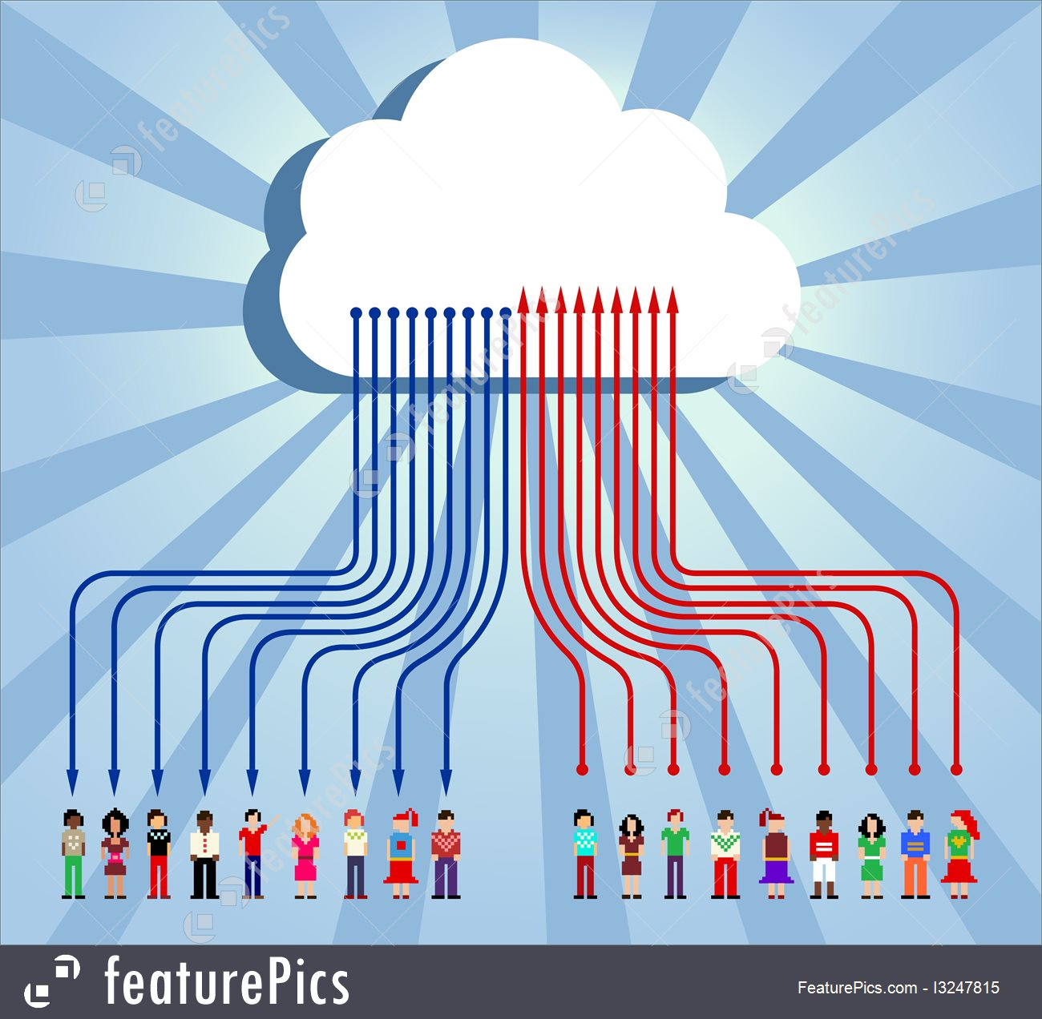
Cloud Communications
Data can be uploaded to the cloud from computers, cellphone etc. and the same people or other people can download the data.

Slide 5
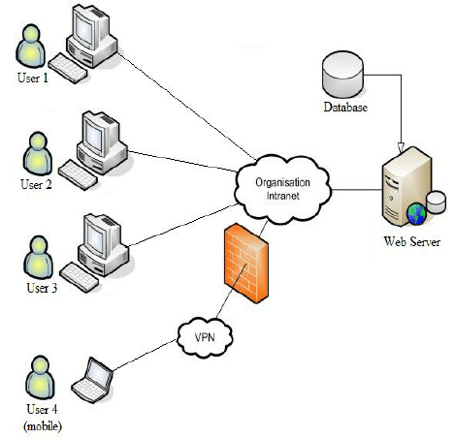
Client Server Computing.
Examples: Facebook, Tweeter LinkedIn
Isn’t Client Server Computing the same as Cloud Computing?

Slide 6
What is a utility?
Examples
Electric company
Water company
Gas Company
What makes them a utility?
Customers pay when they use (utilize) their service.

Slide 7
Client Server vs. Cloud Computing
Client Server
You buy the server computers
You pay for the IP addresses
You buy the disk space
You pay a fixed price wither you utilize the resources of not.
This is called HOSTing
Cloud Computing
You pay for disk space, processor time, multiple IPs as needed
Grow and shrink as needed .

Slide 8
Access to your cloud
You don’t have direct access to a server to store your code, data files etc. so how do you access it?
From your PC that is connected to the internet
Ex) If you have a Gmail account, do you really care where it is hosted?
Or just that you can get to it anywhere? That it is reliable? easy to use?

Slide 9
Cloud front and back ends

Slide 10
Advantages to Cloud Computing
Scalability. Data and processor time is limitless.
Instant access to more/less computing
Save money…you pay for what you use.
Your company doesn’t have to provide software for each PC. Instead the cloud company can provide licenses as needed.
No physical space needed for processors and disk space.
The “IT guy” will now work at the cloud company and not at each individual company.

Slide 11
Disadvantages to Cloud Computing
Security
Your Intellectual property (code) is on their servers.
Privacy
Usage fees
Bandwidth caps

Slide 12
Public, Private and Hybrid Clouds
Public Clouds resources are available to the public for a fee.
Public Cloud is connected to the public internet.
Public Clouds cost less that Private because the use shared resources.
Examples of companies
Amazon AWS
Rackspace

Slide 13
Public, Private and Hybrid Clouds
Private Clouds – same capabilities are available though private networks or the internet.
Big Data and Data Science applications typically run in Private clouds.

Slide 14
Public, Private and Hybrid Clouds
Hybrid Clouds – a mix of public and private clouds.
Typically applications run in a private cloud and will jump to the public cloud during cloud bursts.
Cost vs. security tradeoffs are considered when deciding where to put parts of the application.

Slide 15
Cloud Companies
Kamatera
phoenixNAP
Amazon Web Services
Microsoft Azure
Google Cloud Platform
Adobe
VMware
IBM Cloud
Rackspace
Red Hat
Salesforce
Oracle Cloud
SAP
Verizon Cloud
Navisite
Dropbox
Egnyte

Slide 16
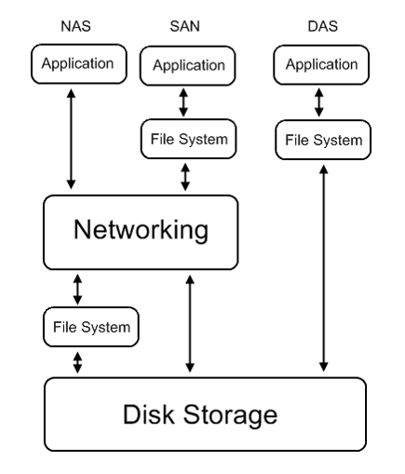
Storage – Grows as needed
NAS – Network Attached Storage. Connected to our LAN
SAN – Storage Area Network connected to disk via Host Bus Adapters HBA
DAS – Directly Attached Storage connected by Small Computer Systems Interface SCSI, USB, Firewire etc.

Slide 17
Database schema for orders

Slide 18
Customer places an order
In SQL – with tables) customer, product, order
If customer c431, bought one of product p22 and two of p523 on March 2,20xx, what table do we record the:
Ship to address? Customer
Product description? Products
Quantity of each product bought? Orders
Price of the product? Products
What if the customer used an online coupon? ???????
What if there were 2 shipments? And 1 was retuned? ????

Slide 19
Customer places an order
With noSQL
If customer c431, bought one of product p22 and two of p523 on March 2,20xx, what table do we record the:
Ship to address? o999 document
Product description? o999 document
Quantity of each product bought? o999 document
Price of the product? o999 document
Customer used an online coupon? o999 document

Slide 20
SQL vs. No SQL databases

Slide 21
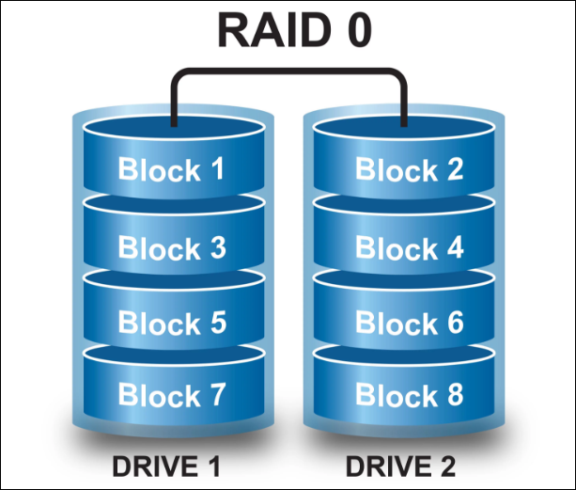
Redundant Array Independent Disks RAID 0
Blocks are striped across 2 drives for faster searching
No Redundancy

Slide 22
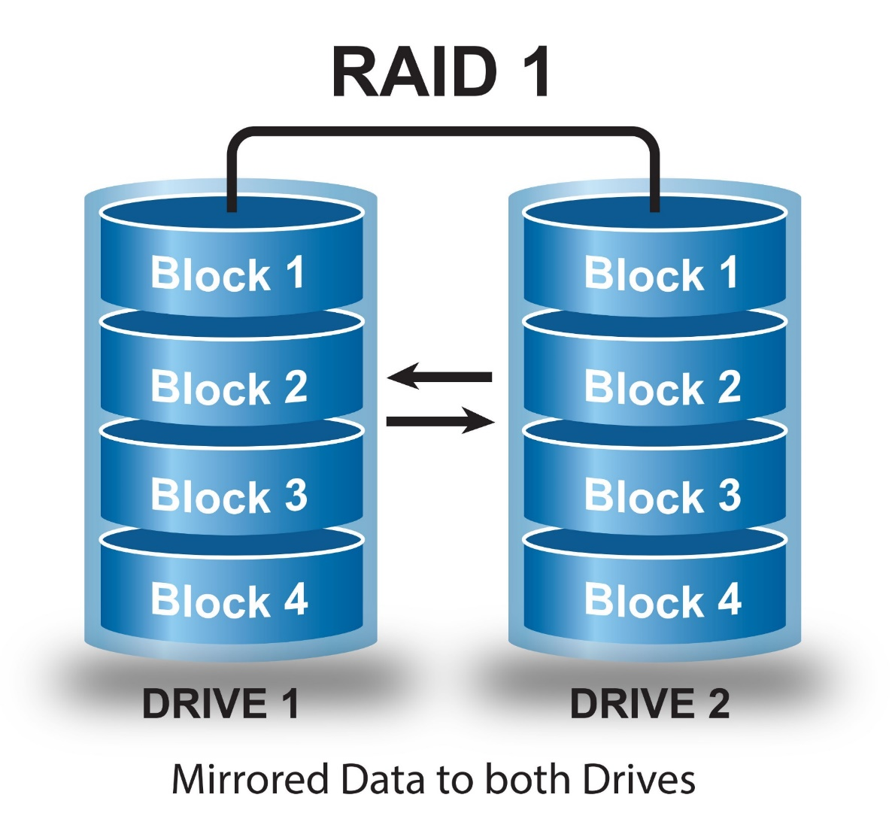
Redundant Array Independent Disks RAID 1
Blocks are striped across 2 drives and duplicated for faster searching and disaster recovery
Uses Redundancy
Twice as much storage is needed.

Slide 23
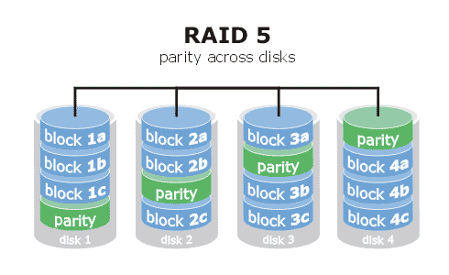
Redundant Array Independent Disks RAID 5
Blocks are striped across many drives for faster searching
Parity is used for disaster recovery.
Extra space needed for parity.
Updates require parity writes too.
# drives = #blocks
1 Drive used for parity
1001 1011 1100 1110
RAID 5 can survive 1 disk crash
Writes require a parity write

Slide 24
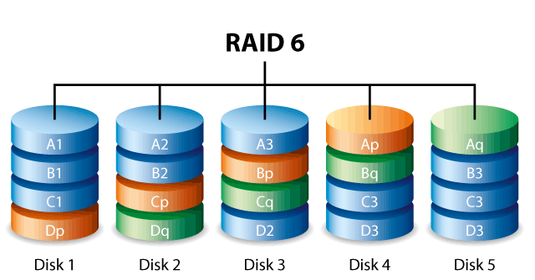
Redundant Array Independent Disks RAID 6
Blocks are striped across many drives for faster searching
2 Parities is used for disaster recovery.
Extra space needed for 2 parities.
Updates require parity writes too.
# drives = #blocks + 1
1 Drive used for parity
1001 1011 1100 1110 0001
RAID 6 can survive 2 disk crashes.
Writes require 2 parity writes

Slide 25
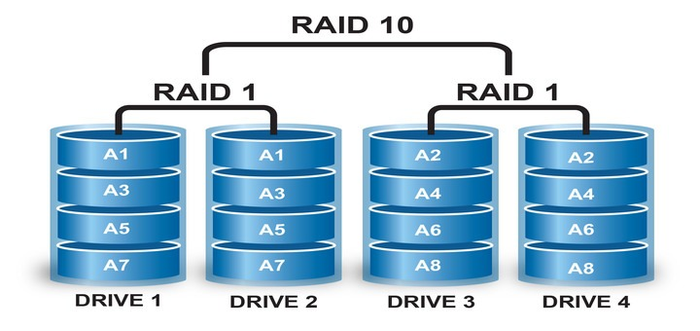
Redundant Array Independent Disks RAID 10
Combination of 2 RAID 1’s and a RAID 0
Parity is used for disaster recovery.
Extra space needed for parity.

