Slide 1
Exceptions in Java
Exceptions handling
Try, catch blocks
Throwing exceptions.

Slide 2
What is an Exception?
An exception is an event, which occurs during the execution of a program, that disrupts the normal flow of the program's instructions.

Slide 3
Example (file not found)
void readFile()
{
Charset charset = Charset.forName("US-ASCII");
BufferedReader reader = Files.newBufferedReader(“input.txt”, charset))
String line = null;
while ((line = reader.readLine()) != null)
{
System.out.println(line);
}
}
Should work fine, however, what if the file input.txt is not there one day when you are running this program?

Slide 4
Example (file not found)
void readFile()
{
Charset charset = Charset.forName("US-ASCII");
try {
BufferedReader reader = Files.newBufferedReader(file, charset))
String line = null;
while ((line = reader.readLine()) != null)
{
System.out.println(line);
}
}
catch (IOException x) {System.err.format("IOException: %s%n", x);}
}

Slide 5
3 kinds of exceptions
1) Checked exceptions. User can anticipate
Ex) file not found.
2) Error exceptions. Error that are external to the applications like hardware exceptions.
Ex) cell phone overheats.
3) Runtime exception. Logic error in code and improper used of API, etc.
Ex) divide by zero

Slide 6
Flow of control when an exception
Should the exception be ignored?
Show the Operating System always terminate the Process?
Can the exception be handled (go to plan B) and then program continue?
Should the programmer have the option to do some clean up prior to the Operating System terminating the program?
Should all exceptions be handled the same way.
Should the programmer anticipate an exception, and then be able to handle it as they choose.

Slide 7
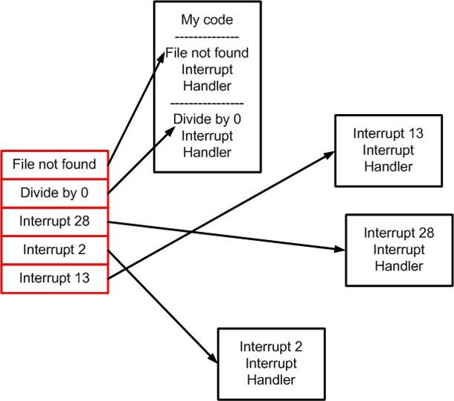
Exception stack.
Exception Handler code for various Exceptions are available from the Operating System.
A process has a stack of addresses of where the code is located.
When an exception occurs, an object of the type of the exception is created and “thrown” to the stack (top to bottom) looking for the first type match…that code is then run

Slide 8
Creating you own exception objects
Consider the following :
Your Mathematical exception library might be organized like this.
class ArithmeticException
{
void toString( ) { return (instanceof() + “{: “ + getLocalizedMessage()); }
} ;
class UnderflowException extends ArithmeticException { } ;
class ZeroDivideException extends ArithmeticException { } ;
class OverflowException extends ArithmeticException
{
void toString( ) { return “no problem here…” ;}
} ;

Slide 9
Catching exceptions
Comments:
the Dividezero will never run because Dividezero is a Mather
try {
// some math code goes here
}
catch (OverflowException)
{
// code to handle an over flow
}
catch(ArithmeticException)
{
// Handle any math error that is not an overflow
}
catch(Dividezero)
{
// Handle any Divide by zero
}

Slide 10
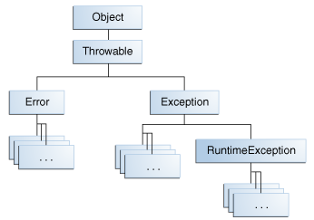
Throwable Class in Java
class Throwable extends Object implements Serializable { }
class Exception extends Throwable

Slide 11
Stack Trace
A stack trace is a list of the method calls that the application was in the middle of when an Exception was thrown.
Exception in thread "main" java.lang.IllegalStateException: A book has a null property
at com.example.myproject.Author.getBookIds(Author.java:38)
at com.example.myproject.Bootstrap.main(Bootstrap.java:14)
Caused by: java.lang.NullPointerException
at com.example.myproject.Book.getId(Book.java:22)
at com.example.myproject.Author.getBookIds(Author.java:35)
... 1 more

Slide 12
Throwing Exceptions (intentionally)
static int divide(int x, int y)
{
if(y==0) { throw new ZeroDivisionException; }
return x/y;
}
…
try {
divide(12, 0);
}
catch (DivideByZero)
{
System.out.print(“divide by zero error”);
}
System.out.print(“Moving right along”);

Slide 13
throw e vs throw new e
...
Catch (MathError ME)
{
// handle it then throws exception of whatever type came in
throw ME;
}
vs.
Catch (MathError ME)
{
if (ME instanceOf ZeroDivisionException)
throw new ZeroDivisionException;
// throws exception of type MathError
}

Slide 14
throws
public void func()
void gunc() throws IOException { }
void hunc()
{
try {
func();
gunc();
}
catch (IOException e) { … }
}

Slide 15
finally
The finally block always executes when the try block exits.
This ensures that the finally block is executed even if an unexpected exception occurs.
But finally is useful for more than just exception handling — it allows the programmer to avoid having cleanup code accidentally bypassed by a return, continue, or break. Putting cleanup code in a finally block is always a good practice, even when no exceptions are anticipated.

Slide 16
read a list<Integer> from a file
List<Integer> list = new ArrayList<Integer>();
File file = new File("file.txt");
BufferedReader reader = null;
try {
reader = new BufferedReader(new FileReader(file));
String text = null;
while ((text = reader.readLine()) != null)
{ list.add(Integer.parseInt(text)); }
}
catch (FileNotFoundException e) { e.printStackTrace(); }
catch (IOException e) { e.printStackTrace(); }
finally {
try { if (reader != null) { reader.close(); } }
catch (IOException e) { }
}
}

Slide 17
Exceptions are Thread Safe
Java exception handling is thread safe. Throwing on one thread (including re-throws) has no impact on any throw/catch in progress on another thread.

