Slide 1
JavaScript to:
Print current date
Print Screen
Include JavaScript files (Head & Body)
Forms

Slide 2
How JavaScript fits into the client/server architecture

Slide 3
JavaScript that gets the current date and year
<p>
<script>
var today = new Date();
document.write("Current date: ");
document.write(today.toDateString());
</script>
</p>
<p>
<script>
var today = new Date();
document.write("&copy;&nbsp;");
document.write(today.getFullYear());
document.write(", San Joaquin Valley Town Hall")
</script>
</p>

Slide 4
The JavaScript for current date and year in a web browser

Slide 5
A script element in the head section that loads an external JavaScript file
<script src="set_date.js"></script>

Slide 6
JavaScript embedded in the head section
<head>
...
<script>
var $ = function (id) {
return document.getElementById(id);
}
window.onload = function() {
var today = new Date();
$("date").firstChild.nodeValue =
"Current date: " + today.toDateString();
}
</script>
</head>

Slide 7
JavaScript embedded in the body
<p>
<script>
var today = new Date();
document.write("Current date: ");
document.write(today.toDateString());
</script>
</p>

Slide 8
The code for a web page
<!DOCTYPE html>
<html>
<head>
<title>Join Email List</title>
</head>
<body>
<h1>Please join our email list</h1>
<form id="email_form" name="email_form"
action="join.php" method="get">
<label for="email_address">Email Address:</label>
<input type="text" id="email_address">
<span id="email_error">*</span>
</form>
</body>
</html>

Slide 9
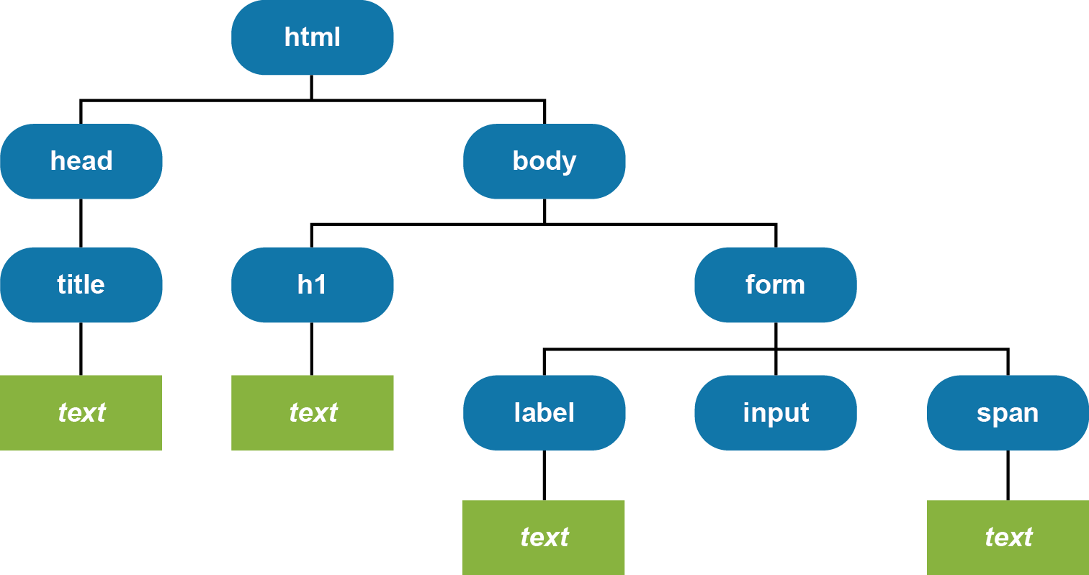
The DOM for the web page

Slide 10
DOM nodes commonly used in DOM scripting
Element
Attr
Text

Slide 11
The document object
Methods of the document object
getElementById(id)
write(string)
Examples of document methods
// returns the object for the HTML element
var rateBox = document.getElementById("rate");
// writes a string into the document
document.write("Today is " + today.toDateString());
A standard $ function that gets the object for an element by using its id
var $ = function (id) {
return document.getElementById(id);
}

Slide 12
Scripting the DOM
Three properties for scripting the DOM
value
firstChild
nodeValue
How to get the text of an HTML element
var emailAddress = $("email_address").value;
How to set the text of an HTML element
$("email_error").firstChild.nodeValue = "Entry is invalid.";

Slide 13
The DOM event cycle

Slide 14
The HTML file for the Email List application
<!DOCTYPE html>
<html>
<head>
<meta charset="UTF-8">
<title>Join Email List</title>
<link rel="stylesheet" href="email_list.css">
<script src="email_list.js"></script>
</head>
<body>
<main>
<h1>Please join our email list</h1>
<form id="email_form" name="email_form"
action="join.php" method="get">
<label for="email_address1">
Email Address:</label>
<input type="text" id="email_address1"
name="email_address1">
<span id="email_address1_error">*</span><br>

Slide 15
The HTML file for the Email List app (continued)
<label for="email_address2">
Re-enter Email Address:</label>
<input type="text" id="email_address2"
name="email_address2">
<span id="email_address2_error">*</span><br>
<label for="first_name">First Name</label>
<input type="text" id="first_name"
name="first_name">
<span id="first_name_error">*</span><br>
<label>&nbsp;</label>
<input type="button" id="join_list"
value="Join our List">
</form>
</main>
</body>
</html>

Slide 16
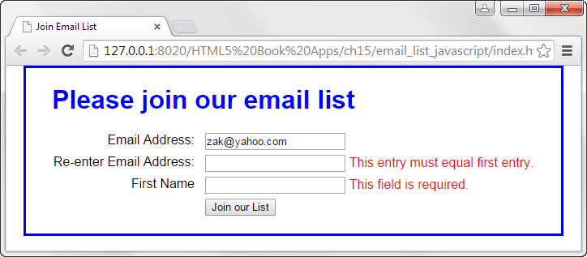
The Email List application with JavaScript

Slide 17
The code for the JavaScript file (email_list.js)
var $ = function (id) {
return document.getElementById(id);
}
var joinList = function () {
var emailAddress1 = $("email_address1").value;
var emailAddress2 = $("email_address2").value;
var isValid = true;
if (emailAddress1 == "") {
$("email_address1_error").firstChild.nodeValue =
"This field is required.";
isValid = false;
}
else {
$("email_address1_error").firstChild.nodeValue =
""; }

Slide 18
The code for the email_list.js file (continued)
if (emailAddress1 !== emailAddress2) {
$("email_address2_error").firstChild.nodeValue =
"This entry must equal first entry.";
isValid = false;
}
else {
$("email_address2_error").firstChild.nodeValue =
""; }
...
if (isValid) {
// submit the form if all entries are valid
$("email_form").submit();
}
}
window.onload = function () {
$("join_list").onclick = joinList;
}

Slide 19
The JavaScript in a file named printPage.js
var $ = function (id) {
// this function returns the object for the element
return document.getElementById(id);
}
var printPage = function() {
// this is the event handler
// for the click event of the button
window.print();
}
window.onload = function() {
// this is the event handler for the onload event
$("printButton").onclick = printPage;
}
HTML that includes the JavaScript file
<script src="printPage.js"></script>
HTML for the Print the Page button
<input type="button" id="printButton"
value="Print the Page">

