Slide 1
Loops
For, While, Do-While (aka Repeat-Until), Infinite loops, GOTO-label, Break, continue,

Slide 2
Print all numbers from 3 to 10
Print(‘3’);
Print(‘4’);
Print(‘5’);
Print(‘6’);
Print(‘7’);
Print(‘8’);
Print(‘9’);
Print(‘10’);
i=3; Print(i);
i=4; Print(i);
i=5; Print(i);
i=6; Print(i);
i=7; Print(i);
i=8; Print(i);
i=9; Print(i);
i=10; Print(i);
i=3;
Print(i); i=i+1;
Print(i); i=i+1;
Print(i); i=i+1;
Print(i); i=i+1;
Print(i); i=i+1;
Print(i); i=i+1;
Print(i); i=i+1;
Print(i); i=i+1
for( i=3; i <=10; i=i+1)
{
Print(i);
}

Slide 3
Flow chart for a FOR loop

Slide 4
While Loop (repetitive if)
i = 3;
if (i <= 10)
{
Print(i);
i = i+1;
}
// will print 3
// i will be 4
i = 3;
while (i <= 10)
{
Print(i);
i = i+1;
}
// Will print 3 4 5 6 7 8 9 10
// i will be 11
// while is like if but the block repeats until false

Slide 5
For loop syntax
for( Initialize statement; Boolean statement; Final statement )
{
// block of code that runs in a loop
}
// Initialize statement is run once before the loop starts
// Boolean statement is evaluated before the block runs
// Final statement run after the block of code is run

Slide 6
For/While equivalence
for( int i=0; i <= 10; i=i+1 )
{
// block of code
}
int i=0;
while(i <= 10)
{
// block of code
i=i+1
}

Slide 7
Infinite Loop (loop that never terminates)
for( i=3; i <=10; i=i+1)
{
Print(i);
i = i-1;
}
i = 3;
while (i <= 10)
{
Print(i);
}
while (true)
{
runClock();
}

Slide 8
Apple Headquarters (infinite loop)

Slide 9
Do-While (aka Repeat-Until)
do {
// block of code
} while (Boolean statement)
// like while loop but block of code will run at least once.
repeat
// block of code
until (Boolean statement)
Note: used in Pascal

Slide 10
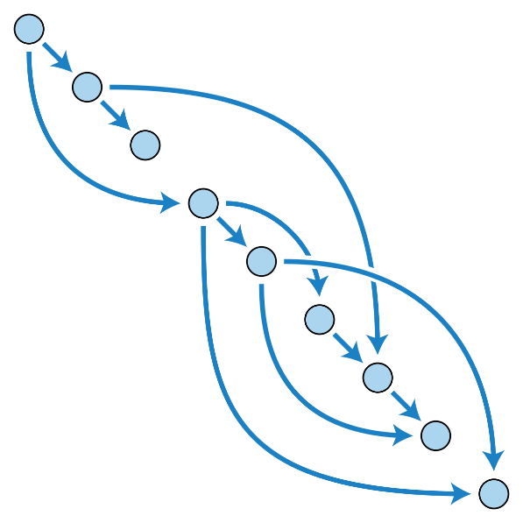
Goto with Labels (simulate do-while)
LOOPSTART:
// block of code
if (condition) goto LOOPSTART;
Note: GOTO is used in C, C#, Perl
LabelA:
// do stuff
goto labelC;
LabelB:
// do stuff
goto LabelA;
LabelC:
// do stuff
goto LabelB
Note: infinite loops are hard to detect.

Slide 11
Loops with Exit-when (simulate do-while)
loop
// block of code
exit when Boolean-condition;
end loop;
Like do-while except Boolean-condition must be true to exit out of the loop
Note: used in Ada

Slide 12
break (goto code after loop)
for (int i = 0; i < 10; i++)
{
print(i);
if (i == 3) { break; }
}
// output 012

Slide 13
continue (iterate and goto start of loop)
for (int i = 0; i < 10; i++)
{
if (i == 3) { continue; }
print(i);
}
// output 012456789

Slide 14
Nested loops
int size = length(A); // A is an array with 6 elements
for (int i=0; i <= size-1; i = i + 1)
{
for (int j=i; j <= size-1; j = j + 1)
{
print(j);
}
print(‘ ’);
}
// assuming size of array is 6 then the output is: 012345 12345 2345 345 45 5

Slide 15
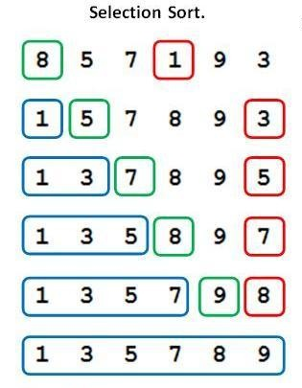
Nested loops – Ex) Selection Sort
int size = length(A);
for (int i=0; i <= size-1; i = i + 1)
{
min = A[i];
for (int j=i; j <= size-1; j = j + 1)
{
if (A[j] < min) { minValue = A[j]; minIndex = j; }
}
temp = A[i]; A[i] = A[minIndex]; A[minIndex] = temp; // Swap A[i] and A[minIndex]
}

Slide 16
For-of (iterate through array [] )
<script>
var personBB = [“Bill",“Byrne",200]; var values = “”; for (x of personBB) { values = values + personBB[x] + “ “; }
</script>
Recall: a set associative array is an array with attributes names instead of an index

Slide 17
For-in (set associative array {} )
<script>
var personBB = {firstName:“Bill", lastName:“Byrne", weight:200}; var values; for (x in personBB) { values = values + personBB[x] + “ “; }
</script>
Recall: a set associative array is an array with <attributes-value> pairs instead of an index

Slide 18
Python Range
range(stop)
stop: Number of integers (whole numbers) to generate,
starting from zero. eg. range(3) == [0, 1, 2].
range([start], stop[, step])
eg. range(99,2,-1)
start: Starting number of the sequence.
stop: Generate numbers up to, but not including this number.
step: Difference between each number in the sequence.
alphabet = ['a', 'b', 'c', 'd']
for i in range(len(alphabet)):
print(alphabet[i])

Slide 19
Python - In
fruit = ["apples", "oranges", "bananas"] for x in fruit: print(x)
Output: apples oranges bananas

Slide 20
Python – While (loop body is indented)
x = 1
while True:
print(“Counting to infinity … at %d now!" % (x))
x += 1

