Slide 1
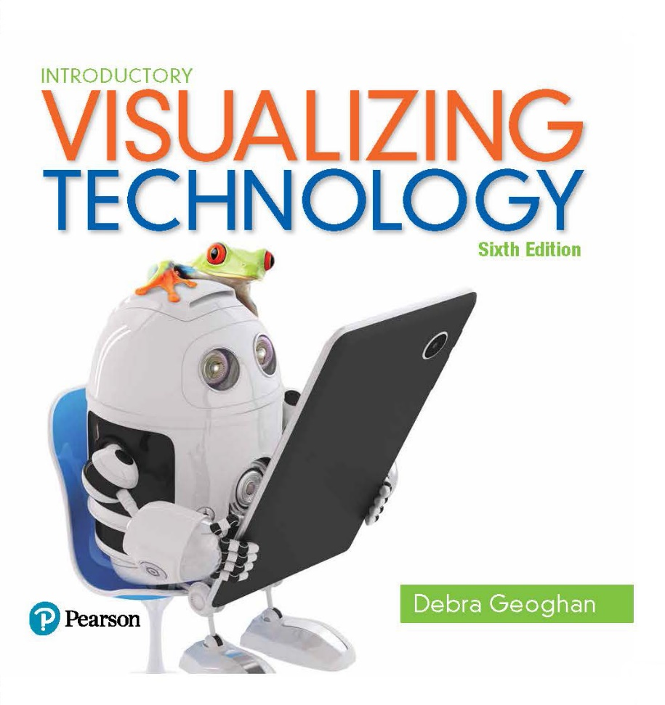
Introductory Visualizing Technology
Sixth Edition
Chapter 7
The Internet
Notes:
Welcome to Chapter 7 of Visualizing Technology, the sixth edition, by Debra Geoghan. This chapter will discuss the Internet, popular browsers, and how to determine the credibility of information found on the Web.

Slide 2
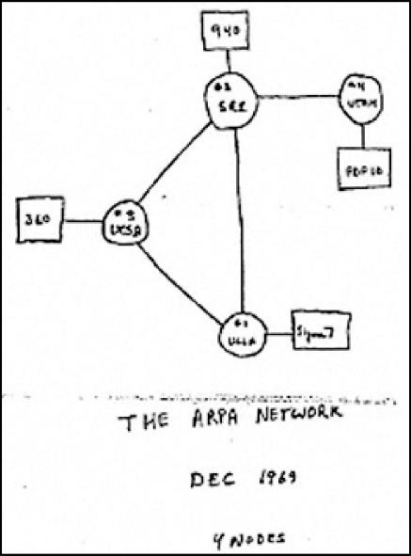
Internet Timeline – How it All Got Started (1 of 3)
How it all got started:
1957 – Soviet Union launches Sputnik
1960s – U.S. Department of Defense develops the ARPA project
Notes:
In 1957, the Soviet Union launched the first space satellite, Sputnik. The U.S. Department of Defense responded with the ARPA project. This project was to develop a system through which information could travel. The original system was called ARPANET (Advanced Research Projects Agency Network). The idea behind the ARPA project was to have multiple pathways so that losing one part of the system would not cripple the entire project. This project became the Internet.

Slide 3
Internet Timeline – How it All Got Started (2 of 3)
ARPANET
Started in 1958 by President Eisenhower
Originally called the Advanced Research Projects Agency (ARPA)
Had four school sites – UCLA, Stanford, Univ Utah, UC Santa Barbara
The Computer Science Network (CSNET)
Founded in 1979 by the National Science Foundation
Connected computer science departments at universities
Used ARPANET technology
Notes:
The original project was called ARPANET and had four sites located at the University of California at Los Angeles, Stanford Research Institute, University of Utah, and University of California at Santa Barbara. In 1979, the National Science Foundation (NSF) created CSNET to connect the computer science departments at universities using the ARPANET technology.

Slide 4
Internet Timeline – How it All Got Started (3 of 3)
Internet backbone – high-speed connection points between networks
Mid-1980s – NSF created NSFNET
Late1980s – NSFNET was the primary Internet backbone
1995 – NSF backbone was decommissioned and privatized – establishing the first five Network Access Points
NJ, San Fran, San Jose, Chicago, Wash. DC
Today the backbone is composed of Internet Exchange Points around the world
Notes:
In the mid-1980s, the National Science Foundation (NSF) created NSFNET and gave other academic disciplines access. By the late 1980s, NSFNET was the primary Internet backbone: the high-speed connection points between networks. In 1995, the NSF backbone was decommissioned and privatized. The first five Network Access Points were established in Chicago, New Jersey, San Francisco, San Jose, and Washington, D.C. Today, the backbone is composed of several Internet Exchange Points around the world.

Slide 5
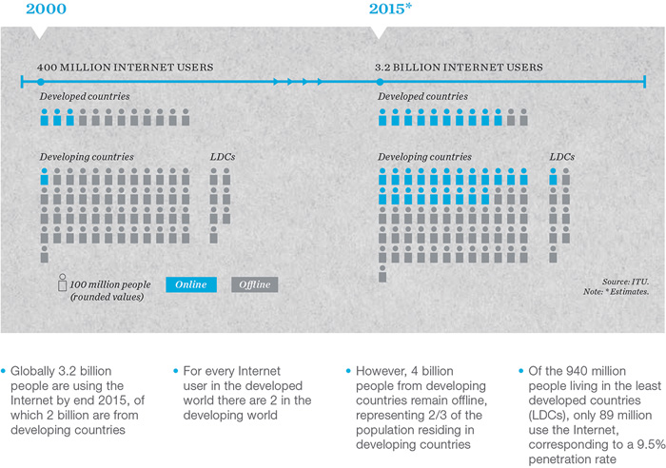
Internet Timeline – World Wide Web
Internet and World Wide Web are two different things
Other ways to use the Internet
Email
Instant messaging
VoIP (Voice over IP)
Hypertext – text that contains links to other objects
Hyperlink – links that connect web objects
Notes:
While many people use the terms “Internet” and “World Wide Web” interchangeably, they are two different things. The Internet is the physical entity—a network of computer networks. The World Wide Web is just one way that information moves on the Internet. Navigation on the World Wide Web is done through hypertext. Hypertext is text that contains hyperlinks that, when clicked, send you to another object on the web.

Slide 6
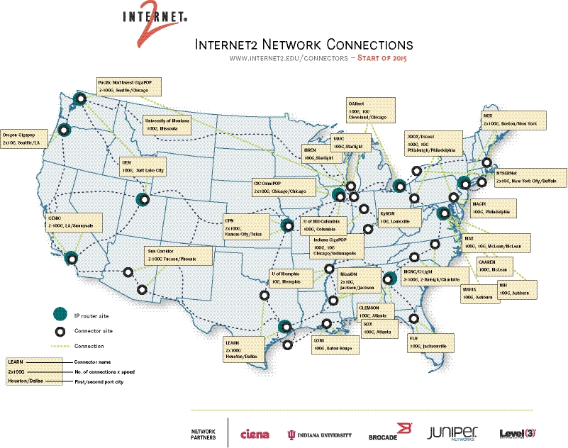
Internet Timeline – Internet2
A second internet for education, research, and collaboration
Internet2 membership includes:
Universities
Museums
Art galleries
Libraries
Hospitals
Notes:
The original uses of the Internet, education and research, have been overtaken by commercial and social uses. Even as bandwidth and infrastructure have increased, educational and research institutions have been unable to access the speeds and resources needed. As a result, Internet2 was created. It is a second Internet for education, research, and collaboration. Membership is limited to colleges, universities, other educational institutions, museums, art galleries, libraries, hospitals, and organizations that work with them.

Slide 7
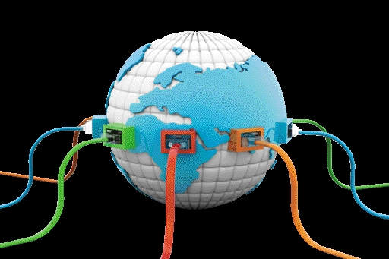
Compare Types of Internet Connections
Notes:
Objective 2 compares the types of Internet connections.

Slide 8
Get Connected – How Do You Get Connected (1 of 3)
Internet Service Providers – companies that offer Internet access
Comparing bandwidth of Internet connections
Bandwidth – the data transfer rate of a network; measured in kilobits per second, megabits per second, or gigabits per second
Notes:
Internet service providers are companies that offer Internet access.
Bandwidth is the data transfer rate of a network and is measured in kilobits per second, megabits per second, or gigabits per second. Advertised rates are the maximum download speeds, but the actual rate can fluctuate and may often be much lower. Most types of Internet access deliver slower upload speeds.

Slide 9
Get Connected – How Do You Get Connected (2 of 3)
Dial-up – cheapest, slowest
DSL – uses phone lines for digital signals
Cable
FTTH – Fiber-to-the-Home
Broadband
Faster Web Access
Notes:
Dial-up connections use regular phone lines, are slow, and cost $10 to $30 per month.
Broadband connections include cable, DSL, and fiber-to-the-home (FTTH). Cable is offered through your cable TV provider and has speeds from 1 to 150 Mbps. Digital subscriber line (DSL) uses telephone lines to carry digital signals at an average speed of 384 Kbps to 20 Mbps. Fiber-to-the-home (FTTH) is the fastest broadband option, with top speeds of 500 Mbps.

Slide 10
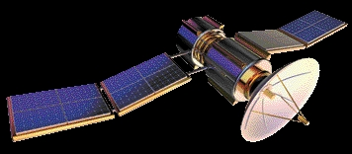
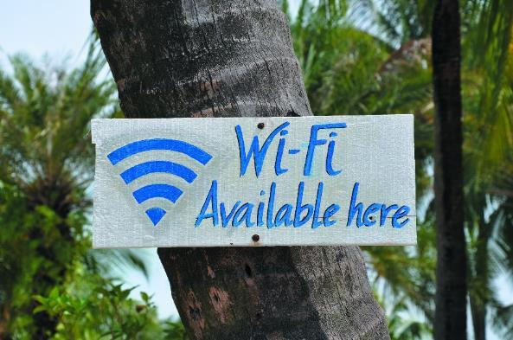
Get Connected – How Do You Get Connected (3 of 3)
Wireless
Satellite – Remote Areas
Municipal Wi-Fi
Radio Waves in cities
Wi-Fi Hotspots – public place
Notes:
Long Term Evolution (LTE) and WiMAX Mobile use 4G services to connect users to the Internet via cellular networks. Satellite Internet access is a more global and more expensive option usually considered when other options are not available. It requires a clear view of the southern sky, and service can be affected by weather conditions.
Municipal Wi-Fi uses radio waves. Wi-Fi hotspots can be free or fee-based and provide connectivity in public places.
Smartphones, tablets, video game consoles, and newer iPods are able to connect to the Internet via cellular towers or Wi-Fi. Satellite phones connect to satellites instead of cellular towers, and services are very expensive.

Slide 11
Compare Popular Web Browsers
Notes:
Objective 3 compares popular web browsers and shows how to customize them for your own use.

Slide 12
Surf’s Up – Web Browsers (1 of 4)
PC browsers
Internet Explorer and Microsoft Edge
Firefox
Chrome
Safari
Notes:
Internet Explorer was released in 1995 and is included with the Windows operating system. Microsoft Edge was included with Windows 10. Mozilla Firefox was released in 2004. Its appearance is similar IE, it is free, and it is easy to install. Google Chrome was released in 2008 and loads webpages more quickly than any other browser. Apple Safari is a browser for Mac users.

Slide 13
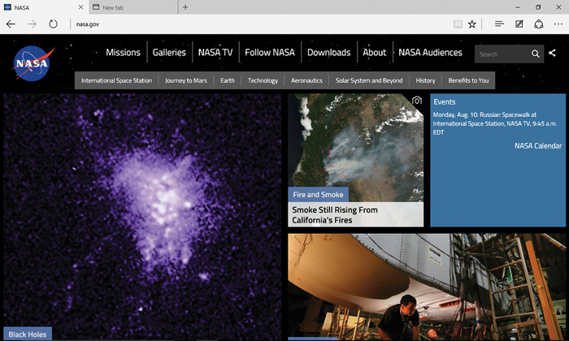
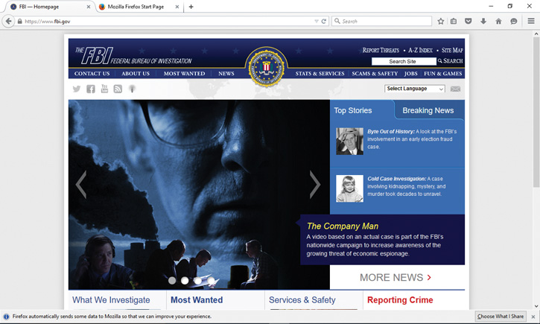
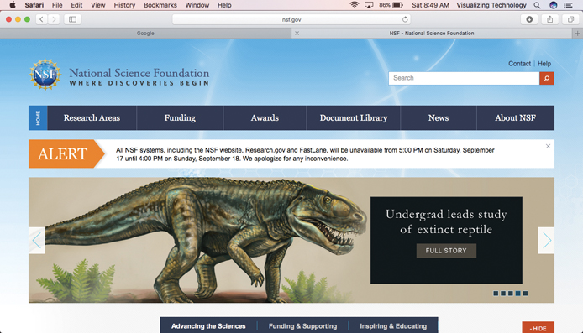
Surf’s Up – Web Browsers (2 of 4)
Notes:
Shown here are the Microsoft Edge, Firefox, and Safari browser windows.

Slide 14
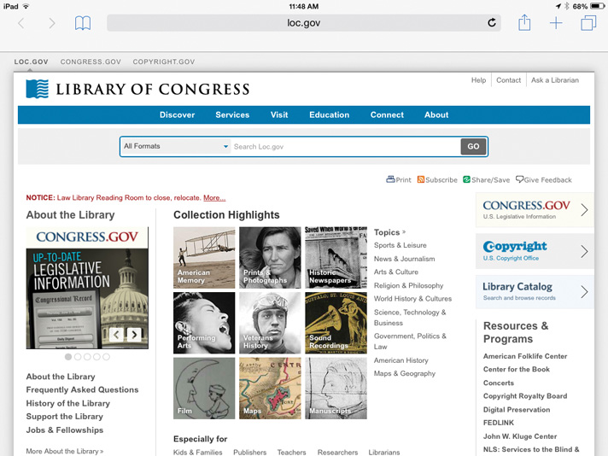
Surf’s Up – Web Browsers (3 of 4)
Mobile browsers
Chrome
Firefox
Safari
Opera
Notes:
Mobile browsers, also referred to as microbrowsers, include Chrome, Firefox, Safari, and Opera. Proprietary microbrowsers include Kindle and Android. This slide shows the Safari mobile browser window.

Slide 15
Surf’s Up – Web Browsers (4 of 4)
HTML
Hypertext Markup Language
Authoring language that defines the structure of a webpage
Web browsers
Programs that interpret the HTML
Display webpages
Home page — the first page of a website; page that appears when you first open your browser
Notes:
HTML (Hypertext Markup Language) is the authoring language that defines the structure of webpages. Web browsers are programs that display webpages according to the structure defined by the HTML. The first web browser was Mosaic, released in 1993. Mosaic eventually became Netscape. Popular browsers in use today include Mozilla Firefox, Internet Explorer, Apple Safari, Google Chrome, and Opera.

Slide 16
Surf’s Up – Add-Ons, Plug-Ins, and Toolbars
Plug-in
Third-party program, ex. Adobe Reader, Adobe Flash Player
Add-on
Created for a specific browser to add features to it
Toolbar
Can be added to a browser for quick access to a feature of an application that installed it
Be wary of toolbars that come bundled with software
Can be a source of malware and can slow down browsing
Notes:
An add-on is created for a specific browser to add features to it. A plug-in is a third-party program, such as Adobe Reader. Plug-ins help you display multimedia-rich, interactive, dynamic content, such as Adobe Flash Player. Installing plug-ins is easy and free. Adding a toolbar to your browser gives you quick access to the features of the application that installed it. Be wary, because some toolbars can be a source of malware.

Slide 17
Demonstrate How to Navigate the Web
Notes:
Objective 4 discusses how to successfully navigate the web. It examines the parts of a web address and how to conduct smart searches.

Slide 18
Navigating the Net
Two ways to navigate to a website
Type the URL (uniform resource locator) webpage address
http://www.google.com
http – protocol
https - secure
google – domain name
.com – top-level domain (TLD) type of website
Follow hyperlinks embedded in the webpages
Notes:
There are two ways to navigate to a website: either by typing in the URL (uniform resource locator) webpage address or by following hyperlinks.
The http is the protocol that tells your computer what type of page you’re looking at. The www is the domain portion of the name and Google is the domain name. The .com is the top-level domain (TLD) and represents the type of website you are visiting.

Slide 19
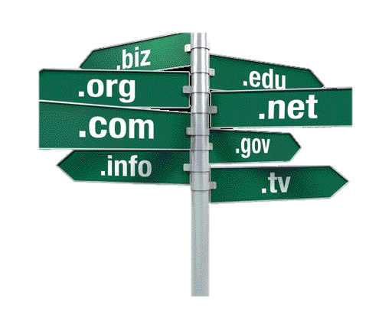
Navigating the Net – Web Addresses (1 of 2)
ICANN
Internet Corporation for Assigned Names and Numbers
Coordinates the Internet naming system
IP address
Internet Protocol address
Unique numbered address associated with a website ex. 192.88.98.255
FTP
Tranfers files
Notes:
ICANN (Internet Corporation for Assigned Names and Numbers) coordinates the Internet naming system by making sure every name assigned is unique. Internet Protocol (IP) is a unique numbered address associated with a website, such as 165.123.193.432.

Slide 20
Navigating the Net – Web Addresses (2 of 2)
DNS
Domain Name System
Provides a friendly name instead of an IP address
Notes:
The Domain Name System (DNS) is the service that allows you to use a friendly name instead of the actual IP address to access a website.

Slide 21
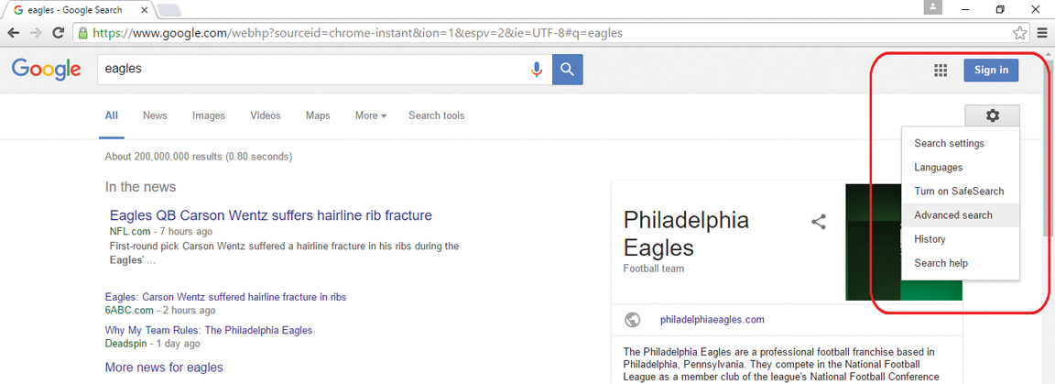
Navigating the Net – Smart Searching
Search engines are databases that index the Web
Notes:
Search engines are huge databases. They send out software called spiders, or bots, to crawl the web and gather information, which is then indexed. Because the Web is constantly changing, this method helps search engines stay up-to-date.
Advanced search tools help you refine your keyword searches by filtering to include or exclude certain types of results.

Slide 22
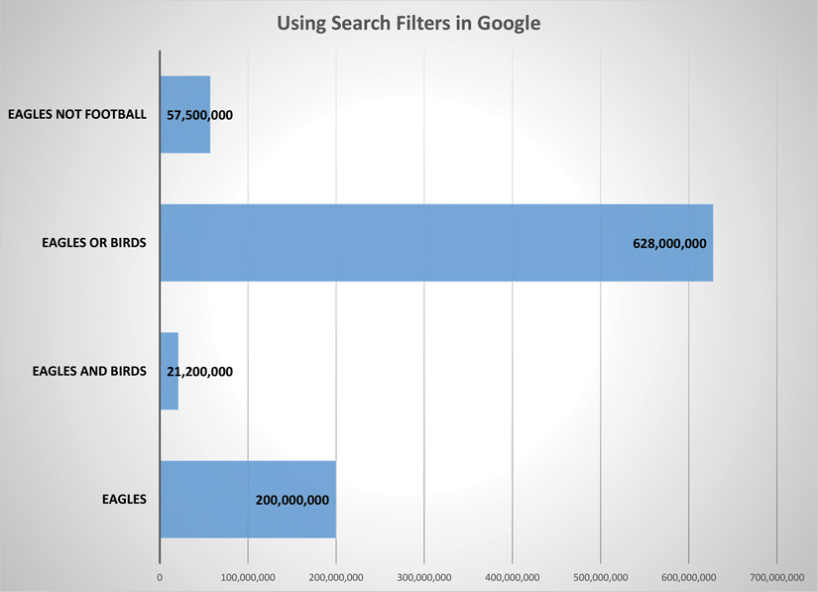
Searching the Web
Boolean operators define a relationship between words
AND - both
OR - either
NOT - none
Notes:
Boolean operators define a relationship between words or groups of words and are used to create a search filter. There are three Boolean operators: AND, OR, and NOT.

Slide 23
Discuss How to Evaluate the Credibility of Information Found on the Web
Notes:
Objective 5 discusses how to evaluate the credibility of information found on the web.

Slide 24
Would I Lie to You? – Who Wrote It? (1 of 3)
User-generated content
Content written by everyday users
Blogs
Websites
Wikis
Social media sites
It is important to know Blogs:
What is credible
How to evaluate the information you find
Notes:
The Internet is full of user-generated content; this is content written by everyday users. Blogs, websites, wikis, and social media sites are all examples of user-generated content. It is important to know what is credible and how to evaluate the information you find.

Slide 25
Would I Lie to You? – Who Wrote It? (2 of 3)
Check for credibility:
Look at the URL
TLD—.edu, .gov, or .com
Read the home page and the About Us page
Conflicts of interest or obvious biases
Contact information
Stick with well-known sources for important information
Use Google Scholar for scholarly research
Notes:
When finding information on the web, it is important to not believe everything you read. There are many things to consider. Start by checking the URL and also read the home page and the About Us page to determine whether there are conflicts of interest or an obvious bias. Stick with well-known sources for important information, such as WebMD and the American Cancer Society websites for health-related information and Google Scholar for scholarly research.

Slide 26
Would I Lie to You? – Who Wrote It? (3 of 3)
Check for credibility:
How up-to-date is the website?
Usually found at the bottom of the home page
Look at the design of the website
Sophisticated
Lacks grammar and spelling errors
Does the information match other sites?
Notes:
When assessing whether a website is credible, you might consider how up-to-date it is, how sophisticated its design is, and whether it has good grammar and spelling.

Slide 27
Would I Lie to You? – What about the Design?
Sophistication
Grammar
Spelling
Notes:
Look at the design of the site, including its sophistication, grammar, and spelling. What impression do you get from the site? Don’t be fooled: A well-designed and well-executed site can still have bad information, and a poorly designed site might have really good information.

