Slide 1
Multithreaded Programming
Processes vs. Threads
Process states and state transitions
Hazards and Semaphores

Slide 2
What is a process? (Operating Systems)
In computing, a process is an instance of a computer program that is being executed. It contains the program code and its current activity.
A computer program is a passive collection of instructions
A process is the actual execution of those instructions. Several processes may be associated with the same program.
Note: opening up several instances of the same program often means more than one process is being executed.

Slide 3
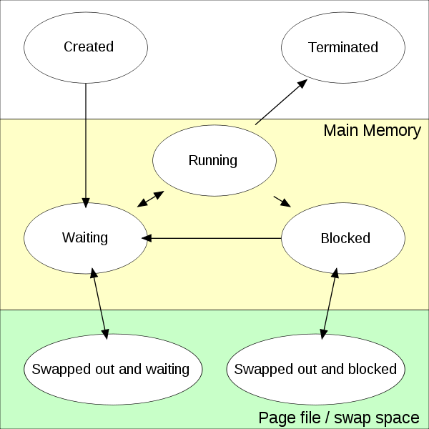
Process States

Slide 4
Question
Suppose you are writing software to run a clock.
Your have a method/function void addOneSecond() that adds one second to the current time of day.
You have a method/function void setTime(h,m) that sets the time of day.
You want to be able to run addOneSecond() forever and occasionally run setTime()
How can you do this?

Slide 5
Possible solution in pseudo code
while (1)
{
addOneSecond();
sleep(1 second);
}
setTime(3,20);
Issue: setTime will never run

Slide 6
Possible solution in pseudo code
setTime(3,20);
while (1)
{
addOneSecond();
sleep(1 second);
}
Issue: setTime will never run a second time

Slide 7
Process Control Blocks (PCBs)

Slide 8
PCBs with Threads Added

Slide 9
Threads are not Processes
Threads differ from traditional multitasking operating system processes in that:
Processes are typically mean time, while threads exist as subsets of a process
Processes carry considerably more state information than threads, whereas multiple threads within a process share process state as well as memory and other resources
Processes have separate address spaces, whereas threads share their address space
Processes interact only through system-provided inter-process communication mechanisms

Slide 10
Multithreaded Solution to clock issue
runClockThread
{
while (1)
{
addOneSecond();
sleep( 1 second);
}
}
setClockThread
{
while (1)
{
setClock(h,m);
}
}
start runClockThread;
start setClockThread;

Slide 11
Critical Section Issue
Consider a multi-threaded program where 1 thread adds 5% interest to your checking and savings account and another thread transfers $100 from savings to checking.
You start off with $100 in each account. What are the final balances when the 2 threads are done?
A) $0 in savings and $210 in checking
B) $5 in savings and $205 in checking
C) $0 in savings and $205 in checking
D) all of the above are possible

Slide 12
Consider the following
Transfer Thread Interest Thread
savings = savings – 100
savings = savings * 1.05
checking = checking * 1.05
checking = checking + 100

Slide 13
Semaphores
In computer science, a semaphore is a variable or abstract data type that provides a simple but useful abstraction for controlling access by multiple processes to a common resource in a parallel programming environment.
Concept implemented by Dijkstra 1965

Slide 14
Atomic operations on Semaphores
P(s)
{
if (s = 1) { s = 0; }
else { move process/thread onto the end of s-queue }
}
V(s)
{
if (s-queue is not empty) { move head back to ready }
else { s = 1; }
}

Slide 15
Solution to the missing interest problem
CreateSemaphore(x)
InterestThread
P(x)
savings = savings * 1.05
checking = checking * 1.05
V(x)
TransferThread
P(x)
savings = savings - 100
checking = checking + 100
V(x)

Slide 16
Consider the following
Transfer Thread Interest Thread
P(x)
savings = savings – 100
P(x)
checking = checking + 100
V(x)
savings = savings * 1.05
checking = checking * 1.05
V(x)

Slide 17
When P(x) finds the resource in use

Slide 18
Example) 2 threads free for all
Thread 1
{
while(1)
{ print “thread 1”; }
}
Thread 2
{
while(1)
{ print “thread 2”; }
}
Run thread1;
Run thread2;

Slide 19
Example) 1 producer and 2 consumers
a = 1;
b = 0;
c = 0
ProducerThread
{
P(a);
// produce 1
V(b);
P(a);
// produce 2
V(c);
}
Consumer1Thread
{
P(b)
// consume 1
V(a)
}
Consumer2Thread
{
P(c)
// consume 2
V(a)
}

Slide 20
Condition Variables
The value of a variable will determine if your thread can proceed or must wait.
Ex) cashier1thread always runs and cashier2thread only runs if the condition (customerCount > 5) if true.
This variable (i.e. customerCount) is referred to as a condition variable.
You need obtain a mutex to access a condition variable.
Based on that variables current value, your thread should continue or wait.

Slide 21
Condition Variables
Question: You access the mutex for the condition variable, based on it’s value you determine you should wait…how do you release the mutex and make yourself wait?
P(cc)
if (customerCount < 5)
{
P(c5);
}
V(cc)
// Handle customers
P(cc)
if (customerCount < 5)
{
V(cc);
P(c5);
}
// Handle Customers
P(cc)
if (customerCount < 5)
{
CP(cc,c5);
}
V(cc)
// Handle customers

