Slide 1
Queueing theory
Applications
Examples applied to Operating Systems

Slide 2
Distributions for CPU $λ and μ$times
An operating system like LINUX may use 100 milliseconds as a time slice for a process on the processor.
#define RR_TIMESLICE (100 * HZ / 1000)
- Are the service time perfectly Deterministic?
- Does every process gets exactly 100 milliseconds?
- Could they get less time?
- Could then get more time?
- Is the time distribution totally random (Markovian)?
- The service time is modeled as a hybrid (Deterministic and Uniform)
CPU modeled as an M/Hybrid(M & U)/1$∞$/$∞$/Priority queue

Slide 3
Distributions for Disk Drive $λ and μ$times
The disk drive gets requests from the Processor when a process executes an instruction where data from the disk is requested
page faults,
open/close data files,
etc.
The service time of a disk request is based on:
- Size of data requested (small file, large file, 1 data page, x bytes.)
Layout of files on disk (sequential, indexed, linked)
- read or write
Disk queueing discipline algorithms generally do not follow FCFS (instead SSTF - Shortest Seek Time First)
Modeled as an M/M/c/$∞$/$∞$/SSTF

Slide 4
Distributions for Semaphore $λ and μ$times
The semaphore queues gets arrivals when a process issues P(S) and the resource is not available.
The service time of a disk request is based on how long the process takes until it issues V(S)
Modeled as an M/M/1 queue

Slide 5
Turnaround time
During the life of a process, the process
visits the P queue 10 times taking 0.1 second each
visits the D queue 2 time taking 1 second each
visits the S queue 1 time taking 0.5 second
What is it’s turnaround time (how long from start to finish)?
T = (10 * 0.1 sec) + (2 * 1 sec) + (1 * 0.5 sec) = 1+2+0.5=3.5 seconds
D
P
S

Slide 6

Expected visits to networked queues
$E_{P}\left[v\right]=1+(0.9)E_{P}\left[v\right]$ ➔ $E_{P}[v]$ = 10
$E_{D}[v]=\left(0.2\right)E_{P}\left[v\right]$ ➔ $E_{D}[v]=2$
$E_{s}[v]=\left(0.1\right)E_{P}\left[v\right]$ ➔ $E_{s}[v]=1$
D
0.2
0.6
P
0.1
0.1
S

Slide 7

$λ$ for networked queues
$λ_{P}$= ${λE}_{P}[v]$ = 10/sec
${λ_{D}=\left(0.2\right)λ}_{p}$ ➔ (0.2)(10/sec) $=$ 2/sec
${λ_{S}=\left(0.1\right)λ}_{p}$ ➔(0.1)(10/sec)$=$ 1/sec
D
0.2
0.6
$$λ=1/sec$$
P
0.1
0.1
S

Slide 8

$ρ$ and Expected # for M/M/1 Queues
$ρ_{p}= \frac{λ_{p}}{μ_{p}}= \frac{10/sec}{20/sec}=\frac{1}{2}$ ➔ $E_{p}[\#]=\frac{ρ_{p}}{{1−ρ}_{p}}= \frac{1/2}{1 − 1/2}=1$
$ρ_{d}= \frac{λ_{d}}{μ_{d}}= \frac{2/sec}{3/sec} =\frac{2}{3}$ ➔ $E_{d}[\#]=\frac{ρ_{d}}{{1−ρ}_{d}}= \frac{2/3}{1 −2/3}=2$
$ρ_{s}= \frac{λ_{s}}{μ_{s}}= \frac{1/sec}{3/sec} =\frac{1}{3}$ ➔ $E_{s}[\#]=\frac{ρ_{s}}{{1−ρ}_{s}}= \frac{1/3}{1 − 1/3}=0.5$
D
0.2
$μ_{d}$=3/sec
0.6
$$λ=1/sec$$
P
$μ_{p}$=20/sec
0.1
0.1
S
$μ_{s}$=3/sec

Slide 9
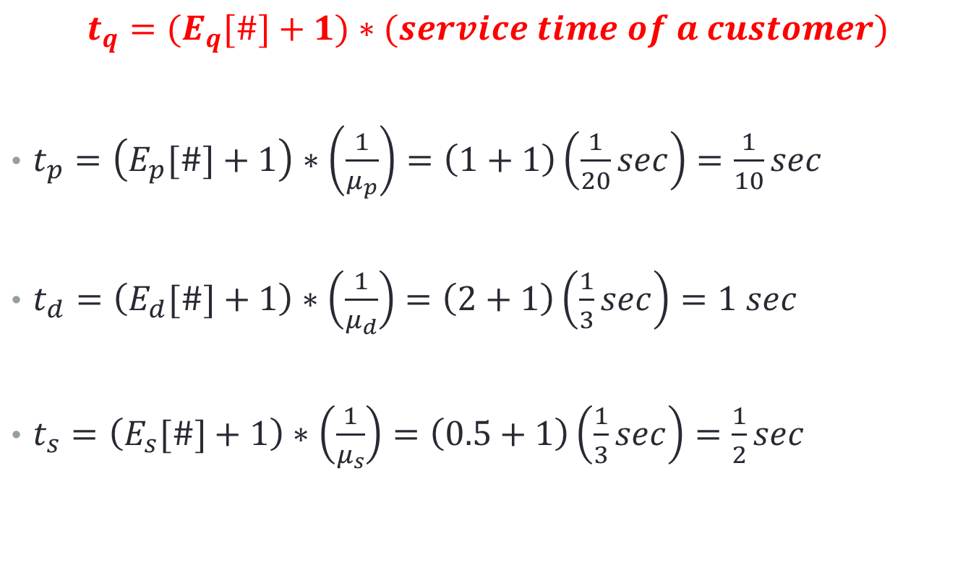
Time per visit to each queue
$$t_{q}=(E_{q}[\#]+1)∗(service time of a customer)$$
$t_{p}=\left(E_{p}[\#]+1\right)∗\left(\frac{1}{μ_{p}}\right)=\left(1+1\right)\left(\frac{1}{20}sec\right)=\frac{1}{10}sec$
$t_{d}=\left(E_{d}[\#]+1\right)∗\left(\frac{1}{μ_{d}}\right)=\left(2+1\right)\left(\frac{1}{3}sec\right)=1 sec$
$t_{s}=\left(E_{s}[\#]+1\right)∗\left(\frac{1}{μ_{s}}\right)=\left(0.5+1\right)\left(\frac{1}{3}sec\right)=\frac{1}{2}sec$

Slide 10

Expected Total time in entire system
$$E[T]= \sum_{q=0}^{all queues}{{(E}_{q}[v]∗t_{q})}$$
$$={(E}_{p}[v]∗t_{p})+{(E}_{d}[v]∗t_{d})+{(E}_{s}[v]∗t_{s})$$
$$=(10∗\frac{1}{10}sec)+(2∗1 sec)+(1∗\frac{1}{2}sec)$$
$$=1\sec{+ }2sec+\frac{1}{2}sec$$
$$=3.5 sec$$

Slide 11

Bottleneck - queue with largest $ρ$
$$λ=\frac{1}{sec} gives ρ_{p}=\frac{10}{20},ρ_{d}=\frac{2}{3},ρ_{s}=\frac{1}{3}$$
$$λ=\frac{2}{sec} gives ρ_{p}=\frac{20}{20}and ρ_{d}=\frac{4}{3} and ρ_{s}=\frac{2}{3}$$
D
0.2
$ρ_{d}$=2/3
0.6
$$λ=1/sec$$
P
$ρ_{p}$=1/2
0.1
0.1
S
$ρ_{s}$=1/3

Slide 12

Saturated System - Bottleneck $ρ=100\%$
$$λ=\frac{1.5}{sec} gives ρ_{p}=\frac{15}{20},ρ_{d}=\frac{3}{3},ρ_{s}=\frac{1.5}{3}$$
D
0.2
$ρ_{d}$=100%
0.6
$$λ=1.5/sec$$
P
$ρ_{p}$=75%
0.1
0.1
S
$ρ_{s}$=50%

