Slide 1
HTML with client and server Programming
HTML
Server Side programming (php)
Client Side programming (JavaScript)

Slide 2
index.html file on the server
<html>
<head>
// head related stuff
</head>
<body>
<h1> Welcome to my web page </h1>
<p> Glad you could be here. </p>
</body>
</html>
Welcome to my web page
Glad you could be here.

Slide 3
History of HTML, JavaScript, php
1991 HTML (Hyper Text Markup Language)
Stored in files on the server and requested by a client.
1995 JavaScript
Script code embedded into the .html files, sent to client
Scripts run on the client machine (PC, smart phone, tablet)
1995 php (Personal Home Page)
Script code embedded into .html (now called .php) files
Scripts run on the server, only results are sent to the client.

Slide 4
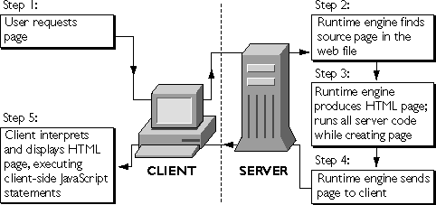
Server and Client Programming

Slide 5
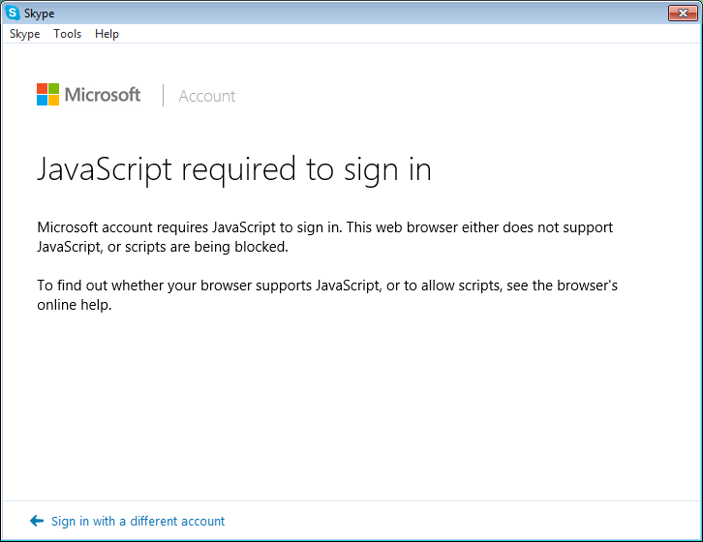
Phone/PC doesn’t have JavaScript

Slide 6
index.html - dynamic data?
<html>
<body>
<h1> Welcome to my web page </h1>
<p> Today is Wednesday</p>
</body>
</html>
Note: Between 1991 and 1995 this could not be done because html has no programming
Welcome to my web page
Today is Wednesday

Slide 7
index.php with php code on server
<html>
<body>
<h1> Welcome to my web page </h1>
<p> Today is
<?php
$dayOfWeek = date(‘l’);
echo($dayOfWeek);
?>
</p>
</body>
</html>

Slide 8
index.php that the client receives
<html>
<body>
<h1> Welcome to my web page </h1>
<p> Today is
Wednesday
</p>
</body>
</html>
Welcome to my web page
Today is Wednesday

Slide 9
index.html with JavaScript on server
<html>
<body>
<h1> Welcome to my web page </h1>
<p> Today is
<script>
var d = new Date(); // get all date information
var n = d.getDay(); // get day number 0=Sunday 1=Monday etc.
var weekdays = new Array("Sunday", "Monday","Tuesday", "Wednesday", "Thursday", "Friday", "Saturday");
document.write(weekdays(n));
</script>
</p>
</body>
</html>

Slide 10
Client receives (same exact file)
<html>
<body>
<h1> Welcome to my web page </h1>
<p> Today is
<script>
var d = new Date(); // get all date information
var n = d.getDay(); // get day number 0=Sunday 1=Monday etc.
var weekdays = new Array("Sunday", "Monday","Tuesday", "Wednesday", "Thursday", "Friday", "Saturday");
document.write(weekdays(n));
</script>
</p>
</body>
</html>
Welcome to my web page
Today is Thursday

Slide 11
Important Note: The day of week depends on the client or server.
For example, if you are in New Jersey and you are logged into a server in Californiaa, and you load the web page at 1:30am ET Thursday morning,
If the line Today is XXXXday was calculated in a server side programming language like PHP, it would say “Wednesday” because the server is in a location where it is Wednesday.
But if it was done by a client side program, like JavaScript, then the web page would say Thursday, because the Client is in a location where it is Thursday.

Slide 12
When to use client vs. server
Since the server can be very busy serving millions of clients, the motivation to do as much programming as possible on the client exists.
Also, if the client can do programming without out the server, then there will be less traffic in and out of the server.

Slide 13
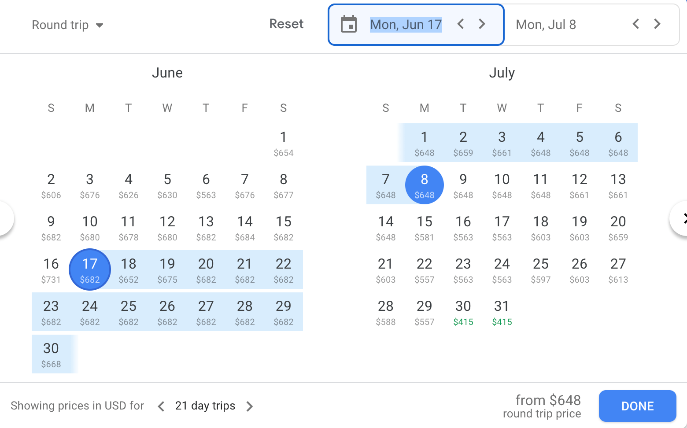
Booking a flight

Slide 14
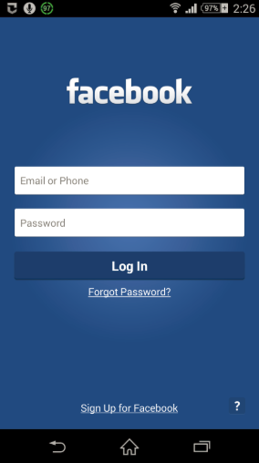
Logging in a client
Client enters and email and password…a check needs to be done to validate the user.
Code must login to the server database, get the users password, check that the password entered matches the one in data base and if so, allow the user in.

Slide 15
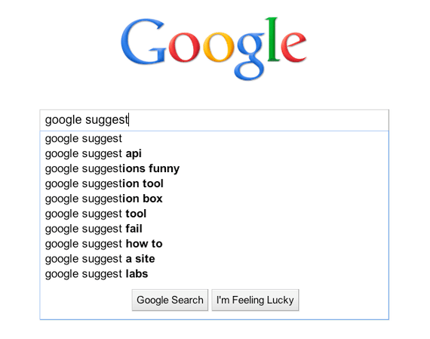
Google Suggestions

