Slide 1
Cheating
Impact on the you, students and the University
Cheating on tests
Cheating on projects/HWs

Slide 2
Suppose there is a class of 5 students
Student A – 93 average deserves A
Student B – 84 average deserves B
Student C – 75 average deserves C
Student F1 – 29 average deserves F
Student F2 – 14 average deserves F
If the professor grades correctly, the student will get the grade they deserve.
For simplicity there are no +/- grades just A,B,C, and F

Slide 3
Suppose there is a class of 5 students
Student A – 93 average deserves A
Student B – 85 average deserves B
Student C – 77 average deserves C
Student F1 – 99 average deserves A
Student F2 – 96 average deserves A
If the professor grades correctly, the student will get the grade they deserve.
For simplicity there are no +/- grades just A,B,C, and F

Slide 4
Suppose there is a class of 5 students
Student A – 93 average deserves A → B
Student B – 85 average deserves B → C
Student C – 77 average deserves C → F
Student F1 – 99 average deserves A
Student F2 – 96 average deserves A
Suppose the Department Chair, Dean, Provost wants professors to grade on a curve so no professor grades too high or too low.
For simplicity there are no +/- grades just A,B,C, and F

Slide 5
Suppose Students F1 and F2 cheated
Student A – 93 average deserves A → B
Student B – 85 average deserves B → C
Student C – 77 average deserves C → F
Student F1 – 99 average deserves F → A
Student F2 – 96 average deserves F → A
Suppose student F1 and F2 cheated. Deserve F’s but their grades show A and the teacher curves the course grades.
For simplicity there are no +/- grades just A,B,C, and F

Slide 6
Suppose this is in an MS-STEM degree
Suppose this is happening in an MS program.
10 courses and this is happening in most courses.
When companies interview students, they want the students with the higher degrees and GPAs.
If they interview the 4.0 GPA graduate students, and they get idiots the will develop the impression that this university is very bad.
They will not be interested in the students with 3.0 GPA undergrads (the ones who deserve a 4.0) because they believe they are far worse the idiots.

Slide 7
Job interviews in Computer Science
When interviewing for a job in Computer Science (and many other technical fields too) the interviewing company (Google, Facebook, IBM, Bell Labs, Apple, startups etc. ) will test applicants for their knowledge.
All applicants are tested and tests usually take over 5 hours.
Many companies give applicants a quick test and if the applicant does poorly, (s)he are asked to leave saving the company the unnecessary time to conduct the remaining tests.
All companies record the applicants results and universities.

Slide 8
Suppose Students F1 and F2 cheated
Student A - 93 average deserves A → B
Student B - 85 average deserves B → C
Student C - 77 average deserves C → F
Student F1 – 99 average deserves F → A
Student F2 – 96 average deserves F → A
Students F1 and F2 will not be able to get a reasonable job and students A,B and C may not be considered because of F1 and F2.
All Students will recommend friends to not to come to this university.
Everybody loses.
Winners are the students and universities where this doesn’t happen.

Slide 9
Cheating during tests

Slide 10
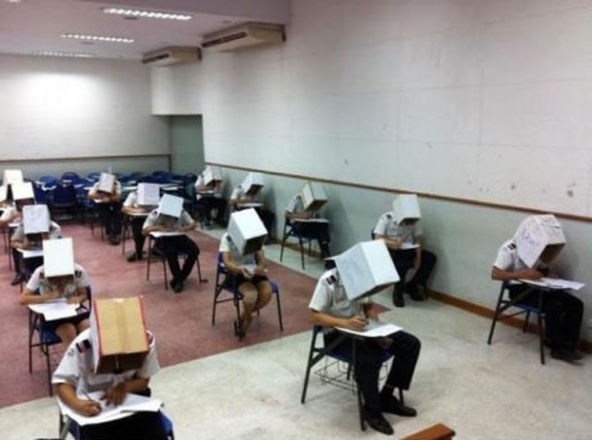
Solution – Put a box on students heads

Slide 11
Cheating during a test
Student walk up to professors during the exam and ask questions about the exam.
What does this mean?
Is this answer correct?
This distracts the professor and then other students can discuss answers, pass answers around on paper, take cell phone pictures of the tests and send the test to friends (anywhere in the world) to do the test and quickly email the answers back.
Students go to the bathroom during the tests and discuss the exams in the bathroom.

Slide 12
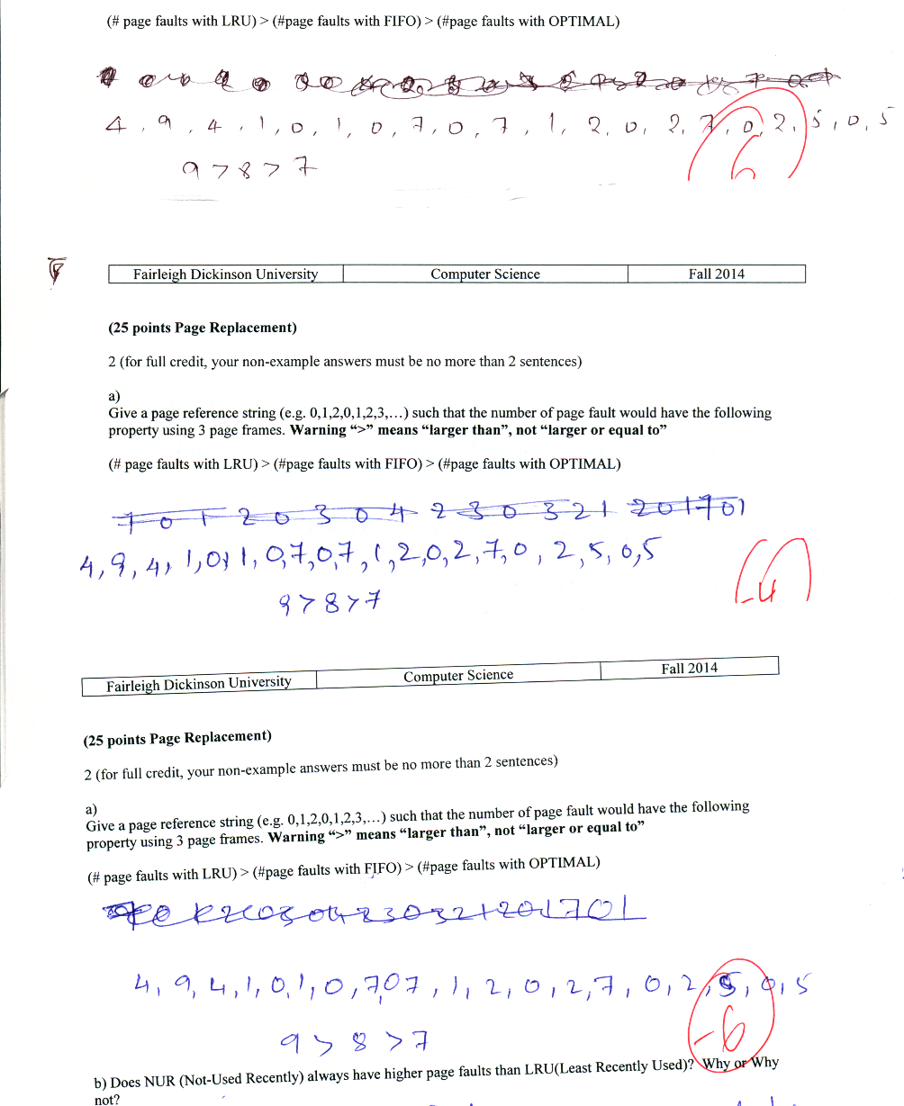
True story
Students answered a question with the same exact wrong answer, then crossed off that wrong answer, and gave the same exact new answer, which was also wrong.
28 out of 32 students did this

Slide 13
Cheating during a test - Solutions
Tell students that they are not allowed to ask questions about the test during the test.
Don’t allow students to go to the bathroom during an test. If a student goes to the bathroom, their test is over.

Slide 14
Cheating prior to a test.
If a professor gives exams over and over semester after semester (or year after year), students can
Makes copies of the exam.
Have an expert answer the exam as best as possible and post the answered exam on the internet for all who need it.
Post the previous exams on the internet with questions answered correctly for future students to have.

Slide 15
Cheating prior to a test - Solutions
The professor can make brand new exams every semester.
This could cause a big gap in the level of difficulty of exams
Certifications boards (ABET) like to see progress each semester.
Professor has a policy that students can not keep the exam (they can only look at the grades exam)
the students can easily take pictures of the exam and in the worst case, a pool students remembering the questions can reconstruct the exam shortly after it is given.

Slide 16
Value of cheating on a test
Prior to the internet, email, text messages etc. cheating on a test could be the difference between getting a B vs. B+ and would have little to no impact on the class curve.
Now it is the difference between getting an A vs. F and a dramatic impact on the class curve.

Slide 17
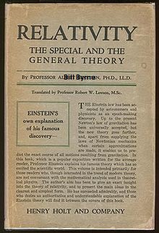
Cheating on Assignments (HW).
If a professor assigns the same assignment each semester (or every other semester), Student who do the assignment and get a good grade can post it on the internet. Other students can download and change the student name to their name.

Slide 18
Cheating on Projects.
If a professor assigns the same project(s) each semester (or every other semester), Student who solved the project can post the solution on the internet for future students do download and put their name on it.
Before the internet (which includes email) this was not possible. Students had to print off the projects on paper and copy the programs in line for line which almost defeats the gains from cheating.
Note: some universities require all sections of a course have identical assignments.

Slide 19
Assignments/Projects Solutions
Professor can interview each student individually about how they did the project? Why they did what they did? Etc.
This takes up far too much class time (reduces learning time)
The first student gets zonked but can relay the questions to the actual person who did the project and they can answer then and pass the answers to the remaining students. (the first student takes a bullet for the team).
Professor can ask questions on the next exam that only students who actually did the project could answer.
Same issues exist about repeated projects/tests each semester.

Slide 20
Solution to cheating
Professor can
Give unique assignments to all students over all semesters.
Give unique tests to all students over all semesters.
If a midterm exam has 10 questions, 25 students per class over 6 semesters, then the professor would have to create 10*25*6=1500 questions/answer keys instead of 10.
Issues
Variance in difficulty of exams and projects.
Certification boards don’t like this approach.

Slide 21
2012 Harvard Cheating Scandal
Grader notices similarities in students answers to take home exam questions.
Students were asked who they worked with? If student A said he worked independently and student B said he work with student A (and Student A and student B handed in similar work), B would be believed and therefore A is lying.
If the grader didn’t mentally notice the similarity in the student papers, this would not have been an issue. Also there many have been other pairs (or sets) of students cheating on this exam but it went unnoticed.

Slide 22
Giving tests in online courses
Online courses means the students don’t come in for a proctored exam.
Proctoring can be done by getting each student to find a proctor:
- local librarian (who is honest)
- a coworker (who is honest)
Not all proctors can proctor the exams at the same time.
If one proctor is dishonest and gives the student the exam early, that student can pass the exam around to a subset of other students and they all work on the exam together.

