Slide 1
Minimum Spanning Tree
Spanning Trees
Kruskel’s Algorithm
Prim’s Algorithm

Slide 2
A Tree
Graph G=(V,E)
There is 1 component
There are no cycles

Slide 3
Spanning Tree of a Graph
A Spanning tree of a graph G=(V,E) is a graph ST=(V,E’) where all vertices in G are also in ST and a subset of E, we will call E’ such that every vertex in G (and there ST) are connected.
G=(V,E) ST=(V,E’)

Slide 4
G may have many spanning trees
This graph has 4 spanning trees

Slide 5
Minimum Spanning Tree of a Graph
MST=(V,E’) of G=(V,E) is a spanning tree of G such that no other spanning tree is has a smaller total weight
has
and

Slide 6
Find a Spanning Tree of G
Algorithms for finding a spanning tree
Run BFS(G) and leave out back edges
Run DFS(G) and leave out back edges

Slide 7
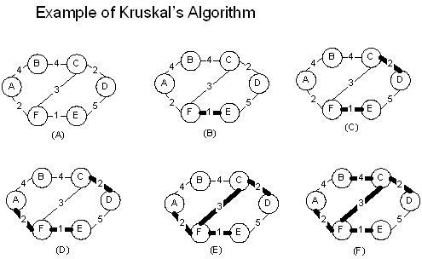
Find a Minimum Spanning Tree of G

Slide 8
Kruskel’s Algorithm
Kruskels(G)
for each vertex v ∈ V[G]
Makeset(v)
Sort edges E by increasing weight w
for each edge(u,v) ∈ E in order
if findset(u) ≠ findset(v)
A ← A ∪ { (u,v) }
Union(u,v)

Slide 9
Heap used for sets (cycles)

Slide 10
Running Time of Kruskel’s Algo
Step 1 runs O( |V| )
Step 2 runs O( |E| lg |E|) using lets say quicksort
Step 3 runs O(|E| lg |E|) if you choose to represent the sets using heaps.

Slide 11
Correctness of Kruskel’s Algo
Inductive hypothesis is that T is always a subset of an MST. Since it eventually contains an entire spanning tree, the final result is a minimum spanning tree.
For the base case, initially, T is empty, and therefore a subset of an MST. Now, consider the processing of an edge (u,v). If u and v are already connected in T, then it can't be part of any MST that contains T, and we toss it out.
Let's say u and v are not connected. Consider the cut with all the nodes connected to u by T on one side and all other nodes on the other side. This is a cut that doesn't intersect T.
By the greedy-grow lemma, the smallest edge across the cut can be added to T maintaining the property that T is contained in an MST.
Claim: (u,v) is the minimum weight edge in the cut. Why?
Therefore, (u,v) can be added to T en route to an MST.

Slide 12
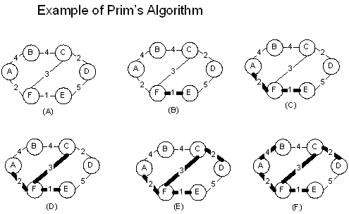
Prim’s Algo for MST

Slide 13
Prim’s Algorithm
Prim (G, w, r)
Q ← V[G]
For each u ∈ Q
Key[u] ← ∞
Key[r] ← nil
π[r] ← nil
while (Q ≠ 0)
u ← extract-min(Q)
for each v ∈ adj[u]
if ( (v ∈ Q) and (w(u,v) <key[v]) )
π[v] ← u
key[v] ← w(u,v)

Slide 14
Running time of Prim’s Algo
Line 2 takes O( |V| )
Lines 3 and 4 take O( |V| )
Extract-min operates as a priority queue(binary heap). Total number of times the for loop in line 9 is executed is 2E which is O( |E| ). Keep a bit for each v ∈ V that tells if it is in Q, so the test runs O(1). Extract-min runs O(lg V) and the loop is executed V times. So Extract-min is O(V lg V). The assignment in line 12 implicitly does a decrease key operation which is implemented in a binary heap in O(lg V).
The over all running time of Prims algorithm is O( V lg V + E ln V). If the graph is fully connected, then V ≤ E –1 so we may say O( E ln V)

