Slide 1
Amortized Analysis
Definition
Examples
Potential Method

Slide 2
Opening a Duncan Donuts
Franchise cost $1,000,000
Cost per donut $1
Question) How much does it cost to make a Duncan Donut?
Answer) The first one costs $1,000,001 and the rest cost $1
If we want to make $1 profit per donut we can sell the first one for $1,000,002 and each donut after that sale goes for $2

Slide 3
Opening a Duncan Donuts
Franchise cost $1,000,000
Cost per donut $1
Question) How much does it cost to make a Duncan Donut?
Answer) Assume we are going to sell 1M Donuts and we scatter the cost of the Franchise over the 1 Million donuts, then the cost per donut would be $2 each.
If we want to make $1 profit per donut, we can sell them for $3.

Slide 4
Amortization
1. The gradual elimination of a liability, such as a mortgage, in regular payments over a specified period of time. Such payments must be sufficient to cover both principal and interest.
2. Writing off an intangible asset investment over the projected life of the assets.

Slide 5
Example: Binary Counter
Binary number Cost to increment
0000 1
0001 2
0010 1
0011 3
0100 1
0101 2
0110 1
0111 4
1000 1 1001 2
If there are k=4 bits needed to represent a number.
What is the cost (number of bits flipped) of increment a number?
What would be the cost of increment number numbers?
O(n k)?

Slide 6
Example: Binary Counter
Binary number Cost to increment
0000 1
0001 2
0010 1
0011 3
0100 1
0101 2
0110 1
0111 4
1000 1 1001 2
Notice that when we increment an even number, we just turn the lower order bit from 0 to 1 and we are finished.
Notice the when we increment an odd number, change all lower order 1’s to zero until we get to the first 0, and we change that to a 1

Slide 7
Take NJ transit to NYC
Cost is $10 to go up to NYC
Cost is $10 to come back from NYC
Total cost is $20
What is we bought a round trip ticket for $20
It would be $20 to go up to NYC and free to come back (because we pre-paid for the ride home) so the Total cost is $20

Slide 8
Example: Binary Counter (Round-trip)
Binary number Cost to increment
0000 2
0001 2
0010 2
0011 2
0100 2
0101 2
0110 2
0111 2
1000 2 1001 2
Suppose we considered changing a bit from 0 to 1 (going up) and changing the bit from 1 to zero going down.
Now suppose that when we go up, we buy a round trip ticket, that is pay a cost of 2 instead of 1 and then the return trip is free.
2n = O(n)

Slide 9

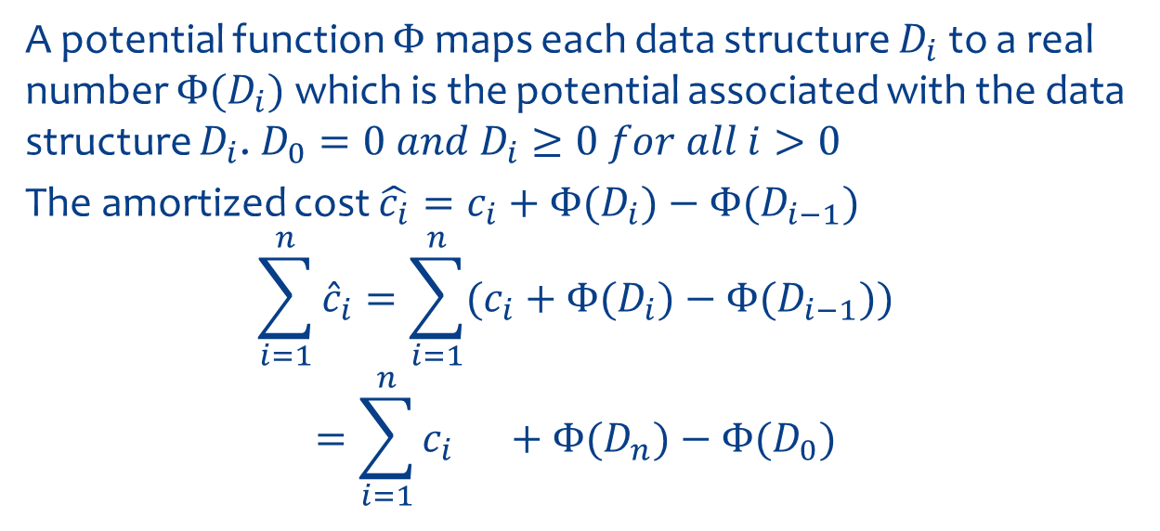
Potential Function $Φ$
A potential function $Φ$ maps each data structure $D_{i}$ to a real number $Φ{(D}_{i})$ which is the potential associated with the data structure $D_{i}$. $D_{0}=0 and D_{i}≥0 for all i>0$
The amortized cost $\hat{c_{i}}=c_{i}+Φ{(D}_{i})−Φ{(D}_{i−1})$
$$\sum_{i=1}^{n}{{\hat{c}}_{i}}=\sum_{i=1}^{n}{(c_{i}}+Φ{(D}_{i})−Φ{(D}_{i−1}))$$
$$=\sum_{i=1}^{n}{c_{i}} +Φ{(D}_{n})−Φ{(D}_{0})$$

Slide 10

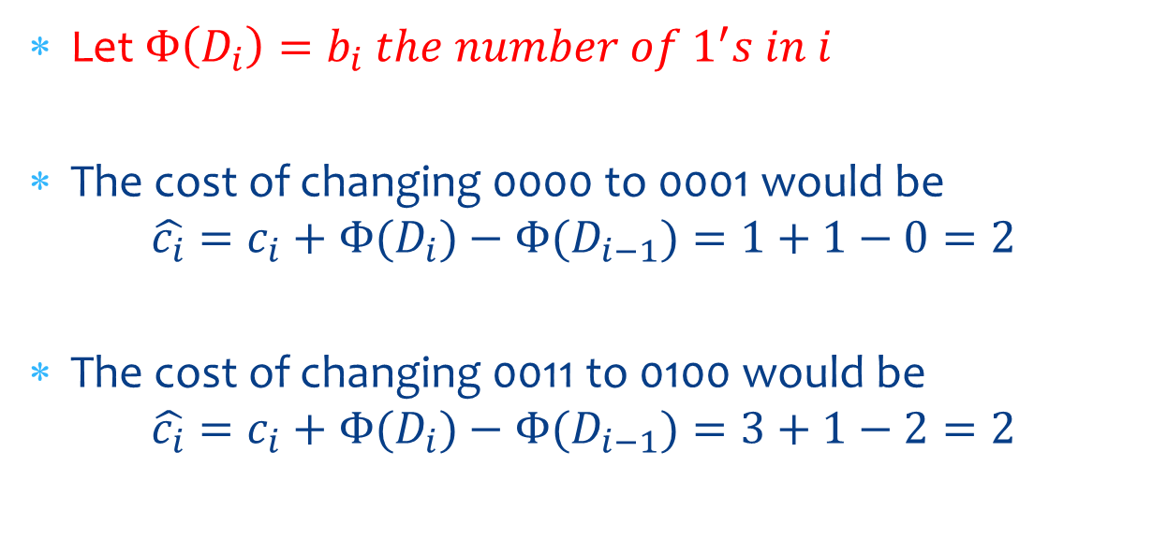
Binary Counter with$Φ$
Let $Φ\left(D_{i}\right)=b_{i} the number of 1^{′}s in i$
The cost of changing 0000 to 0001 would be
$$\hat{c_{i}}=c_{i}+Φ{(D}_{i})−Φ{(D}_{i−1})=1+1−0=2$$
The cost of changing 0011 to 0100 would be
$$\hat{c_{i}}=c_{i}+Φ{(D}_{i})−Φ{(D}_{i−1})=3+1−2=2$$

