Slide 1
Big Oh, Theta, Omega
Efficiency of an Algorithm

Slide 2
Recall Insertion Sort Algorithm
void INSERTION-SORT(int A[ ])
{
for (int j = 1, j < length(A), j++) // cost = c1 number of times = n
{
key = A[j]; // cost = c2 number of times = n-1
/* insert A[j] into a[1..j-1] */ // cost = c3 number of times = n-1
i = j-1; // cost = c4 number of times = n-1
while (i > 0 && A[i] > key) // cost = c5 number of times = (n-1)t
{
A[i+1] = A[i]; // cost = c6 number of times = (n-1)t
i = i –1; // cost = c7 number of times = (n-1)t
}
A[i+1] = key; // cost = c8 number of times = n-1
}
}

Slide 3
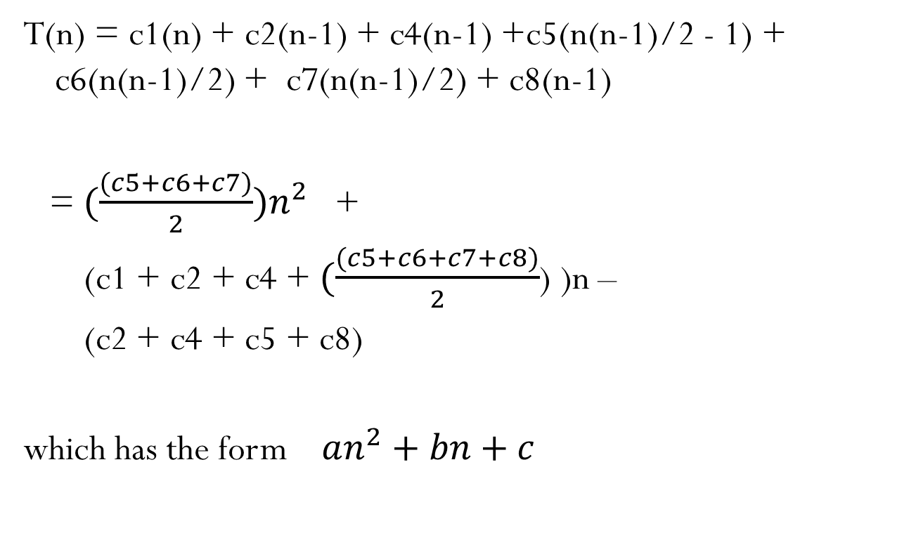
Worst Case: reverse order
T(n) = c1(n) + c2(n-1) + c4(n-1) +c5(n(n-1)/2 - 1) + c6(n(n-1)/2) + c7(n(n-1)/2) + c8(n-1)
= ${(\frac{(c5+c6+c7)}{2})n}^{2}$ +
(c1 + c2 + c4 + $(\frac{(c5+c6+c7+c8)}{2}$) )n –
(c2 + c4 + c5 + c8)
which has the form $an^{2}+bn+c$

Slide 4

Analysis as n gets large
$an^{2}+bn+c$ $an^{2}+ bn +c$
a = | 15 nanoseconds = | 0.000015
b = | 35 nanoseconds = | 0.000035
c = | 25 nanoseconds = | 0.000025
n | Time | Time | Time | Total time | % of time | % of time | % of time
1 | 0.000015 | 0.000035 | 0.000025 | 0.000075 | 20.00% | 46.67% | 33.33%
10 | 0.0015 | 0.00035 | 0.000025 | 0.001875 | 80.00% | 18.67% | 1.33%
100 | 0.15 | 0.0035 | 0.000025 | 0.153525 | 97.70% | 2.28% | 0.02%
1000 | 15 | 0.035 | 0.000025 | 15.035025 | 99.77% | 0.23% | 0.00%

Slide 5
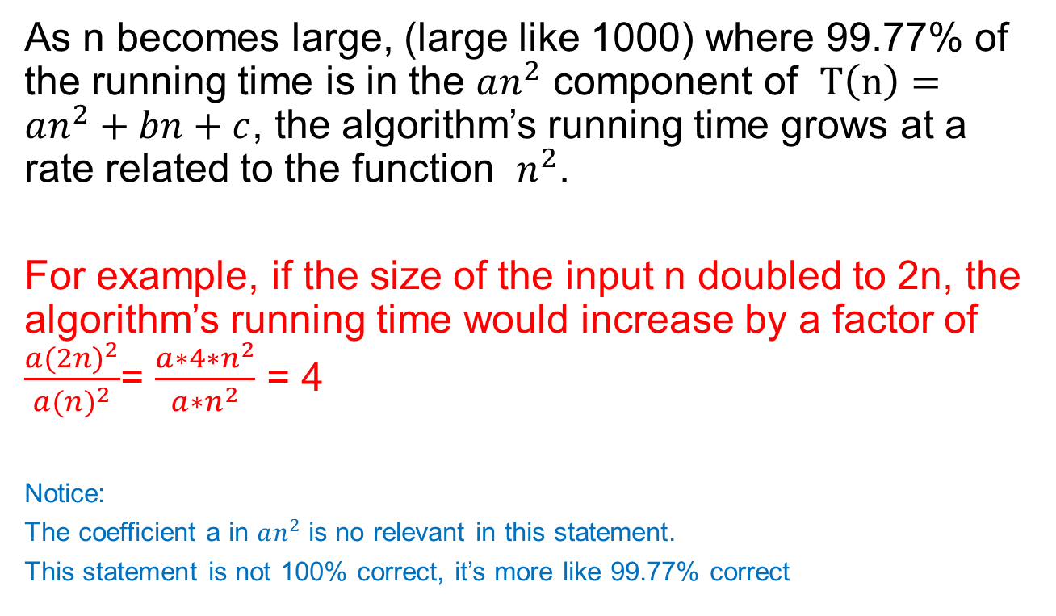
Statement about the algorithm
As n becomes large, (large like 1000) where 99.77% of the running time is in the $an^{2}$ component of $T\left(n\right)=an^{2}+bn+c$, the algorithm’s running time grows at a rate related to the function $n^{2}$.
For example, if the size of the input n doubled to 2n, the algorithm’s running time would increase by a factor of $\frac{a{(2n)}^{2}}{a{(n)}^{2}}$= $\frac{a∗4∗n^{2}}{a∗n^{2}}$ = 4
Notice:
The coefficient a in $an^{2}$ is no relevant in this statement.
This statement is not 100% correct, it’s more like 99.77% correct

Slide 6
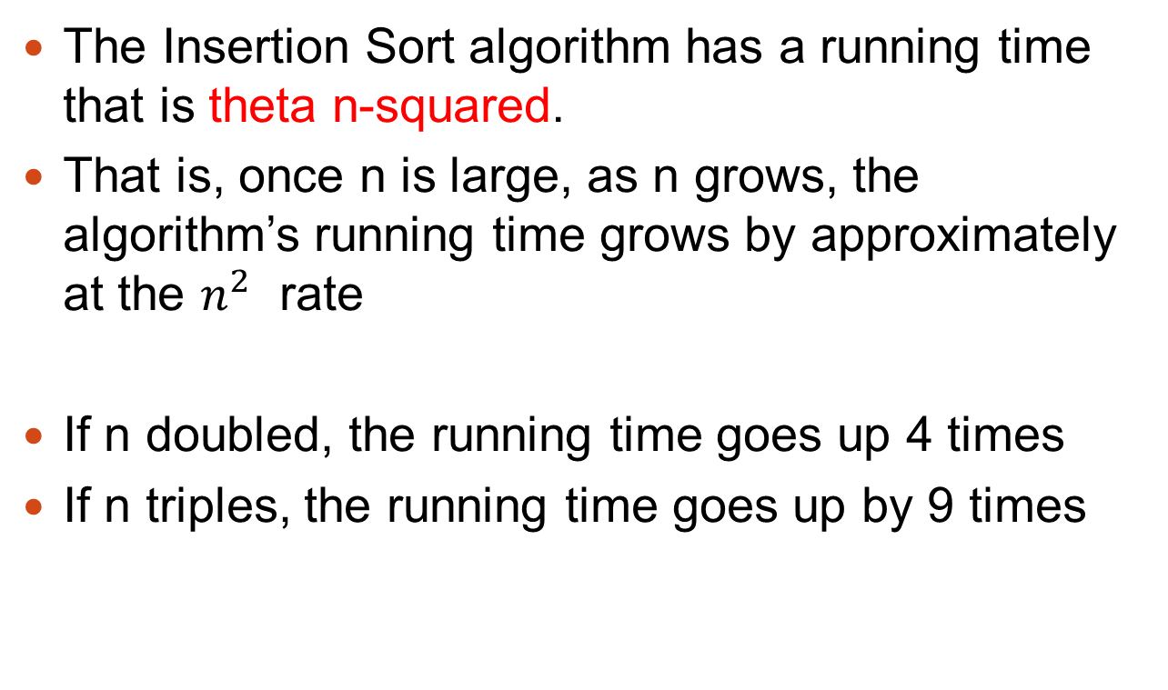

Insertion Sort is $Θ(n^{2})$
The Insertion Sort algorithm has a running time that is theta n-squared.
That is, once n is large, as n grows, the algorithm’s running time grows by approximately at the $n^{2}$ rate
If n doubled, the running time goes up 4 times
If n triples, the running time goes up by 9 times

Slide 7
Definitions
Ο (g(n)) = {f(n) : there exists a positive constant c and n0 such that 0 ≤ f(n) ≤ c g(n)
for all n > n0 .}
Ω(g(n)) = {f(n) : there exists a positive constant c and n0 such that 0 ≤ c g(n) ≤ f(n)
for all n > n0 .}
Θ (g(n)) = {f(n) : there exists positive constants c1 and c2 and n0 such that 0 ≤ c1 g(n) ≤ f(n) ≤ c2 g(n)
for all n > n0 .}

Slide 8
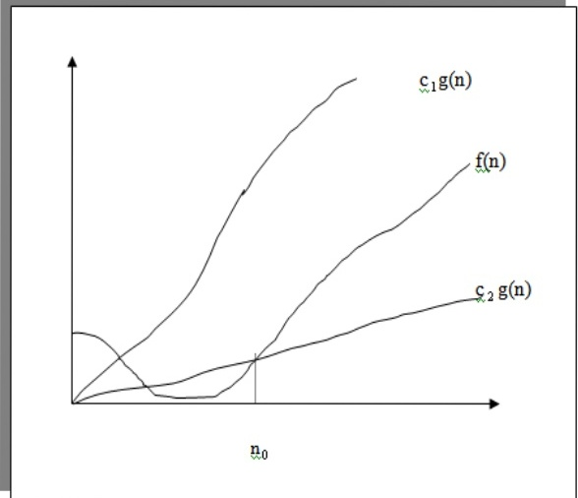
Big Oh, Theta, Omega Notation

Slide 9
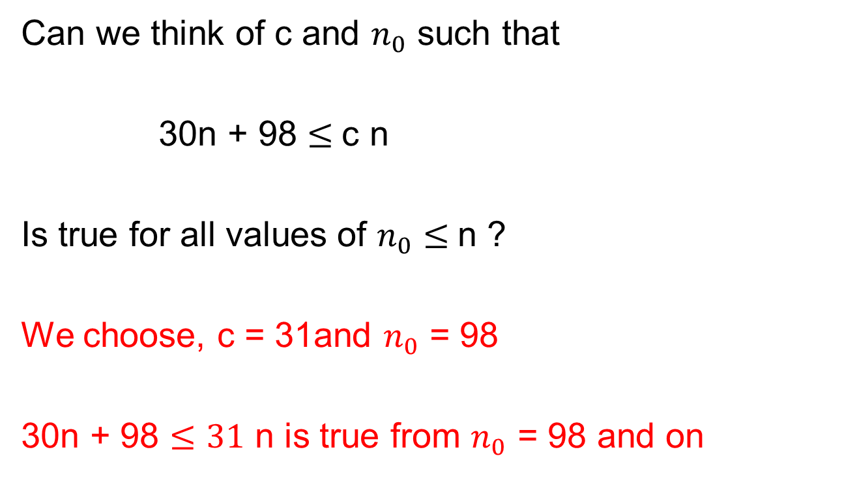
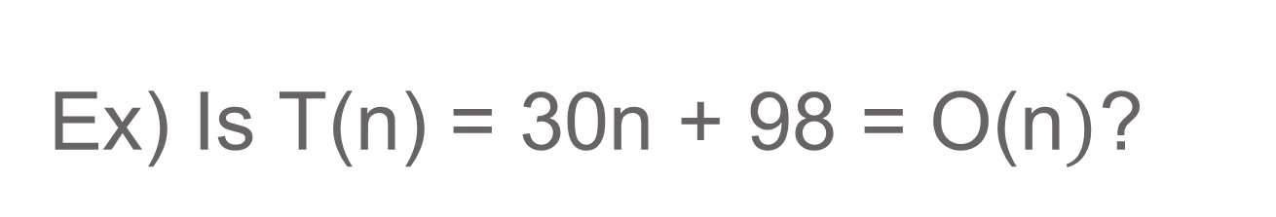
Ex) Is T(n) = 30n + 98 = O(n$)$?
Can we think of c and $n_{0}$ such that
30n + 98 $≤$c n
Is true for all values of $n_{0}≤$n ?
We choose, c = 31and $n_{0}$ = 98
30n + 98 $≤31$ n is true from $n_{0}$ = 98 and on

Slide 10
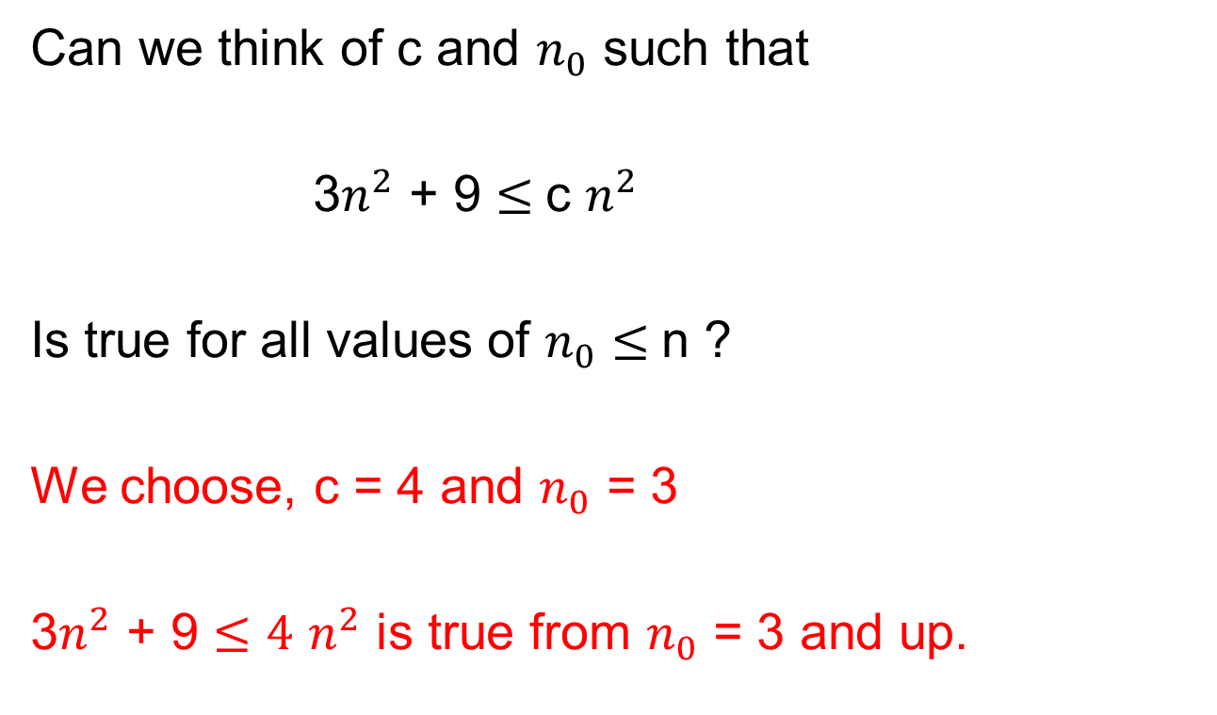
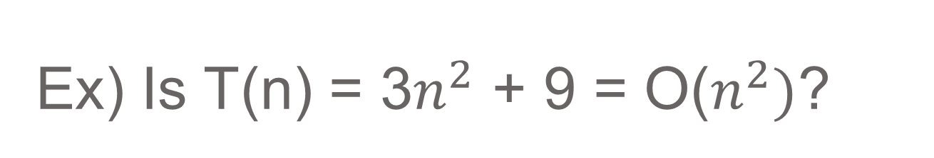
Ex) Is T(n) = 3$n^{2}$ + 9 = O($n^{2})$?
Can we think of c and $n_{0}$ such that
3$n^{2}$ + 9 $≤$c $n^{2}$
Is true for all values of $n_{0}≤$n ?
We choose, c = 4 and $n_{0}$ = 3
3$n^{2}$ + 9 $≤4$ $n^{2}$ is true from $n_{0}$ = 3 and up.

Slide 11
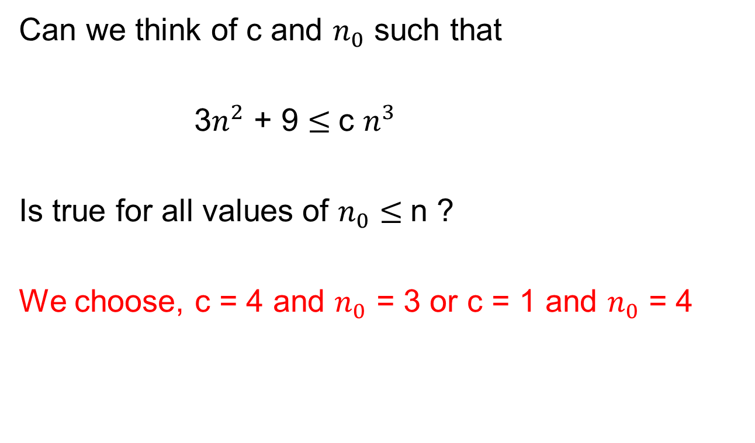

Ex) Is T(n) = 3$n^{2}$ + 9 = O($n^{3})$?
Can we think of c and $n_{0}$ such that
3$n^{2}$ + 9 $≤$c $n^{3}$
Is true for all values of $n_{0}≤$n ?
We choose, c = 4 and $n_{0}$ = 3 or c = 1 and $n_{0}$ = 4

Slide 12
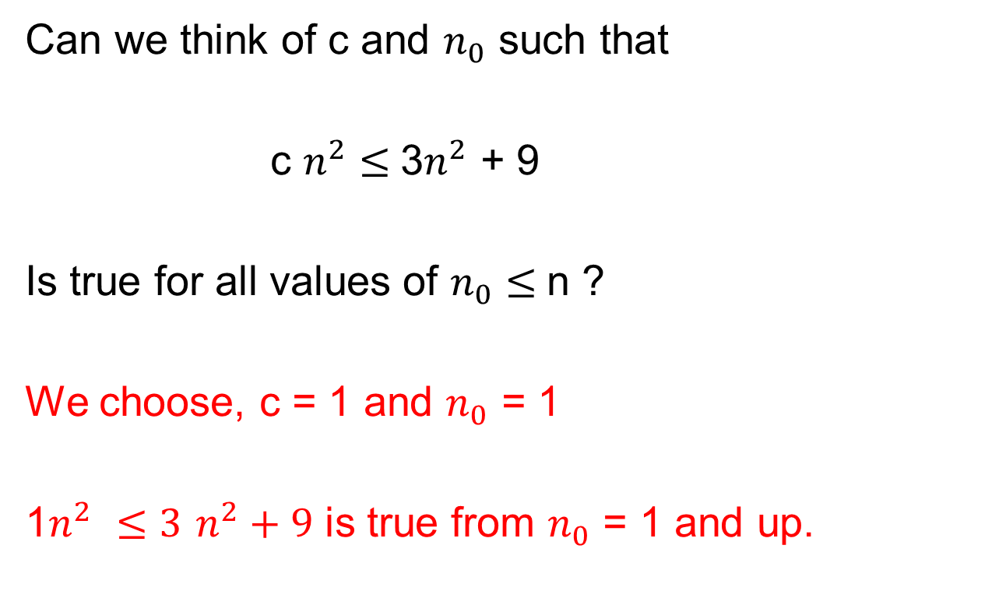
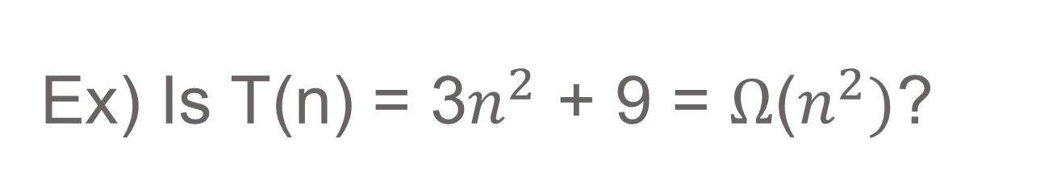
Ex) Is T(n) = 3$n^{2}$ + 9 = $Ω$($n^{2})$?
Can we think of c and $n_{0}$ such that
c $n^{2}≤$3$n^{2}$ + 9
Is true for all values of $n_{0}≤$n ?
We choose, c = 1 and $n_{0}$ = 1
1$n^{2}$ $≤3$ $n^{2}+9$ is true from $n_{0}$ = 1 and up.

Slide 13
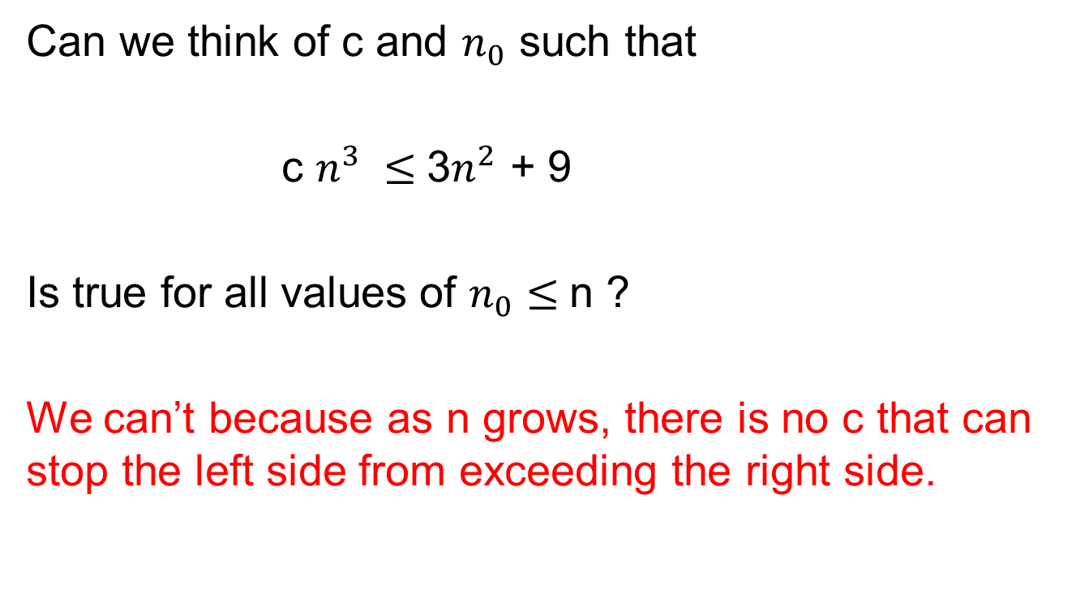
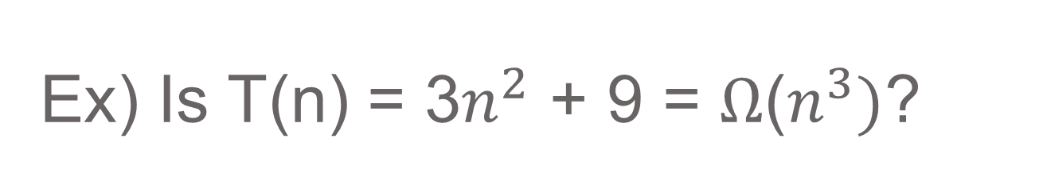
Ex) Is T(n) = 3$n^{2}$ + 9 = $Ω$($n^{3})$?
Can we think of c and $n_{0}$ such that
c $n^{3} ≤$3$n^{2}$ + 9
Is true for all values of $n_{0}≤$n ?
We can’t because as n grows, there is no c that can stop the left side from exceeding the right side.

Slide 14
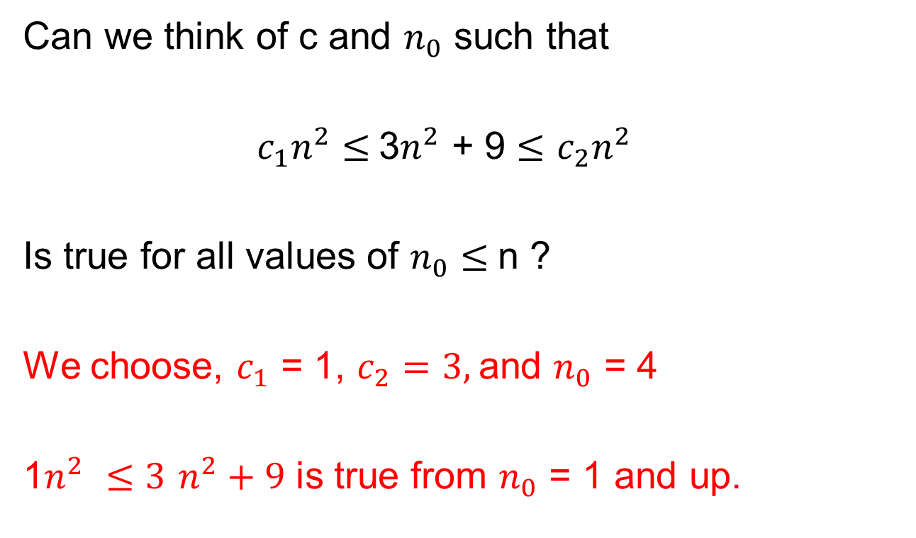
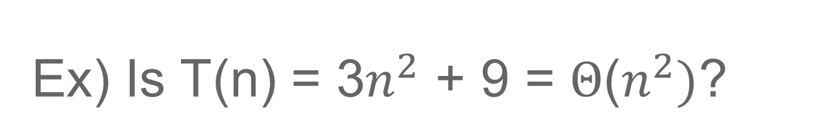
Ex) Is T(n) = 3$n^{2}$ + 9 = $Θ$($n^{2})$?
Can we think of c and $n_{0}$ such that
$c_{1}n^{2}≤$3$n^{2}$ + 9 $≤$ $c_{2}n^{2}$
Is true for all values of $n_{0}≤$n ?
We choose, $c_{1}$ = 1, $c_{2}=3,$and $n_{0}$ = 4
1$n^{2}$ $≤3$ $n^{2}+9$ is true from $n_{0}$ = 1 and up.

