Slide 1
Binary Search
Binary Search Algorithm
Performance, Advantages, Disadvantages
Examples in Java and C++

Slide 2

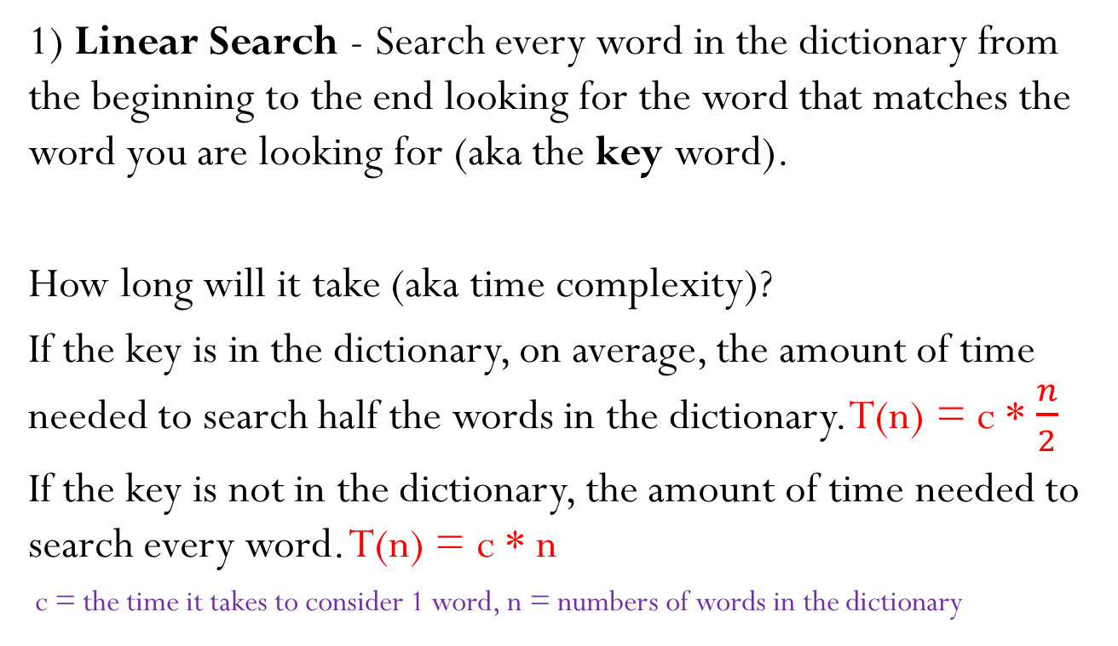
Finding a word in a Dictionary
1) Linear Search - Search every word in the dictionary from the beginning to the end looking for the word that matches the word you are looking for (aka the key word).
How long will it take (aka time complexity)?
If the key is in the dictionary, on average, the amount of time needed to search half the words in the dictionary. T(n) = c * $\frac{n}{2}$
If the key is not in the dictionary, the amount of time needed to search every word. T(n) = c * n
c = the time it takes to consider 1 word, n = numbers of words in the dictionary

Slide 3
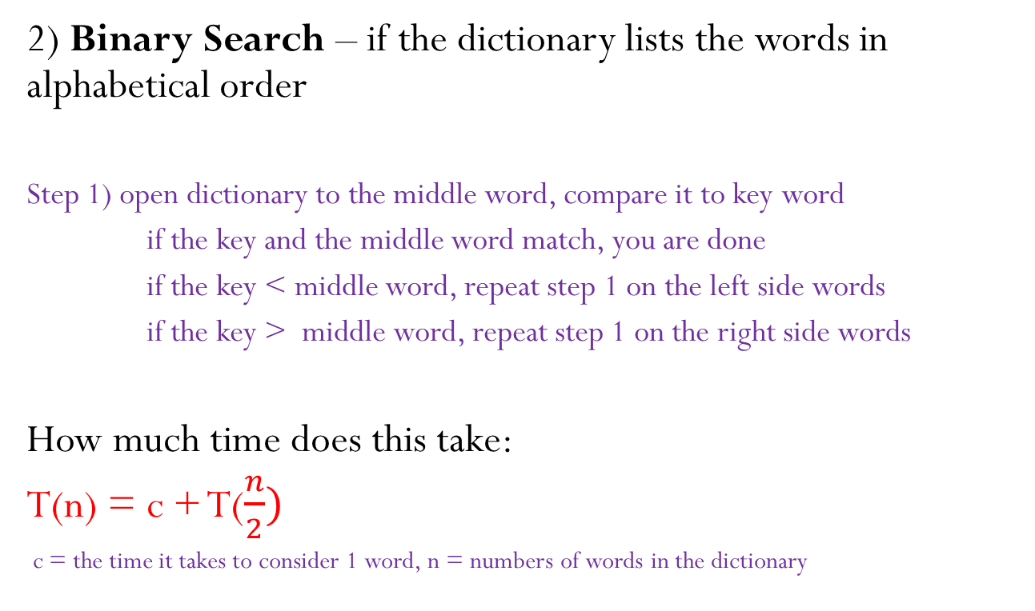
Finding a word in a Dictionary
2) Binary Search – if the dictionary lists the words in alphabetical order
Step 1) open dictionary to the middle word, compare it to key word
if the key and the middle word match, you are done
if the key < middle word, repeat step 1 on the left side words
if the key > middle word, repeat step 1 on the right side words
How much time does this take:
T(n) = c + T($\frac{n}{2})$
c = the time it takes to consider 1 word, n = numbers of words in the dictionary

Slide 4
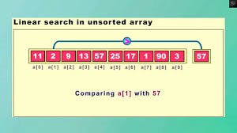
Searching an unsorted array for 57

Slide 5
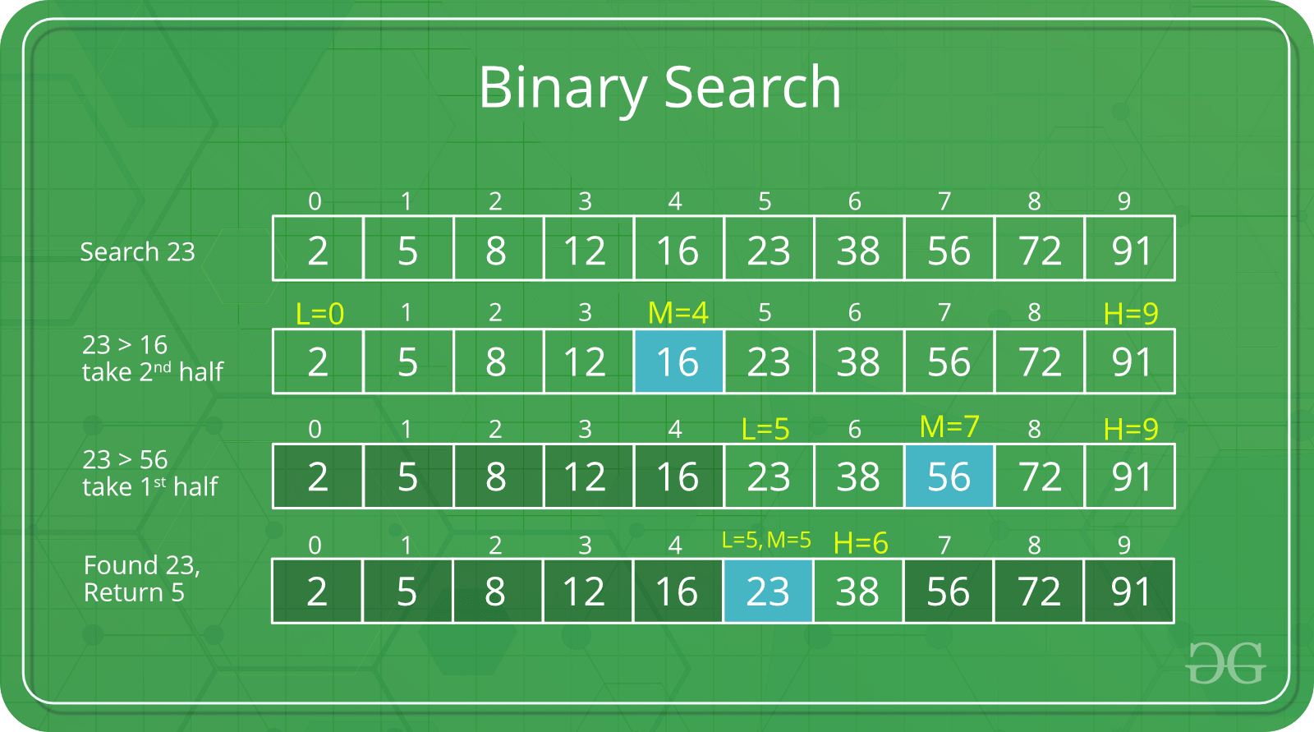
Binary search for 23

Slide 6
Binary Search in Java
class BinarySearch {
int binarySearch(int arr[], int left, int right, int key) {
if (right >= left) {
int mid = left + ((right - left) / 2);
if (arr[mid] == key)
return mid;
if (arr[mid] > key)
{ return binarySearch(arr, left, mid - 1, key); }
else { return binarySearch(arr, mid + 1, right, key); }
}
return -1;
}
}

Slide 7
Binary Search in C++
#include <iostream>
using namespace std;
int binarySearch(int arr[], int left, int right, int key)
{
if (right >= left) {
int mid = left + ((right - left) / 2);
if (arr[mid] == key)
return mid;
if (arr[mid] > key)
{ return binarySearch(arr, left, mid - 1, key); }
else { return binarySearch(arr, mid + 1, right, key); }
}
return -1;
}

Slide 8
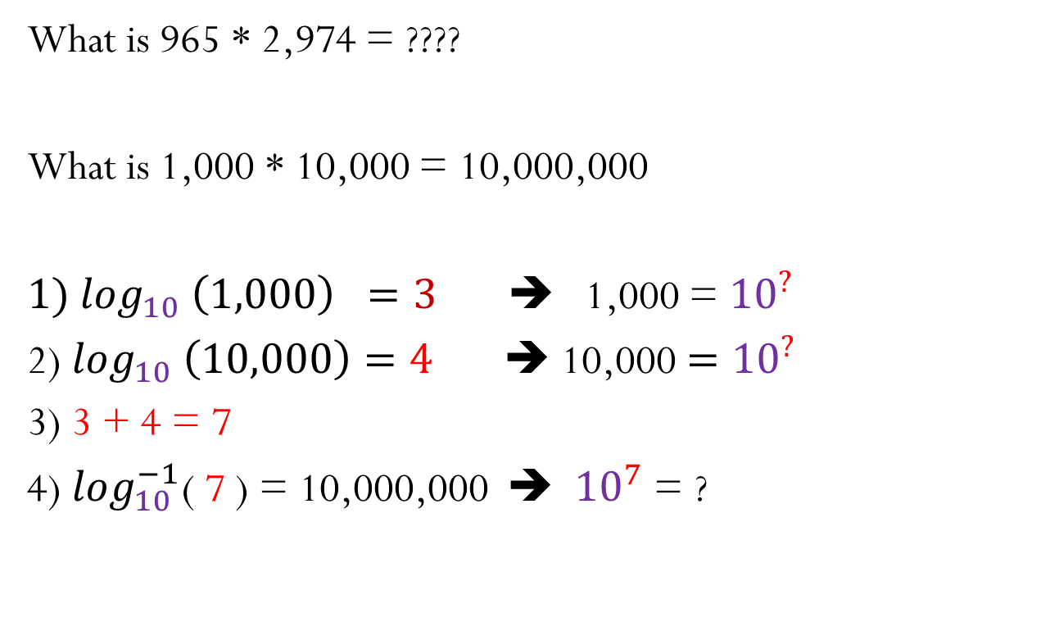
Logorithms (inverse of exponents)
What is 965 * 2,974 = ????
What is 1,000 * 10,000 = 10,000,000
${1) log}_{10} \left(1,000\right) =3$ ➔ 1,000 = ${10}^{?}$
2) $\log_{10} \left(10,000\right)=4$ ➔ 10,000${ =10}^{?}$
3) 3 + 4 = 7
4) $\log_{10}^{−1}$( 7 ) = 10,000,000 ➔ ${ 10}^{7}$ = ?

Slide 9
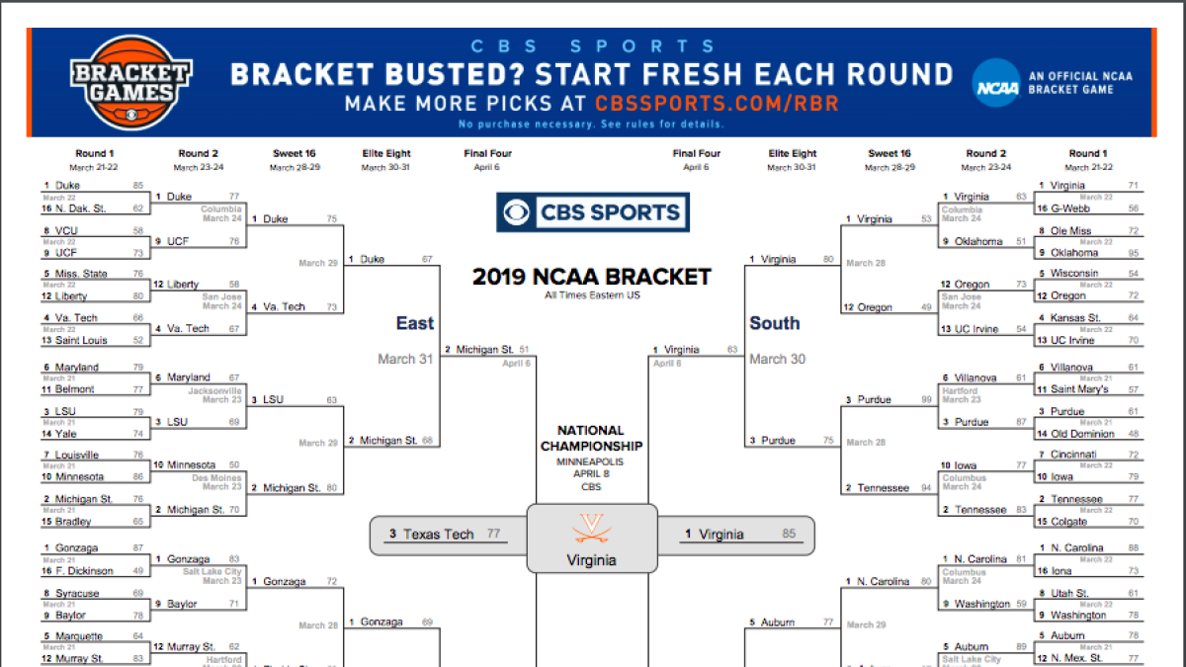
Repeatedly in half (NCAA bracket)

Slide 10

How many rounds until a champion
If the NCAA tournament starts with 64 teams, and each round half the teams are eliminalted, how many rounds will there be until the one final team is left (champion)?
$\log_{2} \left(64\right) =6$ ➔ 64 = $2^{?}$ = 2*2*2*2*2*2

Slide 11
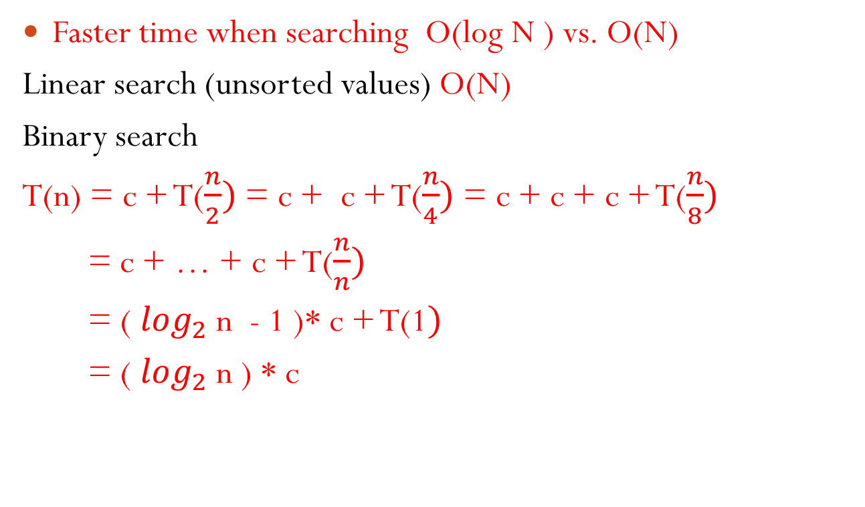
Advantages of binary search
Faster time when searching O(log N ) vs. O(N)
Linear search (unsorted values) O(N)
Binary search
T(n) = c + T($\frac{n}{2})$ = c + c + T($\frac{n}{4})$ = c + c + c + T($\frac{n}{8})$
= c + … + c + T($\frac{n}{n})$
= ( $\log_{2}$ n - 1 )* c + T(1$)$
= ( $\log_{2}$ n ) * c

Slide 12
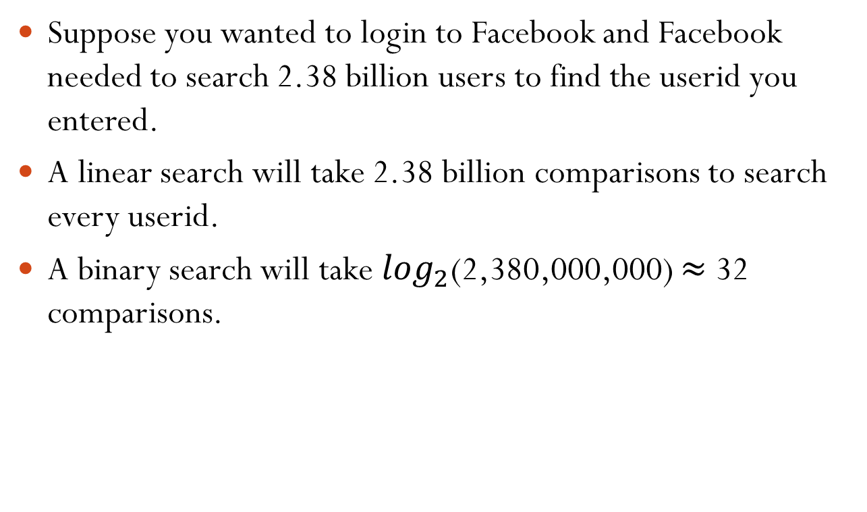
Example: Facebook has over 2B users
Suppose you wanted to login to Facebook and Facebook needed to search 2.38 billion users to find the userid you entered.
A linear search will take 2.38 billion comparisons to search every userid.
A binary search will take $\log_{2}$(2,380,000,000) $≈$ 32 comparisons.

Slide 13
Disadvantages of binary search
In order to do a binary search, the elements must be maintained in a data structure that they can be searched using the binary search algorithm. 2 popular examples:
An array in order
A binary search tree
The disadvantage is that the data structure must be maintained.
Example: Every day facebook has new users join and existing users leave the site, this must all be maintained.

Slide 14
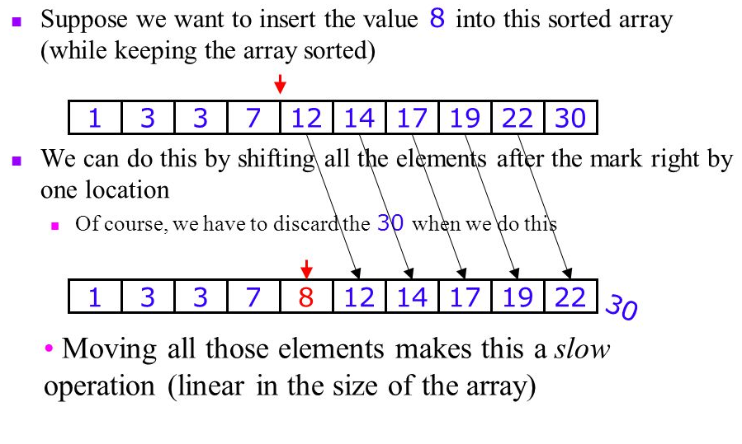
Disadvantages of binary search

Slide 15
Disadvantages of binary search
Overkill for small datasets.
  Recursive calls are time consuming.
  Comparisons of < > are not needed in linear search.
Only work on elements with < , >, == relationships.

Slide 16
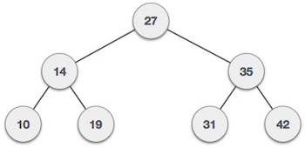
Future Topics
Binary Search Trees (BST)
Inserting into a BST
Deleting from a BST
Balancing a BST

