Slide 1
Dynamic Programming
Greedy Methods
Knapsack Problem
Hoffman Codes

Slide 2
Job Scheduling Problem
Instance
A set of sequential processes on an Operating system.
Problem
Schedule the jobs sequential, so that the processes spend the least amount of overall time (waiting in the Queue plus processing) in the system.

Slide 3
Example of Scheduling problem
There are 3 customers (jobs) in a computer system.
The first takes 5 seconds to complete, the second 10 seconds and the third takes 3 seconds.
The jobs must be serviced one at a time. Your task is to assign a schedule that will produce the smallest average time in the entire system for each job.

Slide 4
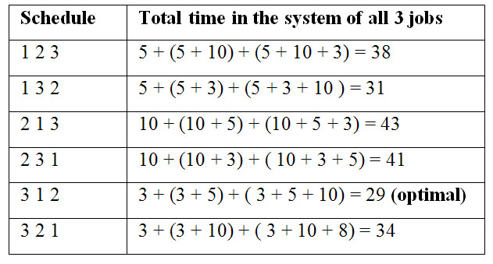
Solution: Greedy Method

Slide 5
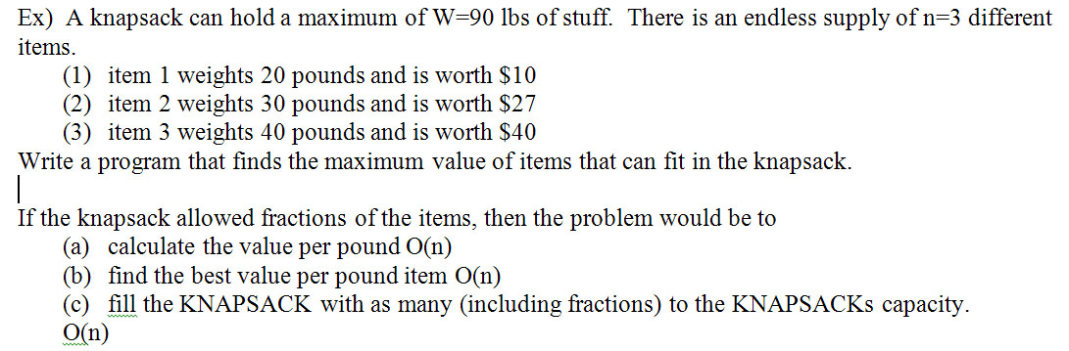
Knapsack Problem: Example

Slide 6
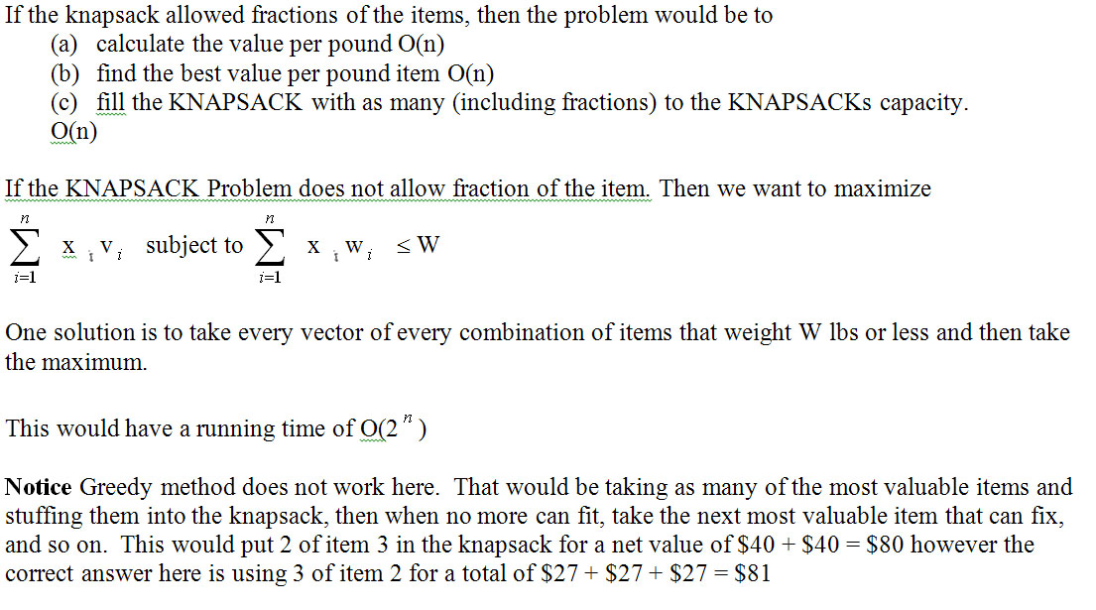
Knapsack Example: Discussion

Slide 7
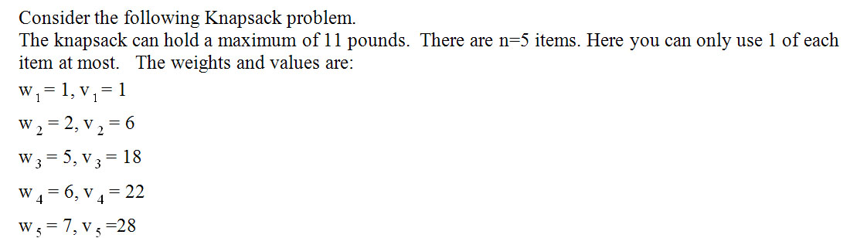
Knapsack: Another Example

Slide 8
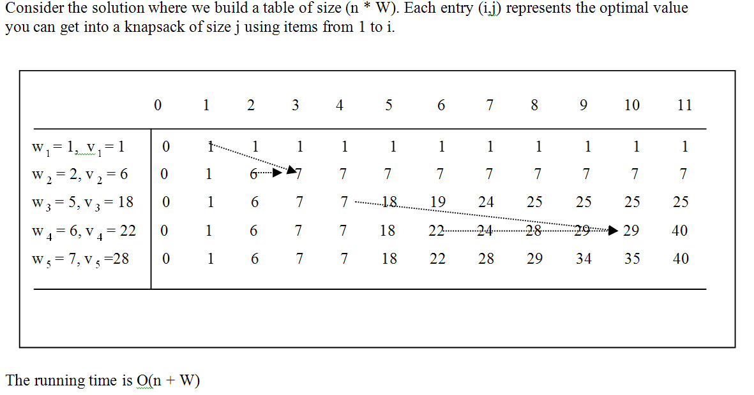
Knapsack: Algorithm/Analysis

Slide 9
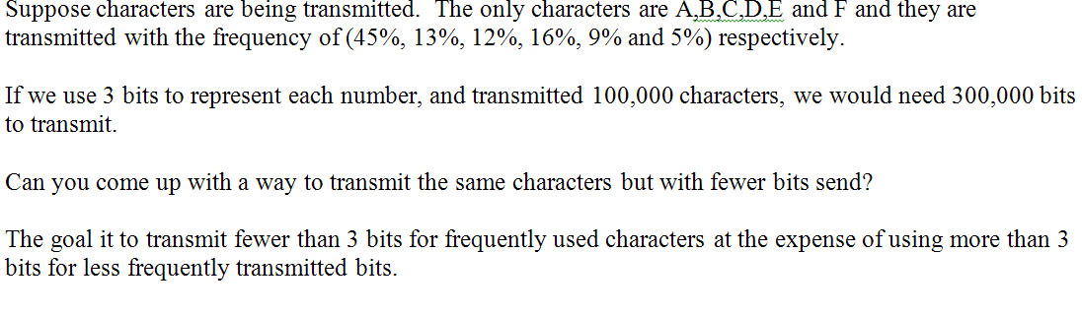
Hoffman Code - Example

Slide 10
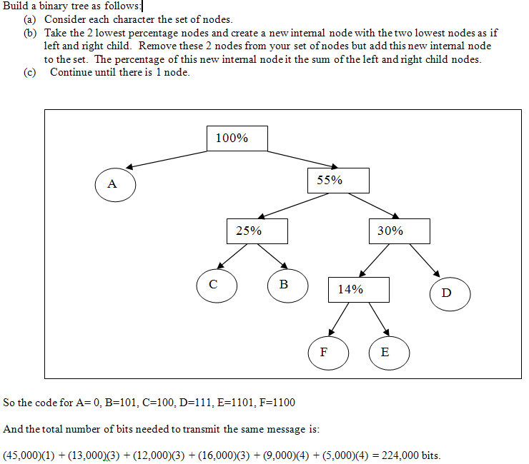
Hoffman Code: Example Solution

