Slide 1
Graph theory
Definitions
Trees, cycles, directed graphs.
Eulerian, Hamiltonian Graphs.
Special graphs

Slide 2
Graphs and Multigraphs
A graph consists of two things:
A set V whose elements are called vertices, points, or nodes.
A set E of unordered pairs of distinct vertices called edges.
We denote such a graph by G(V,E) when we want to emphasize the two parts of a G.
Vertices u and v are said to be adjacent if there is an edge {u,v}.

Slide 3
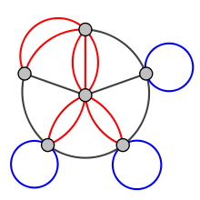
Multi graphs
Loop – an edge that has the same vertex at each end
Multi-edge – and edge that has the same two endpoints as another edge
Multi-graph – a graph that contains at least 1 loop or multi-edge.
Example
Blue – loops
Red - multi edges
Black – standard edges

Slide 4
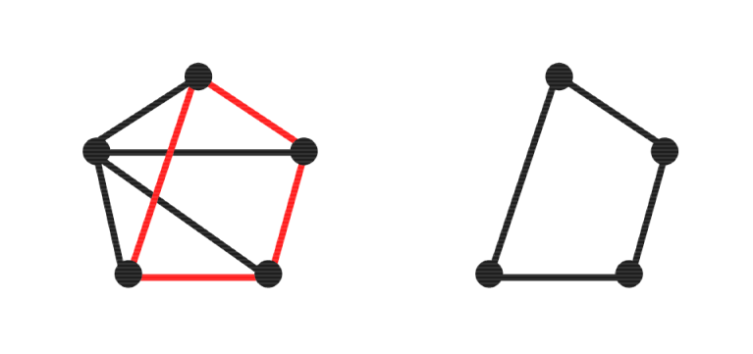
Subgraphs
Let G(V,E) be a graph.
Let V’ be a subset of V and E’ is a subset of E whose endpoints belong to V’.
Then G(V’,E’) is a subgraph of G(V,E)

Slide 5
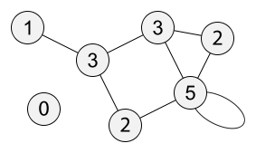
Degree of a vertex deg(v)
If v is an endpoint of an edge e, then we say that e is incident on v.
The degree of a vertex deg(v) is the number of edges which are incident on v.
The graph below has vertices labeled with their degree.

Slide 6
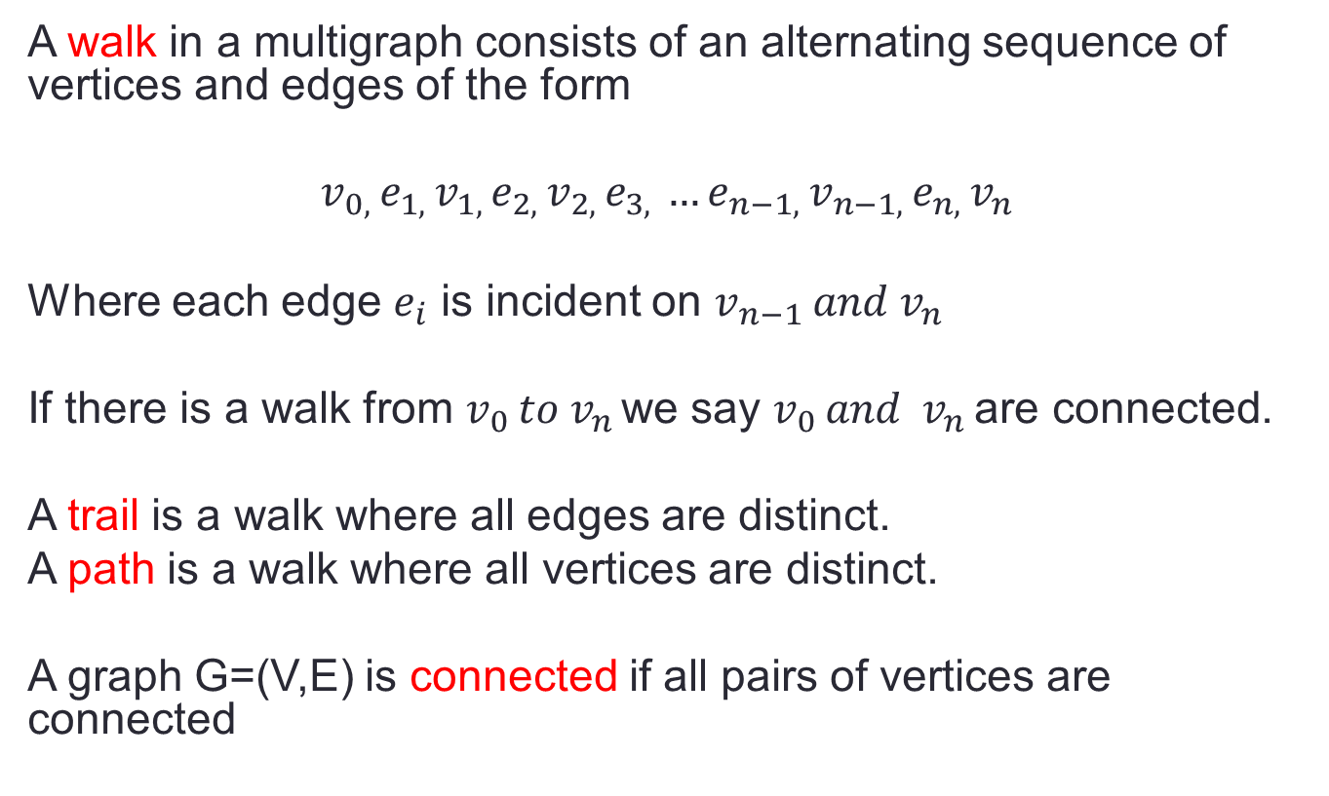
Connectivity
A walk in a multigraph consists of an alternating sequence of vertices and edges of the form
$$v_{0, }e_{1, }v_{1, }e_{2, }v_{2, }e_{3, }…e_{n−1, }v_{n−1, }e_{n, }v_{n }$$
Where each edge $e_{i}$ is incident on $v_{n−1 }and v_{n }$
If there is a walk from $v_{0 }to v_{n }$we say $v_{0 }and v_{n }$are connected.
A trail is a walk where all edges are distinct.
A path is a walk where all vertices are distinct.
A graph G=(V,E) is connected if all pairs of vertices are connected

Slide 7
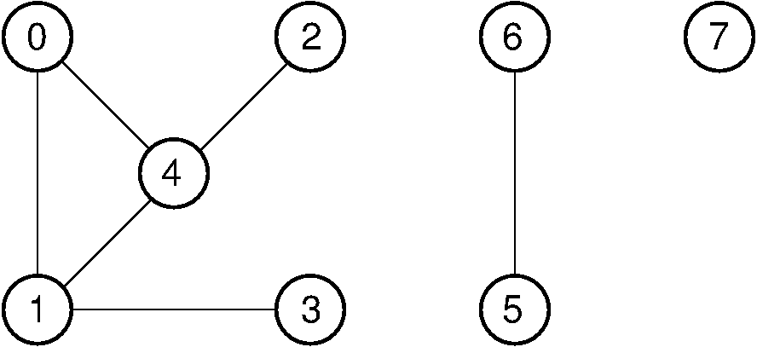
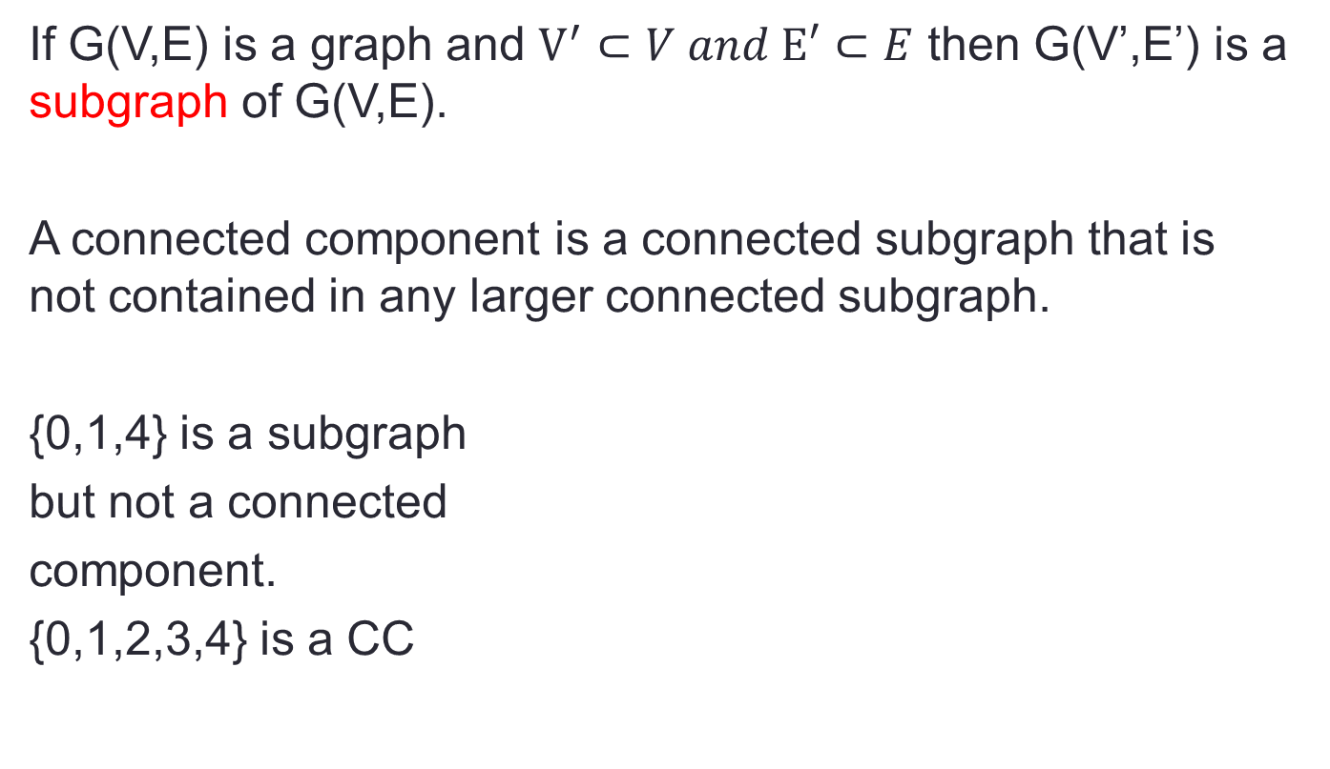
Connected components of G(V,E)
If G(V,E) is a graph and $V^{′}⊂V and E′⊂E$ then G(V’,E’) is a subgraph of G(V,E).
A connected component is a connected subgraph that is not contained in any larger connected subgraph.
{0,1,4} is a subgraph
but not a connected
component.
{0,1,2,3,4} is a CC

Slide 8
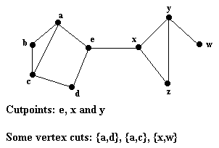
Connected components of G(V,E)
A cut point is a vertex where if removed from a Graph G(V,E) (which would consequentially remove all attached edges) would disconnect the graph.

Slide 9
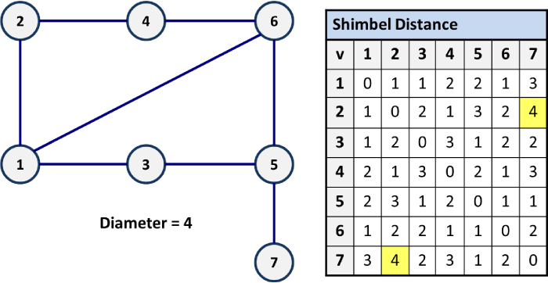
Distance/diameter in connected Graphs
Distance between vertices u and v of a connected graph G, written d(u,v) is the length of the shortest path from u to v.
The diameter of a connected component is the maximum distance between any two of its vertices

Slide 10
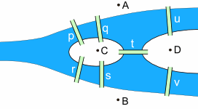
Bridges of Konigsberg
Question: Beginning anywhere can a person walk over each bridge exactly once?
Legend has it that Euler answered the question.

Slide 11
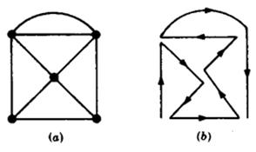
Bridges of Konigsberg – traversable
Such a walk must be a trail since no bridge can be used twice.
A graph is said to be traversable is it can be drawn without any breaks in the curve and without repeating any edge, that is, if there is a walk which includes all vertices and uses each edge exactly once.

Slide 12
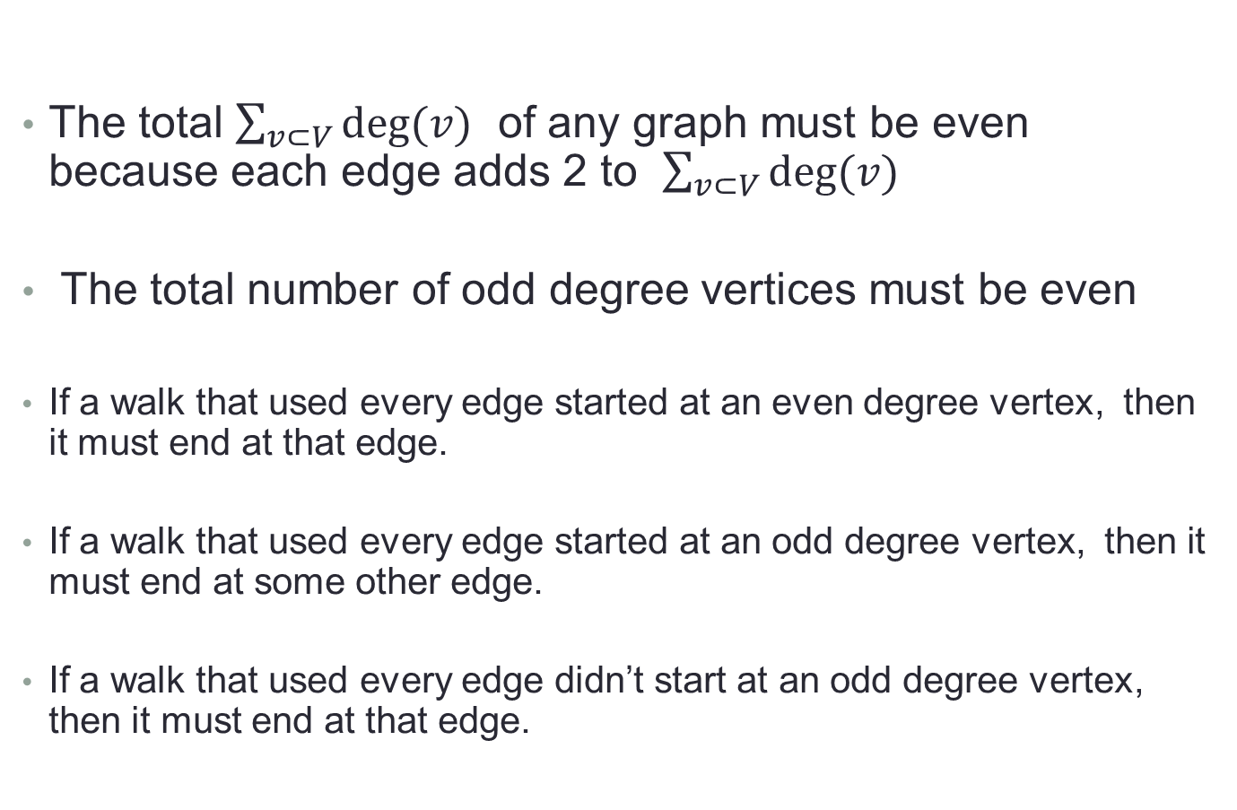
Bridges of Konigsberg – Side facts
The total $\sum_{v⊂V}{deg⁡(v)}$ of any graph must be even because each edge adds 2 to $\sum_{v⊂V}{deg⁡(v)}$
The total number of odd degree vertices must be even
If a walk that used every edge started at an even degree vertex, then it must end at that edge.
If a walk that used every edge started at an odd degree vertex, then it must end at some other edge.
If a walk that used every edge didn’t start at an odd degree vertex, then it must end at that edge.

Slide 13
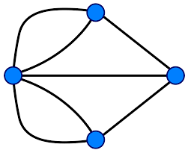
Bridges of Konigsberg – solved
Since the graph has more than 2 odd degree vertices, it can not be traversed.
Euler gets credit for solving this.

Slide 14
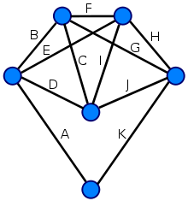
Eulerian Graph
A finite connected graph is Eulerian if and only if each vertex has even degree
Any graph with 2 odd degree vertices is traversable.

Slide 15
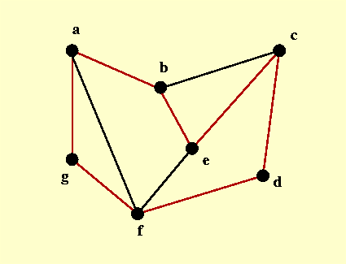
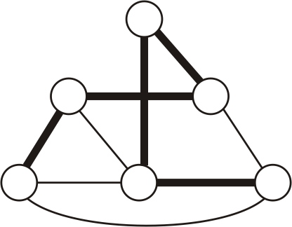
Hamiltonian Graphs
Hamiltonian Cycle is a closed (start and end vertices are the same) walk which includes every vertex exactly once.
Such a walk must be a cycle and is called a Hamiltonian Cycle.
Any graph that contains Hamiltonian cycle is a Hamiltonian Graph.
A path that visits every vertex exactly once is a Hamiltonian Path
Ham-Cycle Ham-Path

Slide 16
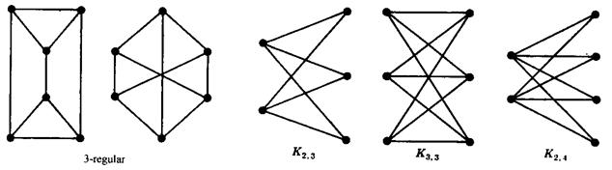
Special Graphs – k regular
A graph is k-regular if every vertex has degree k

Slide 17
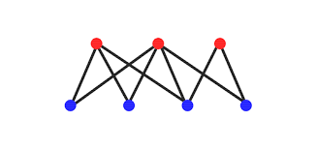
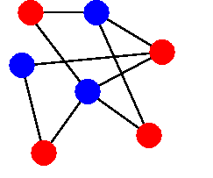
Special Graphs - Bipartite
If a Graph G(V,E) can have it’s vertices in V partitioned into 2 disjoint sets such that every edge in E connects vertices from one set to the other set, then that graph is said to be bipartite.

Slide 18
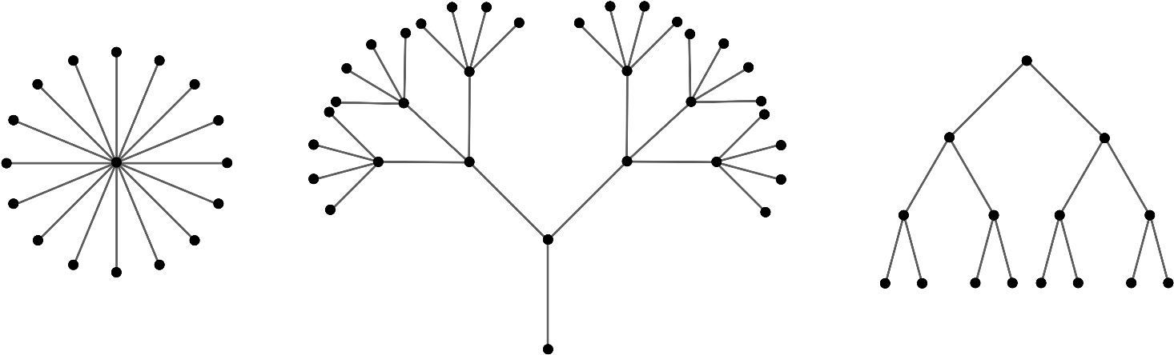
Special Graphs - Trees
A cycle is a closed walk over a subset of vertices where no edge is traversed more than once.
A graph is said to be cycle-free or acyclic if it has no cycles.
A connected graph with no cycles is said to be a tree

Slide 19
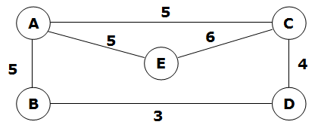
Special Graphs - Labeled
A graph G is said to be labeled if it edges and/or vertices are assigned data of one kind or another.
Generally, if edges are assigned a non-negative value it is called the edge’s weight.
Weighted labeled graph

Slide 20
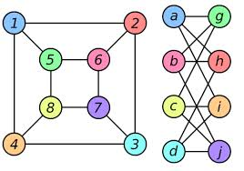
Special Graphs - Isomorphic
Two graphs are isomorphic to each other if there is a one-to-one correspondence of vertices and the vertices they are connected to.

Slide 21
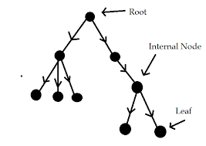
Special Graphs – Rooted Tree
A tree with one special vertex called the root
Internal vertex – vertices that are connected to another vertex that is further from the root than itself
Leaf vertex – a vertex that is further from the root that any vertex it is adjacent to.

Slide 22
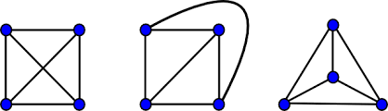
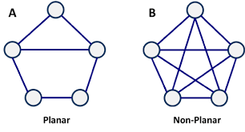
Special Graphs - Planar
A graph or multi-graph that can be drawn on a plane without any edges crossing each other is a planar graph.
Planar

Slide 23
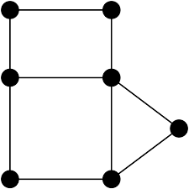
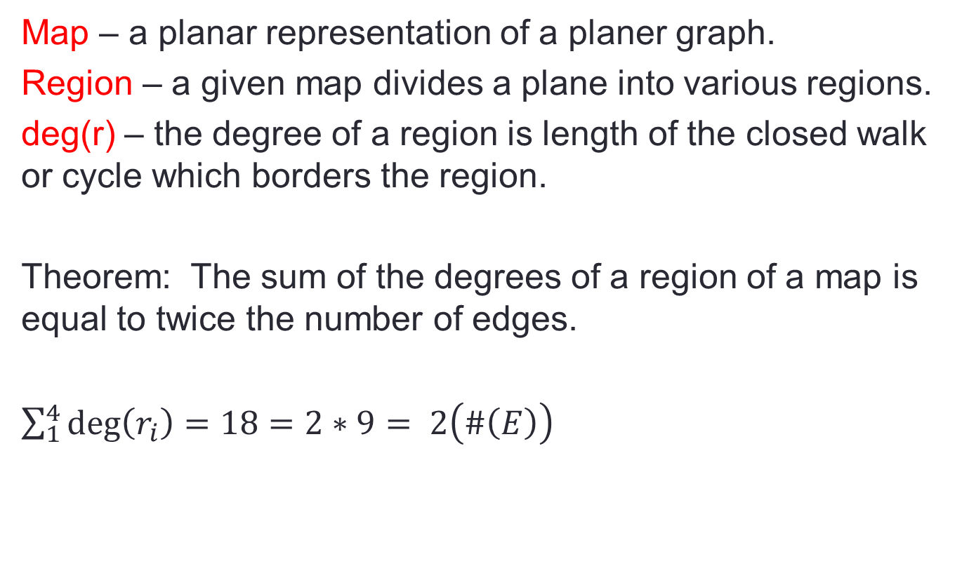
Special Graphs – Maps and Regions
Map – a planar representation of a planer graph.
Region – a given map divides a plane into various regions.
deg(r) – the degree of a region is length of the closed walk or cycle which borders the region.
Theorem: The sum of the degrees of a region of a map is equal to twice the number of edges.
$\sum_{1}^{4}{\deg\left(r_{i}\right)=18=2∗9= 2\left(\#\left(E\right)\right)}$

Slide 24
Euler’s formula
V – E + R = 2
Proof by induction:
Take an existing graph and re build it from scratch
All graphs start with a vertex 1 - 0 + 1 = 2 holds
Repeatedly add edges connected to existing vertices.
Each edge will connect to an existing vertex or introduce a new vertex
If connecting to an existing vertex: E and R each increment
If connecting to a new vertex: V and E each increment

Slide 25
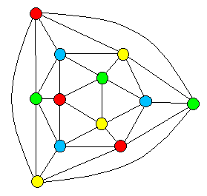
Special Graphs – Colored
A vertex coloring or simply coloring, of a graph G is an assignment of colors to the vertices of G such that adjacent vertices have different colors. We say that G is n-colorable if there exists a coloring of G which uses n colors.
4-coloring for the graph

Slide 26
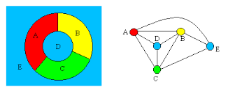
Converting Regions to Vertices
If a graph is planar, we can create a corresponding graph that maps regions to vertices. Edges are added to show regions that border on each other.

Slide 27
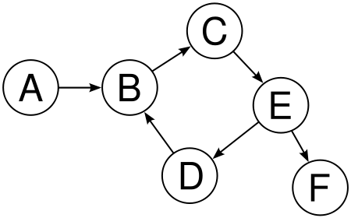
Special Graphs – Directed
A graph G is a directed graph if the edges have orientations.

Slide 28
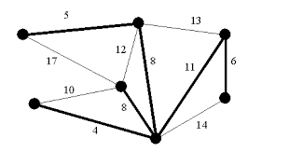
Spanning Tree of a Graph
If G(V,E) is a connected graph, the G(V,E’) if a Spanning Tree if G(V,E’) is connected and contains no cycles.
A graph can have many spanning trees.
For weighted graphs, the spanning tree(s) with the minimum total weight is called Minimum Spanning Tree (MST)

Slide 29
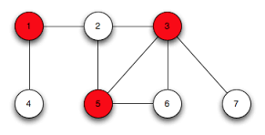
Vertex Cover of a Graph
If G(V,E) is a connected graph, the G(V’,E) if a Vertex Cover (VC) if every edge is connected to a vertex in V’.
A graph can have many vertex covers.
Of all vertex covers, the one with the lowest |V’| is the minimum vertex cover.

Slide 30
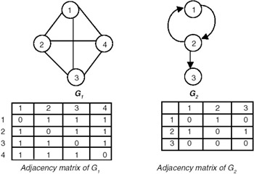
Representing Graphs in Memory
Adjacency matrix

Slide 31
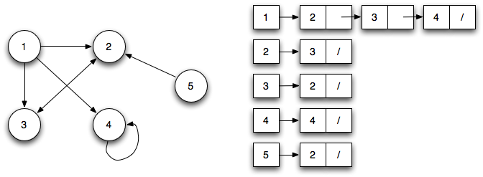
Representing Graphs in Memory
Adjacency lists

