Slide 1
Java Collections
Java Generics
Java Collections

Slide 2
Generic method
static float add(float a, float b)
{
float answer = a + b;
return answer;
}
static int add(int i1, float i2)
{
int answer = a + b;
return answer;
}
static long add(long a, long b)
{
long answer = a + b;
return answer;
}
// Generic method
static <T> add(T a, T b)
{
T answer = a + b;
return answer;
}

Slide 3
Generic Class
class Pair<T,S>
{
public T first;
public S second;
public Pair( T a, S b )
{
first = a;
second = b;
}
}
Pair<String,Color> colorName = new Pair<String,Color>("Red", Color.RED);
Pair<Double,Double> coordinates = new Pair<Double,Double>(17.3,42.8);

Slide 4
Generics – Stack Example
class Stack<E>
{
private final int size;
private int top;
private E[] elements;
public Stack() { this(10); }
public Stack(int s)
{
size = s > 0 ? s : 10;
top = -1;
elements = (E[]) new Object[size]; // create array
}
public void push(E pushValue)
{
if (top == size - 1) // if stack is full
throw new FullStackException(String.format("Stack is full, cannot push %s", pushValue));
elements[++top] = pushValue; // place pushValue on Stack
}
public E pop()
{
if (top == -1) // if stack is empty
throw new EmptyStackException("Stack is empty, cannot pop");
return elements[top--]; // remove and return top element of Stack
}
}

Slide 5
Java Collections
The Java collections framework (JCF) is a set of classes and interfaces that implement commonly reusable collection data structures.^{[1]}
Although it is a framework, it works in a manner of a library. The JCF provides both interfaces that define various collections and classes that implement them.

Slide 6
Three main types of collections
Lists: always ordered, may contain duplicates and can be handled the same way as usual arrays
Sets: cannot contain duplicates and provide random access to their elements
Maps: connect unique keys with values, provide random access to its keys and may host duplicate values

Slide 7
Generic List in Java
List<String> list = new ArrayList<String>;
List<String> list = new ArrayList<String>;
String string1 = "a string";
list.add(string1);
String string2 = list.get(0);
List<String> list = new ArrayList<String>;
Iterator<String> iterator = list.iterator();
while(iterator.hasNext())
{
String aString = iterator.next();
}

Slide 8
Generic Set in Java
Set<String> set = new HashSet<String>;
String string1 = "a string";
set.add(string1);
Iterator<String> iterator = set.iterator();
while(iterator.hasNext())
{
String aString = iterator.next();
}

Slide 9
Generic Map in Java
Map<Integer, String> map = new HashMap<Integer, String>;
Integer key1 = new Integer(123);
String value1 = "value 1";
map.put(key1, value1);
String value1_1 = map.get(key1);
Iterator<Integer> keyIterator = map.keySet().iterator();
while(keyIterator.hasNext()){
Integer aKey = iterator.next();
String aValue = map.get(aKey);
}

Slide 10
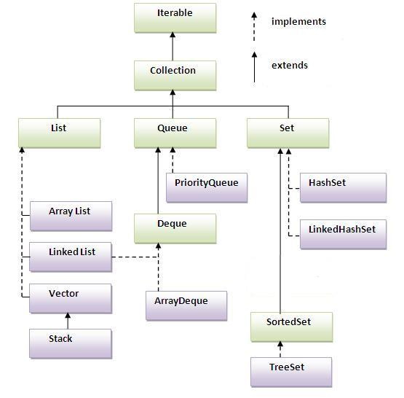
Java Collections Hierarchy

Slide 11
Lists
List listA = new ArrayList();
listA.add("element 0");
listA.add("element 1");
listA.add("element 2");
String element0 = listA.get(0);
String element1 = listA.get(1);
String element3 = listA.get(2);
//access via Iterator
Iterator iterator = listA.iterator();
while(iterator.hasNext()
{
String element = (String) iterator.next();
}
for(Object object : listA)
{
String element = (String) object;
}

Slide 12
Generic Sorting
List list = new ArrayList();
//add elements to the list
Collections.sort(list);
public interface Comparable<T>
{
int compareTo(T o);
}

