Slide 1
Recurrence Equation
Masters Theorem
Mergesort
Logarithms Review
Recurrence Equations
Masters theorem

Slide 2
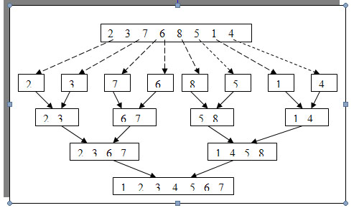
Merge Sort

Slide 3
Merge Sort’s Recursive Algorithm
mergesort(int A[ ], int p, int r)
q = rounddown((p+r)/2)
mergesort(A, p, q)
mergesort(A,q+1, r);
merge(A,p, q, r);

Slide 4
Logarithms Review
What is 956 * 2,985 = ?
What is 1,000 * 10,000 = 10,000,000
Why is the second one much easier that the first even though the number are bigger?
Answer: you are using logarithms

Slide 5
Logarithms Review
Log 10(1,000) = 3
Log 10(10,000) = 4
3 + 4 = 7
Reverse Log10(7) = 10,000,000
Others
Log 2(8) = 3

Slide 6
Recurrence Equation for Mergesort
T(n) = Θ(1) if n=1
2T(n/2) + Θ(n) if n > 1
T(n) = 2( T(n/2) )+ Θ(n)
= 2(2( T(n/4) )+ Θ(n/2) ) + Θ(n)
= 4 (T(n/4) + 2(Θ(n/2)) + Θ(n)
= 4(T(n/4) + 2(Θ(n))
= 4 (2( T(n/8) )+ Θ(n/4)) + 2(Θ(n))
= 8 T((n/8) + 3(Θ(n))
= 16 T((n/16) + 4(Θ(n))
= n T((n/n) + (log n)(Θ(n))
= n(T(1)) + (log n) (Θ(n))
= Θ(n + n log n) = Θ(n log n)

Slide 7
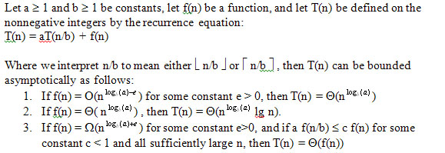
Masters Theorem

Slide 8
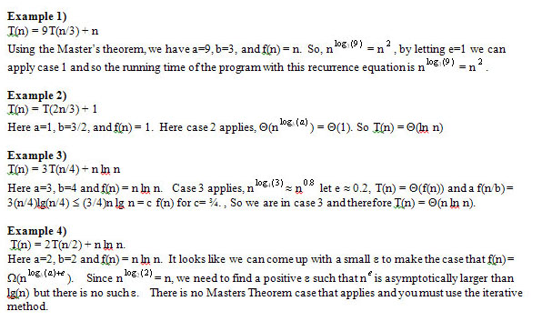
Examples of Masters

