Slide 1
Running Times
Efficiency of an Algorithm

Slide 2
Insertion Sort
For each element 1 to n in the array, insert it into the already sorted elements to the it’s left.
22 | 15 | 37 | 6 | 25 |  |  | key | 22 |  | J=1
22 | 15 | 37 | 6 | 25 |  |  | key | 15 |  | J=2
22 | 22 | 37 | 6 | 25 |  |  | shift
15 | 22 | 37 | 6 | 25 |  |  | insert
15 | 22 | 37 | 6 | 25 |  |  | key | 37 |  | J=3
15 | 22 | 37 | 6 | 25 |  |  | insert
15 | 22 | 37 | 6 | 25 |  |  | key | 6 |  | J=4
15 | 22 | 37 | 37 | 25 |  |  | shift
15 | 22 | 22 | 37 | 25 |  |  | shift
15 | 15 | 22 | 37 | 25 |  |  | shift
6 | 15 | 22 | 37 | 25 |  |  | insert
6 | 15 | 22 | 37 | 25 |  |  | key | 25 |  | J=5
6 | 15 | 22 | 37 | 37 |  |  | shift
6 | 15 | 22 | 25 | 37 |  |  | insert

Slide 3
Insertion Sort Algorithm
void INSERTION-SORT(int A[ ])
{
for (int j = 1, j < length(A), j++) // cost = c1 number of times = n
{
key = A[j]; // cost = c2 number of times = n-1
/* insert A[j] into a[1..j-1] */ // cost = c3 number of times = n-1
i = j-1; // cost = c4 number of times = n-1
while (i > 0 && A[i] > key) // cost = c5 number of times = (n-1)t
{
A[i+1] = A[i]; // cost = c6 number of times = (n-1)t
i = i –1; // cost = c7 number of times = (n-1) t
}
A[i+1] = key; // cost = c8 number of times = n-1
}
}

Slide 4
Best Case (already sorted)
T(n) = c1(n) + c2(n-1) + c4(n-1) + c5(n-1) + c5(n-1) + c8(n-1)
= (c1 + c2 + c4 + c5 + c8)n + (c2 + c4 + c5 + c8)
= linear function = Ο(n)

Slide 5
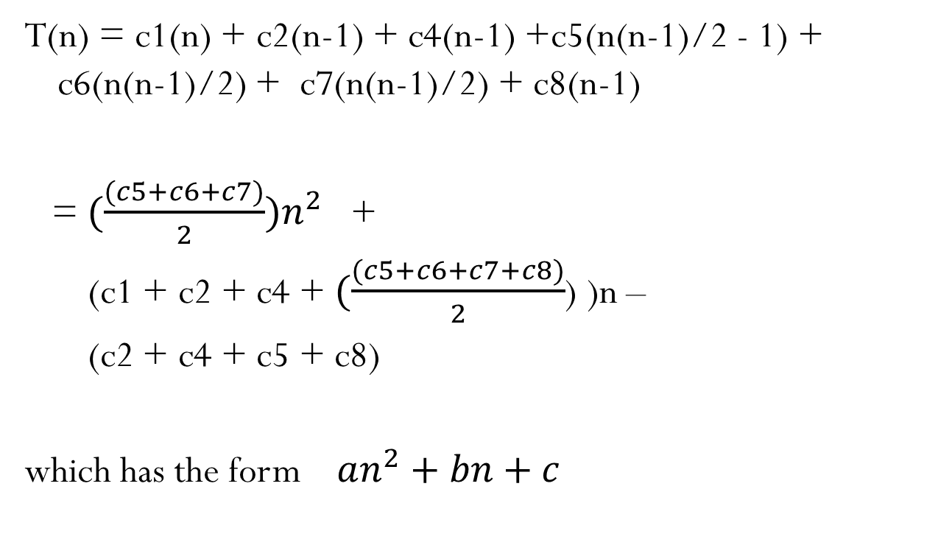
Worst Case: reverse order
T(n) = c1(n) + c2(n-1) + c4(n-1) +c5(n(n-1)/2 - 1) + c6(n(n-1)/2) + c7(n(n-1)/2) + c8(n-1)
= ${(\frac{(c5+c6+c7)}{2})n}^{2}$ +
(c1 + c2 + c4 + $(\frac{(c5+c6+c7+c8)}{2}$) )n –
(c2 + c4 + c5 + c8)
which has the form $an^{2}+bn+c$

Slide 6

Analysis as n gets large
$an^{2}+bn+c$ $an^{2}+ bn +c$
a = | 15 nanoseconds = | 0.000015
b = | 35 nanoseconds = | 0.000035
c = | 25 nanoseconds = | 0.000025
n | Time | Time | Time | Total time | % of time | % of time | % of time
1 | 0.000015 | 0.000035 | 0.000025 | 0.000075 | 20.00% | 46.67% | 33.33%
10 | 0.0015 | 0.00035 | 0.000025 | 0.001875 | 80.00% | 18.67% | 1.33%
100 | 0.15 | 0.0035 | 0.000025 | 0.153525 | 97.70% | 2.28% | 0.02%
1000 | 15 | 0.035 | 0.000025 | 15.035025 | 99.77% | 0.23% | 0.00%

Slide 7
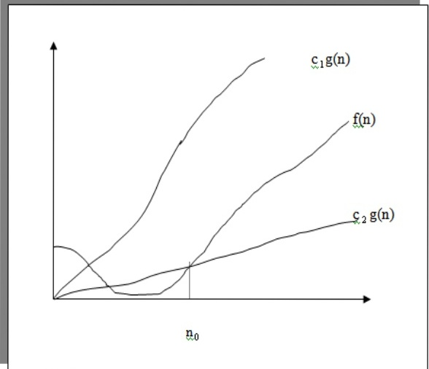
Big Oh, Theta, Omega Notation

Slide 8
Definitions
Ο (g(n)) = {f(n) : there exists a positive constant c and n0 such that 0 ≤ f(n) ≤ c g(n)
for all n > n0 .}
Ω(g(n)) = {f(n) : there exists a positive constant c and n0 such that 0 ≤ c g(n) ≤ f(n)
for all n > n0 .}
Θ (g(n)) = {f(n) : there exists positive constants c1 and c2 and n0 such that 0 ≤ c1 g(n) ≤ f(n) ≤ c2 g(n)
for all n > n0 .}

