Slide 1
Graph Searching Algorithms
Representing Graphs
Depth First Search
Breadth First Search

Slide 2
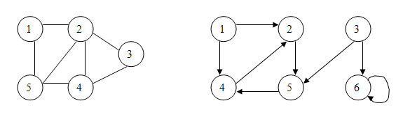
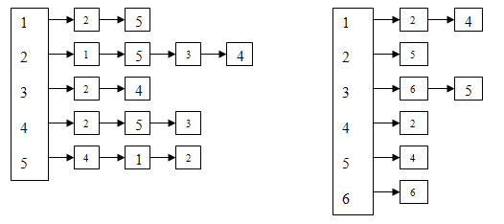
Representing Graphs – Adjacency list

Slide 3
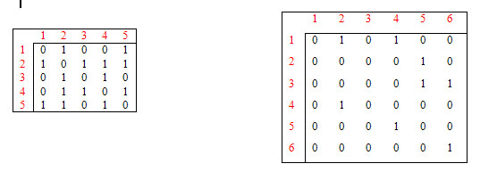
Representing Graphs – Adjacency Matrix

Slide 4
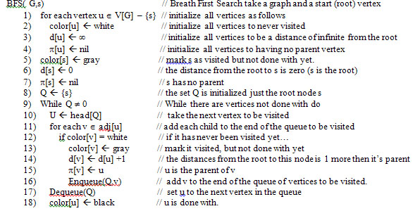
Breadth First Search Algorithm

Slide 5
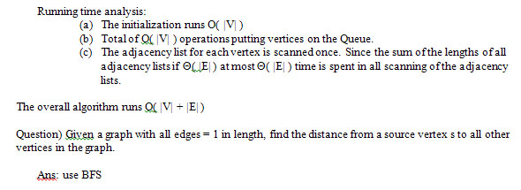
BFS - Analysis

Slide 6
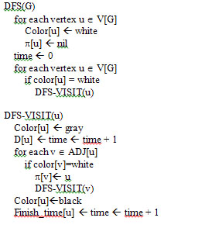
Depth First Search Algorithm

Slide 7
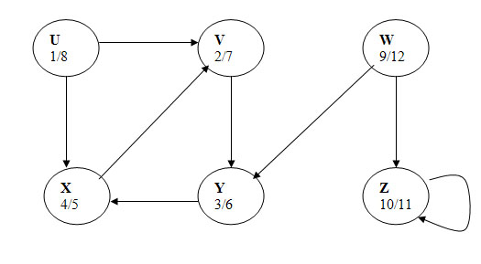
DFS – Example Graph

Slide 8
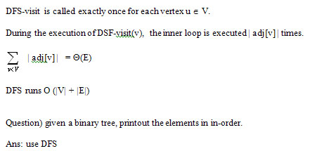
DFS - Analysis

Slide 9
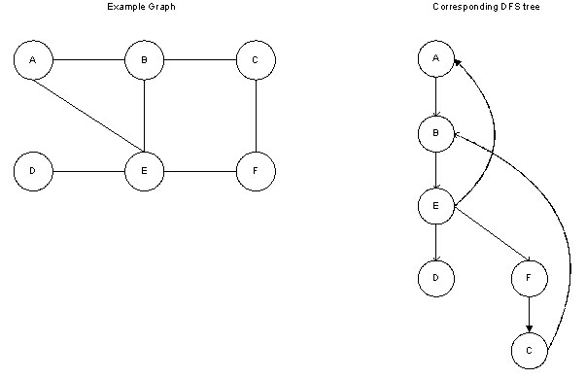
DFS - Tree

Slide 10
Cycle in a graph problem
Instance
Given a graph G = (V,E)
Problem
Does the graph contain a cycle?

Slide 11
Cycle in a Graph - Algorithm
DFS or BFS and if you reach a grey vertex, the answer is yes otherwise the answer is no.
Running time O(|V|) because either we answer no and the graph is a tree (V = E) or we answer “yes” because we stopped the first time we reach a vertex that is grey. At this point we have visited at most V edges regardless of |E|

