Slide 1
Sorting
Counting (Pigeon Hole)
Bucket Sort
Radix Sort
Amortized cost
Heap Sort
Hash Sort

Slide 2
Counting Sort 5
pigeonhole(A) (a.k.a. counting sort) // it is known that all values in A are integers between 1 and 10,000
for k ← 1 to 10,000 // u is an array that contains the counts of each integer in A
u[k] ← 0 // set the counts to zero
for i ← 1 to n do // go through A
k ← A[i] // read each integer in A
u[k] ← u[k] + 1 // add 1 to the count of that integer
i ← 0 // prepare to walk through the A array
for k←1 to 10,000 // go through the counts array
while u[k] ≠ 0 // for each time a particular integer was in the array
i ← i + 1
A[I] ← k // write that integer in the A array
u[k] ← u[k] – 1 // decrement the counts array entry for that array.
The running time is O(10,000 + n)

Slide 3
Bucket Sort
Bucketsort(A)
n ← length[A]
for i ← 1 to n
insert A[i] into list B[ ⎣n * A[i]⎦ / range ]
for i ← 0 to (n-1)
sort list B[i] using InsertionSort
concatenate list B[0], B[1], … B[n-1] together in order
copy the contents of list B into A

Slide 4
Analysis of Bucket Sort 10
The steps of going through A and adding links to the appropriate link list will take order O(n).
The total running time of sorting all linked list will vary.
best case – all linked-list are of length 0 or 1. The running time of all sorts is then O(1)
worst case – there is 1 linked list containing all elements. InsertionSort on that 1 linked list would take Θ (n ).
Average case – this requires intermediate probably theory on the size of the average linked list. However, we can say that in the average case linked list will run O(1).
The running time of bucketsort is n * O(1) = O(n).

Slide 5
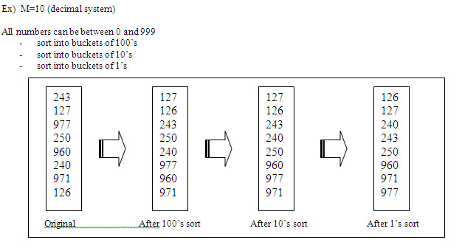
Radix sorting

Slide 6
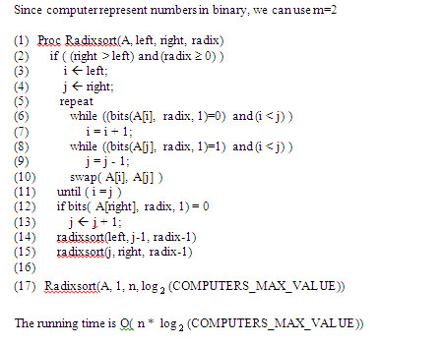
Radix Sort code and analysis 15

Slide 7
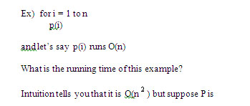
Amortized Cost

Slide 8
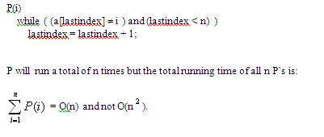
Amortized cost Example 20

Slide 9
Heap Sort
There are 3 procedures.
heapify takes an array A and an index i. It traverses down the tree binary heap and insert the passed in index value in the array into it’s correct location in the heap.
buildheap which will call heapify to insert all elements into the heap. Calling build heap on a arbitrary array will turn it into a binary heap.
heapsort will take an arbitrary array, call buildheap to turn the array into a binary heap. Then will pop the top element out of the heap into the answer array and between each pop, will re-heapify the array so to maintain the heap property.

Slide 10
Heap Sort code - Heapify
heapify ( A, i)
L ← left(i)
R ← right(i)
if ( (L ≤ heapsize [A]) and (A[L] > A[i]) )
then largest ← L
else largest ← i
if ( (R ≤ heapsize [A]) and (A[R] > A[largest]) )
then largest ← R
if (largest ≠ i)
swap( A[i], A[largest] )
heapify(A,largest)

Slide 11
Heap Sort – buildheap/heapsort
buildheap(A)
heapsize ← length(A);
for i ← ⎣ length[A] / 2 ⎦ downto 1
heapify(A, i);
heapsort(A)
buildheap(A)
for i ← length[A] downto 2
swap(A[1], A[i] )
heapsize = heapsize – 1
heapify( A, 1)

Slide 12
Heap Sort – Analysis 30
Heapify runs O(lg n).
Buildheap calls heapify n/2 times so it runs O(n lg n)
Heapsort calls buildheap once which run O(n lg n) and then calls (swap, a subtraction operating and heapify) n/2 times which runs:
O(n/2 * (O(1) + O(1) + O(lg n) ) which is O(n lg n).
Since heapsort runs 2 steps, each running O(n lg n), the overall algorithm runs O(n lg n).

Slide 13
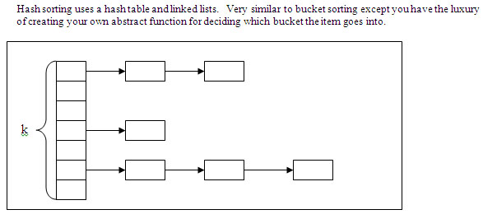
Hash Sort

Slide 14
Hash Sort
for i ← i to n
j ← hashfunction ( A[i] ) // get a linklist to add this into
add (A[i], linklist(j) ) // insert this value into the sorted linked-list
for i ← 1 to k
copy (linklist(i) , A);
Running time O(n * O(hashfunction + add) + k * O(copy)
If you choose a hash function that runs O(1), then the amortized cost of step 2 is O(k + n)
Note: if K << n then step 2 runs O(n)

Slide 15
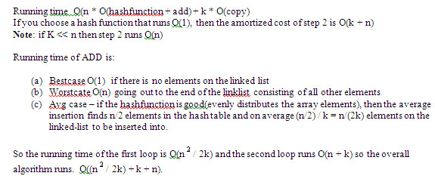
Analysis of Hash Sort 35

Slide 16
Comparison Sorting is O(n lg n)
Some sorting algorithms run O(n lg n) –
Quicksort
Heapsort
Mergesort
Some algorithms run linear time
Counting sort
Radix sort
Hashsort

Slide 17
Comparison Sorting is O(n lg n)40
Linear time sorting algorithms use some side fact such as all number range from 1 to 10,000.
Comparison sorting algorithms require each element must be compared against at least log n other elements before it can be declared in it’s final location.
No comparison sorting algorithm can be better than O(n lg n)
Therefore the problem “sorting” is (n lg n)-complete

