Slide 1
C++ Polymorphism
Reference and pointer implicit type casting
Virtual Functions
Abstract Base Classes
Pure virtual functions.

Slide 2
Polymorphism
Polymorphism means taking on many forms.
Poly=many morph = form.

Slide 3
Ex) Implicit type casting example
float pi = 3.14;
int& ir = pi;
cout << ir;
What if the value of ir?
3.14
3
Compiler will not allow it

Slide 4
Implicit type casting example 2
radio r; // derived from electronics
clock c; // derived from electronics
clock-radio cr; // derived from clock and radio
electronics* ep; // pointer to an electronics
radio* rp; // pointer to a radio
clock* cp; // pointer to a clock
clock-radio* crp; // pointer to a clock-radio

Slide 5
Example 2 – question 1
What happens if you compile/run the following:
ep = &cr; // electronic pointer pointing at a clock-radio
ep->powerUp(); // all 4 classes have a powerUp()
This will not compile
The powerUp() function of electronics will run
The powerUp() function of clock-radio will run
The powerUp() function depends on what the programmer wanted.

Slide 6
Example 2 – question 2
What happens if you compile/run the following:
crp = &r; // a clock-radio pointer pointing at a radio
crp->powerUp(); // all 4 classes have a powerUp function
This will not compile
The powerUp() function of radio will run
The powerUp() function of clock-radio will run
The powerUp() function depends on what the programmers wanted.

Slide 7
Example 2 – question 3
What happens if you compile/run the following:
rp = &cr; // radio pointer pointing to a clock-radio
rp->setVolume(3); // setVolume inherited from radio
This will not compile
The setVolume() from radio will run
The setVolume() from clock-radio (if it exists will run
The setVolume() from clock (if it exists) will run

Slide 8
Example 2 – question 4
What happens if you compile/run the following:
rp = &cr; // radio pointer pointing to a clock-radio
rp->setTime(3,20); // setTime inherited from clock
This will not compile
The setTime() function of radio will run
The setTime() function inherited from clock will run
The setTime() in clock-radio (if it exists) will run

Slide 9
Virtual Functions
class electronics
{
public:
virtual void power-up {stuff to power-up devices }
// more electronics stuff
}
With nonvirtual (by default) function, the type of the pointer/reference determines which function definition will be used.
For a virtual function, (using the new keyword) however, the class of the object pointed to/referred to will determine which function definition will be used.

Slide 10
Virtual function fun facts
The names of nonvirtual functions are bound at compile time (early binding).
The names of virtual functions are bound at run time, specifically, at the time each function is called (late binding).
It is illegal for a derived-class function to have the same name and argument list as an inherited virtual function but a different return type. If it were allowed, you could not tell which function should get called.
Constructors cannot be virtual. A virtual constructor would be useless because a constructor is always called to create an object of a specified class.
Virtual destructors are allowed. When the destructor of a base class is declared virtual, then destructors in derived classes override the base-class destructor, even though destructor functions for different classes have different names. When an object referred to by a pointer or reference is destroyed, the class of the object determines which definition of the virtual destructor will be called.

Slide 11
Abstract Base Classes (ABC’s)
A class that is used only for deriving other classes, and not for creating class objects, is called an abstract base class.
An example might be the electronics class. We would never create an electronics object. We would only create electronic something’s.
However all electronic products might have features in common like a serial number, and the company logo, etc.

Slide 12
Pure Virtual functions
class electronics
{
public:
virtual void power-up( ) = 0; // pure virtual function
// more stuff
}
A virtual function that is set to zero is referred to as a
pure virtual function.

Slide 13
Pure Virtual Functions fun facts
If a class has one or more pure virtual functions, the class is a abstract base class.
Objects can not be instantiated for an ABC.
If a class inherits from an ABC, and doesn’t override the all pure virtual functions inherited, it too is an ABC.
An abstract base class that never get inherited from is pointless, hence the “base” in the ABC.

Slide 14
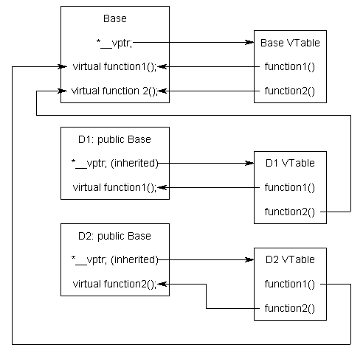
Implementation of Virtual functions

Slide 15
Java (1995) changes to C++ (1985)
Java added a keyword abstract to the declare of ABC’s and removed the “at least one, =0 function” concept.
Java removed the “virtual and non virtual functions” concept by making all methods virtual and therefore the keyword virtual is unnecessary.
An special ABC with NO data and ALL functions being pure virtual functions, is referred to by C++ programmer as an “interface”. Java removed multiple inheritance, created interfaces that you “implement” instead of inherit.

