Slide 1
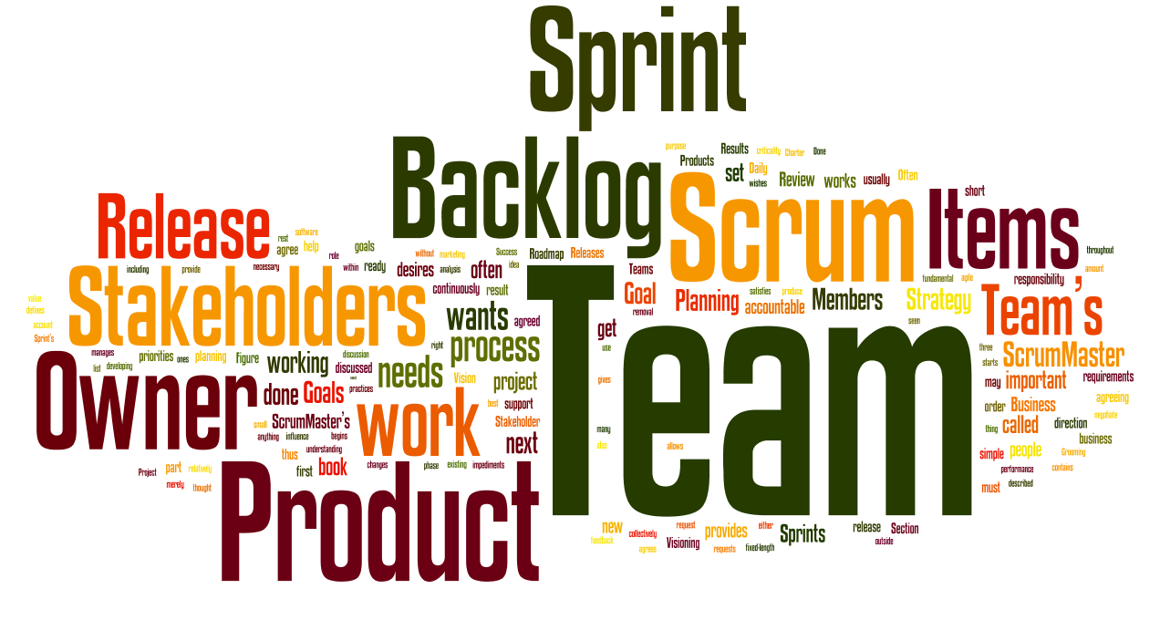
Agile
Adjective: Able to move quickly and easily.
Principles and Values

Slide 2
Agile (Principles and Values)
Agile causes teams to have beliefs
Teams use Beliefs to Makes Decisions
Decisions help to develop software

Slide 3
Agile Manifesto
We are uncovering better ways of developing software by doing it and helping others do it. Through this work we have come to value:
Individuals and interactions over processes and tools. Working software over comprehensive documentation. Customer collaboration over contract negotiation. Responding to change over following a plan
That is, while there is value in the items on the right, we value the items on the left more.

Slide 4
12 principles of Agile
Our highest priority is to satisfy the customer through early and continuous delivery of valuable software.
Welcome changing requirements, even late in development. Agile processes harness change for the customer's competitive advantage.
Deliver working software frequently, from a couple of weeks to a couple of months, with a preference to the shorter timescale.
Business people and developers must work together daily throughout the project.
Build projects around motivated individuals. Give them the environment and support they need, and trust them to get the job done.
The most efficient and effective method of conveying information to and within a development team is face-to-face conversation.
Working software is the primary measure of progress.
Agile processes promote sustainable development. The sponsors, developers, and users should be able to maintain a constant pace indefinitely.
Continuous attention to technical excellence and good design enhances agility.
Simplicity--the art of maximizing the amount of work not done--is essential.
The best architectures, requirements, and designs emerge from self-organizing teams.
At regular intervals, the team reflects on how to become more effective, then tunes and adjusts its behavior accordingly.

Slide 5
Agile’s Utility
Giving people a common foundation for making decisions about the best way to develop software.

Slide 6
Example : Proposed schedule
Release 1.0 Website that users can login to
Release 1.1 Users can upload pictures
Release 1.2 Security on logins
Release 2.0 Users can form friendships
Release 2.1 Users can create form groups
Release 3.0 Mobile device applications.
Release 3.1 Security on mobile devices.
Release 4.X series of releases unique to app

Slide 7
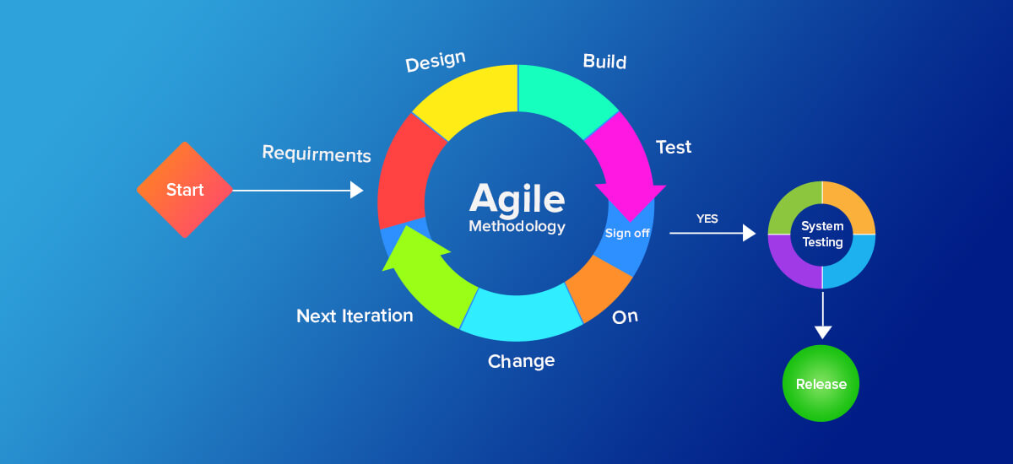
SCRUM
Produce backlog (wishlist)
Map Wish List to Release calendar

Slide 8
People
Product Owner – right features get into wishlist
Scrum Master – meeting, project plan
Developers – build product
Testers – test product
Customers – use product and pay for it

Slide 9
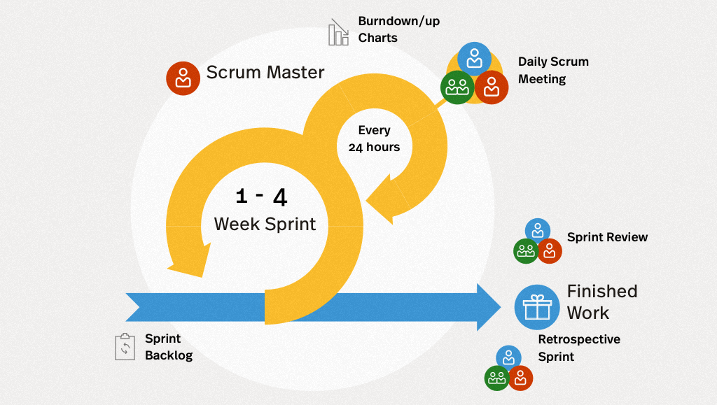
Release Planning
Identify which items on the product backlog go into each release → release backlog

Slide 10
Estimating time for tasks (stories)
1,2,4,8 hours (a 3 hour item will go in 4 hours)
2,3,5,10 days
1,2,3,6 months
Sprints – short duration milestones (2-30 days)
Burndown chart - (work remaining vs. Time)
Daily Scrum (standing, changes since yesterday)
Sprint retrospective meeting

