Slide 1
Dynamic Pricing
Airplane example

Slide 2
Same Seats-Different Prices
Business Travelers
Vacationers
Frequent Flyers
Etc.

Slide 3
Pricing Levels 1,2,3 etc
Level 1 – lowest fare
Level 2 – next lowest
…
Level N – highest fare

Slide 4
Example - 2 levels
Vacationers
Can plan weeks/months in advance
Typically stay over Saturday night
Business Travelers
Typically plan a few days in advance
Typically do not stay over Saturday night.

Slide 5
Assumptions
Level 1 tickets are sold in their entirety before any Level 2 tickets are sold
Once level 2 tickets start selling, no level one tickets can be sold.

Slide 6
Example data
Plane has 100 seats
Vacationers pay $59 each way.
Business travelers pay $99 each way
Vacationers price is in effect up until 7 days before flight
From 7 days to 0 days until the flight, the price is $99
Once the flight takes off, no more seat are sold and there may be empty seats.

Slide 7
Question
How many seats should be “protect” for the Business travelers to maximize the revenue of the flight?

Slide 8
Protecting to many
Suppose you reserve 70 for business travelers
And 100 vacationers want to get on the plane…you would only sell 30 seats to them.
Then suppose only 40 business travelers want tickets during the last week…you would sell them all but the plane would go out with 30 empty seats.
Result
You would have protected too many business seats and lose out on selling more seats to Vacationers

Slide 9
Protecting to few
Suppose you reserve 30 for business travelers
And 100 vacationers want to get on the plane…you would only sell 70 seats to them.
Then suppose 40 business travelers want tickets during the last week…you could only sell the 30 seats you have left. You would have to turn away 10 Business customers.
Result
You would have protected too few business seats and sold vacationers seats that Business people would have paid more money for.

Slide 10
Example 1.1
Plane has 100 seats
Fare 1 = $59
Fare 2 = $99
You know that exactly 40 people will come the last week and want to pay $99 for a seat.
There are an unlimited number of Class 1 customers
How many seats should you protect for class 2?

Slide 11
Example 1.2
Plane has 100 seats
Fare 1 = $59
Fare 2 = $99
There’s a 50% chance that 40 people will come the last week and want to pay $99 for a seat. And a 50% chance that 60 will.
There is an unlimited number of Fare 1 customers?
How many seats should you protect for class 2?

Slide 12
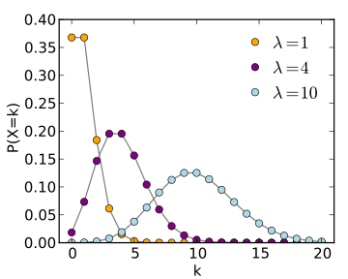
Poisson Random Variable

Slide 13
Example 1.3
Plane has 100 seats
Fare 1 = $59
Fare 2 = $99
The number of people wanting to pay fare 2 will be distributed as Poisson with parameter 40.
There is an unlimited number of Fare 1 customers?
How many seats should you protect for class 2?

