Slide 1
Financial Statements
Financial vs. managerial Accounting
Balance Sheets and Income Statements

Slide 2
Financial vs. Managerial
Financial accounting:
Not for managerial decision making
External accounting
Management/Cost accounting:
For managerial decision making (sunk cost(prospective), opportunity cost)
Internal accounting
Company decides cost accounting systems
Management information system

Slide 3
Realization / Accrual accounting
Realization principle / Accrual accounting
When is a sales revenue recognized in accounting?
1. Order received
2. Service delivered
3. Invoice sent
4. Payment received
Can we estimate the market value of a company from financial statements?

Slide 4
Companies value from Financials
Suppose risk free interest rate is 5%.
If you have an account that pays $10M/year in interest, who much is that account worth?
(Account Value) (5%) = $10M ➔AV = $200M
Now suppose some internet startup produces $10M profit/year, What is the company worth?

Slide 5
Matching Principle
Cost must be recognized when we have recognized the corresponding revenue
Problems with depreciation and future costs of guarantees

Slide 6
Principle of prudence
Do not overestimate your profits (you are allowed to underestimate your profits) R&D cost goes to the income statement: because you are not sure you are getting these benefits in the following years
Many years ago, AOL advertised. Instead of reporting the cost of advertising in the income statement, they considered that customers will stay 10 years. They reported 1/10 of advertising cost in the income statement and the rest went to the balance sheet. When AOL admitted to this aggressive accounting practice, AOL lost 10% in 1 day. This fraudulent behavior allowed them to show profits
A few years ago, AOL-Time Warner laid off people. Instead of reporting the 6-month salary severance in the income statement, they put both the $ acquisition and the cost of restructuring in the balance sheet. As a result, they faced a lot of pressure

Slide 7
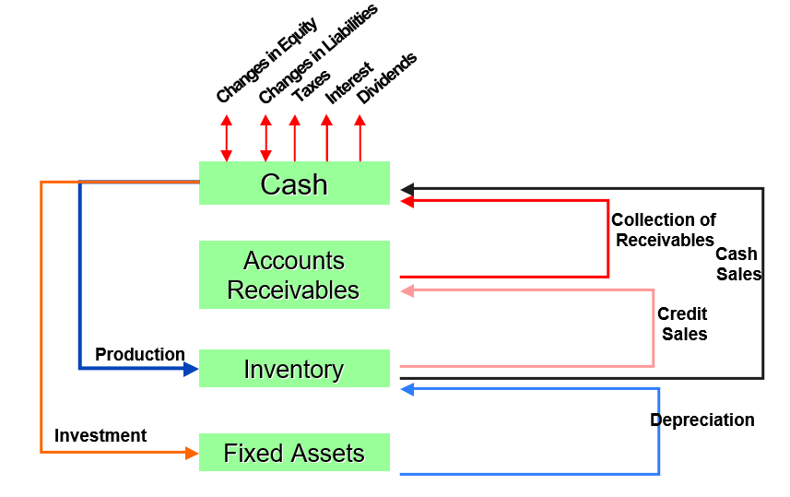
Cash Flow Cycle

Slide 8
Interpreting Financial Statements
Financial snapshot, at a point in time, of all the assets a company owns and all the claims against these assets
Assets = Liabilities + Shareholders’ equity
Question: If a company is short in cash, can it spend some of its shareholders’ equity? Why?

Slide 9
Assets = Liabilities + Stockholder Equity
Assets
Liquid assets
Accounts receivable
Inventories
Net Fixed assets
Other assets
Liabilities+S.E.
Short Term borrowing
Accounts payable
Net accruals
Long-term debt
Owners equity
Paid-in capital
Retained earnings

Slide 10
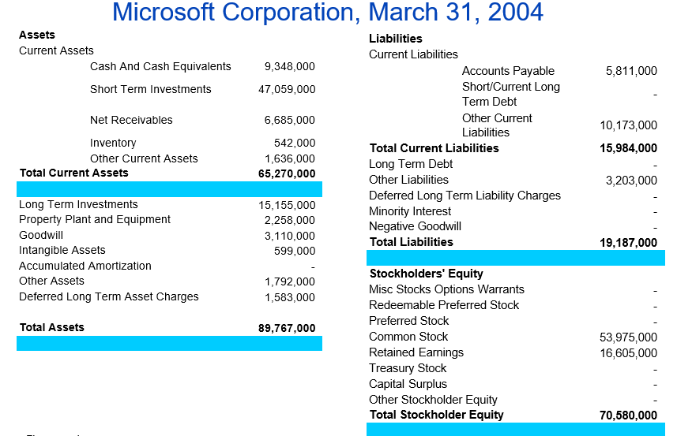
Balance Sheet – Microsoft 2004

Slide 11
Income Statement components
Net Sales
Gross Profit
Operating Profit
Earnings Before Interest & Taxes (EBIT)
Earnings Before Taxes (EBT)
Earnings After Taxes (EAT) or Net Income

Slide 12
Standard Income Statement
Net Sales
Cost of Good Sold (COGS)
Gross Profit
Administrative & Selling Expenses (SG&A) -
Depreciation
Operating Profit (Profit from main business)
+/- Extraordinary Gain/Loss
+ Other Income (Profit from financial investments (e.g. interest on assets))
Earnings Before Interest & Taxes (EBIT)
Interest Expenses
Earnings Before Taxes (EBT)
Provision for Income Taxes
Earnings After Taxes (EAT) (To the owner? (not necessarily: Dividends, Retained earnings))

Slide 13
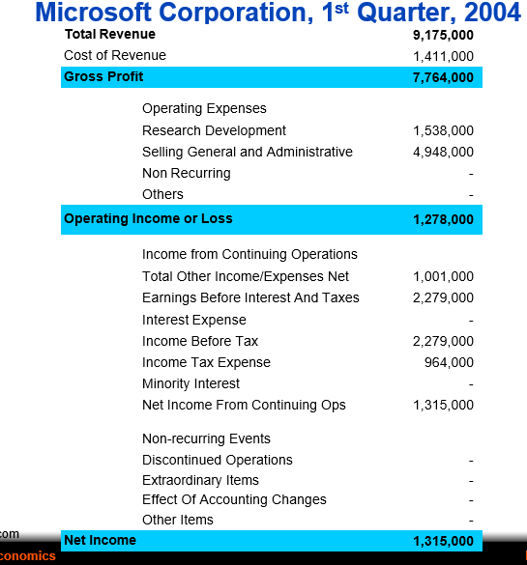
Income Statement – Microsoft 2004

