Slide 1
Outsourcing (Off shoring)
H1-B (B1B) visa program

Slide 2
Total cost of an Employee
Factors:
Salary (base pay, overtime, bonus)
Benefits (health, dental, education)
Employee Taxes (state, federal, unemployment)
Space (office space, desk etc.)
Equipment (computer, phone, pens etc.)

Slide 3
General value of an Employee
Factors:
Education
Experience
Problem solving skills
Drive
Communication
Evaluating an employee
- Weighted average of ratings of categories rate employees from 1 - 5

Slide 4
Utility value of an employee
Factors:
Employees general value
Your companies need for that skill set.
Duplication of skill (existing employees)
Cost of the employee

Slide 5
A Rock Band is hiring
Needs:
Singer
Guitar player(s)
Bass Player
Drummer
Keyboards
Saxophone
You can hire a great Sax player?
You have 2 guitar players, and
Hire a 3rd great guitar player?
You have a great singer and can hire another great singer?

Slide 6
Working Remotely (not in office)
Agile Principle #6
The most efficient and effective method of conveying information to and within a development team is face-to-face conversation.

Slide 7
Working remote (from home)
Pro:
Saves cost on office space and equipment
No commute, more time to work
Employee saves commute costs (can pay less)
Tax advantages

Slide 8
Working remote (from home)
Cons:
Loses value of workers being together
Hard to separate work/personal activities
Distractions, lack of productivity
Bad reputation (in office workers opinion)

Slide 9
Outsource (Offshoring, Onshoring)
Outsource to obtain (goods or a service) from an outside or foreign supplier, especially in place of an internal source.
Offshoring is the practice of hiring an external organization to perform some business functions ("Outsourcing") in a country other than the one where the products or services are actually developed or manufactured ("Offshore").
Onshoring is the practice bring offshore people to your country to work here onshore.

Slide 10
Technology workforce outside USA
The digital workforce of countries like India and China are only paid a fraction of what would be minimum wage in the US.
On average, software engineers are getting paid between 250,000 and 1,500,000 rupees (US$4,000 to US$23,000) in India as opposed to $40,000–$100,000 in countries such as the US and Canada

Slide 11
H1-B visa program in USA (1)
1950’s H-1 visa allowed foreign worker with “distinguished merit and abilities” to find legal employment in USA.
1990 – (IMMACT) H1-B visas allowed bachelor's or higher or equivalent work experience in Technology. 65,000/year cap.
1997 – the cap was hit for the first time

Slide 12
Bill Gates testifies at US Congress

Slide 13
H1-B visa program in USA (2)
1998 H-1B visa cap 115,000 (increase of 50,000)
2001 H-1B visa cap 195,000 (increase of 80,000) plus additional visas for universities and Government research
2004 → 2018 – the cap set back to 65,000
(the law increasing the number from 65,000 expired and was not reset)

Slide 14
H1-B visa program in USA (3)
2018 H-1B visa cap 65,000
H-1B masters 20,000 cap (foreign worker holding a US masters or higher degree)
(a worker can apply to both)

Slide 15
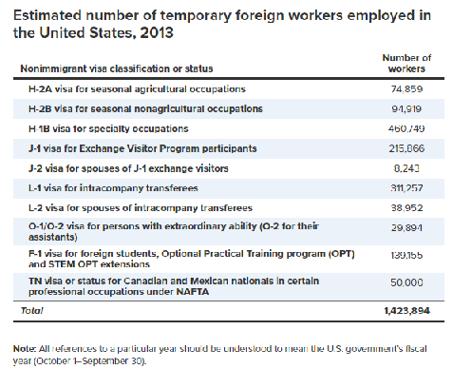
Temporary Foreign Workers in USA

Slide 16
Offshoring
Suppose you have a project that needs 10 people to complete by a certain date.
Questions you might ask:
Why do you need 10 people (8 very good workers can do the same as 12 not so good workers, so where did 10 come from?)
Why is it due on the due date? What would be the cost of it being late? More time could mean less people needed.
What roles must be filled? How long does it take to hire?
What’s the start up budget?

Slide 17
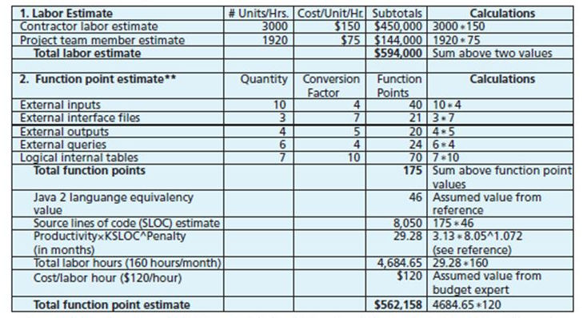
Software Project Cost estimates

