Slide 1
Assembly Language
Adding, Subtracting, multiplying, dividing
IF statements with == and <>
IF statements with <=, <, >=, >

Slide 2
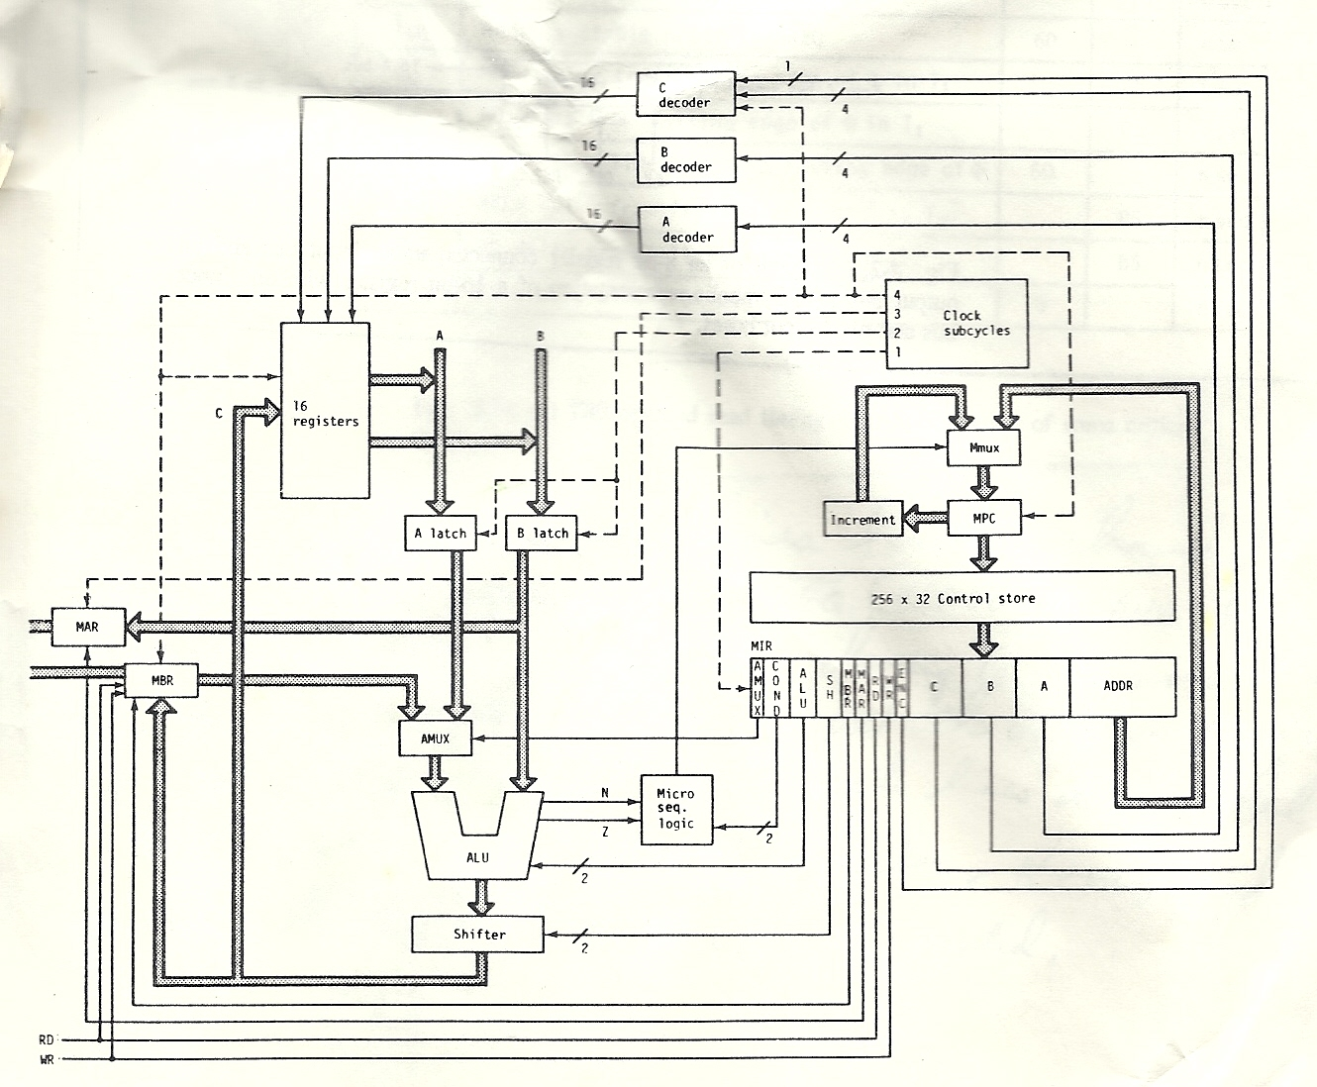
Architecture

Slide 3
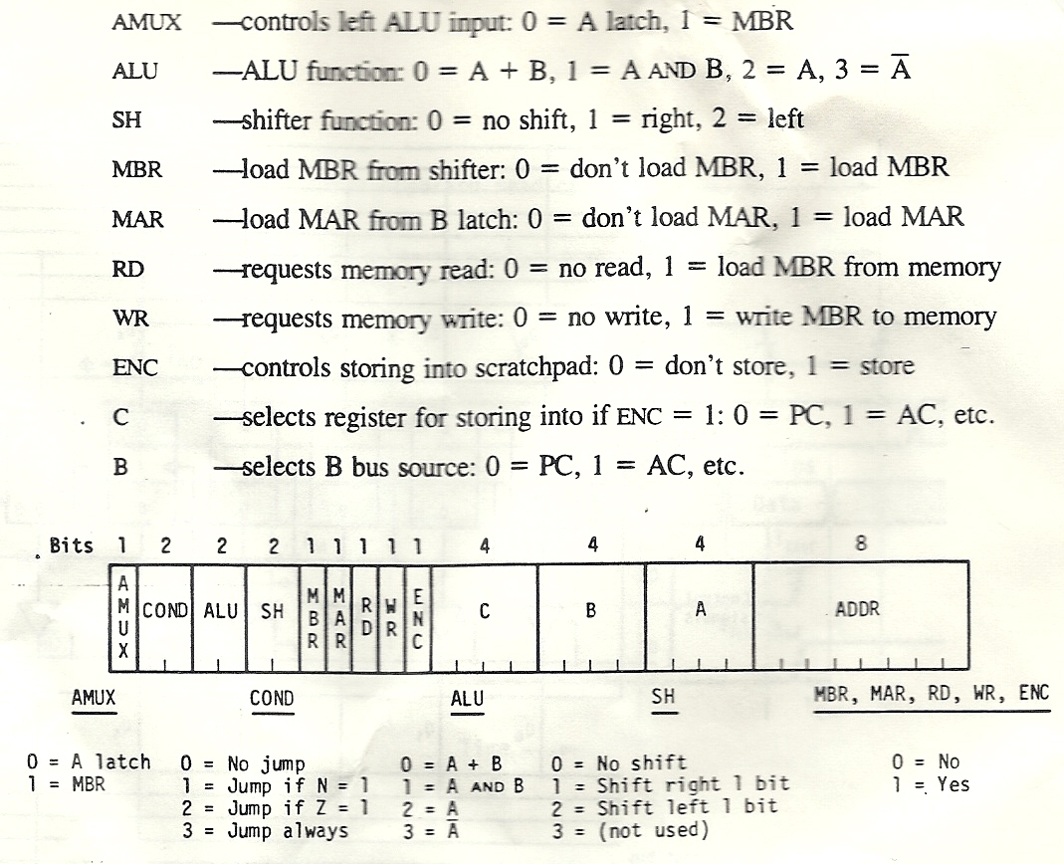
Instruction Format

Slide 4
C = A + B;
LOAD A, R8 // LOAD A into Register 8
LOAD B, R10 // LOAD B into Register 10
ADD R8, R10, R4 // ADD R8 & R10 ans→R4
STOR R4, C // STORe result into C

Slide 5
Recall (or soon learn) 2’s Compliment
2’s compliment negative numbers are calculated by
- taking the positive number
- inverting (flipping) all the bits
- adding 1 to the result
Example (-3) is 0011(+3)
→ 1100 (-3 in 1’s compliment)
→ 1101 (-3 in 2’s compliment)
Then 0101 (+5)
+ 1101 (-3 in 2’s compliment)
-----------
1 0010 (+2)

Slide 6
C = A – B;
LOAD A, R8 // LOAD A into Register 8
LOAD B, R10 // LOAD B into Register 10
COMP R10, R10 // 1’s Compliment of B
ADD R10, #1,R10 // 2’s Compliment of B
ADD R8,R10,R1 // A+(-B) = A-B
STOR R1, C // STORe A-B into C

Slide 7
C = A * 5;
LOAD A, R1 // LOAD A into Register 1
LOAD A, R4 // LOAD A into Register 4
SHFL R4, R4 // R4 = 2 * A
SHFL R4, R4 // R4 = 4 * A
ADD R1,R4,R1 // ADD A to 4*A
STOR R1, C // STORe A*5 into C

Slide 8
if (C >= 0)
if (C >= 0) { thenStuff } else { elseStuff };
afterStuff;
LOAD C, R1
JN else_label
then_label: thenStuff
JMP end_label
else_label: elseStuff
after_label: afterStuff

Slide 9
if (C < 0)
if (C < 0) { thenStuff } else { elseStuff };
afterStuff;
LOAD C, R1
JN then_label
JMP else_label
then_label: thenStuff
JMP after_label
else_label: elseStuff
after_label: afterStuff

Slide 10
Other inequalities
JN ELSE_LABEL
will jump if the result is negative so we want to jump when the condition is false and don’t jump otherwise.
IF (C =< 0) // subtract 1 from C, then ask C < 0
IF (C < 4) // subtract 4 from C, then ask C < 0
IF (C < B) // subtract B from C, then ask C < 0
IF (C > B) // subtract C from B, then ask B < 0
IF (C >= B) // subtract C from B, subtract 1 from B, B<0?

Slide 11
if (C == 0)
if (C == 0) { thenStuff } else { elseStuff };
afterStuff;
LOAD C, R1
JZ then_label // C == 0 so then
JMP else_label // C <> 0 so else
then_label: thenStuff
JMP after_label
else_label: elseStuff
after_label: afterStuff

Slide 12
if (C == B)
if (C == B) { thenStuff } else { elseStuff };
afterStuff;
LOAD C, R1 // load c into register 1
LOAD B, R2 // load b into register 1
CMPL R2, R2 // 1’s compliment of B
ADD R2, #1 ,R2 // 2’s compliment of B
ADD R2,R1, R3 // C + (-B) = C-B
JZ then_label // if 0, C==B
JMP else_label // skip then stuff
then_label: thenStuff
JMP after_label // skip else stuff
else_label: elseStuff
after_label: afterStuff

Slide 13
for (i=1; i < 10; i++) { for loop stuff }
LOAD #1, R1 // load 1 into register 1
LOAD #10, R10 // load 10 into R10
CMPL R10, R10 // 1’s compliment of 10
ADD #1, R10, R10 // 2’s compliment of -10
for_loop: ADD R1, R10, R15 // load b into register 1
JN for_stuff // if I –10 is negative, stay
JMP after_for // if I - 10 >= 0, leave
for_stuff: for_loop_stuff
ADD #1, R1, R1
JMP for_loop
after_for: More Stuff

