Slide 1
Binary, Decimal and Hexadecimal Numbers

Slide 2
Numbering Systems
Radix - In mathematical numeral systems, the radix or base is the number of unique digits, including zero, that a positional numeral system uses to represent numbers.
For example, for the decimal system (the most common system in use today) the radix is ten, because it uses the ten digits from 0 through 9.
Source: Wikipedia

Slide 3
Creating a Numbering System
Create r unique symbols.
Order the symbols from lowest value to highest value
Sequentially list the symbols from lowest to highest until all r symbols are used up.
Once the highest value symbol is reached, the next number is obtained by resetting the symbol back to the lowest value and adding one to the next column to the left.

Slide 4
Decimal Numbering System
Symbols = { 0,1,2,3,4,5,6,7,8,9}
Order = { 0<1<2<3<4<5<6<7<8<9}
Numbering:
0,1,2,3,4,5,6,7,8,9,
10,11,12,13,14,15,16,17,18,19
20,21,22,23,24,25,26,27,28,29
…
90,91,92,93,94,95,96,97,98,99
100,101,102,103,104,105,106,107,108,109
110,111 etc.

Slide 5
Why do we use Base(Radix) 10?
Nobody knows for sure but is it widely believed that it is because human beings have 10 fingers.

Slide 6
Inches, Feet and Yards
Inches count up to 12 ( 1 foot = 12 inches)
Feet count up to 3 (1 yard = 3 feet)
Counting in Inches, Feet and Yards
1 inch, 2 inches…11 inches
1 foot 0 inches, 1 foot 1 inch...1 foot 11 inches
2 foot 0 inches, 2 foot 1 inch...2 foot 11 inches
1 yard 0 foot 0 inches, 1 yard 0 foot 1 inches

Slide 7
Converting from yards, feet and inches to inches
Question:
How many inches is 2 yards, 2 feet and 4 inches?
Answer:
2 yards = 2 * 3 feet * 12 inches = 72 inches
2 feet = 1 * 12 inches = 24 inches
4 inches = 4 inches
-----------------
Total 100 inches

Slide 8
Time system: hours, minutes, seconds
60 seconds = 1 minutes
60 minutes = 1 hour
24 hours = 1 day
What time comes after 23:59:59?
Answer: 00: 00: 00

Slide 9
Time system: hours and minutes to minutes
Question:
A movie is 2 hours and 10 minutes long. How many minutes is that?
Answer:
2 hours = 2 * 60 minutes = 120 minutes
10 minutes = = 10 minutes
----------------------
Total 130 minutes

Slide 10
Binary Numbering System
Radix based system with Radix = 2
The 2 Symbols are = { 0, 1}
Order = { 0 < 1 }
Advantage: low number of symbols to memorize
Disadvantage : numbers take up a lot of space

Slide 11
Counting in Binary
0
1
10
11
100
101
110
111
1000

Slide 12
Counting in Binary
Question:
What binary number comes after 1011011?
Answer:
1011100

Slide 13
Hexadecimal Numbering System
Radix based system with Radix = 16
The 16 Symbols and their order is:
{ 0<1<2<3<4<5<6<7<8<9<A<B<C<D<E<F }
Advantage: takes up less space
Disadvantage : more symbols than 10 to memorize

Slide 14
Counting in Hexadecimal
0,1,2,3,4,5,6,7,8,9,A,B,C,D,E,F
10,11,12,13,14,15,16,17,18,19,1A,1B,1C,1D,1E,1F
20,21,22,23,24,25,26,27,28,29,2A,2B,2C,2D,2E,2F

Slide 15
Counting in Hex
Question:
What hex number comes after 39F?
Answer:
3A0

Slide 16
Why use the Binary system?
Computers run on electricity!
Electricity is either on or off
So we need to represent the state of the parts of a computer with a numbering system that has 2 symbols.
Generally 1 means Electricity is on and 0 means electricity is off

Slide 17
Why use the Hexadecimal system?
Binary numbers are too big. Hexadecimal is a numbering system that maps binary to hex numbers and doesn’t require us to memorize too many symbols.
Every group of 4 binary symbols is exactly 1 hexadecimal symbol.

Slide 18
Mapping Binary to Hex
Binary | Decimal | Hexadecimal
0 | 0 | 0
1 | 1 | 1
10 | 2 | 2
11 | 3 | 3
100 | 4 | 4
101 | 5 | 5
110 | 6 | 6
111 | 7 | 7
1000 | 8 | 8
1001 | 9 | 9
1010 | 10 | A
1011 | 11 | B
1100 | 12 | C
1101 | 13 | D
1110 | 14 | E
1111 | 15 | F

Slide 19
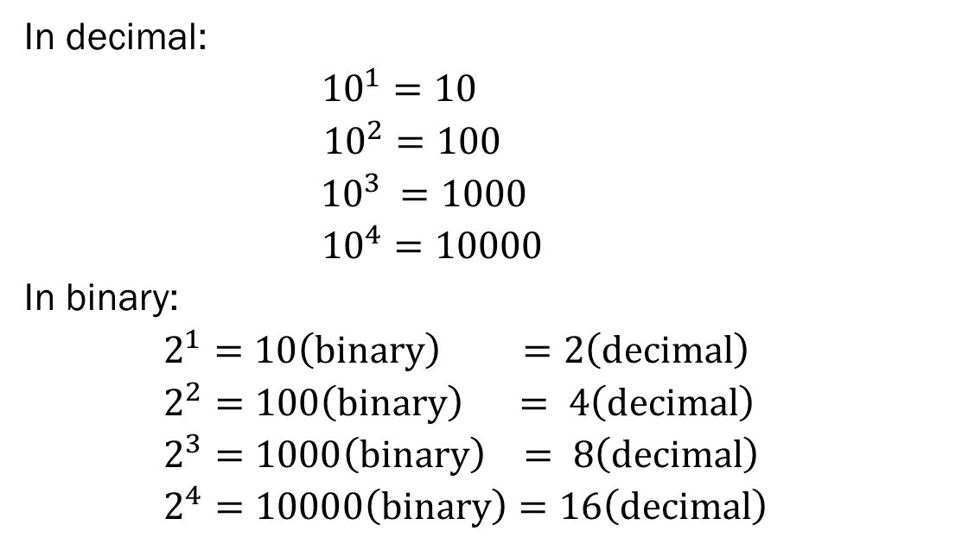
Powers
In decimal:
${10}^{1}=10$
${10}^{2}=100$
${ 10}^{3} =1000$
${10}^{4}=10000$
In binary:
$2^{1}=10\left(binary\right) =2\left(decimal\right)$
$2^{2}=100\left(binary\right) = 4\left(decimal\right)$
$2^{3}=1000\left(binary\right) = 8\left(decimal\right)$
$2^{4}=10000\left(binary\right)=16\left(decimal\right)$

Slide 20
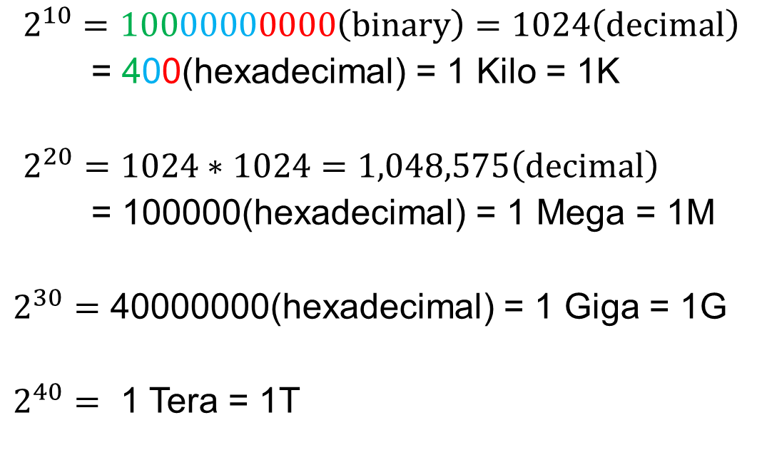
Kilo, Mega, Giga, Tera Etc.
$2^{10}=10000000000\left(binary\right)=1024\left(decimal\right)$
= 400(hexadecimal) = 1 Kilo = 1K
$2^{20}=1024∗1024=1,048,575\left(decimal\right)$
= 100000(hexadecimal) = 1 Mega = 1M
$2^{30}=$ 40000000(hexadecimal) = 1 Giga = 1G
$2^{40}=$ 1 Tera = 1T

Slide 21
Computer specs are quoted in powers of 2
Example)
You might by a computer with
4 gigahertz processor
256 megabytes of RAM
1 Terabyte hard drive
Example)
Apple Ipad’s are now available in 16, 32 and 64 gigabytes of memory

