Slide 1
Cache Memory
Memory Review
Cache Memory
Translation Lookaside Buffers
Write-back vs. Write-Through

Slide 2
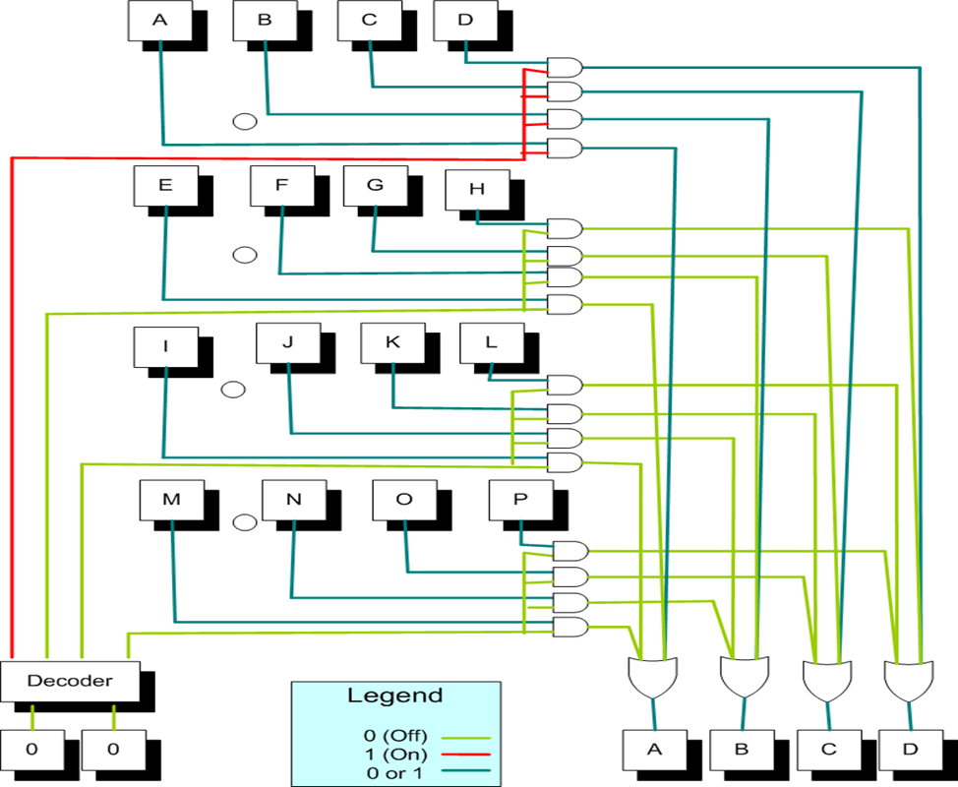
Reading From Memory

Slide 3
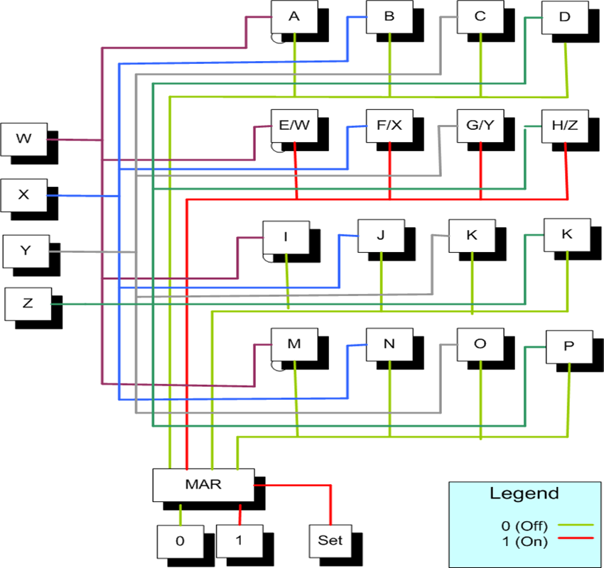
Writing To Memory

Slide 4
Accessing memory
When accessing memory (reading or writing) we need to “address” the memory location where the are reading or writing to. When reading memory, for example, recall that in hardware, we place the address in the MAR register, the value goes through a demux which causes all memory locations to be ANDed with a zero with the exception of the address location we are interested which gets ANDed with a one. The output of all of these ANDed copies of all memory locations go through a massive OR gate and eventually all bits of the memory location we are interested in get copied to the MBR…An equal amount of hardware is needed to write to memory.
Since the larger the memory is, the longer the access time is for each memory reference, the concept of a smaller memory containing the most commonly referenced pages could save time in memory reference times.

Slide 5
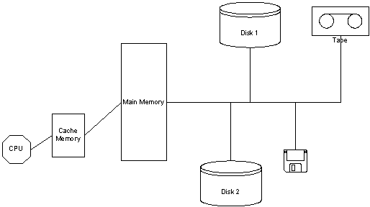
Processor with Cache Memory

Slide 6
Hierarchy of memory access
With a cache memory added in front of the Main memory, when the processor running a program goes to access storage, the storage will of course be on disk, it may be in main memory (MM is a subset of disk), and it may be in the cache (cache is a subset of MM).
If the page referenced is in the cache, great!!! the access time will be very short
if not, then the next step is to access main memory
if not in MM (page fault) then we go out to the disk.

Slide 7
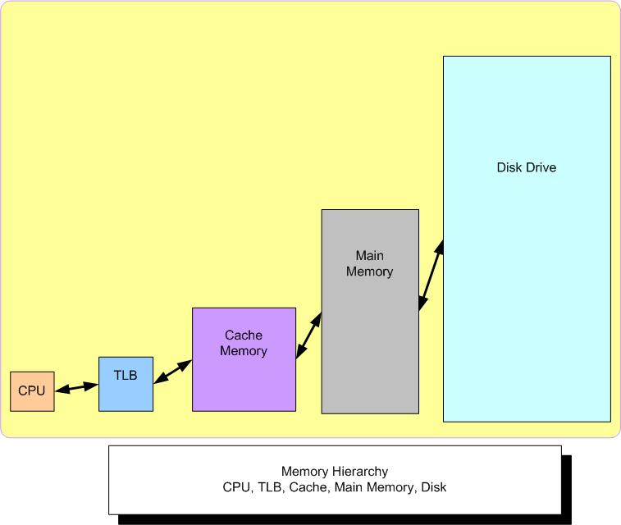
Memory Hierarchy

Slide 8
Hardware for page translation(TLB)

Slide 9
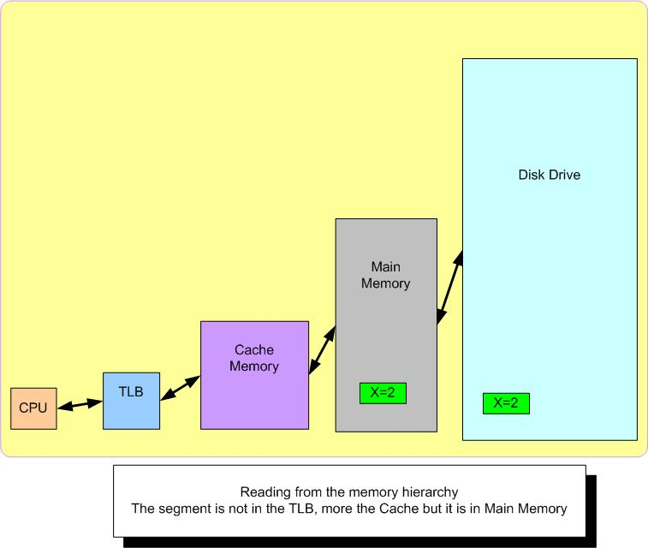
Variable X is in MM and on Disk

Slide 10
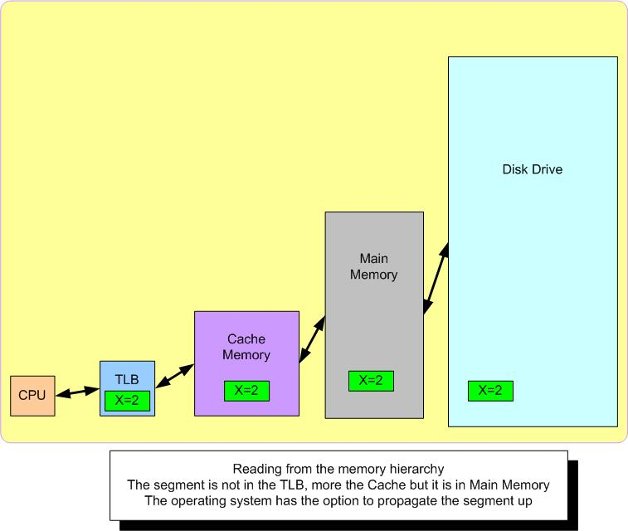
We need to read X

Slide 11
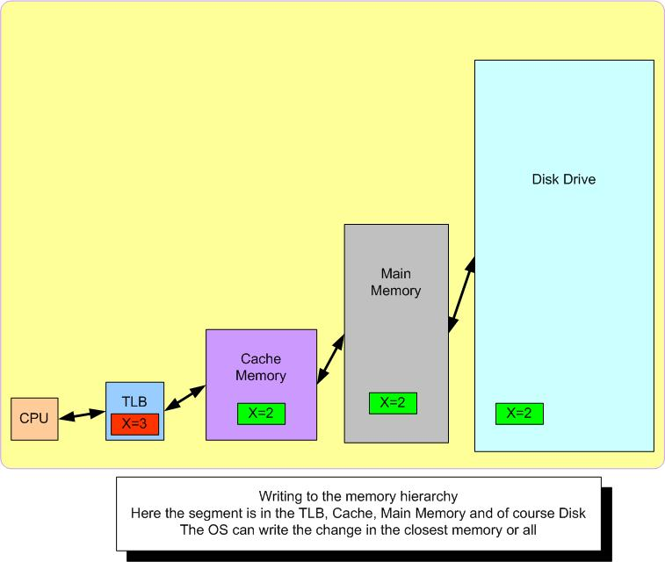
We need to write X

Slide 12
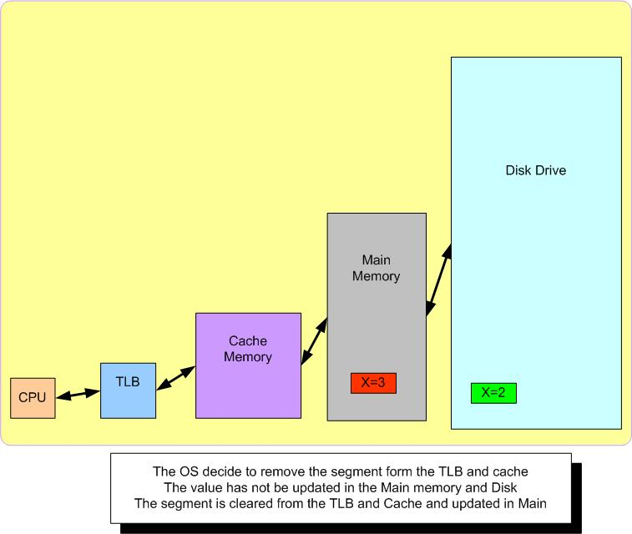
We need to make room

Slide 13
Writing policy with Caches
Write Back Cache
Cache policy where if a change is made to the page of cache storage then the corresponding page in main memory is not updated. Reads obviously do not need to be updated but writes are not updates here.
Write Through Cache
Cache policy where if a change is made to the page of cache storage then the corresponding page in main memory is also updated. Reads obviously do not need to be updated but writes do.

Slide 14
Hit Ratio (Miss ratio)
The probability of the reference being in the cache is the hit ratio. The probability of the reference not being in the cache is the miss ratio.
Consider the following example:
If access to the cache takes 1 μS and access to the main memory is 10 μS
What value of p (the hit ratio) would it be advantages to use the cache?
Without the cache the access time is 10 μS per memory reference.
With the cache, the average memory reference is:
(Hit ratio) * (cache access time) + (miss ratio)*(cache access time + MM access time) = (hit ratio) (1) + (1 – hit ratio) (1+10)
= (hit ratio) + 11 – (hit ratio)(11) = 11 – 10(hit ratio)
So when is 11 – 10(hit ratio) < 10
Hit ratio > 1/10.

Slide 15
Which Cache is better (if any)?
Consider using 1 of 2 caches, a 32K cache or a 64K cache, and then MM.
Access to the 32K cache takes 1 μS, and has a miss ratio of 1/3.
Access to the 64K cache takes 2 μS and has a miss ratio of 1/6
Access to MM is 10 μS and never misses.
Which cache should be used if any?
The expected number of seconds per memory reference is:
Enocache = 10 μS
E32K = (2/3) (1 μS) + (1/3) (1+10) = 4 1/3 μS.
E64K= (5/6) (2 μS) + (1/6) (2+10) = 3 2/3 μS
So here the 64K cache is the best of the 3 options.

Slide 16
Multiple caches
Consider 2 caches, MM and disk.
Access to the 32K cache takes 1 μS, and has a miss ratio of 1/2.
Access to the 64K cache takes 2 μS and has a miss ratio of 1/4
Access to MM is 10 μS and has a miss ratio of 1/10.
Disk has all pages and takes 100 μS.
The expected number of seconds per memory reference is:
E = (0.5)(1 μS) + (0.25)(1+2 μS) + (0.15)(1+ 2+10 μS) + (0.10)(1+ 2+10+100 μS) = 14.5 μS

Slide 17
Multiple caches with TLB
Consider 2 caches, MM and disk.
TLB access time is 1 μS and has a miss ratio of 4/5.
Access to the 32K cache takes 5 μS, and has a miss ratio of 1/2.
Access to the 64K cache takes 10 μS and has a miss ratio of 1/4
Access to MM is 30 μS and has a miss ratio of 1/10.
Disk has all pages and takes 100 μS.
The expected number of seconds per memory reference is:
E = (0.2)(1 μS) + (0.3)(5 μS) + (0.25)(5+10μS) + (0.15)(5+10+30 μS) (0.10)(5+10+30+100 μS) = 26.7 μS

Slide 18
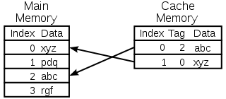
Tagging MM address

Slide 19
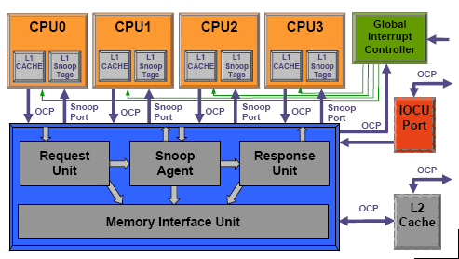
Snooping for cache changes

