Slide 1
CPU Clocks
Delays
Slow down / speed up
Processor speed
Instruction per second

Slide 2
Clock
The clock rate typically refers to the frequency at which a chip like a central processing unit (CPU), one core of a multi-core processor, is running and is used as an indicator of the processor's speed.
The clock rate of a CPU is normally determined by the frequency of an oscillator crystal. Typically a crystal oscillator produces a fixed sine wave—the frequency reference signal. Electronic circuitry translates that into a square wave at the same frequency for digital electronics applications (or, in using a CPU multiplier, some fixed multiple of the crystal reference frequency).

Slide 3
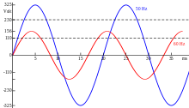
USA vs. Europe

Slide 4
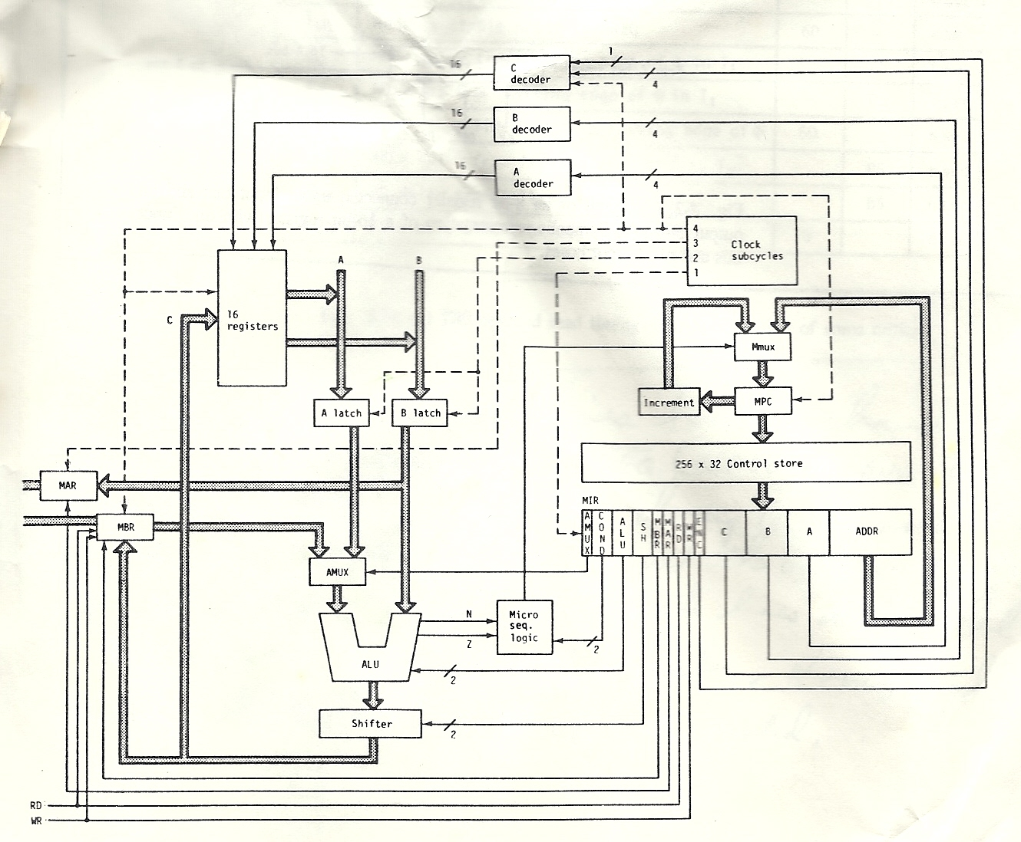
Simple processor design review

Slide 5
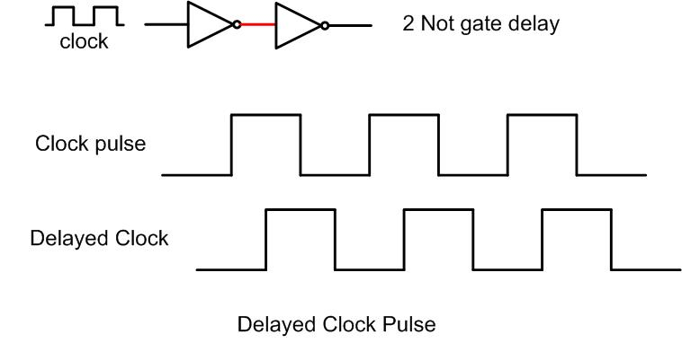
Delay clock pulse

Slide 6
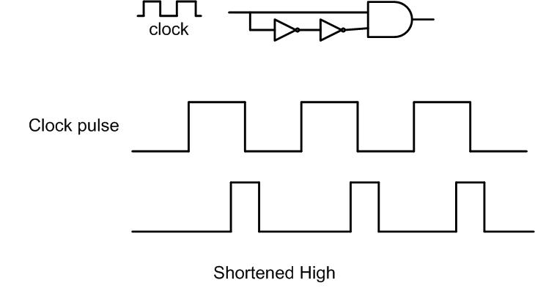
Clock pulse high shortening

Slide 7
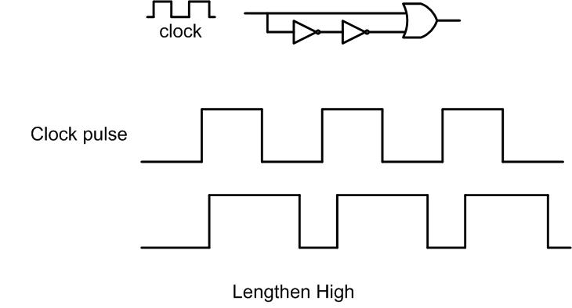
Clock pulse high lengthening

Slide 8
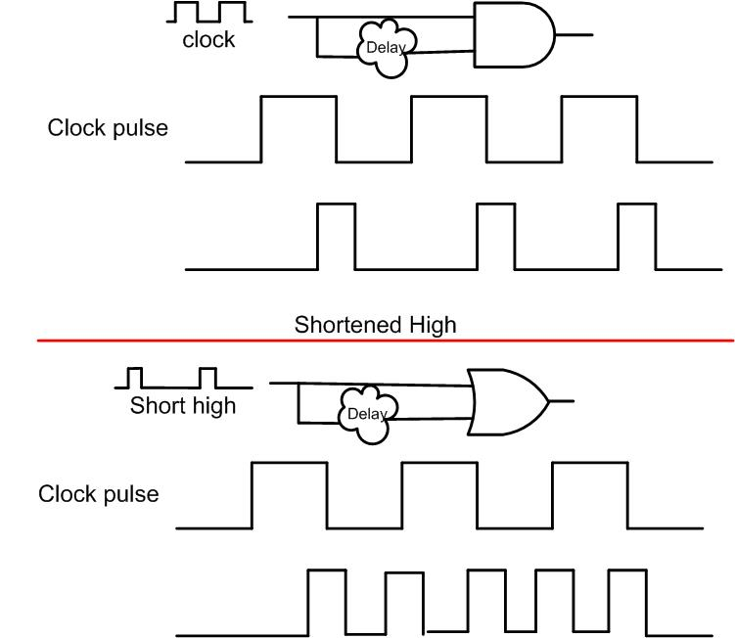
Speeding up the clock

Slide 9
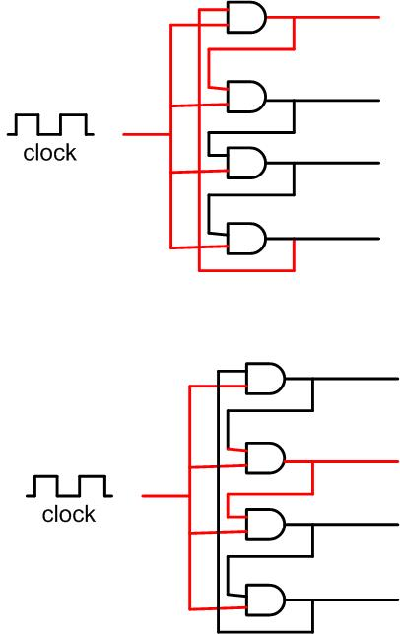
4 stage clock

Slide 10
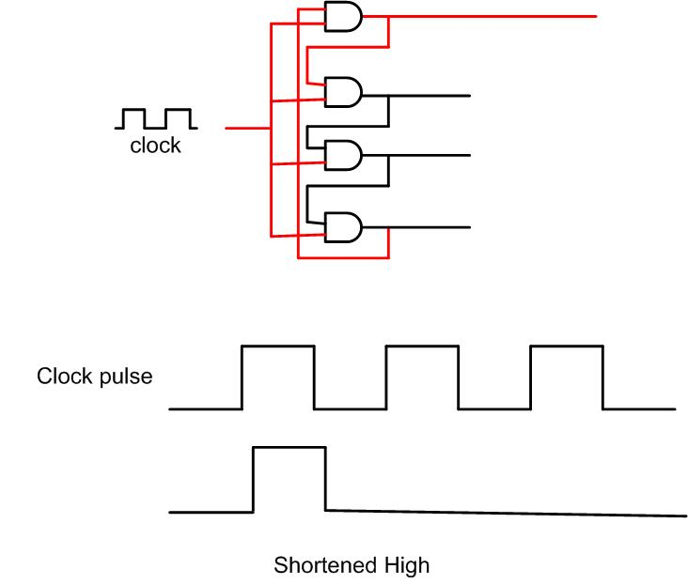
Slowing the clock down

Slide 11
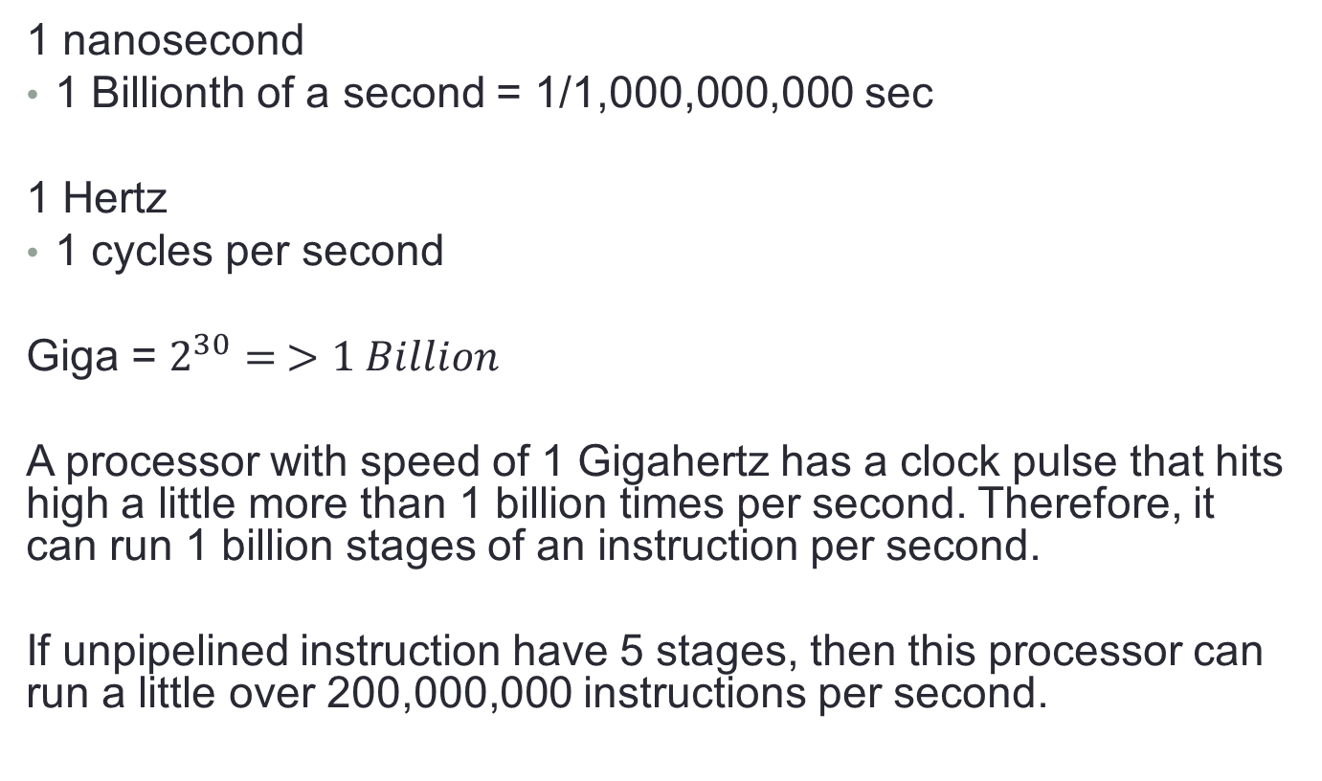
Definitions
1 nanosecond
1 Billionth of a second = 1/1,000,000,000 sec
1 Hertz
1 cycles per second
Giga = $2^{30}= >1 Billion$
A processor with speed of 1 Gigahertz has a clock pulse that hits high a little more than 1 billion times per second. Therefore, it can run 1 billion stages of an instruction per second.
If unpipelined instruction have 5 stages, then this processor can run a little over 200,000,000 instructions per second.

Slide 12
Clock rates through history
The first electromechanical general purpose computer, the Z3 operated at a frequency of about 5–10 Hz. The first electronic general purpose computer, the ENIAC, used a 100 kHz clock in its cycling unit. As each instruction took 20 cycles, it had an instruction rate of 5 kHz.
As of 2011^{[update]}, the Guinness World Record for fastest CPU is by AMD with a Bulldozer based FX chip "overclocked" to 8.805 GHz, trumping the maximum recorded 8.670 GHz performance of their next generation FX "Piledriver" chips.^{[3]}

