Slide 1
Interrupts
Hardware
Software

Slide 2
Interrupt definition
Dictionary definition: stop the continuous progress of (an activity or process).
Hardware interrupts are used by devices to communicate that they require attention from the operating system
A software interrupt is caused either by an exceptional condition in the processor itself, or a special instruction in the instruction set which causes an interrupt when it is executed.

Slide 3
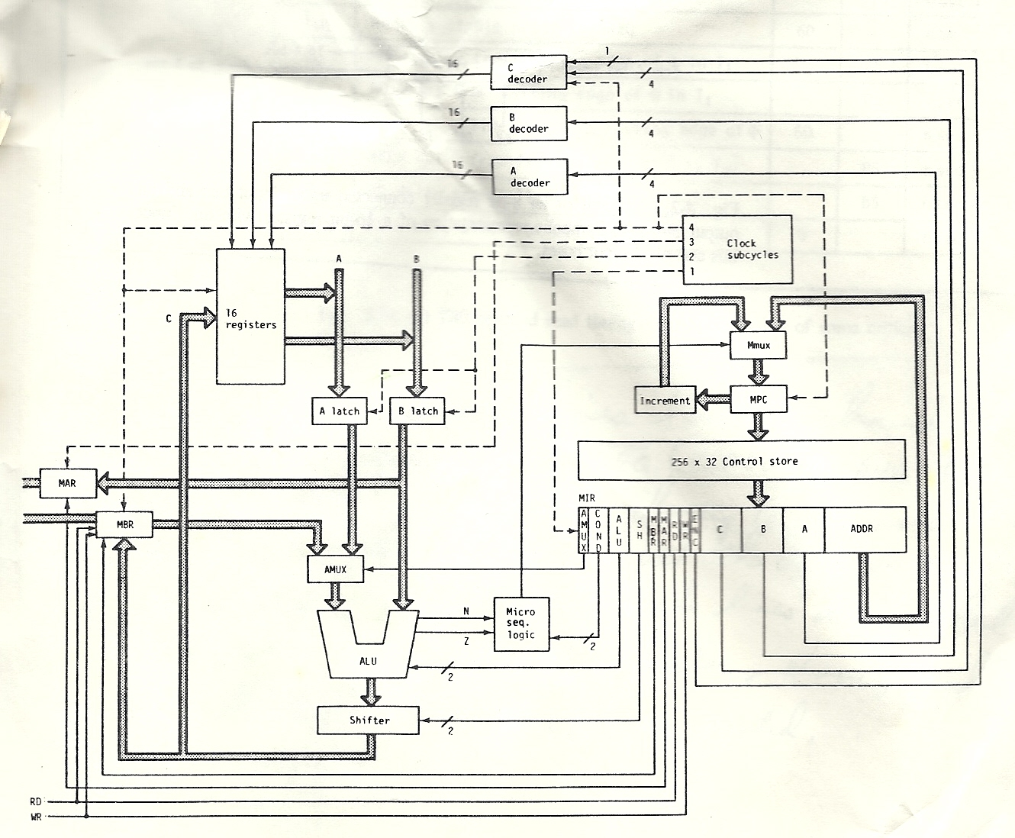
Simple processor design review

Slide 4
New Register Interrupt Register (IR)
A hardware register (bits) that contains a value at all times.
Silly example of a nibble IR and possible problems
0000 – No problem
0001 – Printer is out of paper
0010 – Processor is overheating
0011 – Disk drive is disconnected
0100 – Internet connection is lost

Slide 5
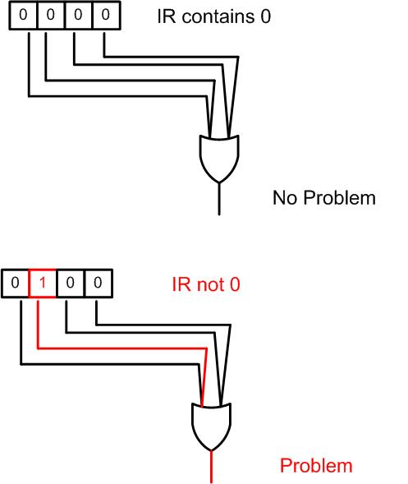
Interrupt Register (IR)

Slide 6
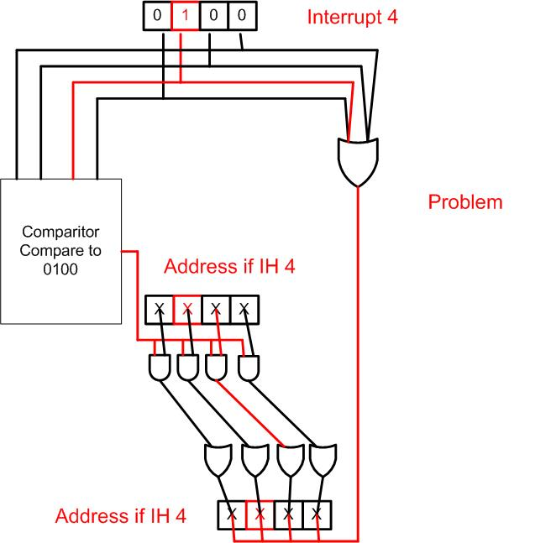
Hardware Interrupt Handler locator

Slide 7
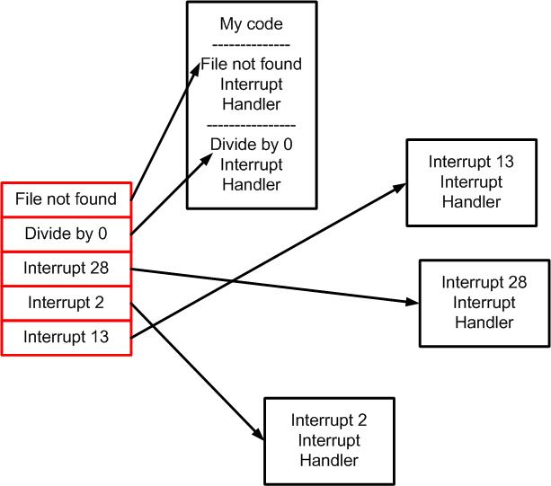
Software Interrupts

Slide 8
What is an Exception?
An exception is an event, which occurs during the execution of a program, that disrupts (interrupts) the normal flow of the program's instructions.
Exceptions are a software version of interrupts

Slide 9
Example (file not found)
void readFile()
{
openFile = open(“input.txt”);
strings[] s = readFrom(openFile);
doStuff(s);
close(openFile);
}
Should work fine, however, what if the file input.txt is not there one day when you are running this program?

Slide 10
3 kinds of exceptions
1) Checked exceptions. User can anticipate
Ex) file not found.
2) Error exceptions. Error that are external to the applications like hardware exceptions.
3) Runtime exception. Logic error in code and improper used of API, etc.

Slide 11
Class definitions for exception objects
Consider the following :
The Mathematical exception library might be organized like this.
class Matherr
{
virtual void debug_print( ) const { cerr << “Math error”;}
} ;
class Overflow : public Matherr { } ;
class Underflow : public Matherr { } ;
class Zerodevide: public Matherr { } ;
class overflow : public Matherr
{
const char* op;
int a1, a2:
public:
void int_overflow(const char* p, int a, int b) { op = p;a1= x; a2 = y;}
virtual void debug_print( ) const { cerr << op << ‘(‘ << a1 << ‘,’ << a2 << ‘)’; }
} ;

Slide 12
Catching exceptions
void f( ) {
try {
// some math code goes here
}
catch (Overflow) {
// code to handle an over flow
}
catch(Matherr) {
// Handle any Matherr that is not an overflow
}
catch(Dividezero) {
// Handle any Divide by zero
}
catch(…) {
// Handle any exception not listed above
}
}
Comments:
the Dividezero will never run because Dividezero is a Matherr
catch(…) will catch any exception object

