Slide 1
Multiprocessing

Slide 2
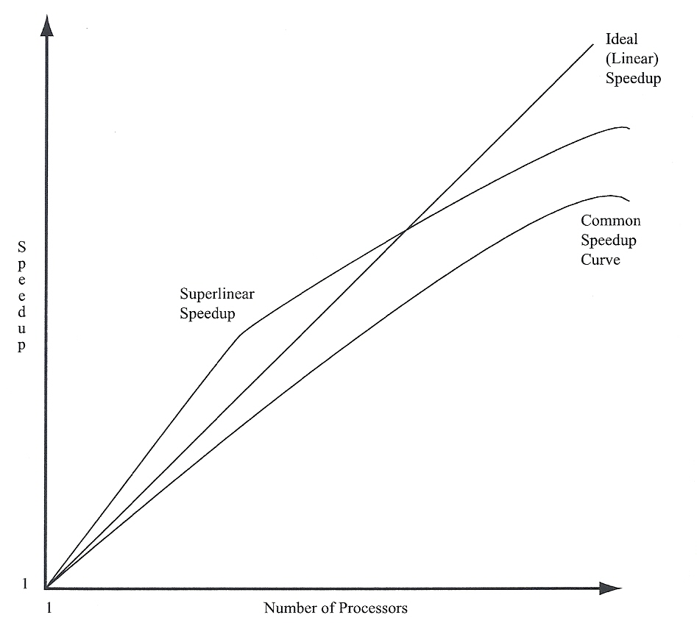
Linear Speedup

Slide 3
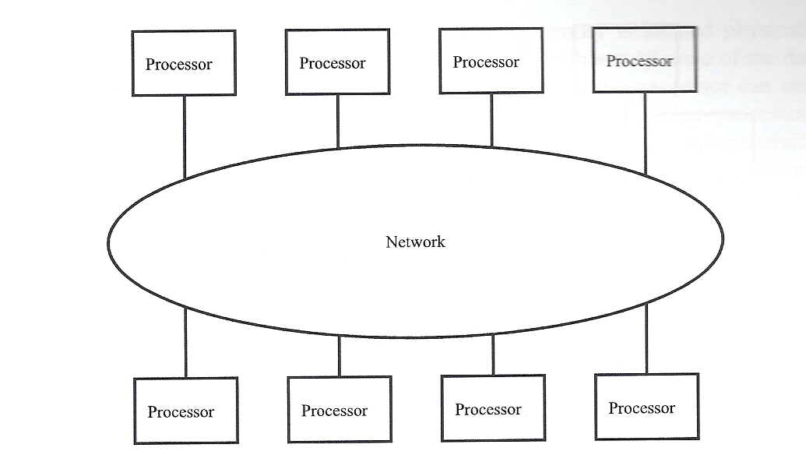
Basic Multiprocessor

Slide 4
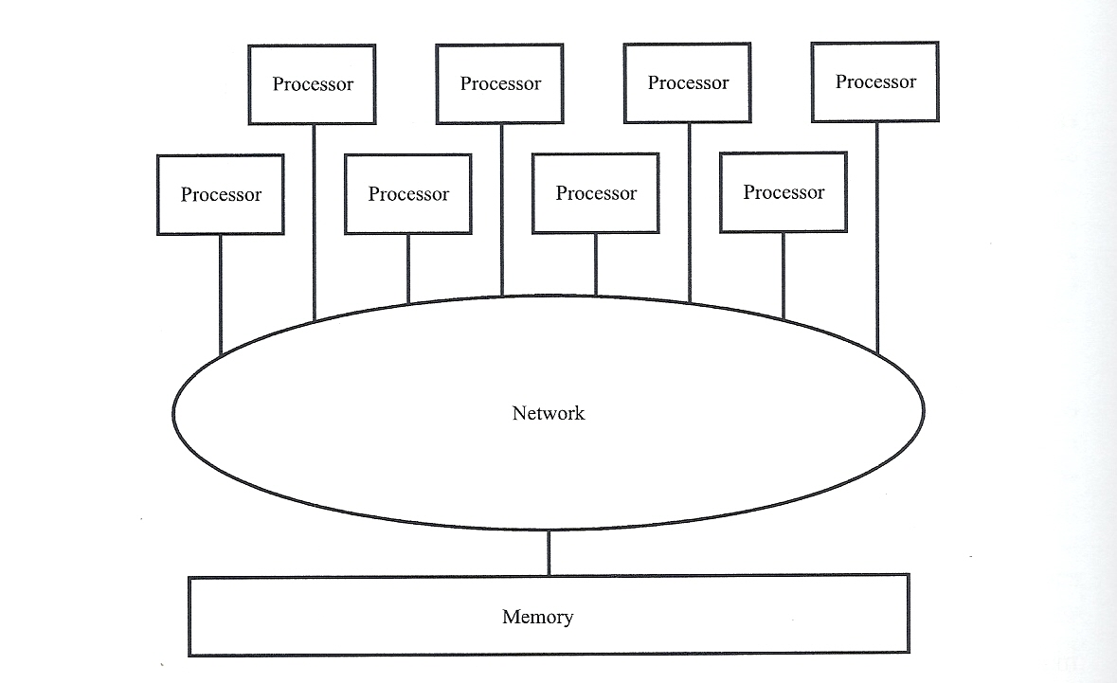
Centralized-memory multiprocessor

Slide 5
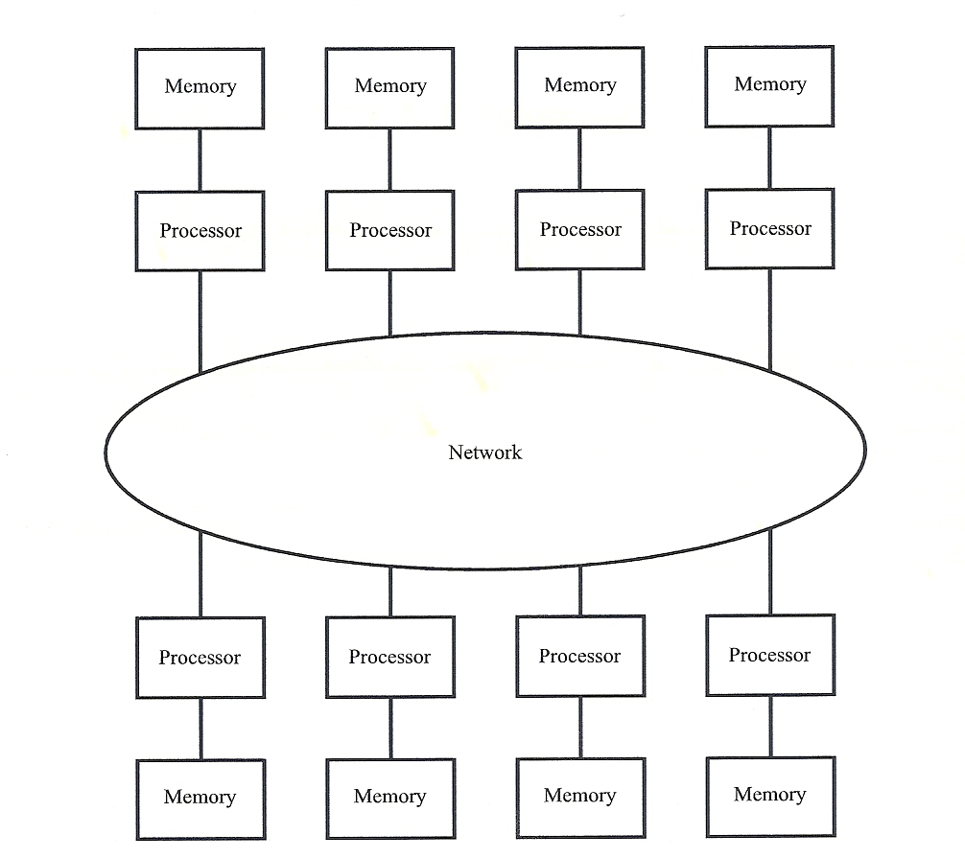
Distributed-memory multiprocessor

Slide 6
Invalid Based Cache Coherence Protocol
  Processor 1 Processor 2 Processor 3 Event
  0) No Copy No Copy No copy Initial
  1) Read-only No Copy No Copy P1 Reads line
  2) Read-only Read Only No Copy P2 Reads line
  3) No Copy No-copy Writable copy P3 writes line
  4) No Copy Read only Read Only P2 Reads line

Slide 7
Update Based Cache Coherence Protocol
  Processor 1 Processor 2 Processor 3 Event
  0) No Copy No Copy No copy Initial
  1) Writable copy No Copy No Copy P1 Reads line
  2) Writable copy Writable copy No Copy P2 Reads line
  3) Writable copy Writable copy Writable copy P3 writes line
  4) Writable copy Writable copy Writable copy P2 Reads line
  All writes broadcast data to all writable copies

Slide 8
MESI (Modify, Excusive, Shared, Invalid)
Each line in a processors cache is assigned on of four states:
Modified – the processor is the only one with a copy of the line, and it has written the line since it acquired it.
Exclusive – the processor is the only one that has a copy of the line, but is has not written the line since it acquired the copy. So any subsequent write requires no broadcasting.
Shared – the processor has a valid copy of the line and at least one other processor has a valid copy. Ok to read but any attempt to write will invalidate the other copies.
Invalid – the processor does not have a valid copy of the line.

Slide 9
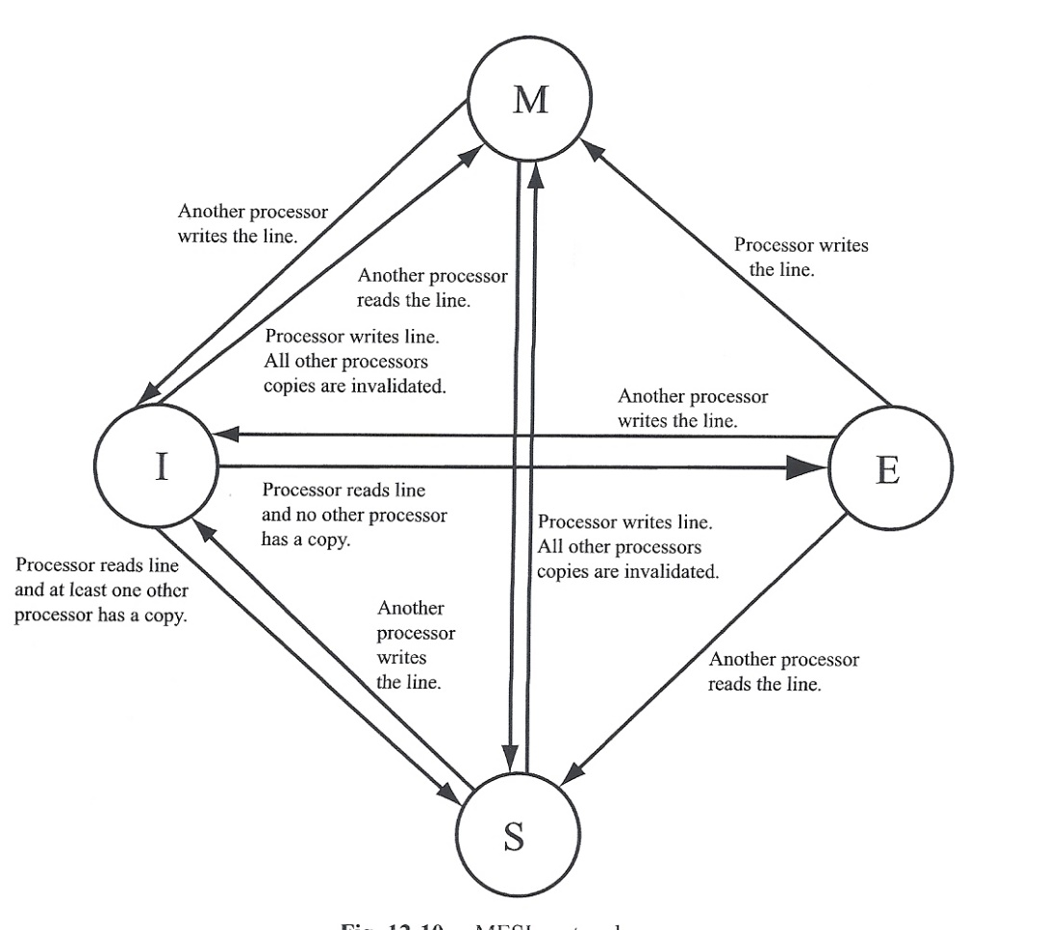
MESI state transitions

Slide 10
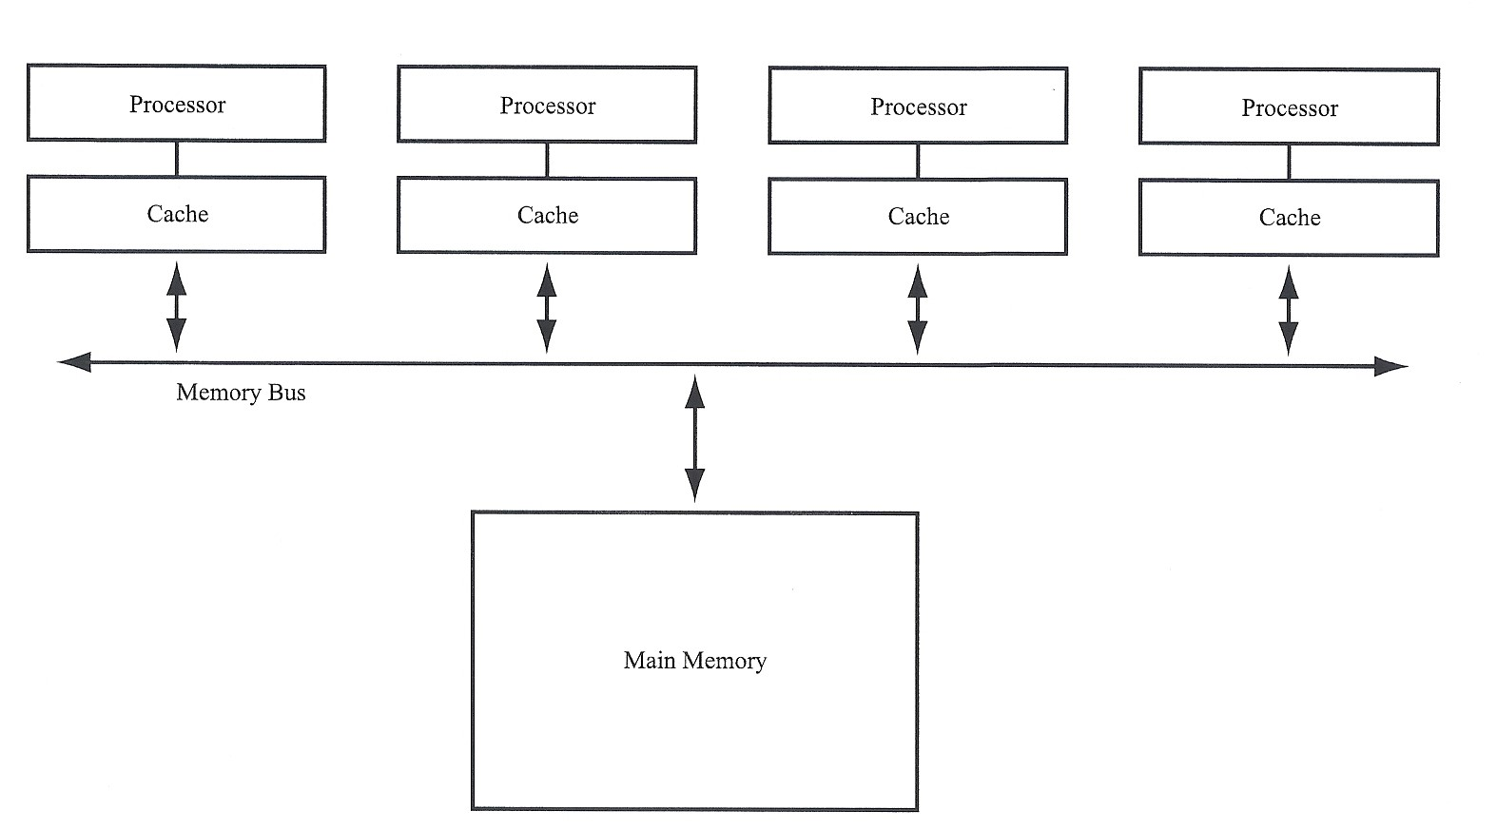
Bus-based shared-memory system

Slide 11
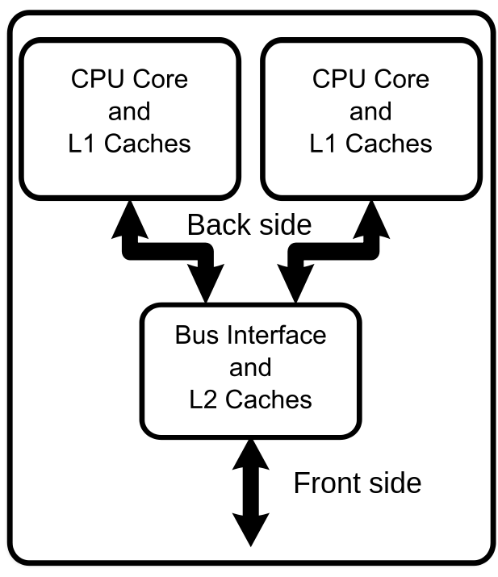
Multi-core processor
A multi-core processor is a single computing component with two or more independent actual processing units (called "cores"), which are units that read and execute program instructions.^{[1]}
The instructions are ordinary CPU instructions (such as add, move data, and branch), but the multiple cores can run multiple instructions at the same time, increasing overall speed for programs amenable to parallel computing.^{[2]}
Manufacturers typically integrate the cores onto a single integrated circuit die (known as a chip multiprocessor or CMP), or onto multiple dies in a single chip package.
Source: Wikipedia

Slide 12
Core Communications
A multi-core processor implements multiprocessing in a single physical package.
Designers may couple cores in a multi-core device tightly or loosely. For example, cores may or may not share caches, and they may implement message passing or shared-memory inter-core communication methods.
Common network topologies to interconnect cores include bus, ring, two-dimensional mesh, and crossbar.

Slide 13
Advantages/Disadvantages of multi-cores
Advantages
The proximity of multiple CPU cores on the same die allows the cache coherency circuitry to operate at a much higher clock rate than what is possible if the signals have to travel off-chip. Combining equivalent CPUs on a single die significantly improves the performance of cache snoop (alternative: Bus snooping) operations. Put simply, this means that signals between different CPUs travel shorter distances, and therefore those signals degrade less.
Disdvantages
Maximizing the usage of the computing resources provided by multi-core processors requires adjustments both to the operating system (OS) support and to existing application software. Also, the ability of multi-core processors to increase application performance depends on the use of multiple threads within applications.

Slide 14
Intel Turbo Boost
Intel Turbo Boost is a technology implemented by Intel in certain versions of its processors that enables the processor to run above its base operating frequency via dynamic control of the processor's clock rate.
Processor generations supporting this feature are based on the Nehalem (Turbo Boost 1.0), Sandy Bridge (Turbo Boost 2.0), Ivy Bridge, Haswell, Broadwell, Skylake and Broadwell-E (Intel Turbo Boost Max 3.0)^{[1]} microarchitectures, while the examples of Turbo-Boost-enabled processors are the Core i5 and Core i7 series.^{[2]}
Turbo Boost is activated when the operating system requests the highest performance state of the processor. Processor performance states are defined by the Advanced Configuration and Power Interface (ACPI) specification, an open standard supported by all major operating systems; no additional software or drivers are required to support the technology.^{[2]}
The design concept behind Turbo Boost is commonly referred to as "dynamic overclocking".[

Slide 15
Core i7-920XM
For Core i7-920XM, normal operating frequency is 2.0 GHz. Turbo is indicated as: 2/2/8/9 in which the first number is the multiple of 133⅓ MHz supported when four cores are active, the second number is the multiple for three cores, the third number is for two cores, and the fourth number is for one active core.
Subject to limits on temperature, current and power consumption, the processor can increase its clock speed (from a base frequency of 2.0 GHz) in steps of 133⅓ MHz to:
Active Cores | Turbo Steps | Max Frequency | Calculation (in Mega Hertz)
4 or 3 | 2 | 2.26 GHz | 2000 + (2 * 1.33) = 2000 + 267 = 2267
2 | 8 | 3.06 GHz | 2000 + (8 * 1.33) = 2000 + 1067 = 3067
1 | 9 | 3.20 GHz | 2000 + (9 * 1.33) = 2000 + 1200 = 3200

