Slide 1
Multiply and Divide
Integers in 2’s compliment
Floating point

Slide 2
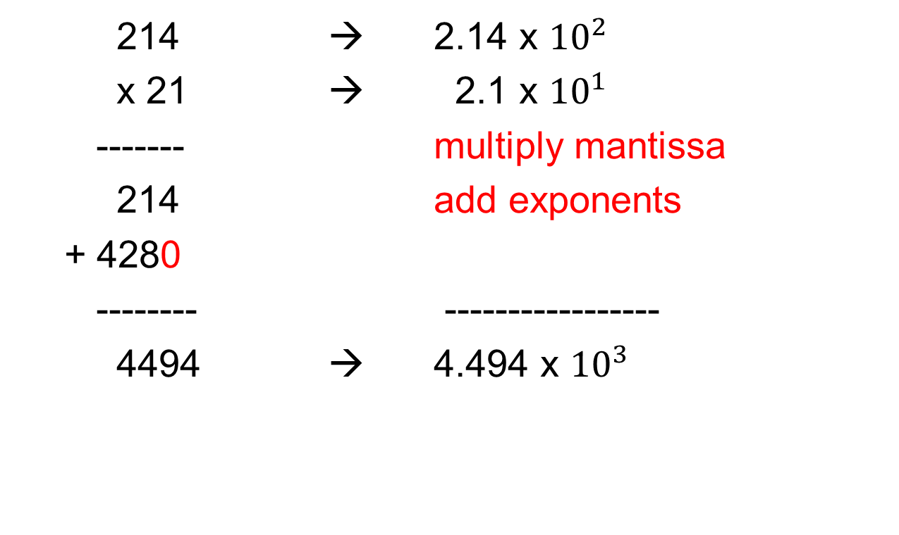
Multiplying in Decimal
214 → 2.14 x ${10}^{2}$
x 21 → 2.1 x ${10}^{1}$
------- multiply mantissa
214 add exponents
+ 4280
-------- -----------------
4494 → 4.494 x ${10}^{3}$

Slide 3
Multiplying in binary
1011 11
x 1110 x 14
------- -------
0000 44
1011 11
1011
1011
----------- ------------
10011010 154

Slide 4
History of binary multiplication
Until late 1970’s most processors did not have a multiply instruction. Programs that repeated shifted and added were used instead.
When much more transistors per chip became available, enough adders could be put on a single chip to um all the partial products at once. Rather than reuse a single adder repeatedly.

Slide 5
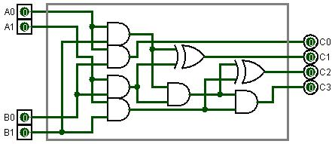
2 by 2 multiplication chip

Slide 6
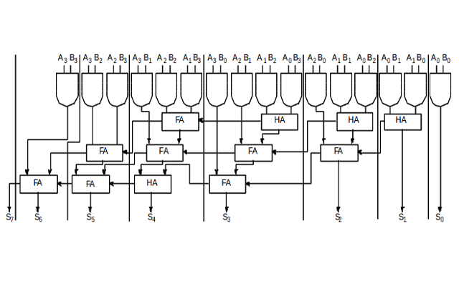
4 by 4 multiplication chip

Slide 7
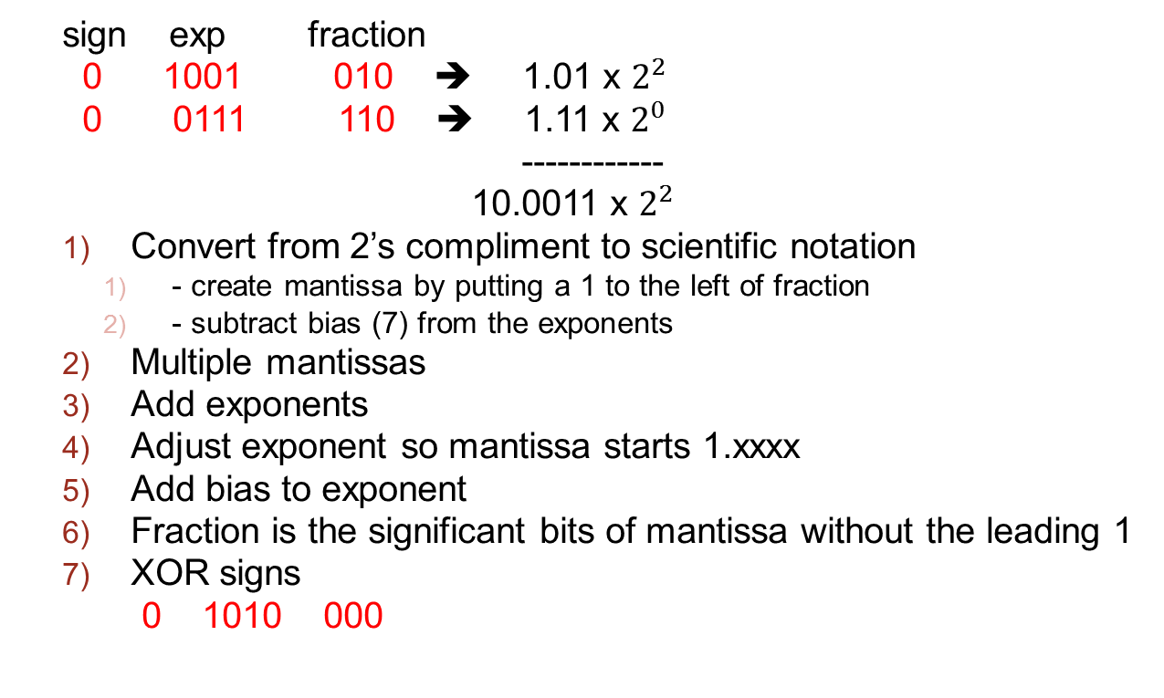
Multiplying floating point numbers
sign exp fraction
0 1001 010 ➔ 1.01 x $2^{2}$
0 0111 110 ➔ 1.11 x $2^{0}$
------------
10.0011 x $2^{2}$
Convert from 2’s compliment to scientific notation
- create mantissa by putting a 1 to the left of fraction
- subtract bias (7) from the exponents
Multiple mantissas
Add exponents
Adjust exponent so mantissa starts 1.xxxx
Add bias to exponent
Fraction is the significant bits of mantissa without the leading 1
XOR signs
0 1010 000

Slide 8
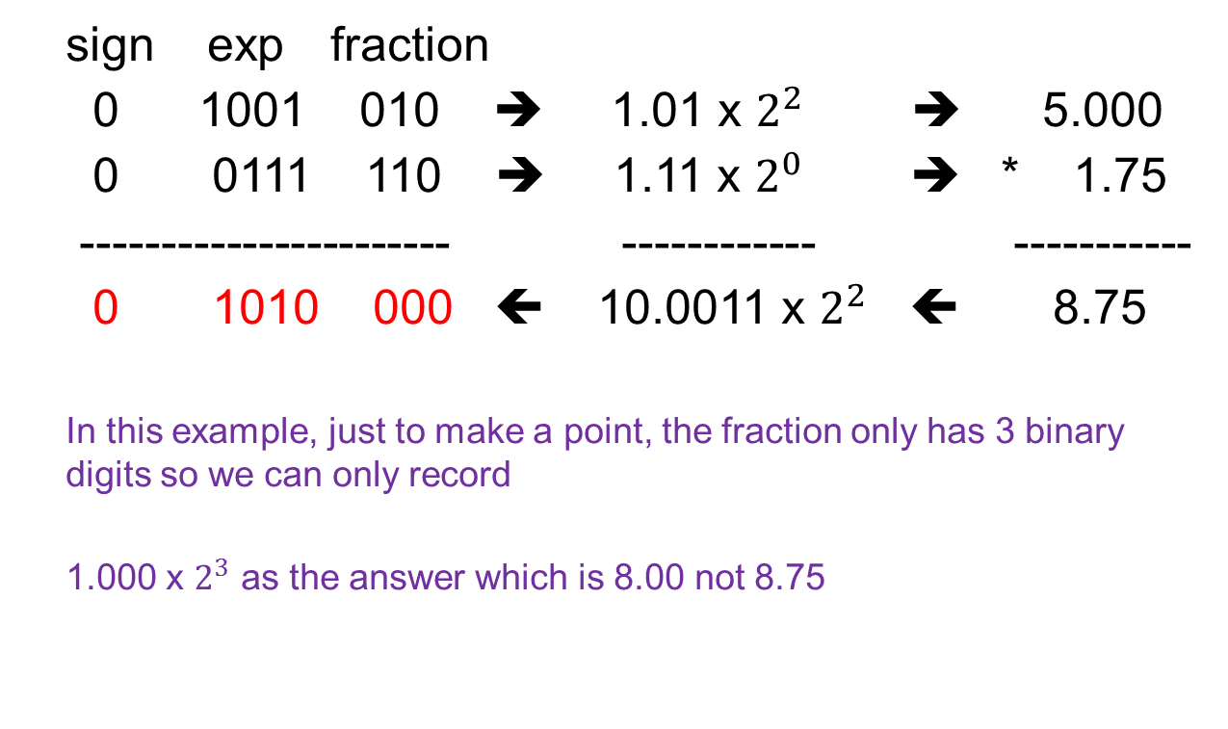
Multiplying floating point numbers
sign exp fraction
0 1001 010 ➔ 1.01 x $2^{2}$ ➔ 5.000
0 0111 110 ➔ 1.11 x $2^{0}$ ➔ * 1.75
----------------------- ------------ -----------
0 1010 000 ⬅ 10.0011 x $2^{2}$ ⬅ 8.75
In this example, just to make a point, the fraction only has 3 binary digits so we can only record
1.000 x $2^{3}$ as the answer which is 8.00 not 8.75

Slide 9
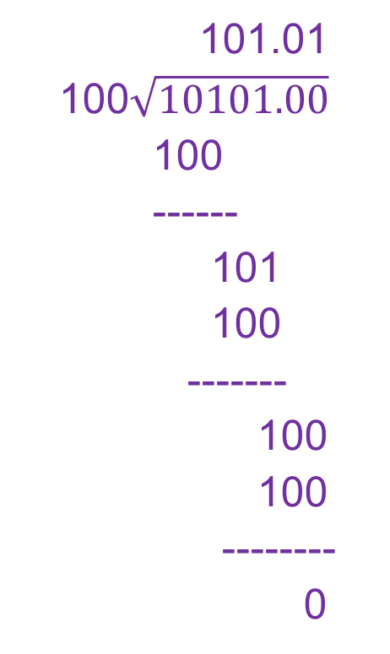
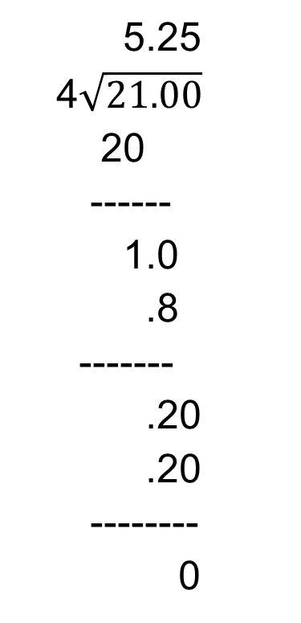
Division in decimal and binary
5.25
4$\sqrt{21.00}$
20
------
1.0
.8
-------
.20
.20
--------
0
101.01
100$\sqrt{10101.00}$
100
------
101
100
-------
100
100
--------
0

Slide 10
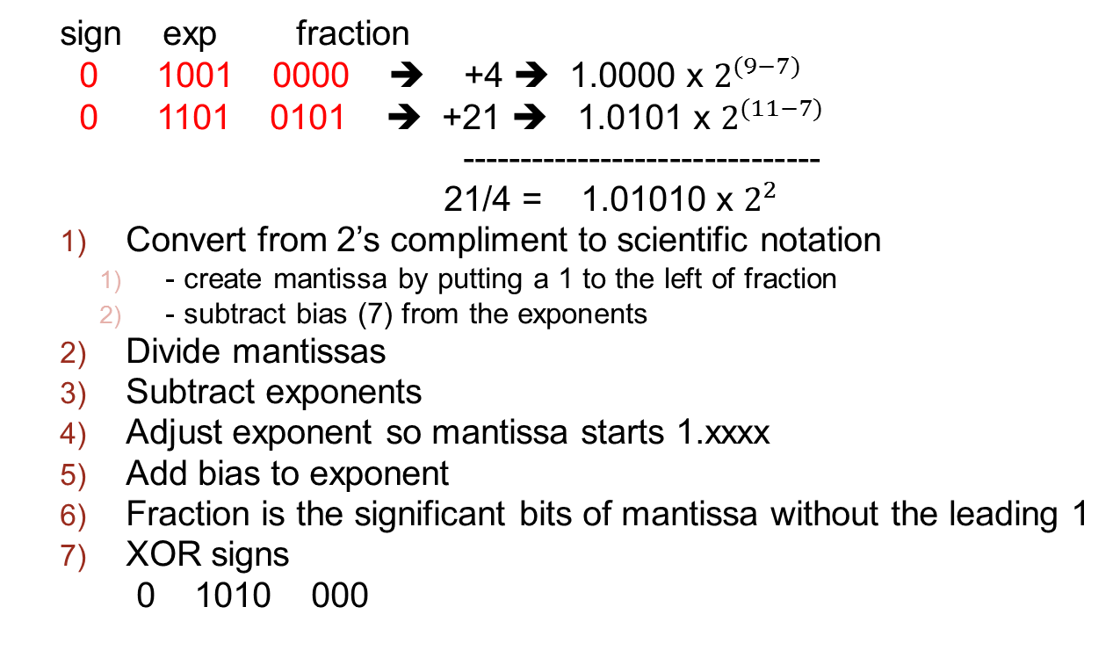
Dividing floating point numbers
sign exp fraction
0 1001 0000 ➔ +4 ➔ 1.0000 x $2^{(9−7)}$
0 1101 0101 ➔ +21 ➔ 1.0101 x $2^{(11−7)}$
-------------------------------
21/4 = 1.01010 x $2^{2}$
Convert from 2’s compliment to scientific notation
- create mantissa by putting a 1 to the left of fraction
- subtract bias (7) from the exponents
Divide mantissas
Subtract exponents
Adjust exponent so mantissa starts 1.xxxx
Add bias to exponent
Fraction is the significant bits of mantissa without the leading 1
XOR signs
0 1010 000

Slide 11
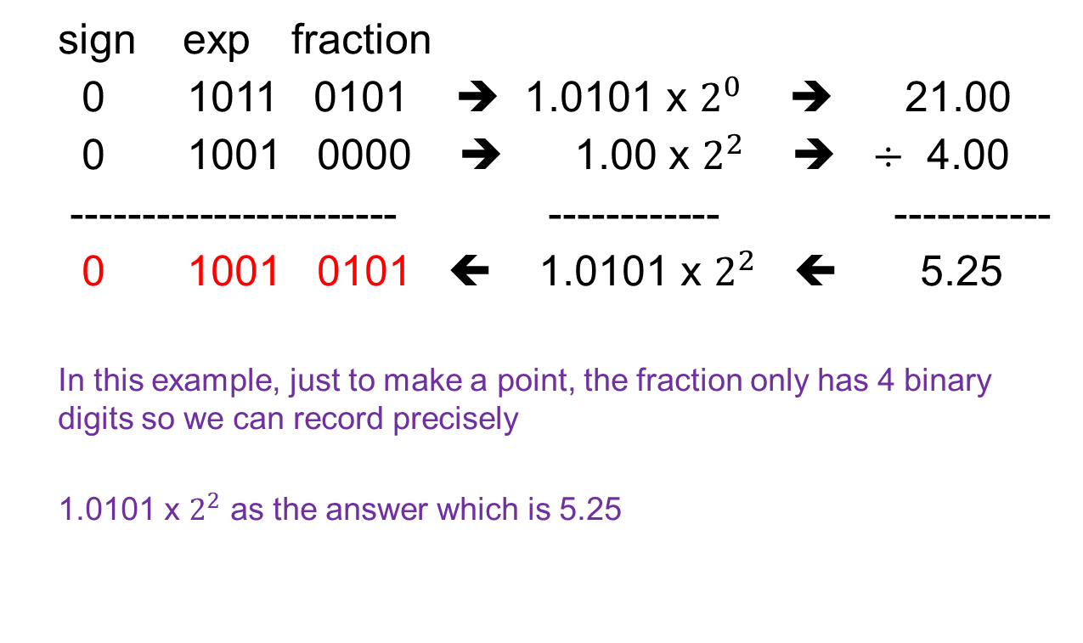
Dividing floating point numbers
sign exp fraction
0 1011 0101 ➔ 1.0101 x $2^{0}$ ➔ 21.00
0 1001 0000 ➔ 1.00 x $2^{2}$ ➔ $÷$ 4.00
----------------------- ------------ -----------
0 1001 0101 ⬅ 1.0101 x $2^{2}$ ⬅ 5.25
In this example, just to make a point, the fraction only has 4 binary digits so we can record precisely
1.0101 x $2^{2}$ as the answer which is 5.25

Slide 12
Appendix A-1: Booth’s Algorithm
If we are going to multiply A*63
+63 ➔ 0011 1111 which would require 6 shift/adds
Isn’t 63 = (64 – 1)?
So instead of A*63, we will do A*(64-1)
+64 ➔ 0100 0000
So we do 1 add and 1 subtract (add 2’s compliment) instead of 6 adds.

Slide 13
Appendix A-2: Booth’s Algorithm
+63 ➔ 0011 1111 but isn’t 63 = (64 – 1)?
+7 ➔ 0000 0111 but isn’t 7 = (8 – 1)?
63 – 7 = 0011 1111 – 000 0111 = 0011 1000 = 56
But isn’t 56 = (63 – 7) = (64 – 1) – (8 – 1) = 64 – 8?

Slide 14
Appendix B: Multiply Overflow?
Suppose you multiplied 2 signed positive 8 bit numbers?
0001 0000 * 0001 0000 = 1 0000 0000 (overflow)
If both numbers have a bit on in the upper half, then there will be an overflow so there is no point in doing the multiplication. Therefore at least 1 number must have it’s upper half bits all set to 0.

Slide 15
Appendix C: worst cast shift/adds
When multiplying 2-N bit positive numbers, at least 1 number must have it N/2 most significant bits = 0
What is the worst case of the number of shift/adds?
N/2?
Or less? (recall Booth’s algorithm can do N/2 consecutive 1’s with just 2 operations?
When multiplying 2-N bit positive numbers, at least 1 number must have it?
The worst case is the lesser of straight multiplying vs. Booth’s

