Slide 1
Numbers in a Computer
Unsigned integers
Signed magnitude
1’s complement
2’s complement
Floating point(float, double)

Slide 2
Unsigned integers
Set bits to the magnitude of the number.
Ex) using a nibble (4 bits)
0) 0000 8) 1000
1) 0001 9) 1001
2) 0010 10) 1010
3) 0011 11) 1011
4) 0100 12) 1100
5) 0101 13) 1101
6) 0110 14) 1110
7) 0111 15) 1111

Slide 3
Signed Magnitude integers
Set 0→n-2 low order bits to the magnitude of the number.
Set highest order bit to 1 if the number is negative
Ex) using a nibble (4 bits)
0) 0000 -0) 1000
1) 0001 -1) 1001
2) 0010 -2) 1010
3) 0011 -3) 1011
4) 0100 -4) 1100
5) 0101 -5) 1101
6) 0110 -6) 1110
7) 0111 -7) 1111

Slide 4
1’s compliment integers
Set 0→n-2 low order bits to the magnitude of the number.
Flip all bits if the number is negative
Ex) using a nibble (4 bits)
0) 0000 -7) 1000
1) 0001 -6) 1001
2) 0010 -5) 1010
3) 0011 -4) 1011
4) 0100 -3) 1100
5) 0101 -2) 1101
6) 0110 -1) 1110
7) 0111 -0) 1111

Slide 5
2’s compliment integers
Set 0→n-2 low order bits to the magnitude of the number.
Flip all bits then add 1 if the number is negative
Ex) using a nibble (4 bits)
0) 0000 -8) 1000
1) 0001 -7) 1001
2) 0010 -6) 1010
3) 0011 -5) 1011
4) 0100 -4) 1100
5) 0101 -3) 1101
6) 0110 -2) 1110
7) 0111 -1) 1111

Slide 6
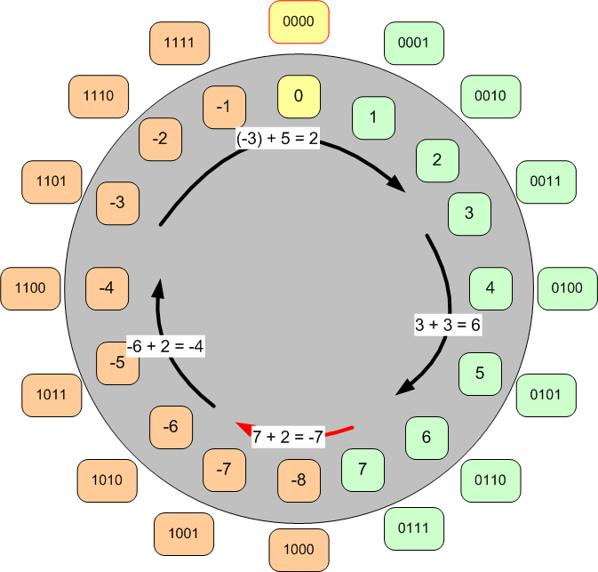
2’s Compliment circle of addition

Slide 7
2’s compliment integers
Set 0→n-2 low order bits to the magnitude of the number.
Flip all bits then add 1 if the number is negative
Ex) Adding using a nibble (4 bits)
3 + 3 = 6 (-3) + 5 = 2 (-6) + 2 = -4 7 + 2 = -7
0011 1101 1010 0111
+ 0011 + 0101 0010 0010
---------- ---------- ---------- ----------
0110 10010 1100 1101

Slide 8

Floating Point Numbers
EX 1)
12.34 = (1 * ${10}^{1}$) + (2 * ${10}^{0}$) + (3 * ${10}^{−1}$) + (4 * ${10}^{−2}$)
= 12.34 * ${10}^{0}$
= 1.234 * ${10}^{1}$
= 1234 * ${10}^{−2}$
Ex 2) using excel

Slide 9
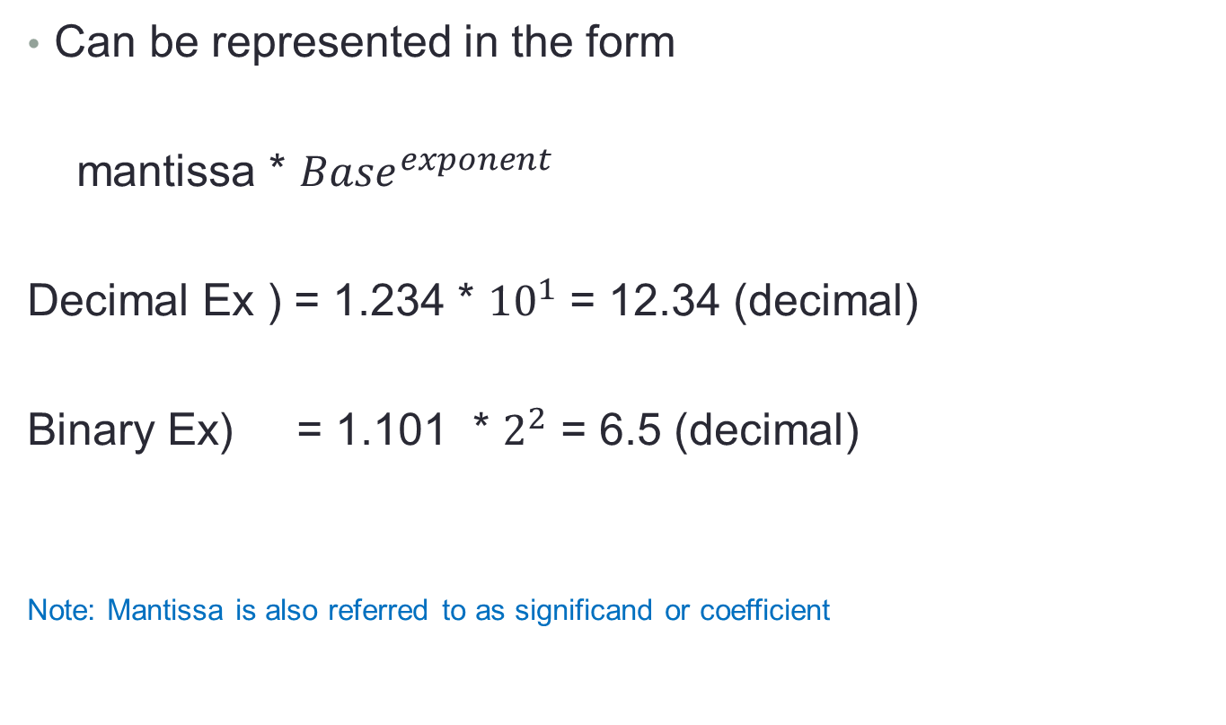
Floating Point Numbers
Can be represented in the form
mantissa * ${Base}^{exponent}$
Decimal Ex ) = 1.234 * ${10}^{1}$ = 12.34 (decimal)
Binary Ex) = 1.101 * $2^{2}$ = 6.5 (decimal)
Note: Mantissa is also referred to as significand or coefficient

Slide 10
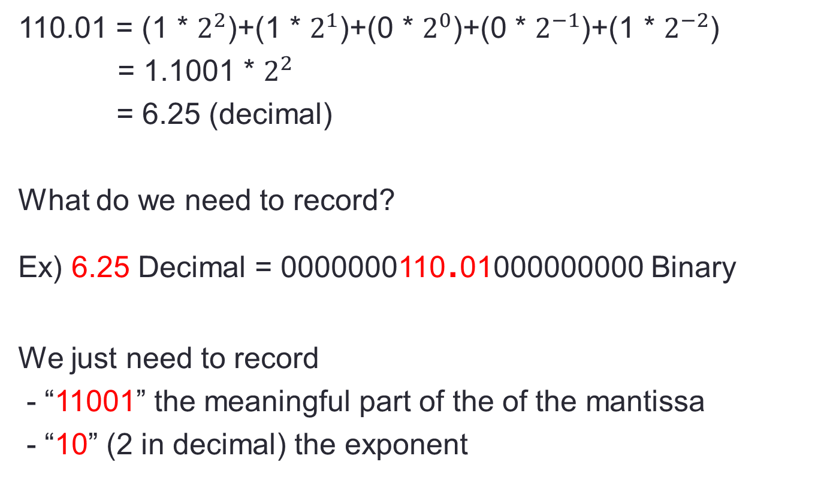
Floating Point Numbers
110.01 = (1 * $2^{2}$)+(1 * $2^{1}$)+(0 * $2^{0}$)+(0 * $2^{−1}$)+(1 * $2^{−2}$)
= 1.1001 * $2^{2}$
= 6.25 (decimal)
What do we need to record?
Ex) 6.25 Decimal = 0000000110.01000000000 Binary
We just need to record
- “11001” the meaningful part of the of the mantissa
- “10” (2 in decimal) the exponent

Slide 11
IEEE 754 format for floating points
Notice that the meaningful part of the mantissa always starts with a non-zero digit and always ends with a non-zero digit.
Decimal Example ) 00012.34000 ➔ 1234
Binary Example ) 00110.01000 ➔ 11001
We will always record as many significant digits as possible but may need to round off, therefore we know the leftmost digit will be a non-zero.
In binary the only non-zero is 1 so we know the leftmost digit will be a 1 (IEEE figures why bother recording it then)

Slide 12
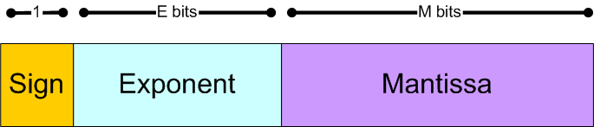
IEEE floating point format
16 bits) E = 5 and M = 10 Half Precision
32 bits) E = 8 and M = 23 Full Precision
64 bits) E = 11 and M = 52 Double Precision

Slide 13
Encoding a number in IEEE 754
6.25 (decimal) encoded into 16 bit (half precision)
Meaningful part of Mantissa = “11001”
Leftmost bit must be a 1 so remove it to a save bit and keep just the 1001 then pad it with 0’s to the right.
The exponent is +2 (decimal) + bias (15) = 17 (10001)

Slide 14
Java primitives
byte (2’s compliment signed number – 8 bits)
short (2’s compliment signed number – 16 bits)
int (2’s compliment signed number – 32 bits)
long (2’s compliment signed number – 64 bits)
float (IEEE 754 number – 32 bits)
double (IEEE 754 number – 64 bits)

