Slide 1
Pipelining
Speed up on cycle time
Stalls – Optimizing compilers for pipelining

Slide 2
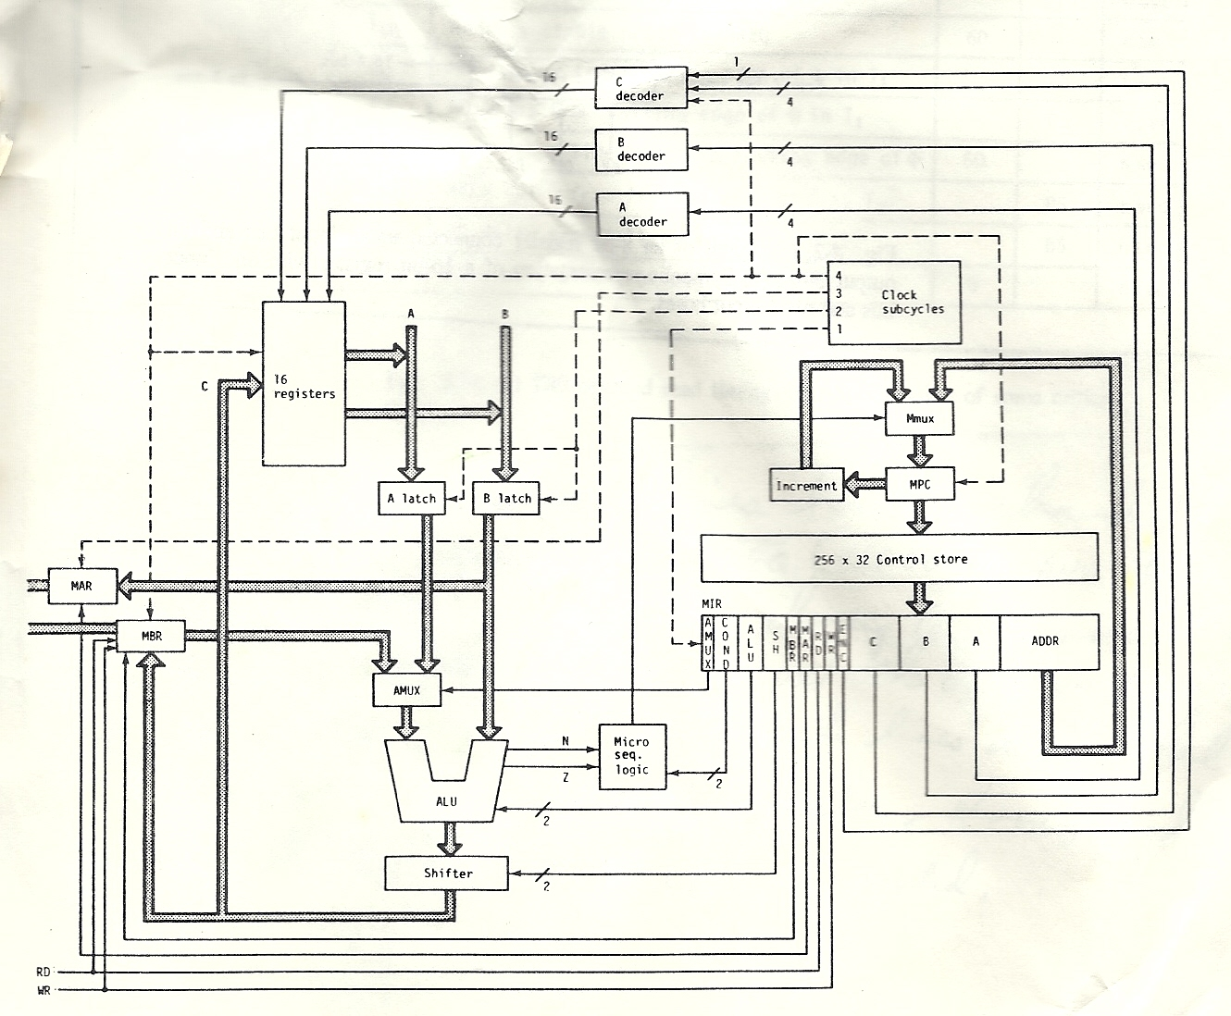
Recall processor

Slide 3
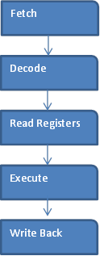
Steps to an instruction

Slide 4
Observations
When the read Registers stage it executing, the fetch and decode steps are already done, so that hardware is not being used, and the execute and write back hardware is idle because they cannot begin.
So there is a lot of hardware sitting idle.
If we know where to fetch the next instruction from, we could begin fetching it as soon as the current instruction’s fetch step has completed. ( We would have to make the assumption that the next instruction is the instruction that comes right after the current instruction (this is not going to be the case when the program branches or when the program hits a page boundary, but it will be correct with a very high probability of the time.

Slide 5
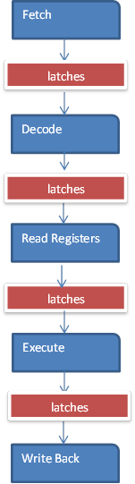
Adding latches between stages

Slide 6
Goals of Pipelining
So our goal is to get maximum use out of each stage of the hardware(i.e. Utilize the idle hardware)
Since each stage produces results that are used at input to the next stage, we can put a series of latches (D-flip flops) between each stage to allow the result to be recorded and therefore feed into the next stage.

Slide 7
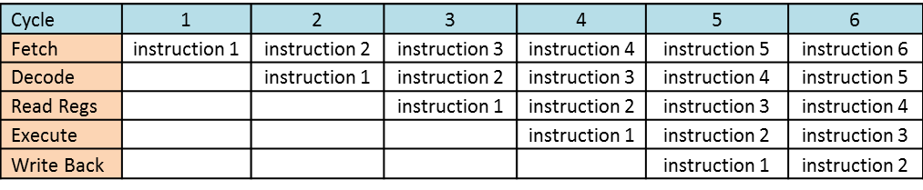
Clock cycles by instruction stages
Start instructions immediately after each stage instead of after the entire instruction.

Slide 8
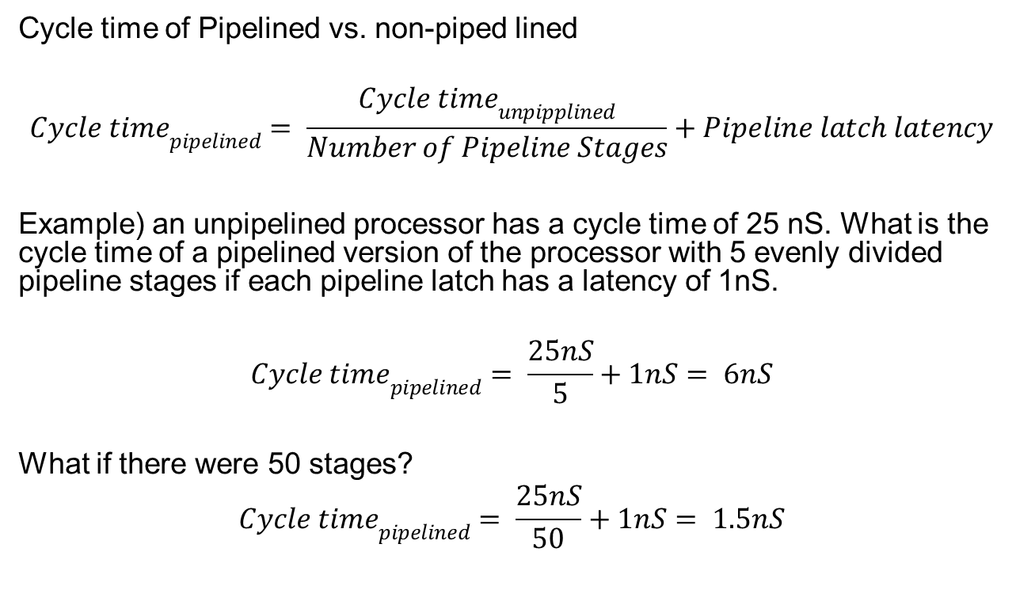
Speed up
Cycle time of Pipelined vs. non-piped lined
$${Cycle time}_{pipelined}= \frac{{Cycle time}_{unpipplined}}{Number of Pipeline Stages}+Pipeline latch latency$$
Example) an unpipelined processor has a cycle time of 25 nS. What is the cycle time of a pipelined version of the processor with 5 evenly divided pipeline stages if each pipeline latch has a latency of 1nS.
$${Cycle time}_{pipelined}= \frac{25nS}{5}+1nS= 6nS$$
What if there were 50 stages?
$${Cycle time}_{pipelined}= \frac{25nS}{50}+1nS= 1.5nS$$

Slide 9
Non-pipelined instructions
When consecutive instructions read and write from the same register, without pipelining, there is no issue. Consider the following assembly code
If the Register values were R1) 1 R2) 2 R3) 3 R4) 44 R5) 55
And the following instructions were run
ADD R5, R2, R3 // add R2 and R3 and store the result in R5
SUB R4, R5, R1 // subtract R1 from R5 and store result in R4
The registers should be R1) 1 R2) 2 R3) 3 R4) 4 R5) 5

Slide 10
Pipelined instructions
When consecutive instructions read and write from the same register, we have a hazard. Consider the following assembly code
If the Register values were R1) 1 R2) 2 R3) 3 R4) 44 R5) 55
And the following instruction were run
ADD R5, R2, R3 // add R2 and R3 and store the result in R5
SUB R4, R5, R1 // subtract R1 from R5 and store result in R4
At the EX step (step 4) of the ADD instruction the values of R5 and R1 are being latches for the RR step (step 3) of the SUB instruction. However , R5 has not been written to yet.
The registers should be R1) 1 R2) 2 R3) 3 R4) 54 R5) 5

Slide 11
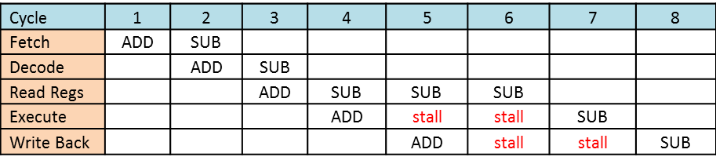
Pipelining with Stalls
Install stalls where needed
Hazard detected after decode of SUB instruction.

Slide 12
Pipelining - Result Forwarding
Read and Write Register bit values in of consecutive instructions can be compared for Hazards and can be detected after the Decode step of the second instruction.
If a Read After Write hazard is detected, the result of the ALU can be passed into the latched register values of the next instruction via a MUX .
Therefore stalls can be avoided with this new hardware.

Slide 13
RaW (Read after Write) Hazard
ADD R5, R2, R3 // add R2 and R3 and store the result in R5
SUB R4, R1, R5 // subtract R5 from R1 and store result in R4
The issue is that one of the values used as inputs of the second instruction is read prior to the previous instruction correctly setting.

Slide 14
Pipeline Optimizing Compiler
A = (B+C) – D;
E = 1;
May compile into the following code with a RaW pipeline hazard needing stalls.
ADD R5, R2, R3 // add R2 and R3 and store the result in R5
SUB R4, R5, R1 // subtract R5 from R1 and store result in R4
STOR A,R4 // store R4 into memory location A
STOR E,#1 // store 1 into memory location E
The following code correctly runs without needing pipeline stalls.
ADD R5, R2, R3 // add R2 and R3 and store the result in R5
STOR E,#1 // store 1 into memory location E
SUB R4, R5, R1 // subtract R5 from R1 and store result in R4
STOR A,R4 // store R4 into memory location A

Slide 15
WaR (Write after Read) Hazard
SUB R5, R2, R3 // subtract R3 from R2 and store result in R5
ADD R2, R4, R1 // add R1 to R4 and store result in R2
This should not be an issue assuming that all instruction states have the same latency. (i.e. the time for the computation to take electronically complete are the same. )
If not, the longer instructions complete after a later quick instructions.

Slide 16
WaW (Write after Write) Hazard
SUB R5, R2, R3 // subtract R3 from R2 and store result in R5
ADD R5, R4, R1 // add R1 to R4 and store result in R5
This should not be an issue assuming that all instruction states have the same latency. (i.e. the time for the computation to take electronically complete are the same. )
If not, the longer instructions complete after a later quick instructions.

Slide 17
Branches (i.e. Jumps)
LOAD R5, A // Load R5 with memory location A
JZ else_label // If last instruction’s result was 0, jump
ADD R1, R2, R3
SUB R4, R1, R2
JMP after_label
else_label: ADD R1,R8,R9
after_label: DIV R9, R1, R3
If A == 0, then the instructions in purple should NOT have run but they would be pipelined and partially run and the clock would naturally complete the instructions once started.

Slide 18
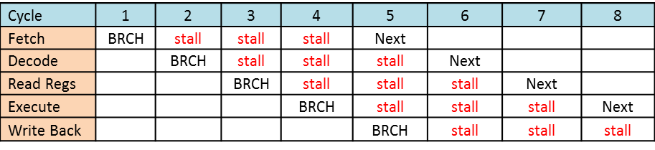
Insert stalls in the Pipelining
Insert stalls where needed

Slide 19
Time for stages of an instruction
Fetch 8nS (calc next, copy in instruction)
Decode 4nS (wires activate hardware)
Read 5nS (register values copied
Execute 3,10 or 30nS (passthru, And/Comp, Add)
Write 5 or 20nS (write to registers/memory)
Non-pipelined, we can set the 5 output clock to turn on the stage lines to 8+4+5+30+20 = 67nS per instruction.
Note: max value for each stage needed to be used to cover worst case

Slide 20
Time for 5 stages of an instruction
Fetch 8nS (calc next, copy in instruction)
Decode 4nS (wires activate hardware)
Read 5nS (register values copied)
Execute 3,10 or 30nS (passthru, And/Comp, Add)
Write 5 or 20nS (write to registers/memory)
Pipelined, we must set a 5 output clock to the same time. That time must be the max of all stage times → 30nS.
If pipelined and between stage latches (2nS) we can get a cycle time of (30+2)nS when no hazards.
Note: all stages must take the max stage time to cover worst case

Slide 21
Time for 14 stages of an instruction
Fetch1 5nS (calc next, copy in instruction)
Fetch2 3nS (copy in instruction)
Decode 4nS (wires activate hardware)
Read 5nS (register values copied
Execute1 5nS (passthru, And/Comp, Add)
Execute2 5nS ( And/Comp, Add)
Execute3 5nS ( Add)
Execute4 5nS ( Add)
Execute5 5nS ( Add)
Execute6 5nS ( Add)
Write1 5nS (write to registers/memory)
Write2 5nS (write to memory)
Write3 5nS (write to memory)
Write4 5nS (write to memory)

Slide 22
Time for 14 stages of an instruction
With 2nS for pipeline latches between each stage, we can get a cycle time of (5+2) = 7nS cycle time when there are no hazards (therefore stalls).
With more states, of course, they are a greater chance of hazards.

