Slide 1
Hardware Components
1 bit Comparators
Comparator chips
Negative/zero checkers
Full Adders
Incrementor
TLB

Slide 2
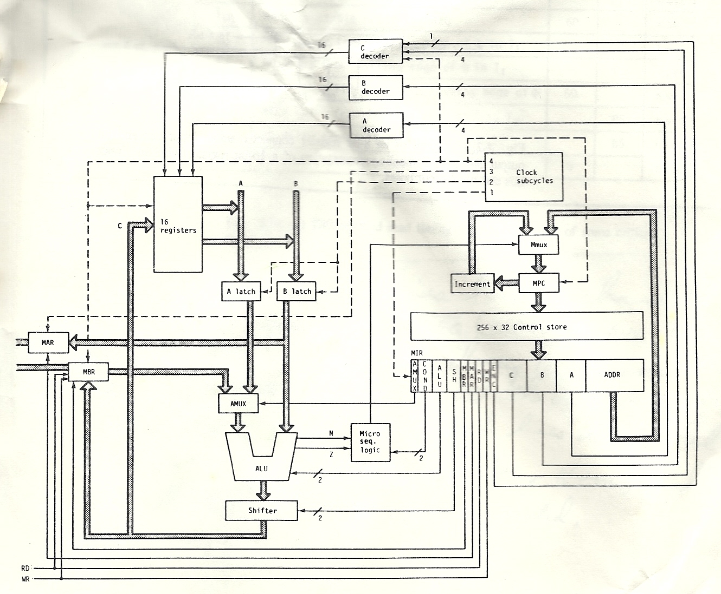
Simple Processor

Slide 3
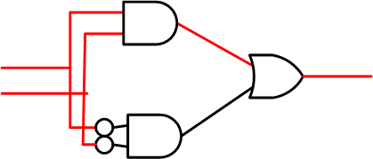
XNOR gate
Gate Latency time
Not is 20, AND is 40 and OR is 50 Nanoseconds
Gate total latancy is 20+40+50=110 nanoseconds

Slide 4
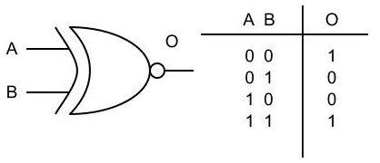
XNOR gate truth table

Slide 5
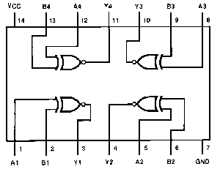
4 bit comparator chip

Slide 6
4 bit Ander

Slide 7
4 Bit Invertor

Slide 8
Negative Checker

Slide 9
Zero Checker

Slide 10
Adding in Decimal
110 ← carry vector
193
+ 698
891
1110 ← carry vector
0111 ← 7
+ 0011 ← 3
1010

Slide 11
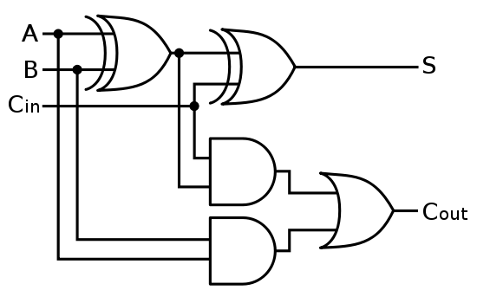
3 input 2 output full adder

Slide 12
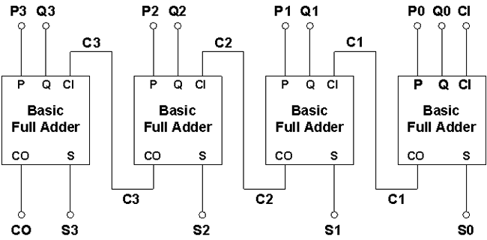
Ripple Adder

Slide 13
Incrementor
Even numbers get the low order bit turned to 1
0000 0000 → 0000 0001
0010 1010 → 0010 1011
Odd numbers get the rightmost 0 turned to 1 and all 1’s right of it turned to 0’s
0000 0001 → 0000 0010
0101 0111 → 0101 1000
0111 1111 → 1000 0000

Slide 14
Incrementor

Slide 15
Translation Lookaside Buffer

