Slide 1
Entity-Relationship
Model

Slide 2
E-R diagram
Rectangles – Represent entity sets
Ellipses – Represent attributes
Diamonds – Represent relationship sets
Lines – Link attributes to entity sets and entity sets to relationship sets
Double ellipses – Represent multivalued attributes
Dashed ellipses – Denote derived attributes
Double Lines – Indicate total participation of an entity in a relationship set

Slide 3
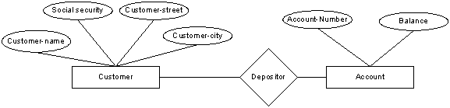
Example of an E-R diagram

Slide 4
Customer (not related) Account

Slide 5
Customer (1-N) Account

Slide 6
Customer (M-N) Account

Slide 7
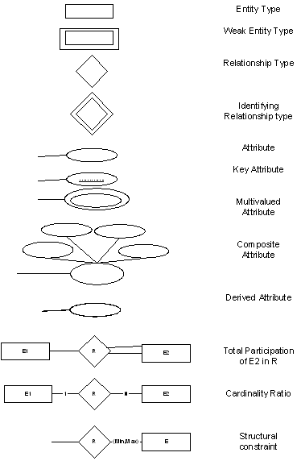

Slide 8
