Slide 1

R Programming Language
Introduction – History, Data Types, Statistics, Uses

Slide 2
History Of R
R is a programming language and software environment for statistical analysis, graphics representation and reporting.
R was created by Ross Ihaka and Robert Gentleman at the University of Auckland, New Zealand, and is currently developed by the R Development Core Team.
The core of R is an interpreted computer language which allows branching and looping as well as modular programming using functions. R allows integration with the procedures written in the C, C++, .Net, Python or FORTRAN languages for efficiency.

Slide 3
Hello World
# My first program in R Programming
myString <- "Hello, World!"
print ( myString)

Slide 4
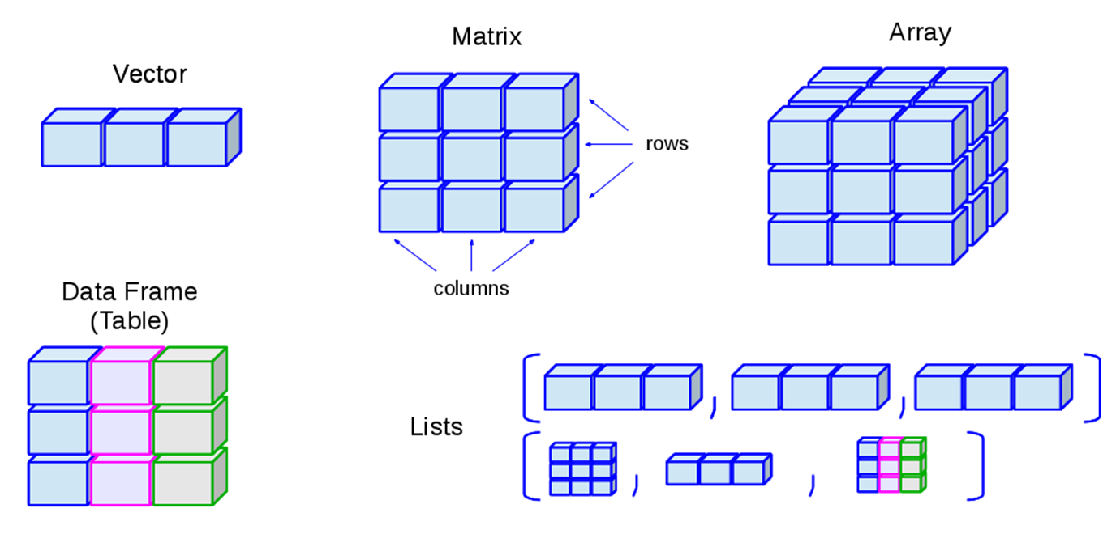
Data Types and Declarations
Unlike C++ and Java, and similar to Matlab, Perl and PHP, R doesn’t not declare data types when using variables. The type of an object is determined at the time of initialization and is determined by the type of the assigned data.
Common types are:
Vectors
Matrices
Arrays
Data Frames
Lists
Factors

Slide 5
Vector
# Create a vector.
routine <- c(‘gym',‘tan',“laundry") # c() is a R function that combines elements
print(routine)

Slide 6
List
# Create a list.
list1 <- list(c(1,2,4))
print(list1)

Slide 7
Matrix
# Create a matrix.
M = matrix( c(‘a1','a2',‘a3',‘b1',‘b2',‘b3' ,'c1',‘c2',‘c3'), ), nrow = 3, ncol = 3, byrow = TRUE)
print(M)
Note: Matrix in R can only have 2 dimensions

Slide 8
Arrays
# Create an array.
a <- array(c(‘heads',‘tales'),
dim = c(3,1,2))
Print(a)
"
, , 1
[,1] [,2] [,3]
[1,] “heads" “tales" “heads"
[2,] “tales" “heads" “tales"
[3,] “heads" “tales" “heads"
, , 2
[,1] [,2] [,3]
[1,] “tales" “heads" “tales"
[2,] “heads" “tales" “heads"
[3,] “tales" “heads" “tales"

Slide 9
Data Frame
# Create the data frame.
stocks <- data.frame(
symbol = c(“IBM", “GOOG",“T"),
price = c(152, 625, 55),
ask = c(153,626, 56),
bid = c(151,624, 54)
print(stocks)
symbol price ask bid
1 IBM 153 153 151
2 GOOG 625 626 624
3 T 152 153 151

Slide 10
Factors
# Create a vector.
sentence <- c(‘me',‘casa',‘tu',‘casa')
# Create a factor object.
factor_sentence <- factor(sentence)
# Print the factor.
print(factor_sentence)
print(nlevels(factor_sentence))
[1] me casa tu casa
Levels: me casa tu
[1] 3

Slide 11
Number of occurrences of words
> mons = c("March","April","January","November","January",
+ "September","October","September","November","August",
+ "January","November","November","February","May","August",
+ "July","December","August","August","September","November",
+ "February","April")
> mons = factor(mons)
> table(mons)
mons
April August December February January July
2 4 1 2 3 1
March May November October September
1 1 5 1 3

Slide 12
Statistics – Mean and standard deviation
a <- c(50,150)
mean(a)
[1] 100
sd(a)
[1] 70.71068

Slide 13
Normal Distribution
What percentage of student got a grade over 84 when the grades are normally distributed with a mean of 72, and a standard deviation of 15.2?
pnorm(84, mean=72, sd=15.2, lower.tail=FALSE)
[1] 0.2149176

Slide 14
Ex) Squares and Linear Regression
> x <- c(1, 2, 3, 4, 5, 6) # Create ordered collection (vector)
> y <- x^2 # Square the elements of x
> print(y) # print (vector) y
[1] 1 4 9 16 25 36
> mean(y) # Calculate average (arithmetic mean) of (vector) y; result is scalar
[1] 15.16667
> var(y) # Calculate sample variance
[1] 178.9667
> lm_1 <- lm(y ~ x) # Fit a linear regression model "y = B0 + (B1 * x)"
# store the results as lm_1
> print(lm_1) # Print the model from the (linear model object) lm_1
Call:
lm(formula = y ~ x)
Coefficients:
(Intercept) x
-9.333 7.000

Slide 15
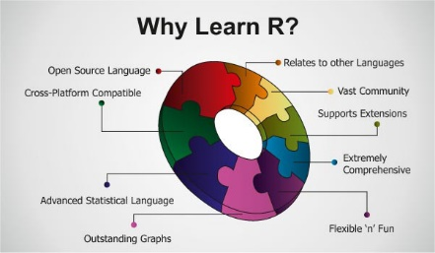
What can you do with R effectively
- Analytics
- Graphics and Visualization
- Applications and Extensions
- Programming Language features

Slide 16
Analytics with R
Basic Mathematics
Basic Statistics
Probability Distributions
Big Data Analytics
Machine Learning
Optimization and Mathematical Programming
Signal Processing
Simulation and Random Number Generation
Statistical Modeling
Statistical Tests

Slide 17
Graphics and Visualization with R
Static Graphics
Dynamic Graphics
Devices and Formats

Slide 18
Applications and Extensions with R
Applications
Data Mining and Machine Learning
Statistical Methodology
Other Distributions Available in Third-Party Packages

Slide 19
Programming Language features of R
Input / Output
Object-oriented programming
Distributed Computing
Included R Packages

