Slide 1
SQL-DML
Structured Query Language (Data Manipulation Language)

Slide 2
SQL
Developed by IBM is San Jose CA.
Originally called (and still commonly referred to as Sequel)
SQL stands for Structured Query Language.
SQL-DML (Data Manipulation Language) is the SQL statements that add, delete and modify data in an already existing database.

Slide 3

SQL – Select, distinct
select distinct Branch-Name
from Loan

Slide 4
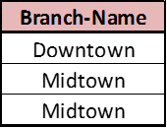
SQL – Select, all
select all Branch-Name
from Loan

Slide 5
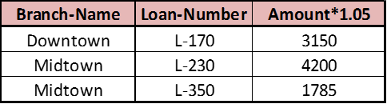
    +, -, *,/ operators
select Branch-Name, Loan-Number, Amount * 1.05
from Loan

Slide 6

And, Or and Not
select Loan-Number
from Loan
where Branch-Name = “Midtown” and Amount > 2000

Slide 7

Rename
select distinct Customer-Name, Borrower.Loan-Number as Loan-ID
from Borrower, Loan
where Borrower.Loan-Number = Loan.Loan-Number and Branch-Name = “Downtown”

Slide 8
Tuples by value
select distinct Customer-Name, T.Loan-Number
from Borrower as T, Loan as S
where T.Loan-Number = S.Loan-Number
of all customers who have a loan from the bank, find their names and loan numbers

Slide 9
Tuple values
select distinct T.Branch-Name
from Loan as T, Loan as S
where T.Amount > S.Amount and S.Branch-Name = “Midtown”
The names of all branches that have loan amount greater than at least one loan at Midtown

Slide 10

Ordering
select distinct Customer-Name
from Borrower
order by Customer-Name

Slide 11
Ordering outer/inner
select *
from Loan
ordered by Branch-name desc, Loan-Number asc

Slide 12
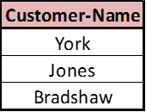
Union
(select Customer-Name
from Depositor)
union
(select Customer-Name
from Borrower)

Slide 13
SQL – Union all
(select Customer-Name
from Depositor)
union all
(select Customer-Name
from Borrower)

Slide 14

SQL – Except (set subtraction)
(select Customer-Name
from Depositor)
except
(select Customer-Name
from Borrower)
By default, except eliminates the duplicates, to leave them in, use all

Slide 15
SQL – Except, all
(select Customer-Name
from Borrower)
except all
(select Customer-Name
from Depositor)

Slide 16
Other Keywords
avg : Average
min : Minimum
max: Maximum
sum : Total
count : Count
group by: group the output by
having : applied after the groups are formed so aggregate functions can be used

Slide 17

Group by - having
select branch-name, avg(amount)
from loan
group by Branch-Name
having avg(Amount) < 3000

Slide 18

Inner join
loan inner join borrower on loan.loan-number = borrower.loan-number

Slide 19
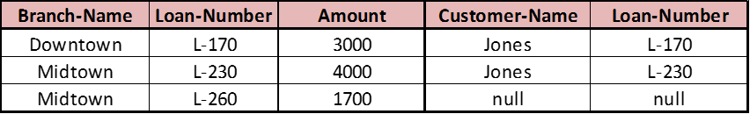
Outer joins – Left, Right
loan left outer join borrower on loan.loan-number = borrower.loan-number
Left outer joins return the entire left table with matching entries form the right table.
Right outer joins return the entire right table with matching entries form the left table.
Full outer joins return the entire contents of both tables plus matching entries.

Slide 20
Outer joins – Left, Right
loan right outer join borrower on loan.loan-number = borrower.loan-number
Left outer joins return the entire left table with matching entries form the right table.
Right outer joins return the entire right table with matching entries form the left table.
Full outer joins return the entire contents of both tables plus matching entries.

Slide 21

Natural Join
loan natural join borrower

Slide 22
Adding a Row to an table
INSERT INTO memberChallengeQuestions
(memberID, question, answer)
VALUES(‘125’,’What is you favorite food?’,’Pizza’)
This will add a challenge question in the memberChallengeQuestion table as a new row for member with the ID 125.

Slide 23
Changing data in a column of a row
UPDATE memberChallengeQuestions
SET answer=‘Hot Dogs’
WHERE memberID=‘125’
This will change the answer field from ‘Pizza’ to ‘Hot dogs’ and leave the question field the same for member with the ID 125.

Slide 24
Deleting a row from a table
DELETE FROM memberChallengeQuestions
WHERE answer=‘Hot Dogs’
This will delete every row in the entire table where the answer is ‘Hot Dogs’

Slide 25
Copy an entire table into another
INSERT INTO memberChallengeQuestionsArchive
SELECT * FROM memberChallengeQuestions
This will copy every row (Archive) the memberChallengeQuestions to a similar structured table.

