Slide 1
SQL for Data Science
Queries and things to think about.

Slide 2
Database for online shopping (Amazon)
members (memberID, first, last, encryptedPassword, gender, dob)
carts (cartID, memberID)
products (productID, name, unitPrice, Description)
cartProducts (cartID, productID, quantity, price)
purchases (memberID, cartID, date)

Slide 3
Data Science Tables products by customer’s age group
DST_ productsAge (product, ageGroup , numberSold)
SELECT productID, count(*)
FROM products, cartsProducts, purchases, members
WHERE products.productID = cartsProducts.productID
AND cartsProducts.cartID = purchases.cartID
AND purchases. memberID = members.memberID
AND members.dob < <xx/xx/xxxx>
AND member.dob > <yy/yy/yyyy>
AGE is dynamic field based on DOB and today’s date. This querie should take into account the purchase date and DOB

Slide 4
Data Science Tables products by customer’s gender
DST_ productsGender (product, gender , numberSold)
SELECT productID, count(*)
FROM products, cartsProducts, purchases, members
WHERE products.productID = cartsProducts.productID
AND cartsProducts.cartID = purchases.cartID
AND purchases. memberID = members.memberID
AND members.gender == <female>

Slide 5
Interesting questions in Data Science
A female user between the age 60 – 74 is logged in.
Should we suggest products that are very popular among people between 60 – 74 but not popular with females that much?
Should we suggest products that are very popular with females but not popular to people between 60 – 74 that much?
What is very “popular” and “not very popular”? ( over 5% have bought it – under 1 % )

Slide 6
Data Science functions done in SQL
1) Data Aggregation
  - adding up counts of products bought with other products.
2) Ranking
  - most popular, second most popular etc.
3) Bucketing of Data
  - people between 24-33 buy this product
4) Statistics
  - statistically this product is popular with costumers who also bought product X
4) Windowing
  - products bought this week, or bought be people just after they turned 21 years old.

Slide 7
Data Science Tables customers also bought this product also..
DST_ alsoBought (productID, also1pid, also2pid, also3pid, also4pid)
SELECT productID, quantity
FROM cartsProducts
WHERE cartID in ( SELECT cartID
FROM cartsProducts
WHERE productID = <input productID> )
This will product repeats of output (A 2, B 3, A 3, C 2, A 2 ) ➔ (A 7, B 3, C 2)…an aggregation must be done
Can we aggregate daily data to this table?
If a person buys products in 2 different carts, would this query catch that?
A customer may be shopping for a group of people (office party, Christmas)

Slide 8
Data Science Tables
Trigger alsoBought on addToCart()
An SQL trigger is set to run when ever an SQL statement is executed.
CREATE OR REPLACE TRIGGER also_bought
AFTER UPDATE ON cartProducts
FOR EACH ROW
BEGIN
SELECT also1pid, also2pid, also3pid, also4pid
FROM DST_alsoBought
WHERE productID = <added productID>
END;
Might be best to have a program (R Python , php etc.) determine on an as needed basis however, your Business Logic is divided and is more error prone now.

Slide 9
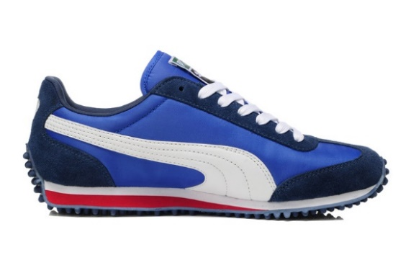
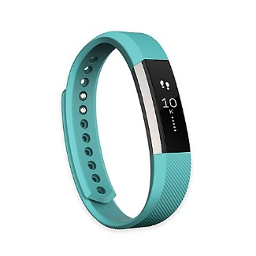
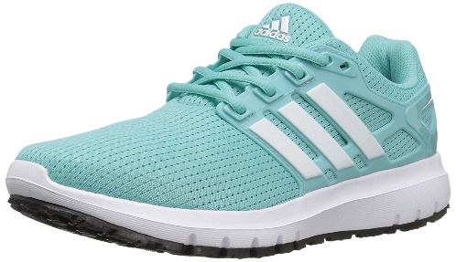
Statistically similar products
Suppose customers that buy Fitbit, also buy 1 pair of running shoes but of different brands.
Maybe people that buy a Teal Fitbit also want Teal running shoes.
Maybe people that buy a Teal fit bit are usually women are not interested in Men’s shoes

Slide 10
Data Science Tables similar (competing) products
DST_ alsoBought (productID, also1pid, also2pid, also3pid, also4pid)
If also1pid and also2pid are to products that are not purchased together but seem to be purchased with productID, then we might conclude also1pid and also2pid are similar products that customers only need 1 of (Adidas and Puma running shoes)

