Slide 1
Binomial Model
Lattices (Binomial, Trinomial etc.)
Option modeling
Replicating an Option

Slide 2
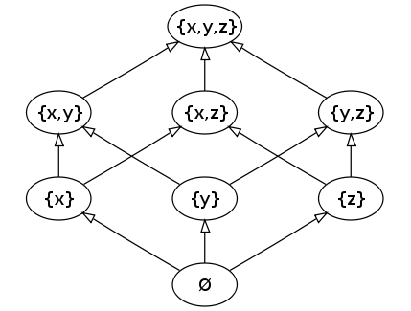
Power Set of {x,y,z} lattice

Slide 3
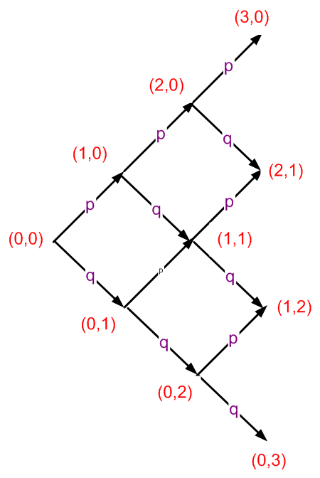
Binomial Lattice (W-L record)

Slide 4
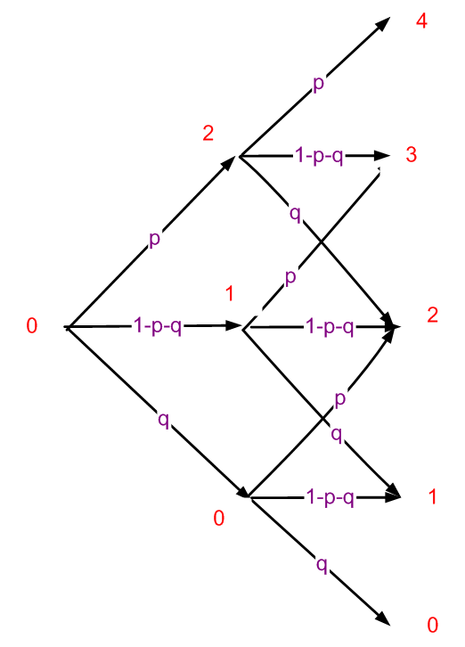
Trinomial Lattice (Hockey Points)

Slide 5
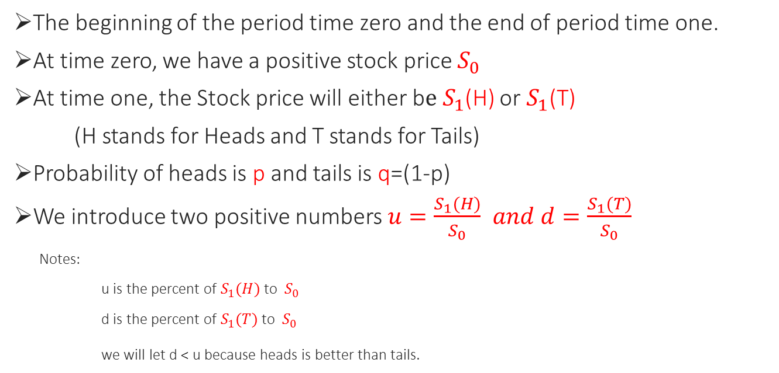
1 period Binomial model for Stock
The beginning of the period time zero and the end of period time one.
At time zero, we have a positive stock price $S_{0}$
At time one, the Stock price will either b$e S_{1}$(H) or $S_{1}$(T)
(H stands for Heads and T stands for Tails)
Probability of heads is p and tails is q=(1-p)
We introduce two positive numbers $u=\frac{S_{1}(H)}{S_{0}}$ $and d=\frac{S_{1}(T)}{S_{0}}$
Notes:
u is the percent of $S_{1}(H)$ to $S_{0}$
d is the percent of $S_{1}(T)$ to $S_{0}$
we will let d < u because heads is better than tails.

Slide 6

Example
Let $S_{0}$= $100 u = 1.2 d = 0.8
$S_{1}(H)$= u$S_{0}$ = $120
p
$S_{0}$ = $100
q
$S_{1}(T)$= d$S_{0}$ = $80
Expected value is of $S_{1}$ = 120p + 80q

Slide 7
We add an interest rate r
We assume that someone may borrow money at the rate r and gain interest at that same rate r (not true in the real world but it’s makes the math easier).
To not allow arbitrage, we assume that:
0 < d < 1+r < u

Slide 8

For our models, we let d = $\frac{1}{u}$
Examples)
d = 0.5 and u = 2
  d = 2/3 and u = 3/2
This is common to do in financial mathematics

Slide 9
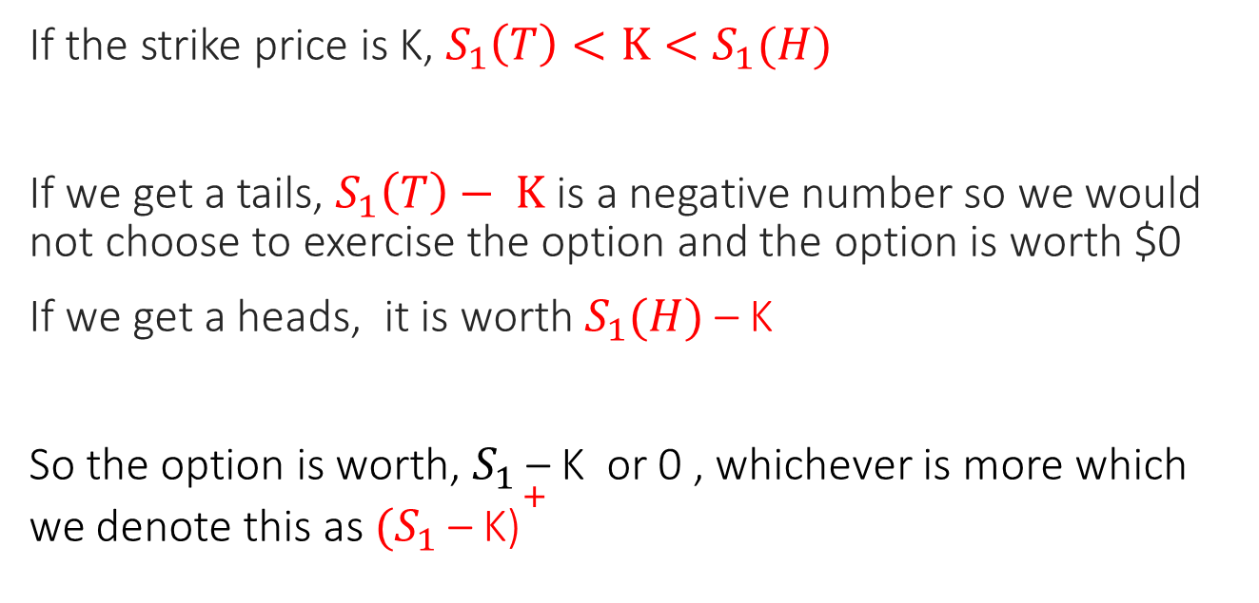
Stock option in Binomial Lattice
If the strike price is K, $S_{1}\left(T\right)<K<S_{1}(H)$
If we get a tails, $S_{1}\left(T\right)− K$ is a negative number so we would not choose to exercise the option and the option is worth $0
If we get a heads, it is worth $S_{1}(H)$ – K
So the option is worth, $S_{1}$ – K or 0 , whichever is more which we denote this as ${{(S}_{1}\text{ – }\text{K}\text{)}}^{+}$

Slide 10
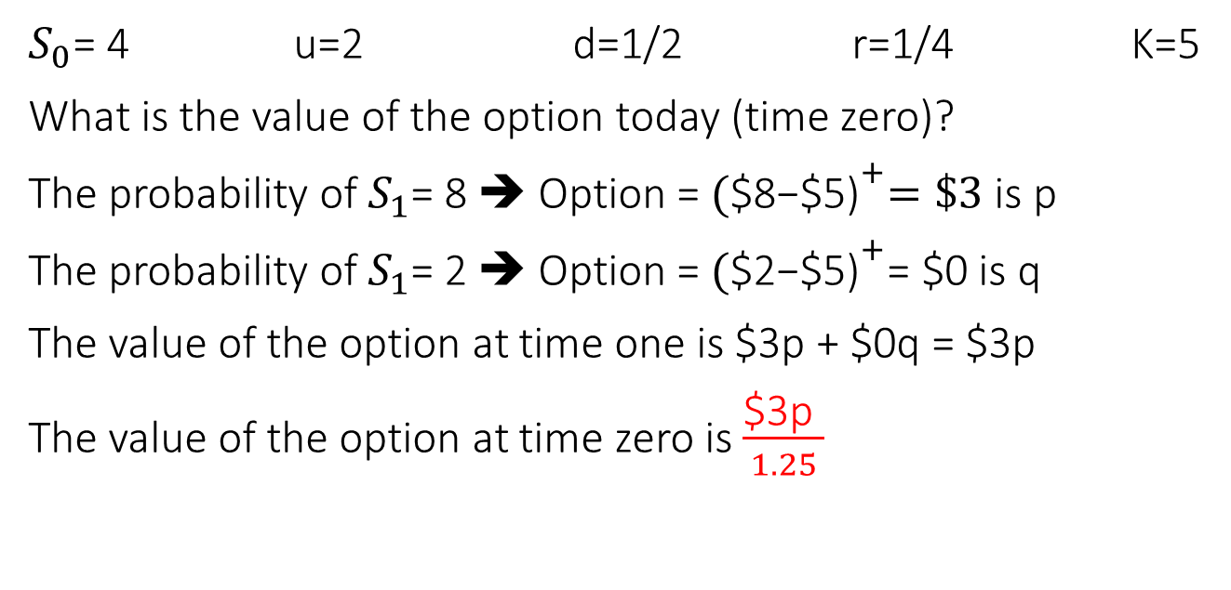
Example) Stock Option (by Shreve)
$S_{0}$= 4 u=2 d=1/2 r=1/4 K=5
What is the value of the option today (time zero)?
The probability of $S_{1}$= 8 ➔ Option = ${\text{(}\text{\$8−\$5}\text{)}}^{+}=\$3$is p
The probability of $S_{1}$= 2 ➔ Option = ${\text{(}\text{\$}\text{2}\text{−\$5)}}^{+}$= $0 is q
The value of the option at time one is $3p + $0q = $3p
The value of the option at time zero is $\frac{\text{\$3}\text{p} }{1.25}$

Slide 11
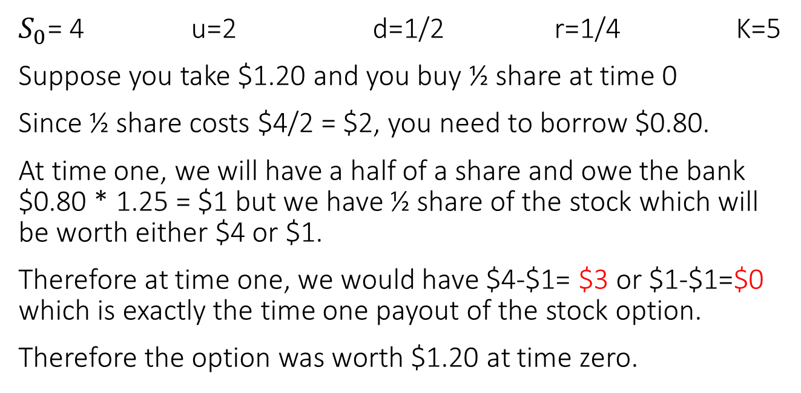
Ex) Replicating the Option(by Shreve)
$S_{0}$= 4 u=2 d=1/2 r=1/4 K=5
Suppose you take $1.20 and you buy ½ share at time 0
Since ½ share costs $4/2 = $2, you need to borrow $0.80.
At time one, we will have a half of a share and owe the bank $0.80 * 1.25 = $1 but we have ½ share of the stock which will be worth either $4 or $1.
Therefore at time one, we would have $4-$1= $3 or $1-$1=$0 which is exactly the time one payout of the stock option.
Therefore the option was worth $1.20 at time zero.

Slide 12

Example) Stock Option (by Shreve)
$S_{0}$= 4 u=2 d=1/2 r=1/4 K=5
Assuming the option was worth $1.20 at time zero,
$\frac{\text{\$3}\text{p} }{1.25}$ = $1.20 ➔ p = 0.50

Slide 13
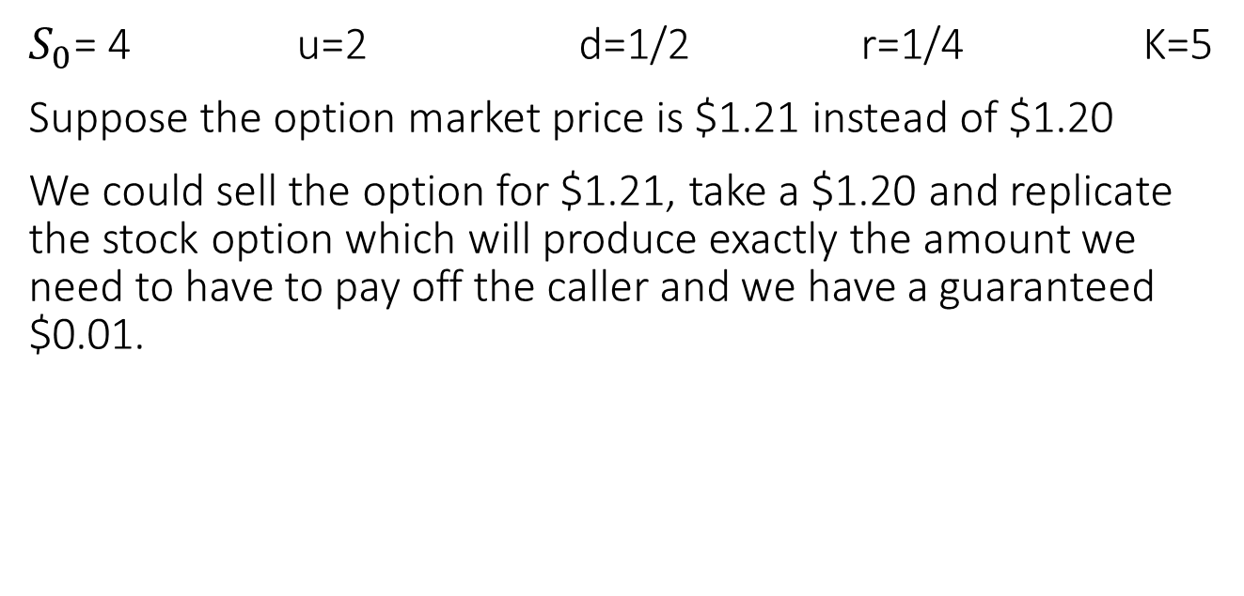
Example) Stock Option (by Shreve)
$S_{0}$= 4 u=2 d=1/2 r=1/4 K=5
Suppose the option market price is $1.21 instead of $1.20
We could sell the option for $1.21, take a $1.20 and replicate the stock option which will produce exactly the amount we need to have to pay off the caller and we have a guaranteed $0.01.

Slide 14
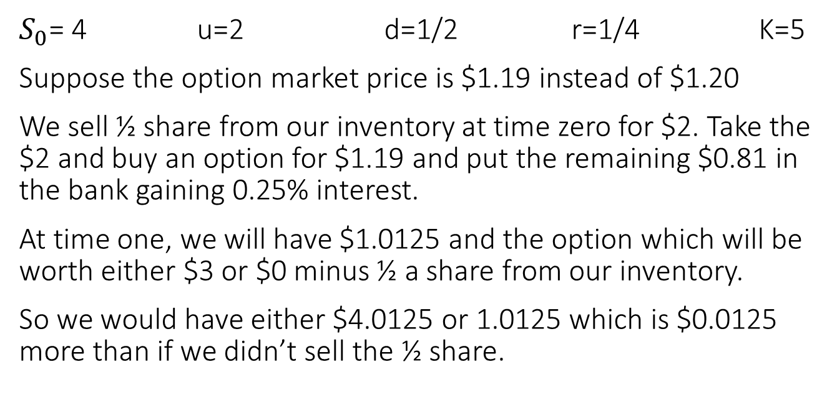
Example) Stock Option (by Shreve)
$S_{0}$= 4 u=2 d=1/2 r=1/4 K=5
Suppose the option market price is $1.19 instead of $1.20
We sell ½ share from our inventory at time zero for $2. Take the $2 and buy an option for $1.19 and put the remaining $0.81 in the bank gaining 0.25% interest.
At time one, we will have $1.0125 and the option which will be worth either $3 or $0 minus ½ a share from our inventory.
So we would have either $4.0125 or 1.0125 which is $0.0125 more than if we didn’t sell the ½ share.

