Slide 1
Bonds

Slide 2
Interest Rate/Present Value
Abby needs money from you now
Abby will give you $5000 in 5 years
Banks currently pay interest rate at 11%
How much should you give Abby now?
PV = $5000 / (1 + 0.11)⁵ = $2,967

Slide 3
What is a Bond?
A debt security, in which the authorized issuer owes the holders a debt and, depending on the terms of the bond, is obliged to pay interest (the coupon) and/or to repay the principal at a later date, termed maturity.
A bond is a formal contract to repay borrowed money with interest at fixed intervals

Slide 4
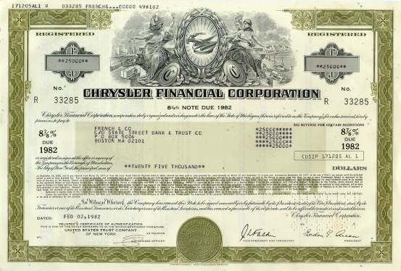
Ex: Chrysler Bond Par: $25, 000 Coupon Rate: 8 7/8

Slide 5
Example: Zero Coupon Bond
Par : $1000
Annual interest = 5%
Duration of the bond = 2 years
What are your payouts?
One payout of $1102.50 two years from today

Slide 6
Example: Coupon Bond
Par : $1000
Annual coupon = 5%
Duration of the bond = 2 years
What are your payouts?
A payment of $50 one year from today
A payment of $50 two years from today
A payment of $1000 two year from today

Slide 7
Pricing a Coupon Bonds
c(1 + r)⁻¹ + c(1 + r)⁻² + . . . + c(1 + r)^{-n} + B(1 + r)^{-n} = P
c = annual coupon payment (in dollars, not a percent)
n = number of years to maturity
B = par value
P = purchase price

Slide 8
Ex) Pricing a Retail Bond
Six years ago someone bought a 10 year coupon bond and would like to get rid of it now.
A coupon rate of 7%
It matures in exactly 4 years.
Par value is $1000.
Current interest rate is 5%
What is bonds market Price?
70(1 + 0.05)⁻¹ + 70(1 + 0.05)⁻² + 70(1 + 0.05)⁻³ +
70(1 + 0.05)⁻⁴ + 1000(1 + 0.05)⁻⁴ = $1071

Slide 9
Yield to Maturity
Coupon Rate:
Annual payout as a percentage of the bond's par value
Current Yield:
Annual payout as a percentage of the current market price you'll actually pay
Yield-to-Maturity:
Composite rate of return off all payouts, coupon and capital gain (or loss)

Slide 10
Yield To Maturity of a Bond
An investor purchases a $1000 Bond that matures in 25 years
8 percent coupon rate .
The price is at 95 (at 95% which is $950). What is the Yield to Maturity (overall interest rate)?
You must amortize the $50 discount over the 25 years of the bond.
YTM = ($80 + $2) / ($975) = 8.41%

Slide 11
Par, Discount, Premium
Bond Selling At Satisfies This Condition
Discount Coupon Rate < Current Yield < YTM
Premium Coupon Rate > Current Yield > YTM
Par Value Coupon Rate = Current Yield = YTM

Slide 12
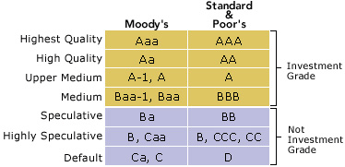
Bond Ratings

Slide 13
Bond Duration
In finance, the duration of a financial asset that consists of fixed cash flows, for example a bond, is the weighted average of the times until those fixed cash flows are received.
Source: Wikipedia

Slide 14
Bond Duration Example
A zero coupon bond
Current price: $500
10 years from now, you receive $1000
What is this bonds interest rate and duration?
Interest rate: 500(1 + r)¹⁰ = $1000, r = 7.17
Duration: by inspection 10 years

Slide 15
Bond Duration Example
A zero coupon bond
Current price: $500
10 years from now, you receive $1000
20 years from now, you receive 1 penny
What is this bonds interest rate and duration?
Isn’t this basically the same as the previous example except for the penny?
Did the penny cause a notable change in the interest rate?
If not, is the duration 20 years?, that is, are you receiving 7.17% for 20 years not instead of 10%

Slide 16
Bond Duration coupon bond
A coupon bond
Current price: $1000
Each year you receive $60
10 years from now, you receive $1000
What is this bonds interest rate and duration?
By inspection the interest rate is 6%
Duration: time weighted average of cash flows

Slide 17
Macaulay's Duration
V =
MacD =

