Slide 1
Chi Square Test
introduction

Slide 2
Example – Rolling a dice
A dice is rolled 100 times and the observes outcomes are:
1) 25
2) 15
3) 20
4) 15
5) 20
6) 5
Is the dice fair? That is, does each outcome have the same probability namely 1/6?
Do odd numbers (1,3,5) come up 50% of the time?

Slide 3
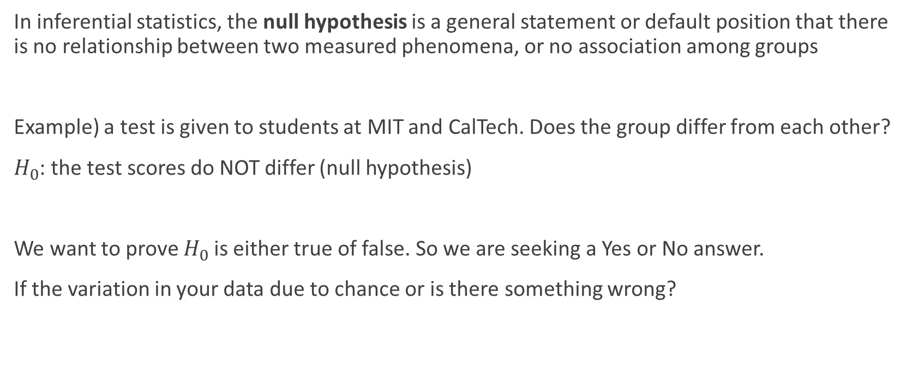
Null Hypothesis
In inferential statistics, the null hypothesis is a general statement or default position that there is no relationship between two measured phenomena, or no association among groups
Example) a test is given to students at MIT and CalTech. Does the group differ from each other?
$H_{0}$: the test scores do NOT differ (null hypothesis)
We want to prove $H_{0}$is either true of false. So we are seeking a Yes or No answer.
If the variation in your data due to chance or is there something wrong?

Slide 4

Chi Square formula
$Χ_{c}^{2}=\sum{\frac{{(O_{i}^{}−E_{i}^{})}^{2}}{E_{i}^{}}}$
$E_{i}^{}$ = expected value
$O_{i}^{}$ = observation value
$Χ_{c}^{2}$= the chi squared value of the experiment

Slide 5
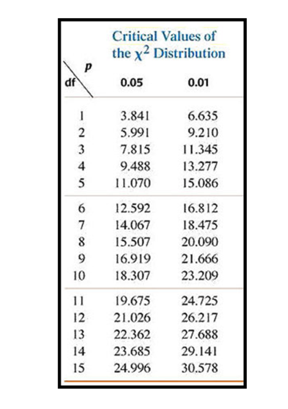
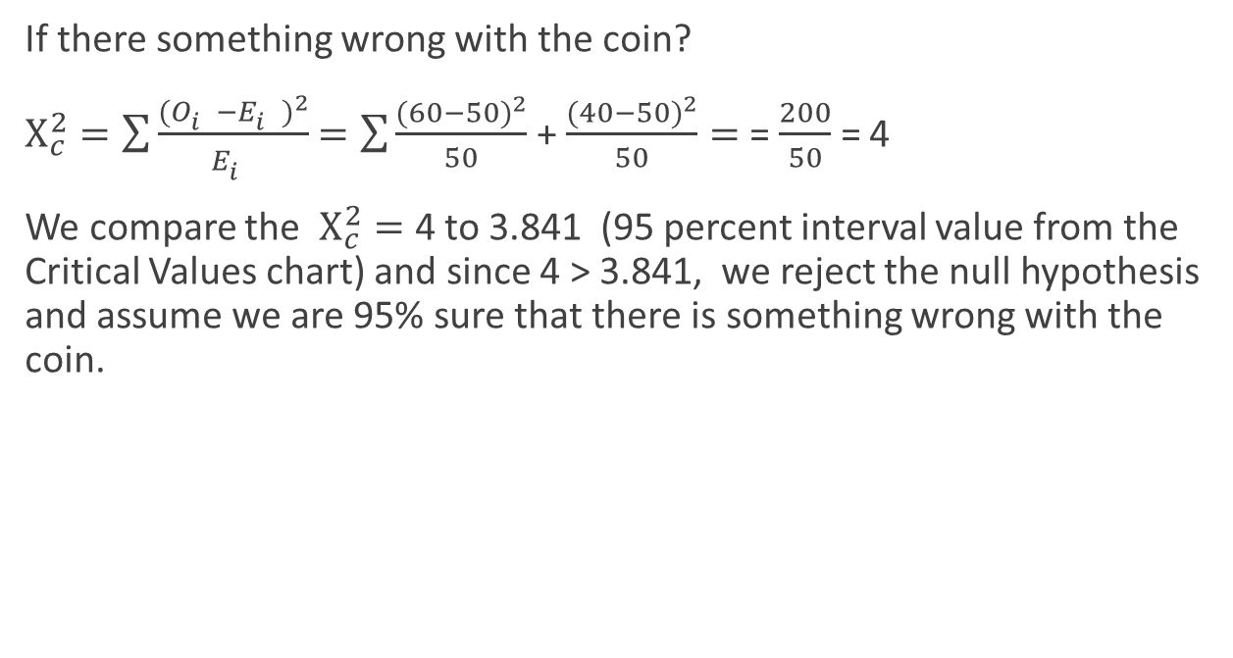
Example: flip a coin 100 times→60 heads
If there something wrong with the coin?
$Χ_{c}^{2}=\sum{\frac{{(O_{i}^{}−E_{i}^{})}^{2}}{E_{i}^{}}}$ $=\sum{\frac{{(60−50)}^{2}}{50}}$ + $\frac{{(40−50)}^{2}}{50}=$ = $\frac{200}{50}$ = 4
We compare the $Χ_{c}^{2}=$ 4 to 3.841 (95 percent interval value from the Critical Values chart) and since 4 > 3.841, we reject the null hypothesis and assume we are 95% sure that there is something wrong with the coin.

Slide 6
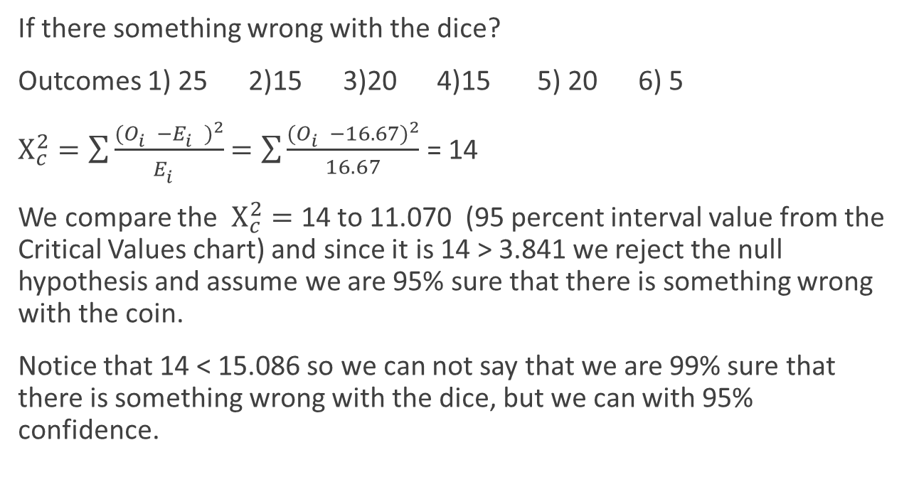
Example: Roll a dice 100 times
If there something wrong with the dice?
Outcomes 1) 25 2)15 3)20 4)15 5) 20 6) 5
$Χ_{c}^{2}=\sum{\frac{{(O_{i}^{}−E_{i}^{})}^{2}}{E_{i}^{}}}$ $=\sum{\frac{{(O_{i}^{}−16.67)}^{2}}{16.67}}$ = 14
We compare the $Χ_{c}^{2}=$ 14 to 11.070 (95 percent interval value from the Critical Values chart) and since it is 14 > 3.841 we reject the null hypothesis and assume we are 95% sure that there is something wrong with the coin.
Notice that 14 < 15.086 so we can not say that we are 99% sure that there is something wrong with the dice, but we can with 95% confidence.

Slide 7
Degrees of Freedom (number of other outcomes)
The number of outcomes that is other that the one we are interested.
Ex) we are counting number of heads on a coin, the degrees of freedom is 1 (tails)
Ex) we are counting the number of 2 from rolling a dice, degrees of freedom is 5 (1,3,4,5,6)

Slide 8
Critical Value (values to provide a confidence interval)
The value on the Chi-square chart that provides the percentage confidence that we are correce in rejecting the null hypothesis allow for being wrong

Slide 9
History of Chi Square testing
χ is a Greek letter
In 1900, Pearson published a paper on the χ² test which is considered to be one of the foundations of modern statistics. In this paper, Pearson investigated the test of goodness of fit.

