Slide 1

Amazon Web Services

Slide 2

AWS (Amazon Web Services)
Public Global cloud service.
Used by 80% of Fortune 500 companies.
Services
  Infrastructure (servers, backup, power supply)
  Platform (Java, php, ruby etc. )
  Software
  Storage
Email sending capabilities

Slide 3
AWS – Getting Started
With a credit card and an email address signup takes minutes
Simple Billing…billing is by the hour of usage.
The integrated dashboard has reports
As AWS grows in customers, the utility price slowly drops.

Slide 4
AWS – Stability
AWS has an outage maybe once every other year and in a particular region (not world wide) 2-3 hours tops.
Small startup companies to large blue chip companies.

Slide 5
AWS – EC2, VPC, S3. RDS
Elastic Compute Cloud (EC2)
  Servers (small and big based on need)
Virtual Private Cloud (VPC)
  You join Amazon’s private cloud and run services networked.
Simple Storage Service (S3)
  Upload and share files.
Relational Database Service (RDS)
  Most famous DBMS. (mysql, Oracle, SQLserver)

Slide 6
AWS – Route 53, ELB, Autoscaling
Route 53
  DNS service (point your URL to a servers or group of servers)
Elastic Load Balancer (ELB)
  Balance internet traffic over several servers
Auto Scaling
  Your application is never down do to a load.
  Adds capacity as needed.

Slide 7
AWS – Dynamo DB
Like mongoDB (humongous Data Base)
We can have a e-Store database
The database has collections like Customers, Orders (Tables)
In collections we have documents (rows in tables but no schema)
No relations (no diamonds connecting tables)

Slide 8
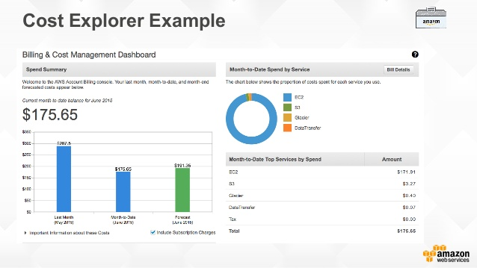
AWS - Billing
Sign up with an email address and a credit card.
Billing is by the hour.

Slide 9
AWS – How Big is it
AWS has 15 regions throughout the world.
All parts of the world are within 1000 miles of a region
Each region has a massive data centers
  Each data center has 300,000 to 500,000 servers

Slide 10
AWS – Certifications & Regulations
NASA uses AWS and complies with all US regulations.
AWS certifies technical professionals. (1 year of free labs)
  Solution architect
  Developer
  SysOps Administrator
  DevOps Engineer
  Advanced Networking
  Big Data

Slide 11
AWS History
1994 – Amazon started
1995 – Online book store
2006 – AWS started (EC2 and S3)
2009 – RDS
2011 – Elastic Beanstalk
2012 – Glacier, DynamoDB, RedShift
2016 – Lambda

Slide 12
AWS – Cloud Buzz words
SaaS – Software as a Service
NAS – Network Attached Storage. Connected to our LAN
SAN – Storage Area Network connected to disk via Host Bus Adapters HBA
DAS – Directly Attached Storage connected by Small Computer Systems Interface SCSI, USB, Firewire etc.
RAID (Redundant Array of Inexpensive Disks)

